Slide 1


Wildfire and Climate Change
Wildfire: Past and Future

Slide 2

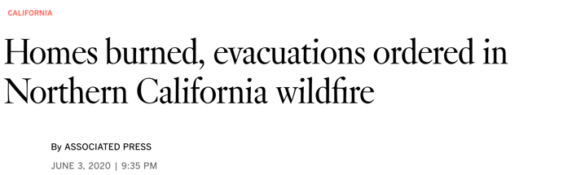
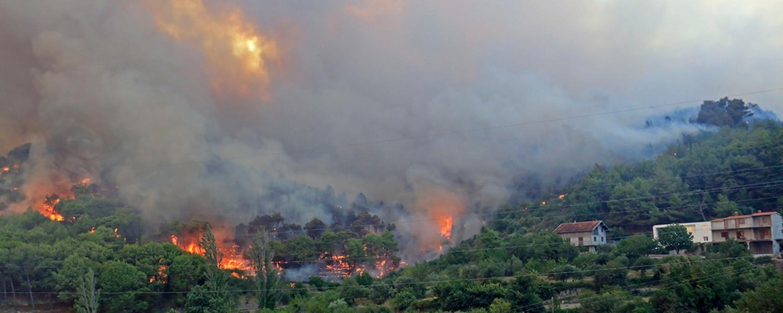
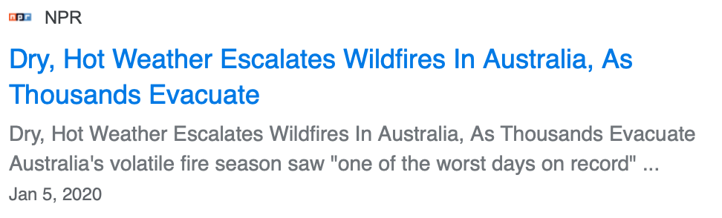
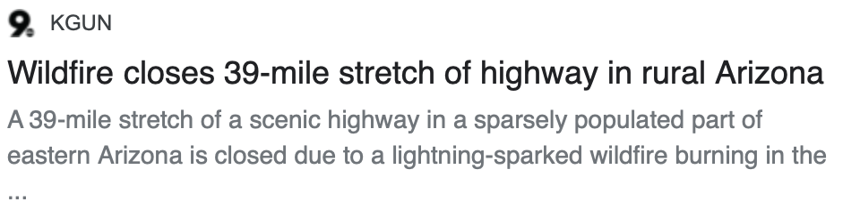
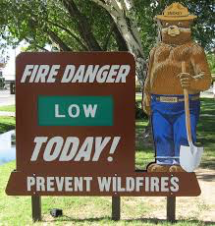
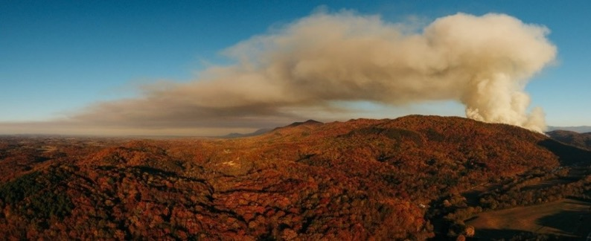
Wildfire
Source: ready.gov
Source: fs.usda.gov
Source: ca.gov
Notes:
Think about a time you've heard about wildfires. Were you affected by the wildfire? How can wildfires affect you? In recent years, we've heard more about large fires, and they are linked to climate change.
a. Wildfires are a natural part of many ecosystems, often originating from dry lightning strikes. They can support ecosystem health, promote certain plant species, and help nutrient cycling in the soil. However, depending on the fire's frequency, severity, and size, they can also be catastrophic and destroy habitats, decrease water and air quality, and decrease the availability of natural resources like lumber or grazing land. Most ecosystems naturally experience large catastrophic fires at some point. Forests in the Southwest have catastrophic fires every 200-500 years.

Slide 3
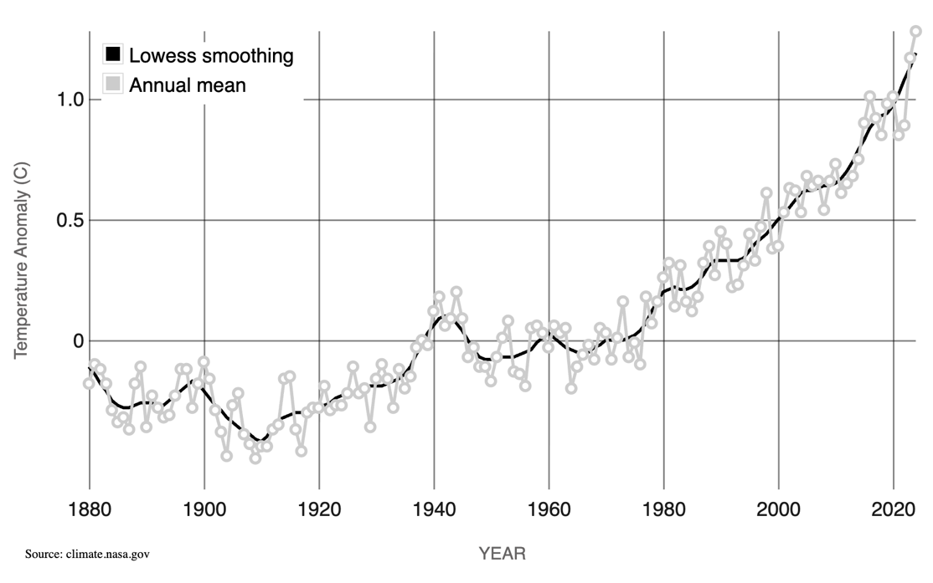
Climate Change
Source: https://climate.nasa.gov/vital-signs/global-temperature/?intent=121
Notes:
Climate change is caused by increased atmospheric carbon dioxide, which leads to higher atmospheric temperatures. This increase in temperatures has many cascading effects.

Slide 4
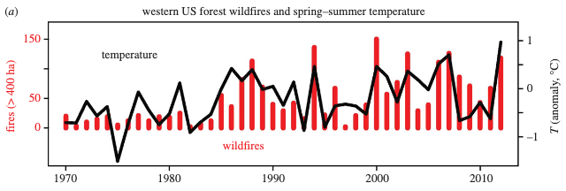
Wildfire and Climate
What is the relationship between temperature and wildfire?
Why?
Westerling ALR. 2016 Increasing western US forest wildfire activity: sensitivity to changes in the timing of spring. Phil. Trans. R. Soc. B 371: 20150178. http://dx.doi.org/10.1098/rstb.2015.0178
Notes:
Based on the graphs, what trends do you see in the relationship between wildfire and temperature? The red y-axis on the left side of the graph shows wildfire frequency, represented by the red bars. The black y-axis on the right side of the graph shows temperature, represented by the black line [Answer: Years with higher temperatures have higher fire frequency]. You might expect the amount of rain to be linked to fire severity, but why temperature? Two major factors affect wildfire risk and severity, (1) moisture levels, or how much water is in the plants and soil, and (2) fuel levels, or how much burnable material, usually dead plants, is present.

Slide 5
Climate Change and Wildfire
What does a fire need?
Oxygen
Ignition
Fuel
Which of these will be affected by climate change?
Notes:
What do you need to make a fire? [Click to show answer: fuel, oxygen, and ignition.]
a. Which of these is most likely to be influenced by climate change? [Answer: Fuel. Oxygen and ignition sources will not change due to climate change, but the amount of plants and dead, dry plant material is likely to change as the temperature and precipitation patterns change.]

Slide 6
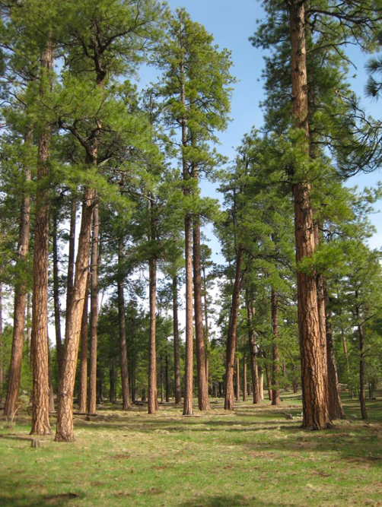
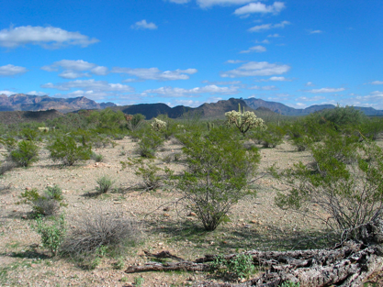
Which is more likely to burn?
1.
2.
Source: NPS
https://www.nps.gov/media/photo/gallery-item.htm?pg=5422915&id=507757e1-923d-4ccb-ae15-330a8f57b477&gid=FF2A7DE0-8FE2-4695-B77E-EA4CEB4FA76C
Notes:
Which of these ecosystems is more likely to burn? [Answer: #1. This is a ponderosa pine forest with little bare ground. The grass on the ground can carry fire between larger plants. Generally, fire is more likely to spread in a forest with more grass and shrubs in the understory. Picture #2 is creosote shrubland, with little vegetation between shrubs, making it hard for fire to spread.]

Slide 7
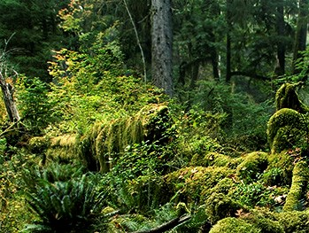
Which is more likely to burn?
1.
2.
Source: NPS
https://www.nps.gov/olym/planyourvisit/visiting-the-hoh.htm
Notes:
Which of these ecosystems is more likely to burn [Answer #1, Again, picture #1 is a ponderosa pine forest, which is much drier than the rainforest shown in picture #2. So despite having more fuel, picture #2 is less likely to catch fire. These three pictures highlight that fuel and moisture levels are important aspects of fire risk.]

Slide 8
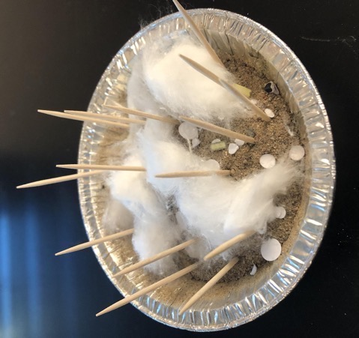
Experiment set up
Question: How will climate change and future changes in moisture and fuel levels impact wildfire?
  Variables: soil moisture and fuel load
Build an ecosystem model:
  Sand
  Water
  Toothpicks (trees)
  Cotton balls (shrubs)
  Paper shreds (grass)
Notes:
We will experiment with how higher temperatures affect wildfire risk, size, and severity. Imagine you're a part of a research team trying to determine how climate change and future changes in moisture and fuel levels impact wildfire. Each group will build an ecosystem.

Slide 9
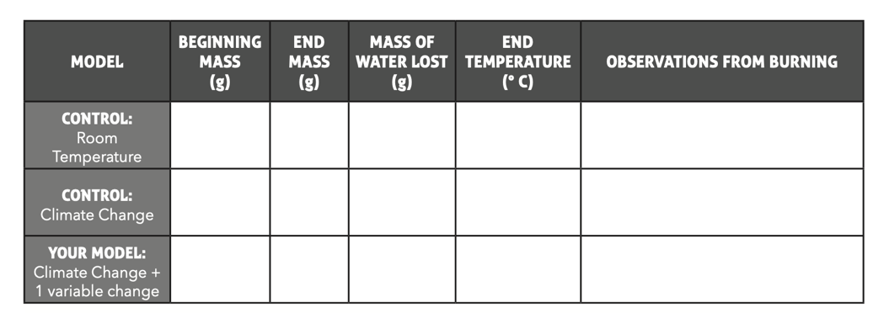
Experiment set up
The control model has already been made.
  Record the beginning mass of both control models on your data table.
Notes:
Show the students the control models you have already made; students will use EXACTLY the same amount of materials as the control models, EXCEPT that they will change one variable by adding more or less of that material to understand the impact of that variable on fire risk. You will assign a change for each group to make. Wet both of your control models by spraying the entire model with five sprays of water from a spray bottle and weigh each model. Students should record these weights on their worksheets.

Slide 10
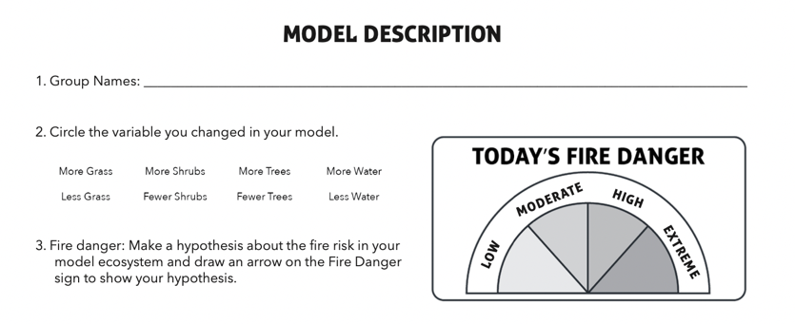
Experiment set up
Using exactly the same amounts of materials, build your own ecosystem model, but you will use more or less of one variable (material) in your model
Instructions:
Build your model and fill out the model description using the instructions on your worksheet.
Place your model under the light with a thermometer.
As a group, answer questions 1-3 on your worksheet.
Notes:
Assign students to small groups (8 groups per class). Give them the materials to make their ecosystem models, and assign each group one of the eight changes on the Model Description Page (adding more or fewer trees, shrubs, grass, or water). If you prefer, you can give students the goal of increasing or decreasing the fire risk. Encourage students to build their models quickly and get them under the lights in the next 5-7 minutes (Figure 2). Students should follow the instructions on their worksheet and then answer questions 1-3.

Slide 11
Make a prediction
Which model do you think has the highest fire risk?
Which model do you think has the lowest fire risk?
Notes:
Ask students to share their observations of the models so far and their predictions for which will have the greatest fire risk.

Slide 12










Transpiration- plants draw water from the soil, and water vapor leaves the plant through pores in the leaves called stomata
Evapotranspiration- all the water entering the atmosphere from evaporation and transpiration
Notes:
One of the changes we see when temperatures increase is an increase in evapotranspiration. Plants act like straws that pull water out of the soil and release it into the air as water vapor through pores in their leaves (stomata). This process is called transpiration and is also how plants regulate their leaf temperature. Evapotranspiration is the combination of evaporation from the earth's surface and transpiration.

Slide 13






Increased Temperature
=
Increased Evapotranspiration
Notes:
Increasing air temperatures mean more water is lost through evapotranspiration. Warmer temperatures also result in a longer growing season, allowing more small plants to grow. This increased plant biomass can later become fuel in a fire.

Slide 14




Increased Temperature and Evaporation
=
More drought and disease
=
More dry, dead fuel for fire
Notes:
Warmer temperatures and increased evapotranspiration weaken plants and lead to more disease and plant death. An increase in dead plant material in an ecosystem means more fuel for fires.

Slide 15
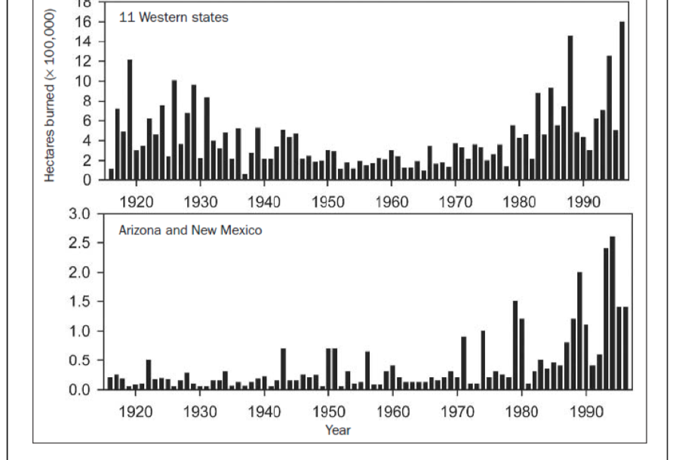
Fire Regime
Data show that fires have become more frequent recently.
The area burned has been low in recent history, but is now increasing again.
Grissino Mayer and Swetnam 2000. Century scale forcing of fire regimes in the American Southwest, Holocene
Notes:
Remember that fire is a natural part of ecosystems. Many ecosystems go through cycles of large and small fires. These graphs show the area burned in wildfires since 1915. What do you notice about the size and frequency of fires across western North America? [Answer: The area burned in wildfires has been increasing in recent years, especially compared to the mid-1900s. This also has to do with a history of fire suppression, which is explored more in the lesson Playing with Fire.]

Slide 16
Experiment results
Weigh each ecosystem model to see how much water has been lost.
Record the temperature of each model.
Use an extra toothpick to try to set each ecosystem on fire and record your observations.
Record the results in your data table.
Notes:
As a class, record the temperature and mass of each control model in the table at the top of the worksheet. Calculate the mass of water lost.

Slide 17
Conclusions
What was the effect of warming on moisture in the ecosystem?
How will that affect fire danger?
How did changing the fuel load change the fire danger?
Answer questions 4-6 on your worksheet.
Notes:
Ask some groups to share their results and observations with the class.
a. What was the effect of the warming on moisture in the ecosystem, and why? [Answer: It decreased due to increased evaporation. Even though we started with the same amount of water in both controls, we lose more to evapotranspiration when it is warmer.]
b. What happens when we increase the fuel load and why? [Answer: We see larger fires. Fuel loads are likely to increase for two reasons; the longer growing season means more small plants can grow, but if/when they dry out, they become fuel. Increased drought will kill trees, and dry/dead trees are great fuel for big fires.] Have students answer questions 4-6 on their worksheets.

Slide 18
Climate change is predicted to increase fire:
Fire risk- how likely is it a fire will start
Low Risk
Fire doesn’t start or spread
High Risk
Fire starts
Notes:
The combination of drier ecosystems and more fuel is predicted to impact fire risk, severity, and size. Fire risk is the likelihood that a fire will start; click to show animation. How did climate change affect the fire risk in our experiment? [Answer: It increased because the ecosystem was drier.]

Slide 19
Climate change is predicted to increase fire:
Fire risk- how likely is it a fire will start
Fire severity- how much vegetation burns
High Severity
Most plants burn and die
Low Severity
Only few or smaller plants burn, many plants survive
Notes:
Fire severity is how much vegetation burns in a fire; click to show animation. How did climate change impact the fire severity in our experiment? [Answer: It increased because the ecosystem was drier, and more fuel allowed the fire to reach the tops of the trees more easily.]

Slide 20
Climate change is predicted to increase fire:
Fire risk- how likely is it a fire will start
Fire severity- how much vegetation burns
Fire size- how large an area burns
Large Fire
Burns a large area
Small Fire
Burns a small area
Notes:
Fire size is how large an area burns; click to show animation. How did climate change impact the fire size in our experiment? [Answer: It increased because more dry fuels in the ecosystem allowed the fire to spread.]

Slide 21
Climate change is predicted to increase fire:
Fire risk- how likely is it a fire will start
Fire severity- how much vegetation burns
Fire size- how large an area burns
Add to your answers to questions 4-6 using the words risk, severity, and size.
Notes:
Students should look back at their answers to questions 4-6 and expand on them using the words fire risk, severity, and size.

