Slide 1


Wildfire and Climate Change
Wildfire Data Jam Day 1

Slide 2
August 7th 2018
443 square miles
Source: https://www.usfa.fema.gov/operations/infograms/022819.html

Slide 3
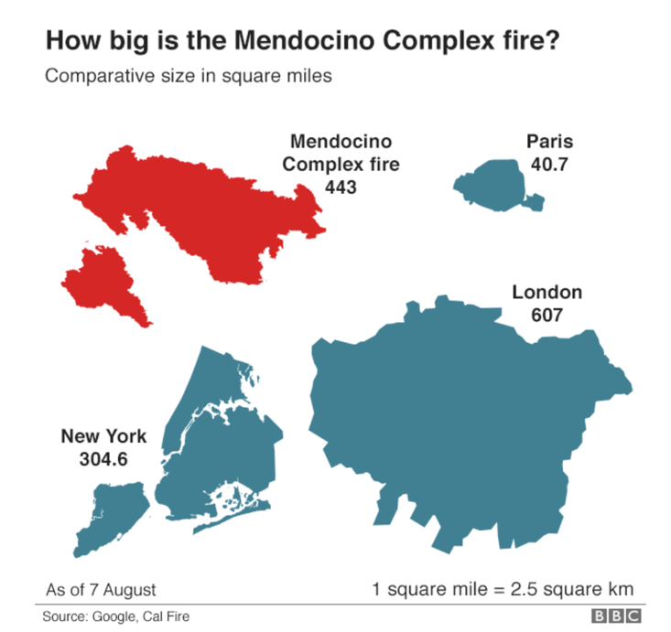
Source: https://www.bbc.com/news/world-us-canada-45102524

Slide 4
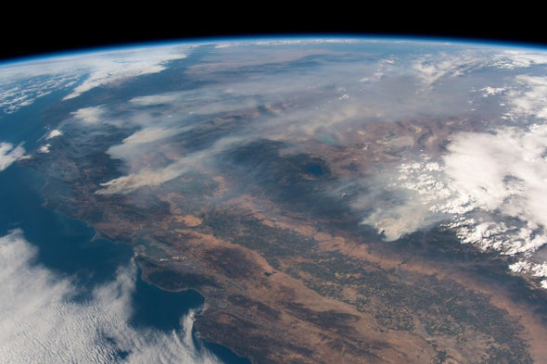
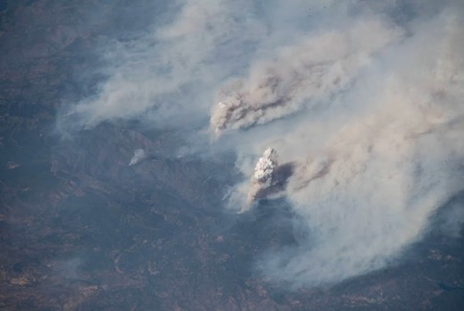
Burned for 56 days
Over 717 square miles
Photos taken August 3, 2018
California wildfires from the International Space Station
Source: Alexander Gerst, ESA / NASA
https://www.scientificamerican.com/article/space-station-crew-photographs-raging-california-wildfires/

Slide 5
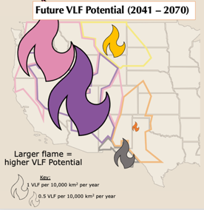
Data Jam!
Your Goal: Communicate data about large wildfires in a unique way through a creative project and presentation.
The Steps:
  Identify a data trend (pattern) from data about wildfires and climate change.
  Make a creative project to represent your data trend.

Slide 6
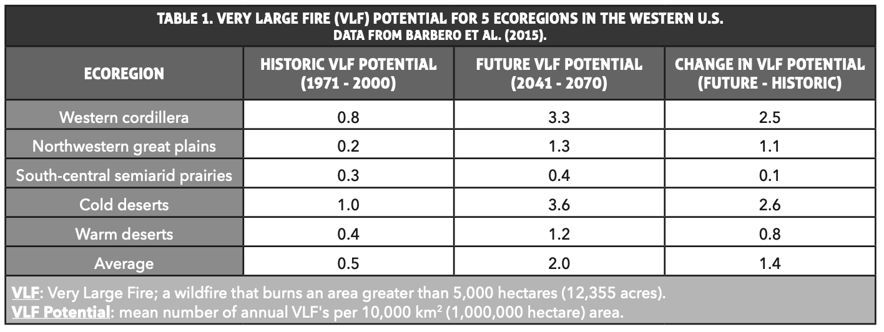
Ecoregions

Slide 7
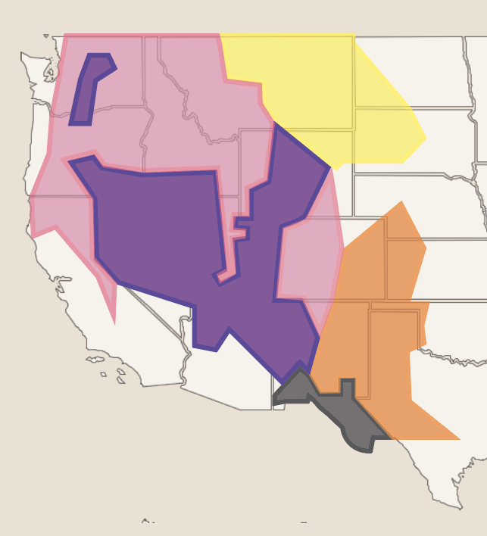
Northwestern great plains
Western cordillera (mountain and intermountain)
Cold desert
South-central semi-arid prairie
Warm desert

Slide 8

Northwestern
great plains
Western cordillera
Source: https://www.usgs.gov/news/future-temperature-and-soil-moisture-may-alter-location-agricultural-regions
Source: https://www.fs.usda.gov/bdnf
Cold desert
South-
central
semi-arid
prairie
Warm desert
Source: https://www.fs.usda.gov/rmrs/upwardly-mobile-western-us-desert-blackbrush-shrublands-respond-changing-climate
Photo Credit: USFS
Source:
Source: Scott Collins https://www.fs.usda.gov/rmrs/science-spotlights/climate-change-impacts-future-carbon-stores-and-management-warm-deserts-united-0

Slide 9
Very Large Fires (VLFs)

Slide 10
Very Large Fires (VLFs)
Wildfires burning over 5,000 hectares (12,355 acres).
Account for only top 5 – 10% of large wildfires, but make up majority of burned area.
Larger than 9,000 football fields!
Source: https://panam.nmsu.edu/facilities/

Slide 11
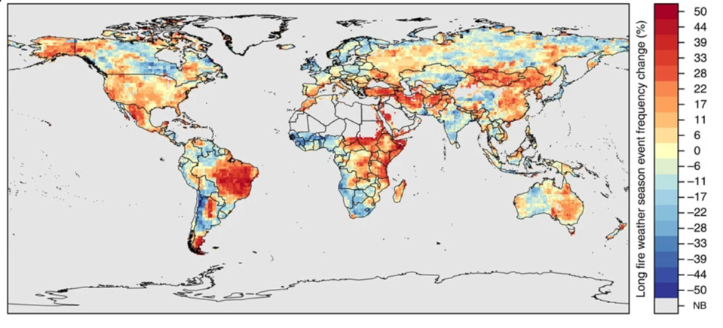
Wildfires are changing globally…
Percent change in frequency of long fire weather seasons from 1979 to 2013.
Red indicates longer fire seasons or more frequent long fire seasons.
Blue indicates shorter fire seasons, or less frequent long fire seasons.
Source: https://www.nature.com/articles/ncomms8537/figures/3

Slide 12
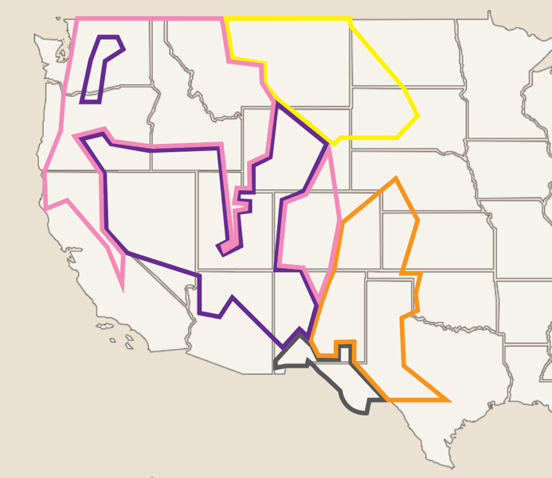






Historic VLF Potential (1971 – 2000)
… and in the Western US…
Northwestern great plains
Western cordillera
Cold desert
South-central
semi-arid prairie
VLF Potential: mean annual VLFs per 10,000 km² area.
Larger flame = higher VLF Potential
Warm
desert
Key:
1 VLF per 10,000 km² per year
0.5 VLF per 10,000 km² per year
Data Source: Barbero et. al (2015)

Slide 13
Future VLF Potential (2041 – 2070)
VLFs
are becoming more common
Northwestern great plains
Western cordillera
Cold desert
South-central
semi-arid prairie
VLF Potential: mean annual VLFs per 10,000 km² area.
Larger flame = higher VLF Potential
Warm
desert
Key:
1 VLF per 10,000 km² per year
0.5 VLF per 10,000 km² per year
Data Source: Barbero et. al (2015)

Slide 14
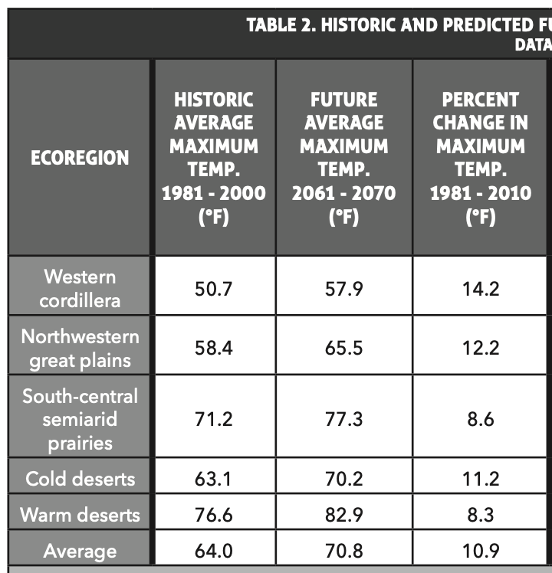
Average Maximum Temperature

Slide 15
Average Maximum Temperature
^{Dry and flammable fuel}
Drought kills plants, which become fuel for fire
1991 - 2012
Source: NASA
https://earthobservatory.nasa.gov/images/83624/climate-changes-in-the-united-states
Temperatures

Slide 16
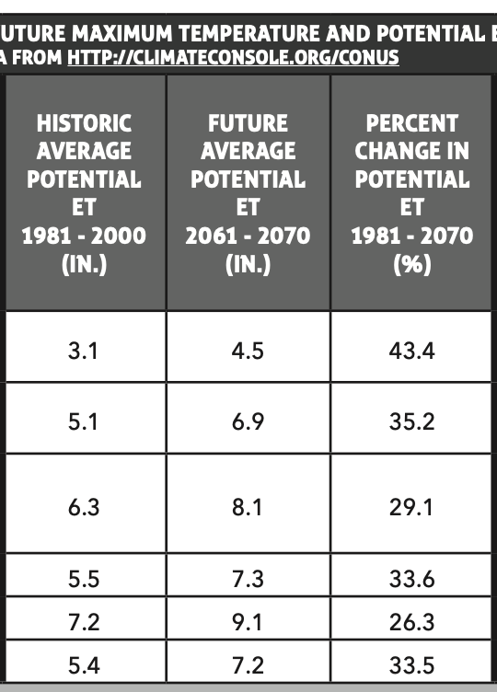
Average Potential Evapotranspiration (ET)

Slide 17
Which location would have a more severe wildfire?
1.
2.
Hoh Rainforest, Olympic National Park
Source: NPS
https://www.nps.gov/olym/planyourvisit/visiting-the-hoh.htm

Slide 18
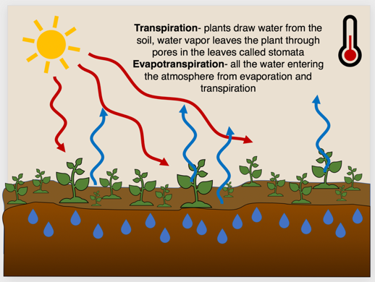
Potential Evapotranspiration (ET)
Evapotranspiration - all the water entering the atmosphere from evaporation and transpiration (plant leaves)
Temperature
Wind speed
Solar radiation
Relative humidity
Hotter temperatures
=
More evapotranspiration

Slide 19
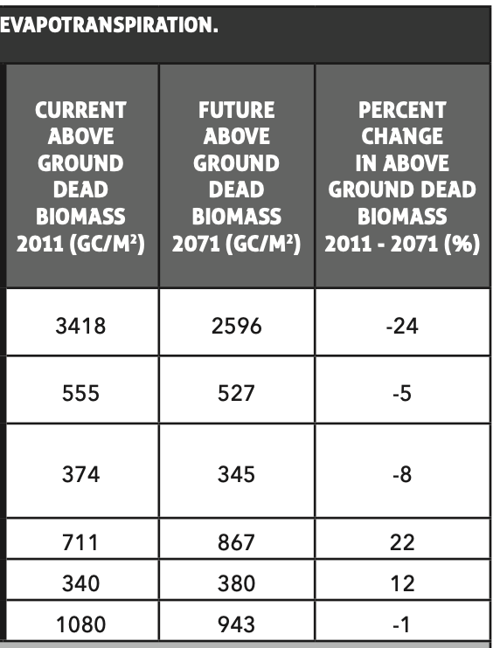
Above Ground Dead Biomass

Slide 20
Which location would have a more severe wildfire?
1.
2.
Source: USFS
https://www.fs.fed.us/rm/pubs/rmrs_gtr149.pdf
Source: USFS
https://www.fs.usda.gov/rmrs/science-spotlights/remnant-old-growth-ponderosa-pine-forests-provide-insights-spatial-patterns
Notes:
1. Long Valley and Fort Valley Experimental Forest, AZ
2. Monument Canyon Research Natural Area, Santa Fe National Forest, NM

Slide 21
Above Ground Dead Biomass
Biomass –
Organic matter
Dead leaves
Stems
Bark
Branches
Tree trunks
Grams of Carbon / m²
Dead Biomass

Slide 22
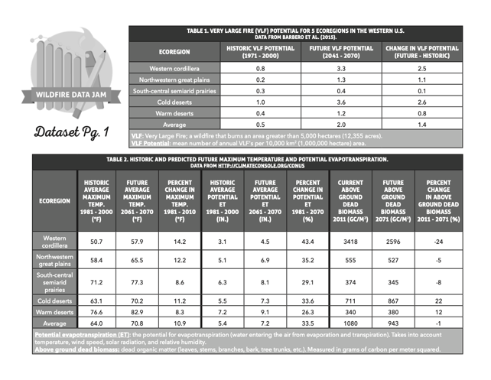
Variables
What variables we have in our dataset?
Variables are something we have information about.
Look for variables in the column titles of your data tables.
Answer questions 1 and 2

Slide 23
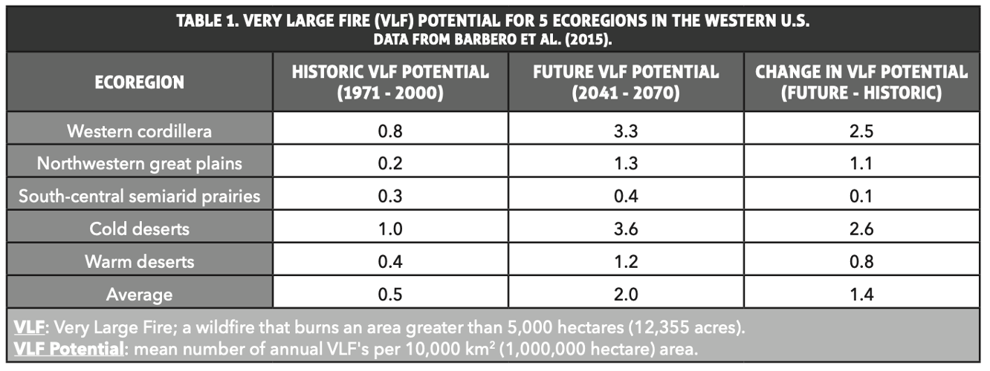
Data Trend – A Pattern in the Data
Table 1
Example: All ecoregions are expected to increase in VLF potential…
Answer question 3

Slide 24
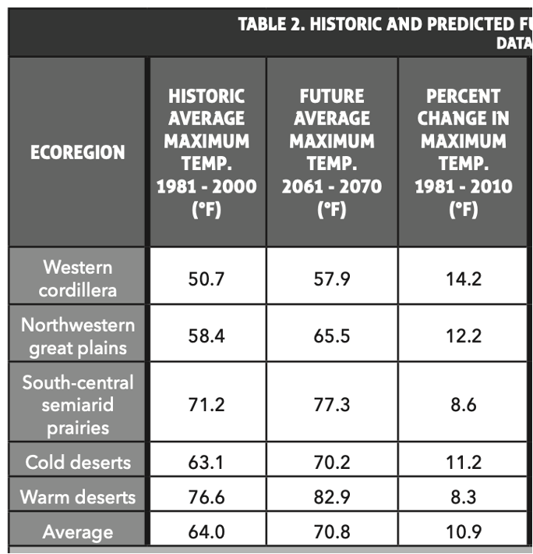
Data Trend – A Pattern in the Data
Table 2
All ecoregions are expected to increase in VLF potential
AND average maximum temperature.
Answer question 4

Slide 25

Identify a Data Trend
Example: All ecoregions are expected to increase in VLF potential and average maximum temperature.
Does not include all data
Includes variables from Table 1 and Table 2
Example: Ecoregions with a high percent change in maximum temperature, also have a high change in VLF Potential.
Specific
Concise
Answer question 5

Slide 26
Wildfire and Climate Change
Wildfire Data Jam Day 2

Slide 27
Data Jam!
Your Goal: Communicate data about large wildfires in a unique way through a creative project and presentation.
The Steps:
  Identify a data trend (pattern) from data about wildfires and climate change.
  Make a creative project to represent your data trend.

Slide 28
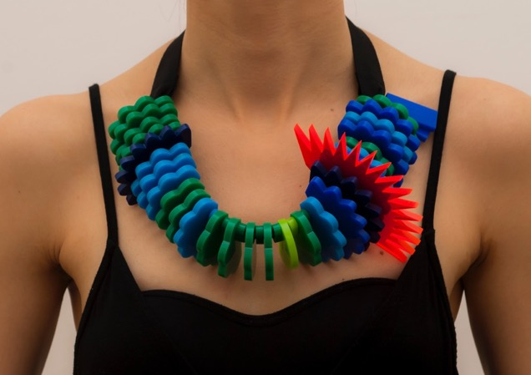
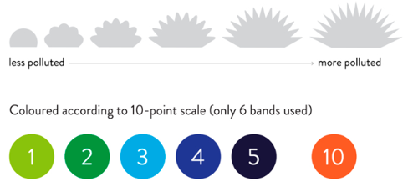
Creative Project
Stefanie Posavec http://www.stefanieposavec.com/
Source: http://www.stefanieposavec.com/airtransformed

Slide 29
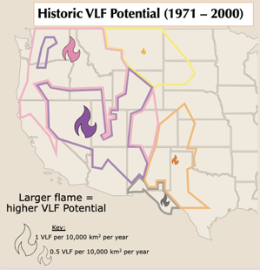
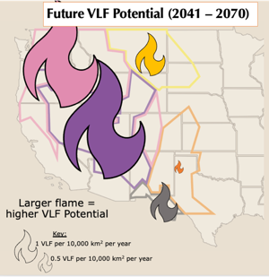
Science Journalist
Infographic
Should include a scale and key
Trend: All ecoregions are expected to increase in VLF potential.

Slide 30
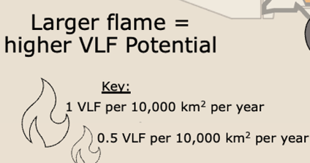

Science Journalist
1
1 inch height of the flame = 1 VLF per 10,000 km² per year
2

Slide 31
Artist
Poem or song
Must include specific references to the data
Water:
Americans use 1,117 gallons per person per day.
That’s three times more than
Each person in France.
Reduce, reuse, recycle – the message we need to give a chance.
Each person in France
Averages 344 gallons per day
Un tollé (outcry) might get more water to stay.
Agua: nearly 800
Gallons per person per day in lovely South American
Uruguay.
An average so high for a country so small.
Meet the people of Botswana,
Earth’s low-water users at 79 gallons per day.
Traditions
Save water
In a land plagued by drought.
Trend: In a sample of countries around the world, per person water use varies widely, with some countries using 14 times as much water per person as other countries.

Slide 32
Creative Project Work Time
Decide what type of creative project you would like to make.
Brainstorm your project, and use the rest of class to create it!
If you finish early, start thinking about how you will present your project to the class next time.

