Slide 1

Southwest Regional
Climate Hub
Developed by the
Asombro Institute for Science Education (www.asombro.org)

Slide 2
National Geographic Video
With Neil deGrasse Tyson
https://www.youtube.com/watch?v=cBdxDFpDp_k

Slide 3
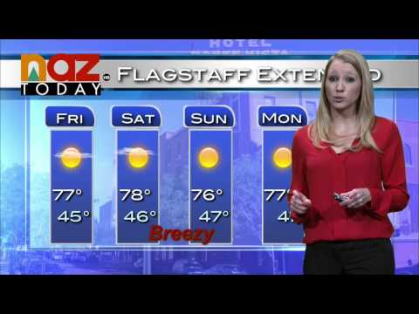
Fig 1. Forecaster in Flagstaff, Arizona
Source: wn.com
Notes:
Figure 1. television forecaster who is giving a prediction of the conditions in Flagstaff, Arizona for a 4-day period [answer: weather].

Slide 4
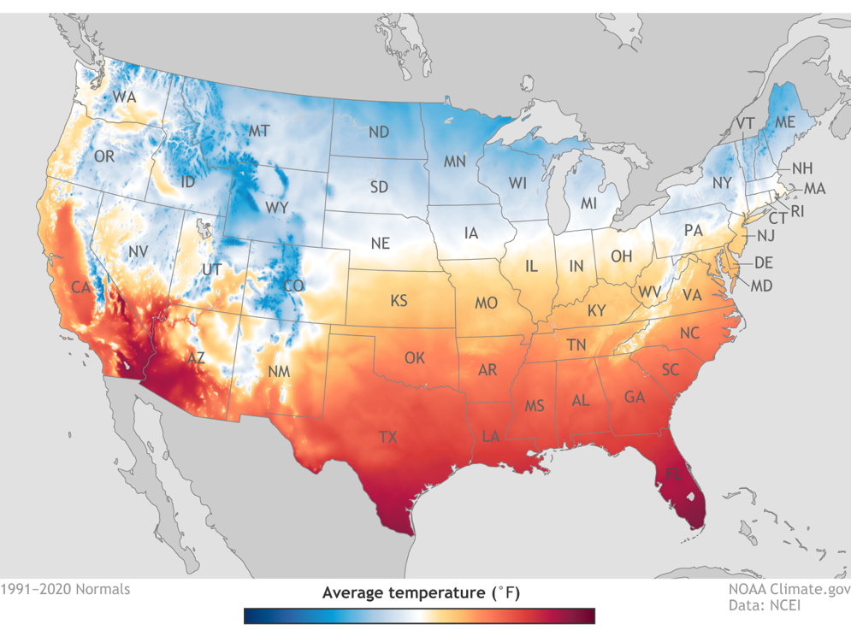
Fig 2. U.S. Annual Average Temperature (1991-2020)
Source: https://www.climate.gov/news-features/featured-images/new-maps-annual-average-temperature-and-precipitation-us-climate
Notes:
Figure 2. map that displays the average temperature in the continental United States from 1961-1990, a 30-year period [answer: climate].

Slide 5
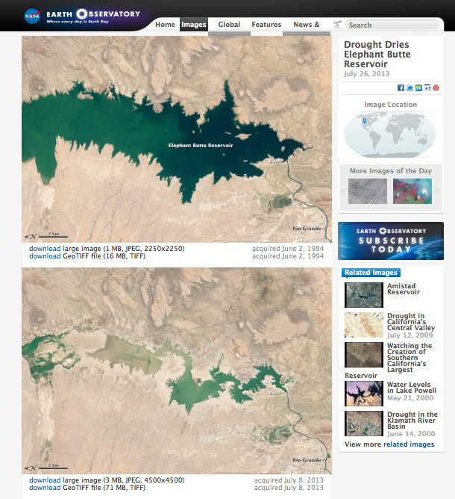
Fig 3. Lowered reservoir levels during drought, Elephant Butte, New Mexico
Source: earthobservatory.nasa.gov/IOTD/view.php?id=81714
Notes:
Figure 3: satellite images of Elephant Butte reservoir in New Mexico taken during a drought. The top photo was taken in 1994, and the bottom photo was taken in 2013, 19 years later [answer: climate].

Slide 6
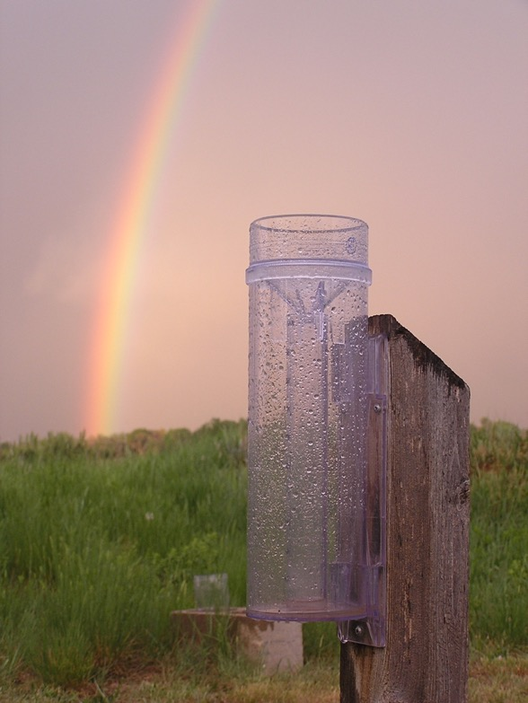
Fig 4. Rain gauge in Fort Collins, Colorado
Source: pmm.nasa.gov/node/739
Notes:
Figure 4: photo of a rain gauge in Fort Collins, Colorado. The rain gauge has collected precipitation from a recent rain event [answer: weather].

Slide 7
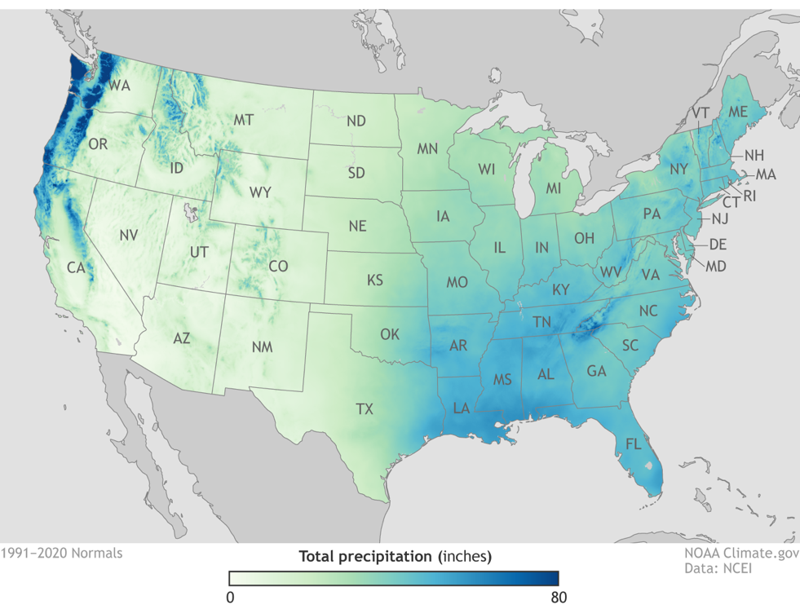
Fig 2. U.S. Annual Average Precipitation (1991-2020)
Source: https://www.climate.gov/news-features/featured-images/new-maps-annual-average-temperature-and-precipitation-us-climate
Notes:
Figure 5: map that displays the average precipitation in the continental United States from 1961-1990, a 30-year period [answer: climate].

Slide 8
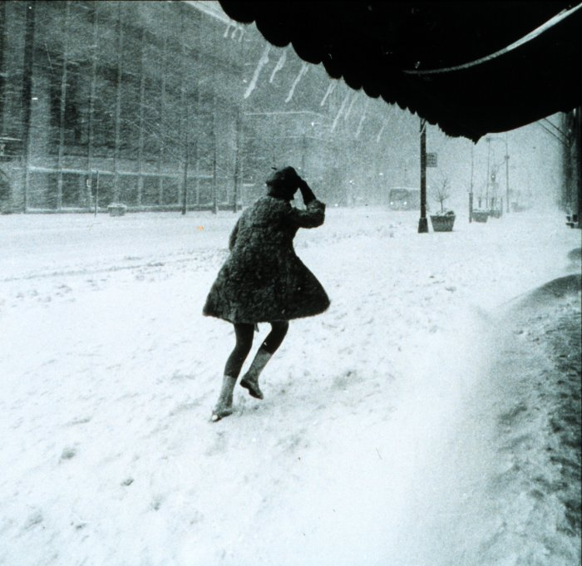
Fig 6. Snowstorm
Source: https://commons.wikimedia.org/wiki/File:Miniskirts_in_snow_storm.jpg
Notes:
Figure 6: photo of a person walking in a snowstorm [answer: weather].

Slide 9
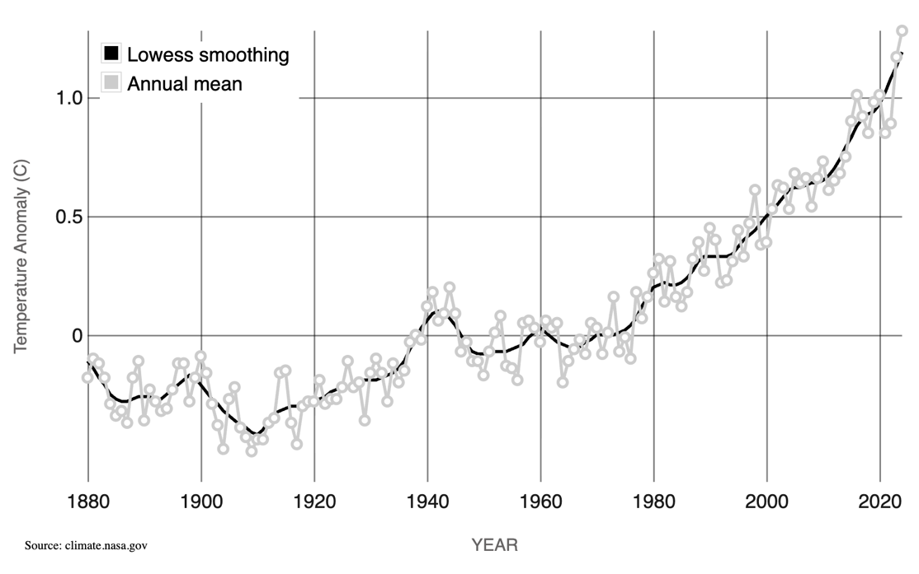
Fig 7. Average global surface temperature
Source: https://climate.nasa.gov/vital-signs/global-temperature/?intent=121
Notes:
Figure 7. graph of the average surface temperature on Earth since 1880 [answer: climate].

