Slide 1
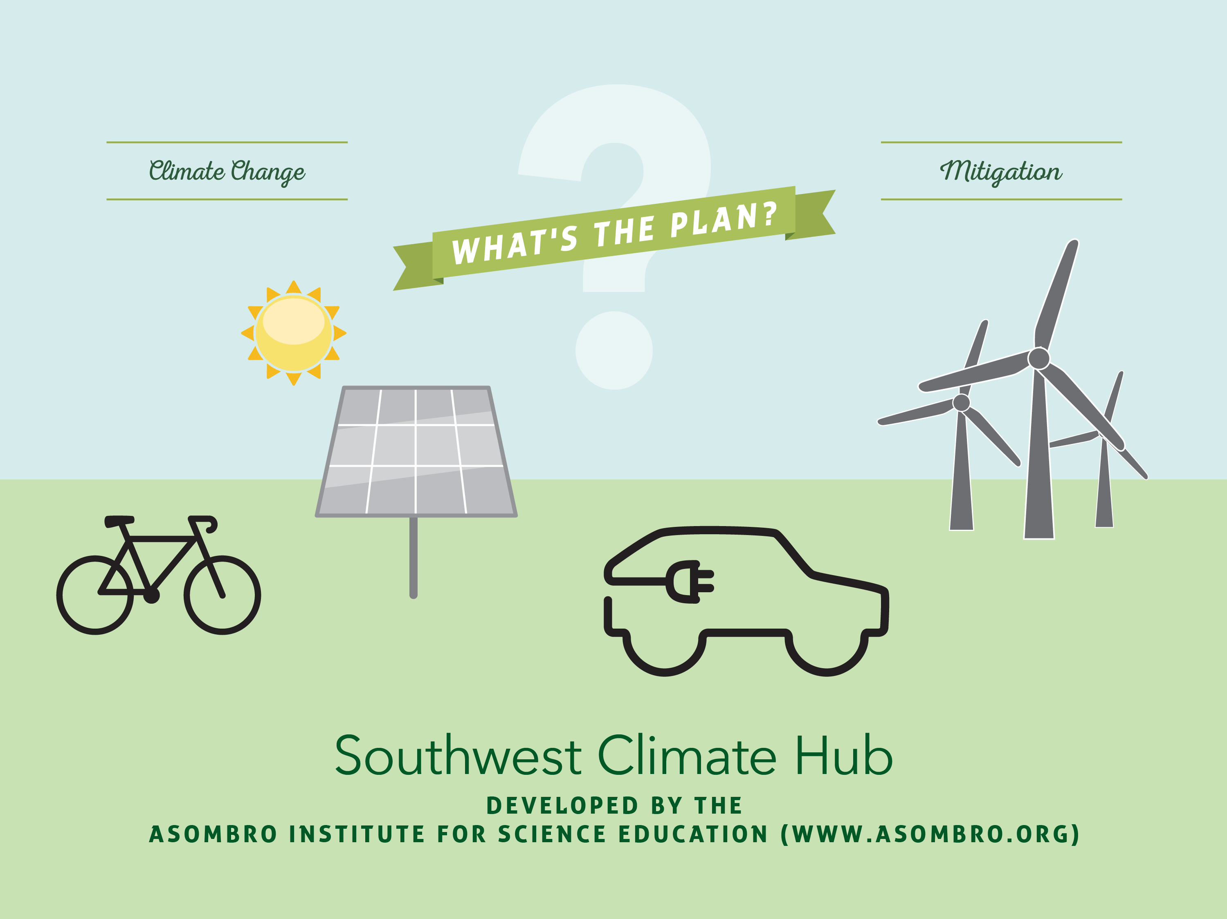

Slide 2
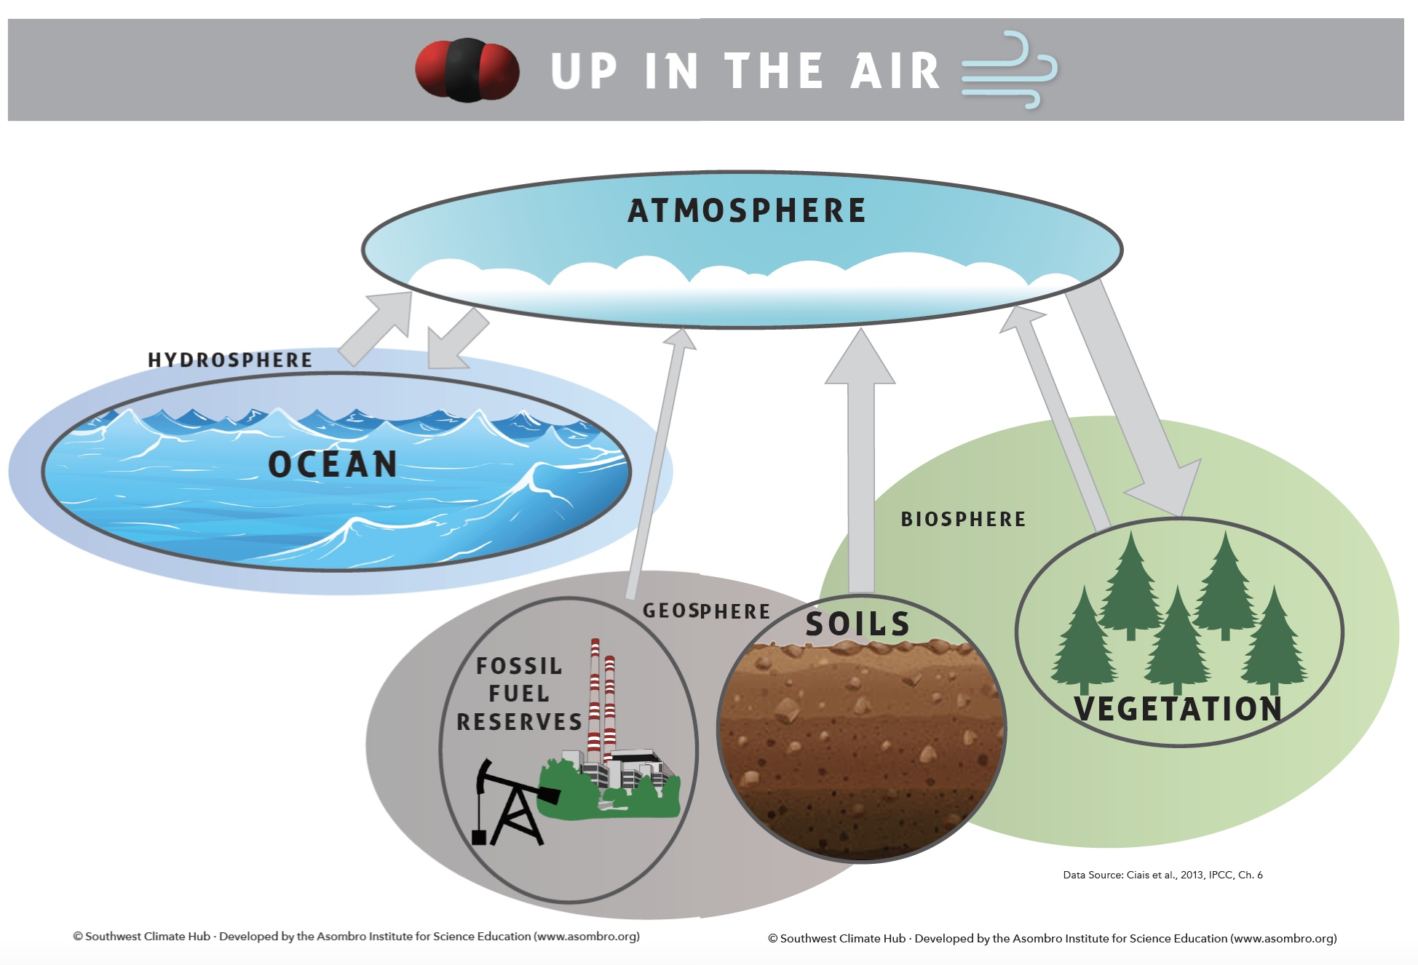
Human Impacts on the Carbon Cycle and Increasing Atmospheric CO₂

Slide 3
Increased Atmospheric CO₂ and Effects on Humans
Feedback loops that melt ice caps and raise sea levels
Disease spread
Growing season changes
Habitat loss
Extreme weather patterns

Slide 4
What are ways that we release carbon dioxide into the atmosphere? What are ways we reduce the amount of carbon dioxide in the atmosphere?

Slide 5
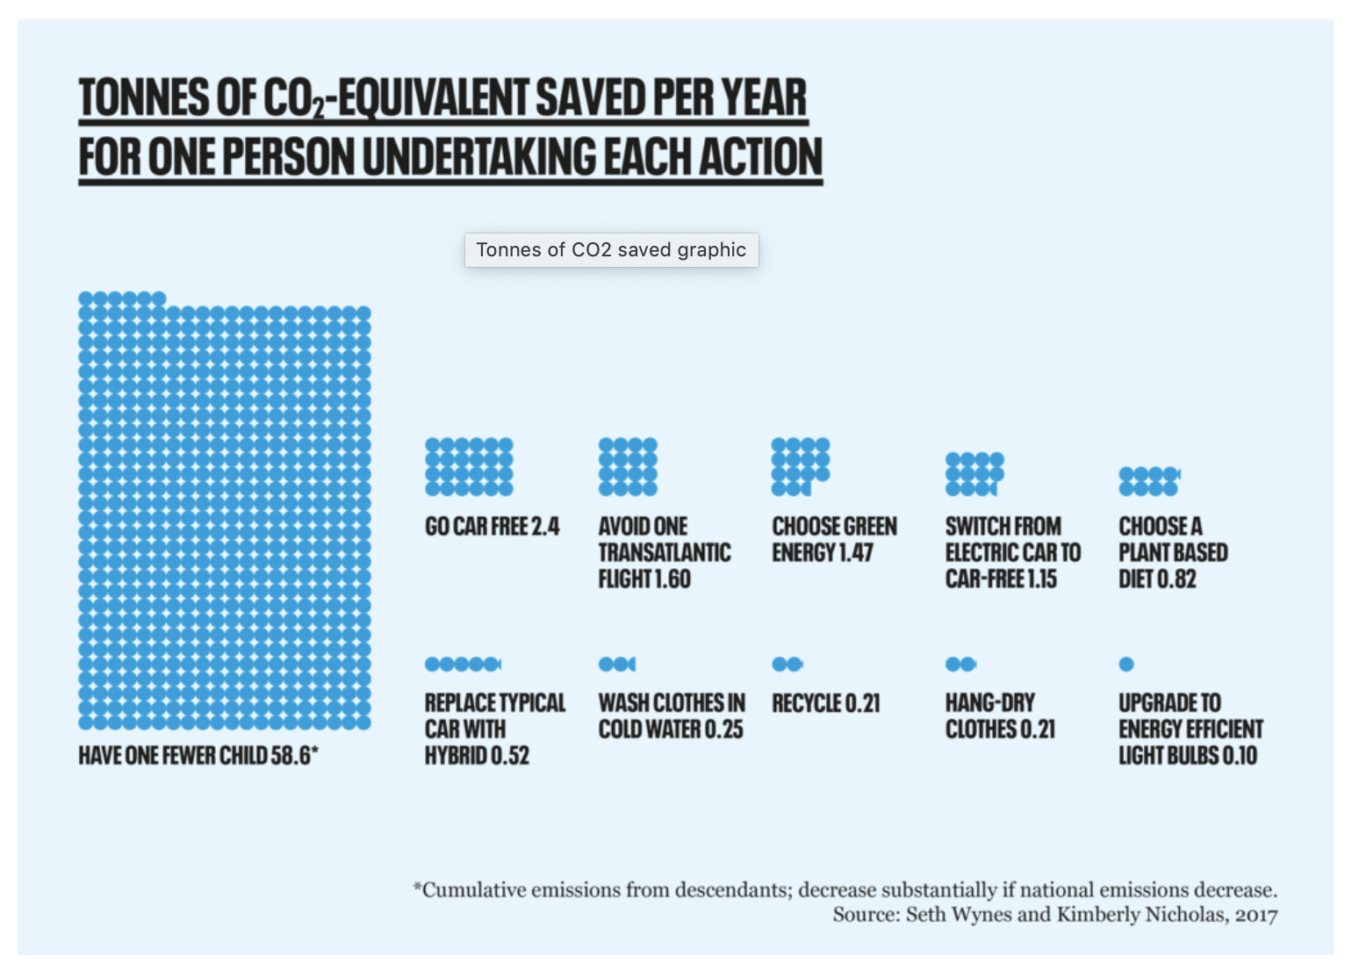
Climate Change Mitigation
Mitigation: an action that reduces the severity of climate change
Source: Wynes and Nicholas. 2017.
The climate mitigation gap: education and government recommendations miss the most effective individual actions.

Slide 6
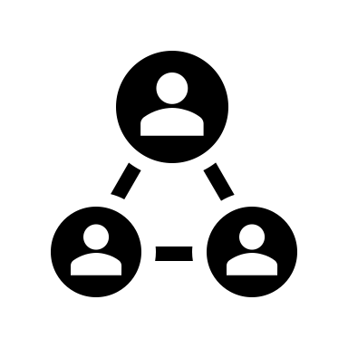
Mitigation is Complicated
Scientific research has determined that these actions can reduce carbon emissions.
It’s up to you to argue whether or not implementing these strategies is feasible.

Slide 7
Solar Energy
Renewable electricity source
Solar panels needed
Would take 3 million solar panels to reduce CO₂ emissions by 0.5 Pg per year
Challenges:
Expense of solar panels
Location for solar panels
Only work in sunlight
Right now, most solar panels are in use by individual people, not energy companies
What could make this happen:
Power companies building solar farms
Requiring new homes to have solar panels
More government
tax breaks
for people who
install solar
panels

Slide 8
Solar Energy
What do you think is the biggest challenge of using solar energy?
Cost to build solar farms
Space needed for solar panels
Resistance from fossil fuel industry
Others

Slide 9
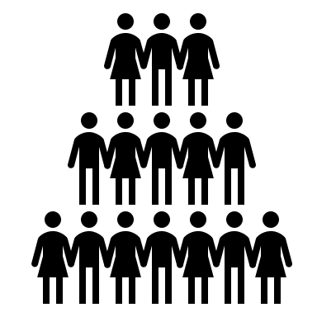
Solar Energy
Whose responsibility is this?
The government?
Individuals?
Companies?
Where in the world could this happen?
Rich countries vs. poor countries?
Regions with a lot of sunlight vs. regions that are cloudy?

Slide 10
Solar Energy
Who will pay for it?
Who will benefit from it?
Who will be hurt by it?

Slide 11
Solar Energy
Pros and Cons?

Slide 12
Solar Energy
If you were in charge of making this happen, how would you do it?

Slide 13
Put It All Together
Solar energy
It will slow climate change.
People need to use less electricity
and low-electricity appliances to make the transition easier. This will require creating more affordable low energy appliances.
Governments need to pass laws that encourage people to use solar energy and not fossil fuel energy.
People who buy solar panels will spend less on energy bills.
Coal companies- against loss of business
Solar energy companies –for more business
Homeowners- for cheaper electricity in the long run
Homeowners- against expensive set up cost
Environmental groups- less air pollution
It will lead to cleaner air and water.
It will save money in the long run.
Power companies that currently burn coal and gas to make electricity need to invest in installing solar panels instead.
To prevent the burning of fossil fuels for electricity, we should use solar energy. Power companies will build solar farms with thousands of solar panels in sunny places like the Southwest. They can use space in cities by putting solar panels over parking lots, and people and businesses can also help by installing solar panels on their roofs.
Thousands of jobs rely on the coal and gas industry.
Rich countries can afford to install solar panels. They can invest in poor countries that are very sunny, especially tropical countries.
It will be expensive to build solar panels.
Solar panels are made with materials that can be harmful to the environment.

Slide 14
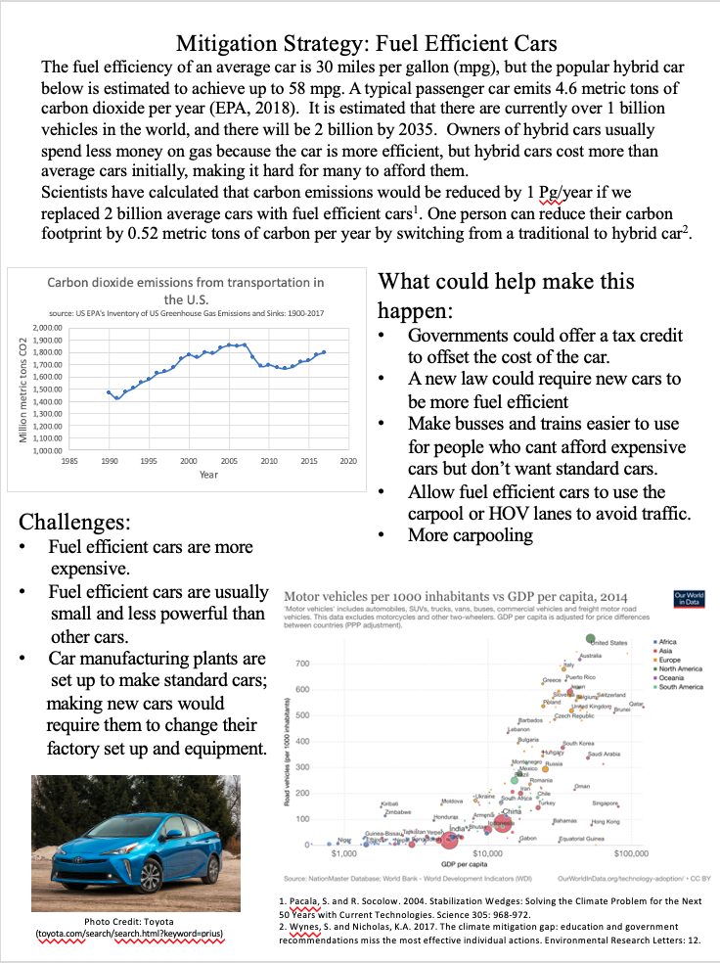
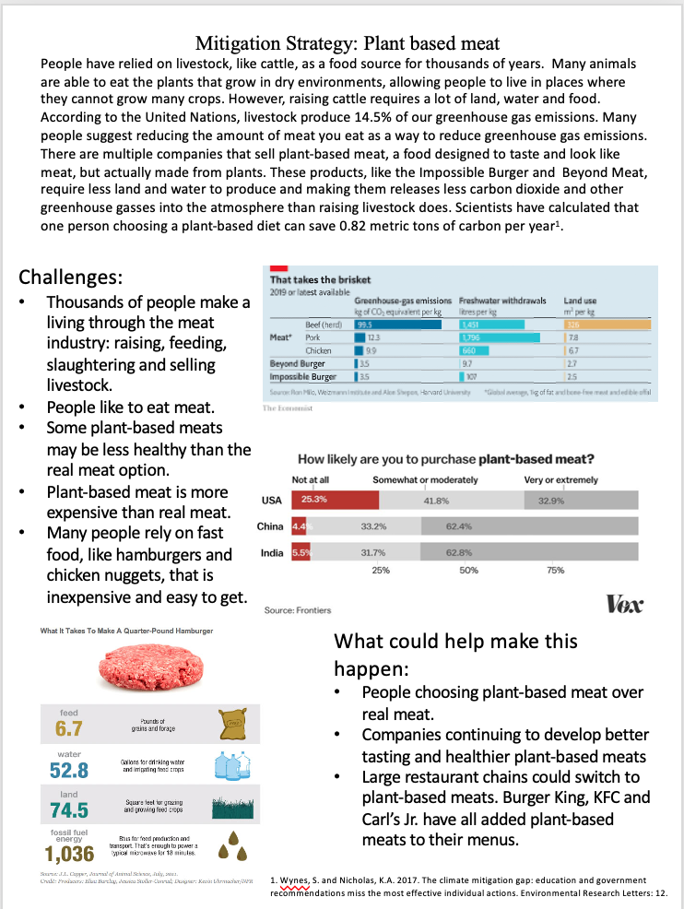
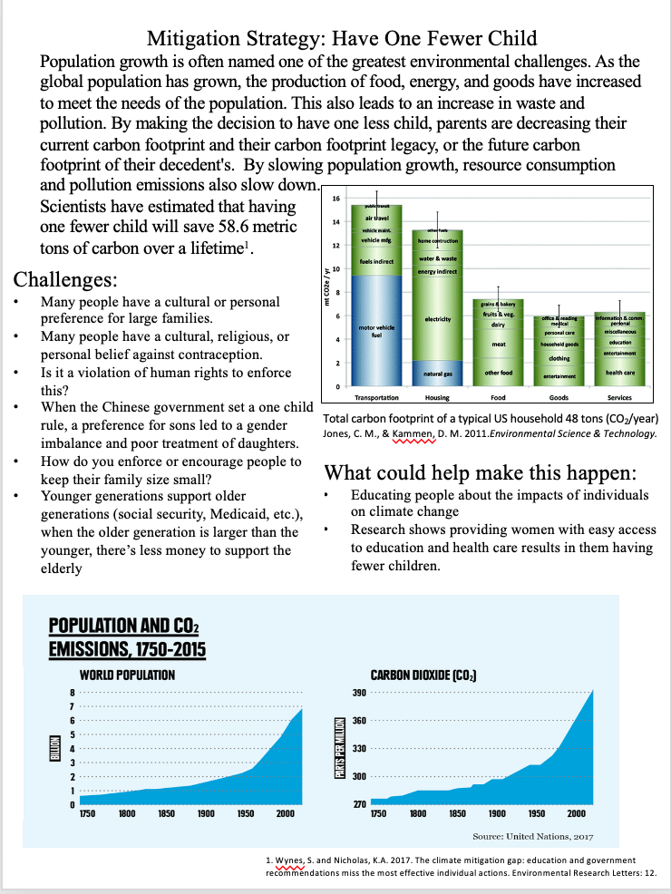
Your Turn
Choose one of the proposed
mitigation strategies, and read
the page.
Consider the strengths and weaknesses
Make arguments for and against it
Refine or add to the strategy to strengthen it
Propose your own version of this strategy
Use the questions on the mini-poster to help you think about different aspects of this mitigation strategy
Consider all the questions before filling in #7 on the poster

Slide 15
Climate Change Mitigation
Mitigation: an action that reduces the severity of climate change
Source: Wynes and Nicholas. 2017.
The climate mitigation gap: education and government recommendations miss the most effective individual actions.

