Slide 1
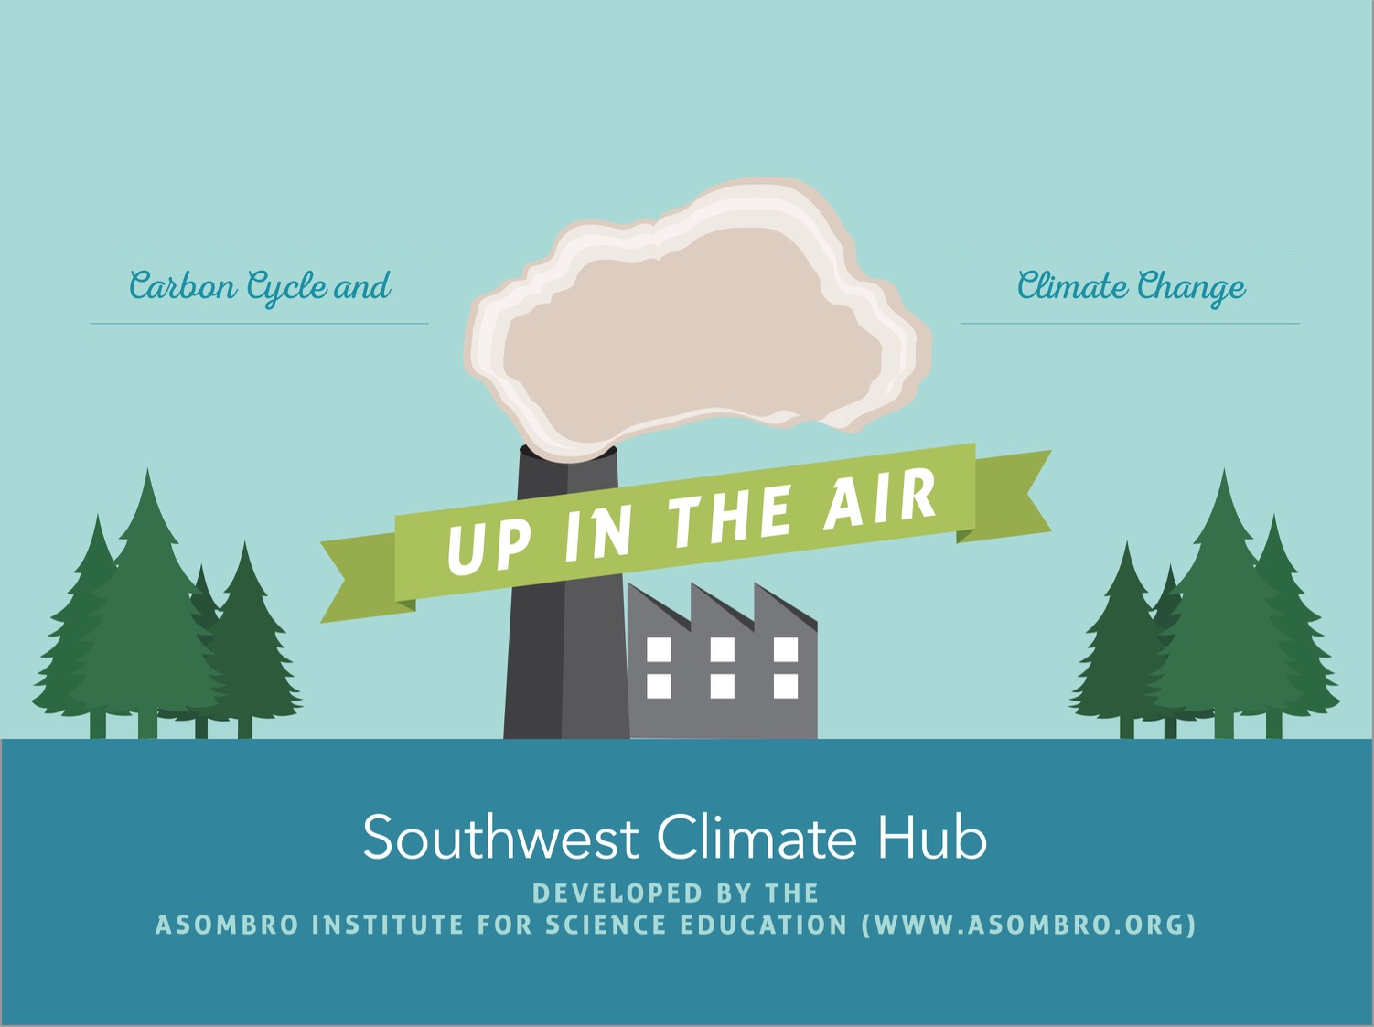

Slide 2
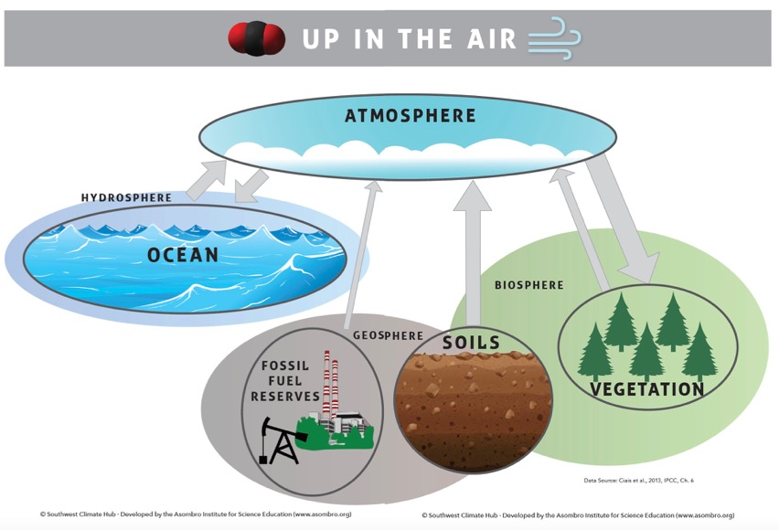
Phenomenon
How are humans impacting the cycling of carbon on Earth?

Slide 3
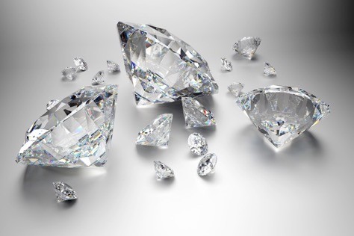
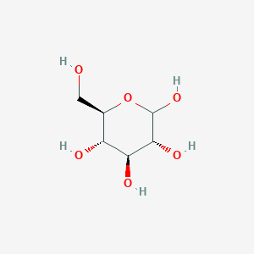

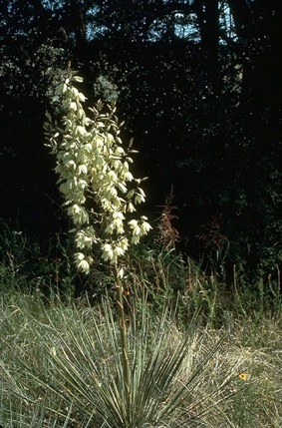
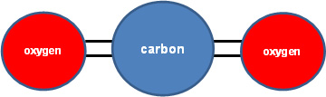
Carbon
C
C₆H₁₂O₆
CO₂
Source: pubchem.ncbi.nlm.nih.gov
Source: climate.nasa.gov/news/2491/10-interesting-things-about-air/
Source: share.america.gov/consumers-ask-questions-about-diamonds/
Source: netl.doe.gov/coal/carbon-storage/faqs/carbon-dioxide-101
Source: https://plants.usda.gov

Slide 4

Spheres:
Atmosphere, Hydrosphere, Geosphere, & Biosphere
Air
Water
Living Systems
Land

Slide 5

Carbon Moves Between Reservoirs

Slide 6
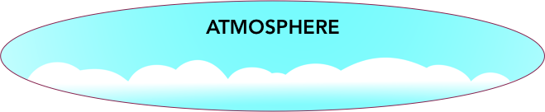
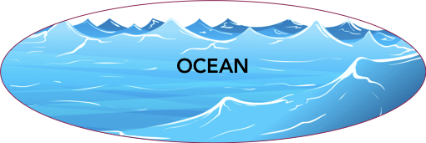
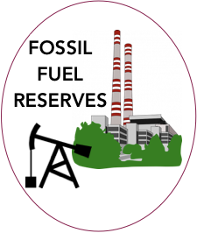
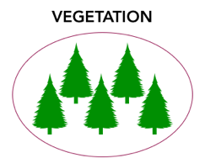
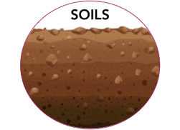
Carbon Cycle and Climate Change
Day 1:
Where is carbon and how does it move?
Day 2:
How much carbon is entering the atmosphere?

Slide 7
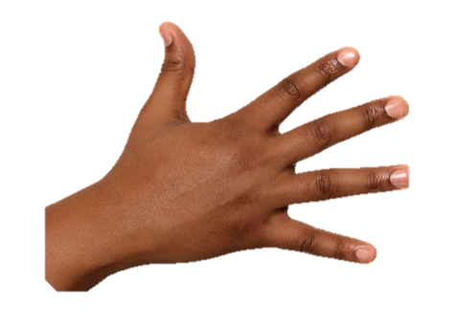
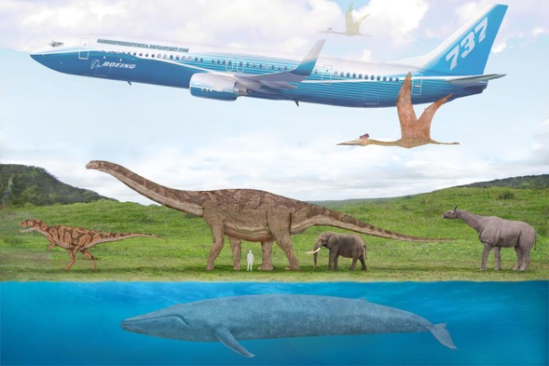
Making a String Model
Every square centimeter in your string model represents 1 Petagram of carbon (PgC).
1 Pg = 10¹⁵ g
  1 quadrillion grams
  Weight of about 6 million blue whales
Source: UMD, Dept. of Geology
(geol.umd.edu/~tholtz/G204/lectures/204whales.html)

Slide 8
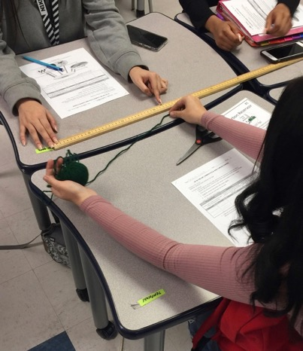
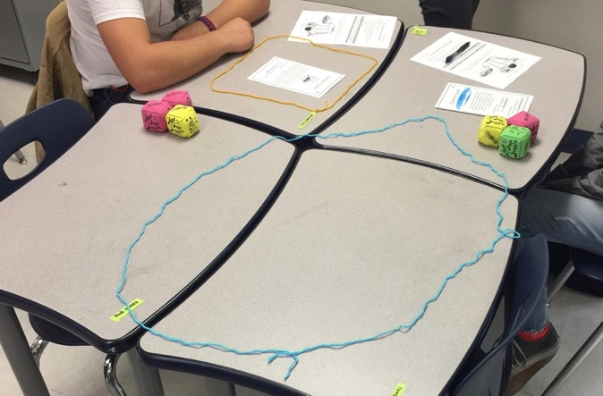
How Much Carbon is There?
Divide into 5 groups and follow the task card instructions (side #1).
  Use string to measure out a circle to represent one of the five carbon reservoirs.

Slide 9
How Does Carbon Move?
How do you think carbon gets into your reservoir?
Where does it go when it leaves your reservoir?

Slide 10
How Does Carbon Move?
Read side #2 of your task card.
Choose jobs:
  1 timer: stopwatch, say when to throw/walk
  1 catcher: collect beanbags from other groups
  1 or 2 throwers (or walkers): toss/walk beanbags to other reservoirs
Throwers will say the represented process LOUDLY.
When your instructor tells you to begin, start your stopwatch, and follow the instructions for moving carbon to other reservoirs.

Slide 11
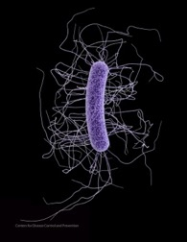
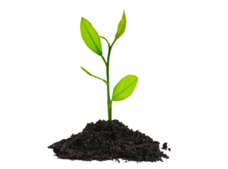
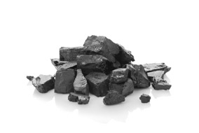
What Words Did You Hear?
Respiration
Photosynthesis
Ocean Absorption
Ocean Release
Decomposition
Combustion
Fossil Fuel Formation
Soils or Vegetation
Atmosphere
Atmosphere
Ocean

Slide 12
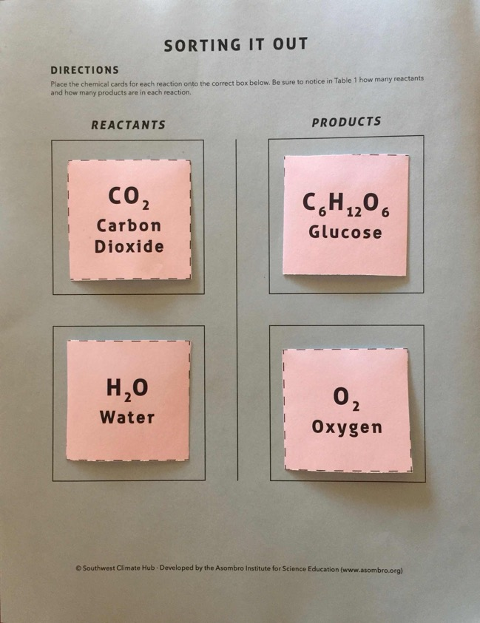
Sorting it Out
Identify the reactants and products in three carbon cycle processes.

Slide 13
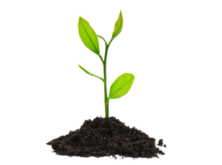
Photosynthesis
Process used by plants to transform light energy into chemical energy
Choose chemicals used as reactants and products.
Place cards in boxes on Sorting it Out page.

Slide 14
Photosynthesis
In Table 1, write the reactants and products in the blanks.
2 Reactants
___________
___________
2 Products
___________
___________
CO₂
C₆H₁₂O₆
H₂O
O₂

Slide 15
Photosynthesis
Carbon cycle: most interested in what happens to carbon.
Circle reactant and product that contain carbon.
2 Reactants
___________
___________
2 Products
___________
___________
CO₂
C₆H₁₂O₆
H₂O
O₂

Slide 16
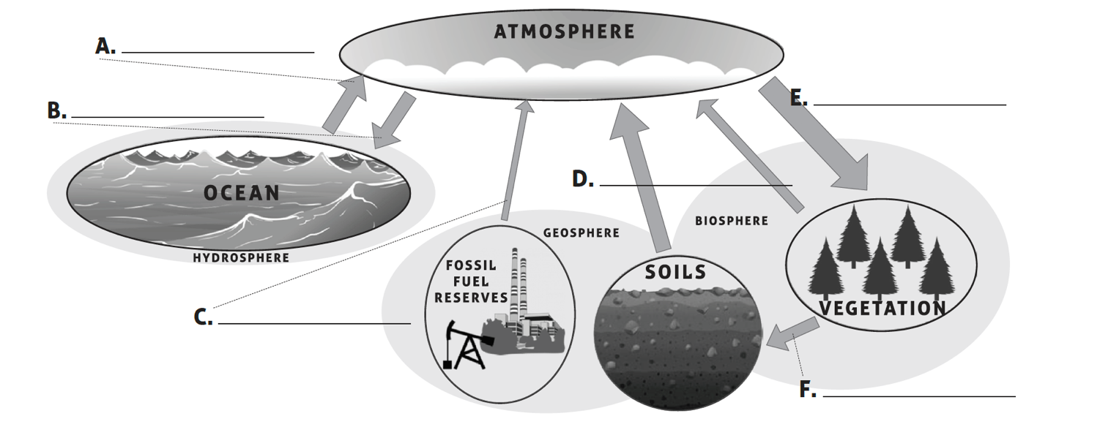
Photosynthesis
Which arrow in the diagram represents photosynthesis?
Photosynthesis

Slide 17
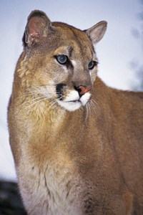
Respiration
Process by which organisms use food molecules to produce energy (ATP) for their cells
Choose chemicals used as reactants and products.
Place cards in boxes on Sorting it Out page.
Source: National Park Service
(nps.gov/romo/learn/nature/mountain-lion.htm)

Slide 18


Respiration
In Table 1, write the reactants and products in the blanks.
2 Reactants
___________
___________
2 Products
___________
___________
C₆H₁₂O₆
CO₂
O₂
H₂O

Slide 19
Respiration
Circle the reactant and product that contain carbon.
2 Reactants
___________
___________
2 Products
___________
___________
C₆H₁₂O₆
CO₂
O₂
H₂O

Slide 20
Respiration
Which arrow in the diagram represents respiration?
Photosynthesis
Respiration

Slide 21

Combustion
Reaction that results in heat and light
Burning
  Combustion of coal
  Approximately 1/3 of power plants in US
  Coal is mostly carbon
Choose chemicals used as reactants and product (only one product).
Place cards in boxes
on Sorting it Out page.
Source: North Dakota Studies
(ndstudies.gov/energy/level2/module-3-coal/what-coal)

Slide 22
Combustion of Coal
In Table 1, write the reactants and product in the blanks.
2 Reactants
___________
___________
1 Product
___________
C
CO₂
O₂

Slide 23
Combustion of Coal
Circle the reactant and product that contain carbon.
2 Reactants
___________
___________
1 Product
___________
C
CO₂
O₂

Slide 24
Combustion of Coal
Which arrow in the diagram represents combustion?
Photosynthesis
Respiration
Combustion

Slide 25
Ocean Release and Absorption
During gas exchange, CO₂ moves between the ocean and atmosphere, but no chemical reaction occurs.
Release
Absorption
Photosynthesis
Respiration
Combustion

Slide 26
Decomposition
During decomposition, organic molecules break down through various processes.
Release
Absorption
Photosynthesis
Respiration
Combustion
Decomposition

Slide 27
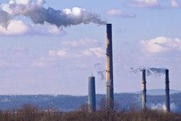

Phenomenon
How are humans impacting the cycling of carbon on Earth?
Source: epa.gov/enforcement/national-compliance-initiative-
reducing-air-pollution-largest-sources

Slide 28

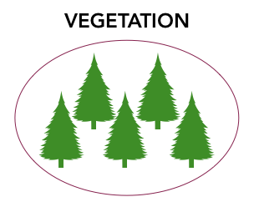

Part II
How are humans impacting the cycling of carbon on Earth?
Processes of carbon cycle
Source
Ends Up
CO₂
C₆H₁₂O₆

Slide 29


Reservoirs and Fluxes
Creating a quantitative model
Reservoir: the places where carbon is stored
Flux: movement of carbon between reservoirs
Reservoir
Reservoir
Flux

Slide 30

Up in the Air Model
Petagram (Pg) =
  10¹⁵ grams OR
  1 quadrillion grams OR
  1 thousand billion grams OR
  6 million blue whales
Source: UMD, Dept. of Geology
(geol.umd.edu/~tholtz/G204/lectures/204whales.html)

Slide 31
Spheres:
Atmosphere, Hydrosphere, Geosphere, & Biosphere
Air
Water
Living Systems
Land

Slide 32
Non-Fluxing Carbon
One year of carbon cycling
Most carbon will not move: non-fluxing carbon
Fill out the reservoir name blanks on cup labels – use pencil
Reservoir Choices:
Ocean
Soils
Fossil Fuel Reserves
Atmosphere
Vegetation
2 minutes

Slide 33
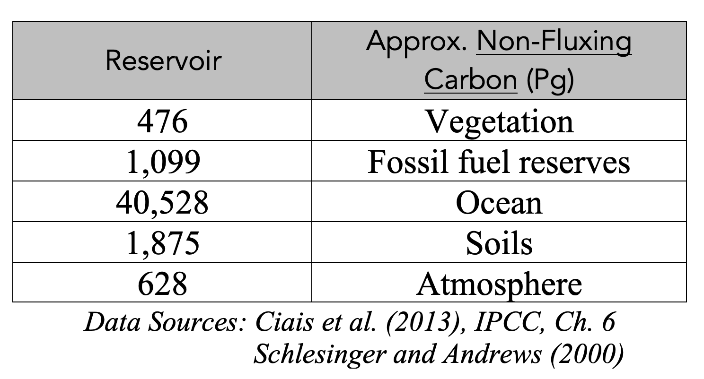
Check Your Choices
Correct any incorrect answers.

Slide 34
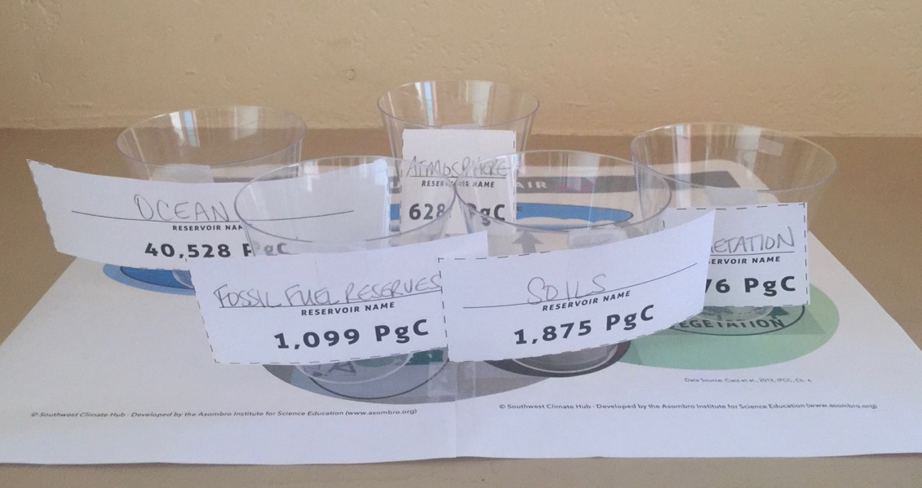
Label and Place Cups
Cut out labels and tape each to a cup.
Place cups on model board reservoirs.

Slide 35
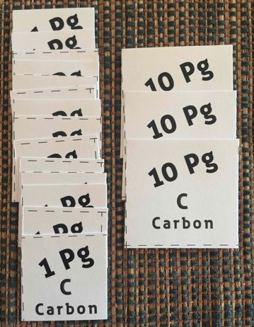
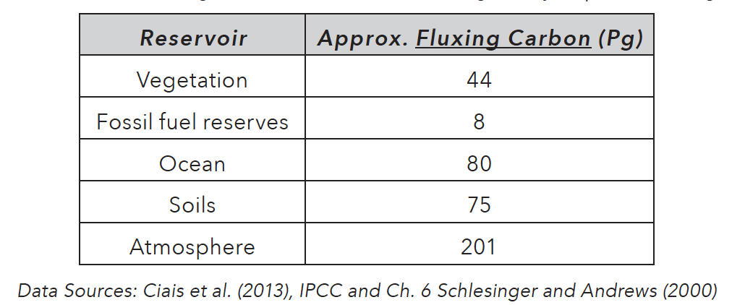
Fluxing Carbon Pieces
Place the correct number of carbon pieces in every reservoir cup.
Each reservoir must contain at least 10 1-PgC pieces.
  Except Fossil Fuel Reserves

Slide 36

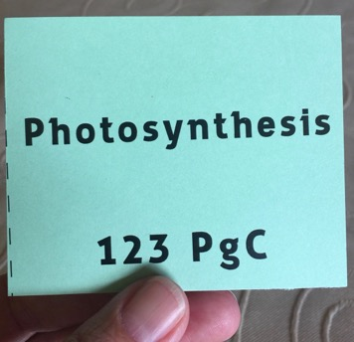
Up in the Air: Play the Game
First, read instructions.
Will draw a card.
  Use Sorting it Out answers
Winner: who moved the LEAST
carbon to the atmosphere?
Keep all game cards that you
draw in a stack next to yourself.

Slide 37
Up in the Air: Play the Game
Shuffle the game cards and place them face down.
The youngest player will go first.
Player 1 draws the first card and moves fluxing carbon pieces from one reservoir to another based on the process listed on the card.
  Determine which reservoirs to transfer carbon between based on the process listed on the card.
Each player will keep the game cards that they draw in a stack next to themselves.
Take turns drawing cards and moving fluxing carbon pieces until all cards have been used.
Once you finish with the game cards, the game is over. Keep each player’s game cards next to them, and leave all of the fluxing carbon pieces in place on the game board.

Slide 38

How Much was Added?
How many PgC were added to the atmosphere?
_______Pg - _______Pg = _______Pg
How many blue whales could you use to represent this amount?
207
201
6
Total fluxing atmospheric C at end of game (Q. 9)
Total fluxing atmospheric C at start of of game (p. 2, sec. II)
Fluxing atmospheric C added during 1-year period of game
Source: UMD, Dept. of Geology
(geol.umd.edu/~tholtz/G204/lectures/204whales.html)

Slide 39

Fluxes to the Atmosphere

Slide 40
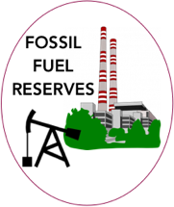

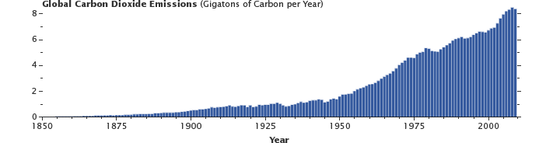
Flux from Fossil Fuel Reserves
Does the flux from Fossil Fuel Reserves account for the increase in atmospheric CO₂?
Source: NASA
(https://earthobservatory.nasa.gov/features/CarbonCycle/page4.php)

Slide 41
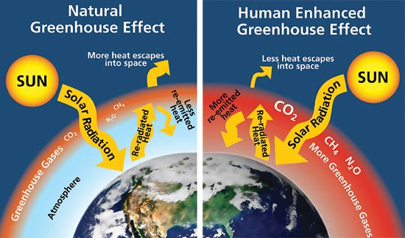

Phenomenon
How are humans impacting the cycling of carbon on Earth?

Slide 42
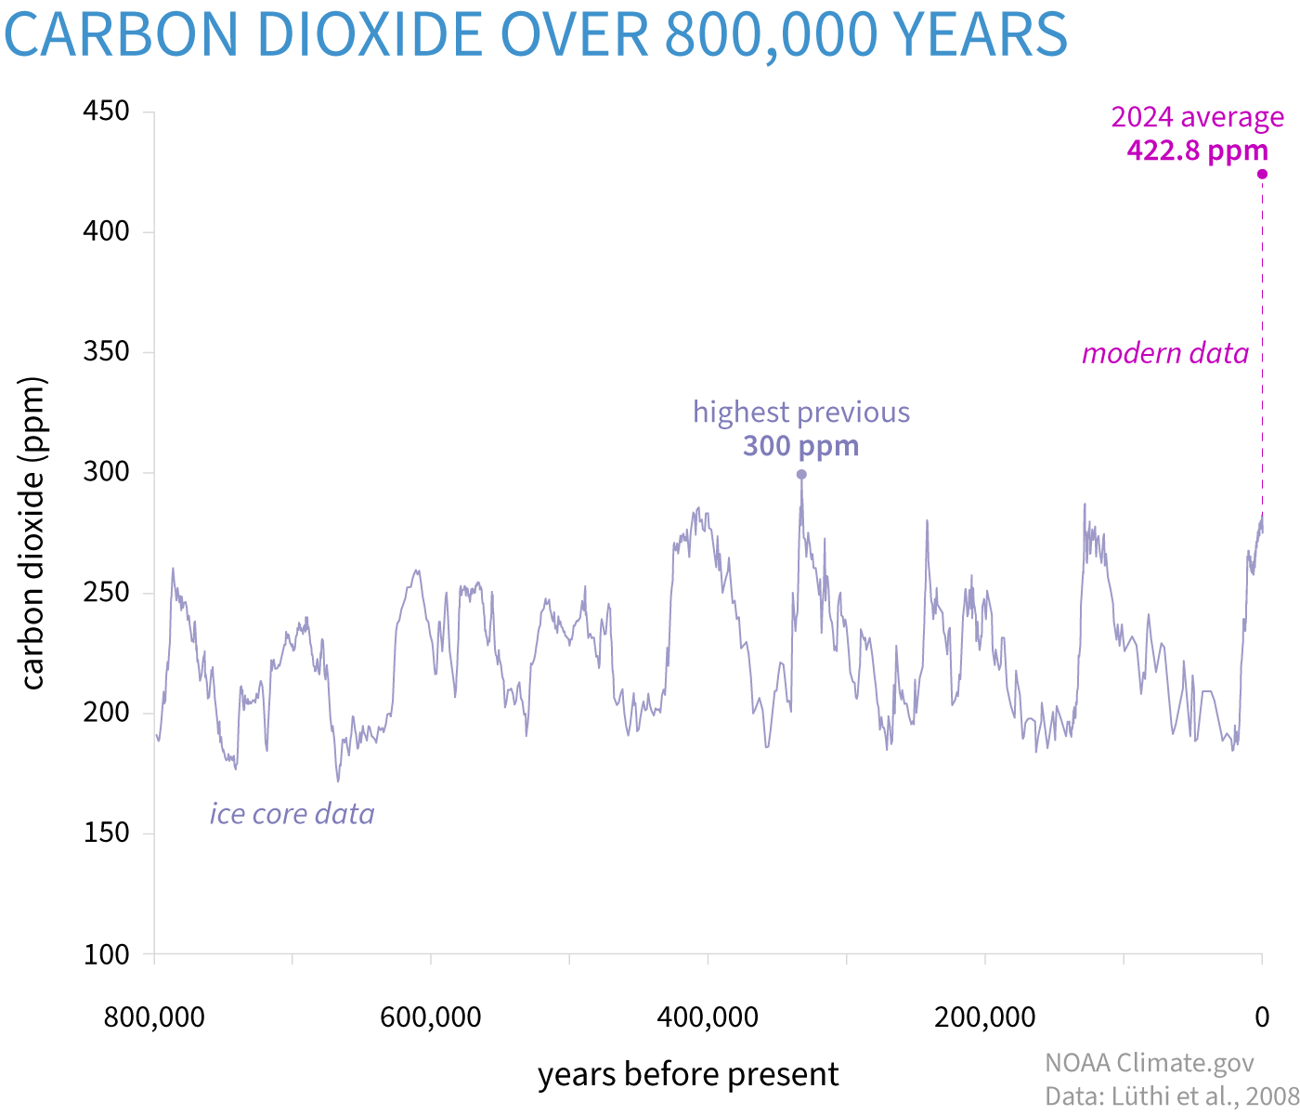
Long-Term Atmospheric CO₂
Atmospheric carbon dioxide was higher in 2017 than any point in last 800,000 years
Source: NOAA Climate.gov
(climate.gov/news-features/understanding-climate/climate-change-atmospheric-carbon-dioxide)

