Slide 1
)
Brought to you by
The Asombro Institute
)
)
)
Sponge Salamanders
)
)
)
)
)
Using Science to Protect the Sacramento Mountain Salamander
)
)
)
)
)
)
)
)
)
© Asombro Institute for Science Education

Slide 2
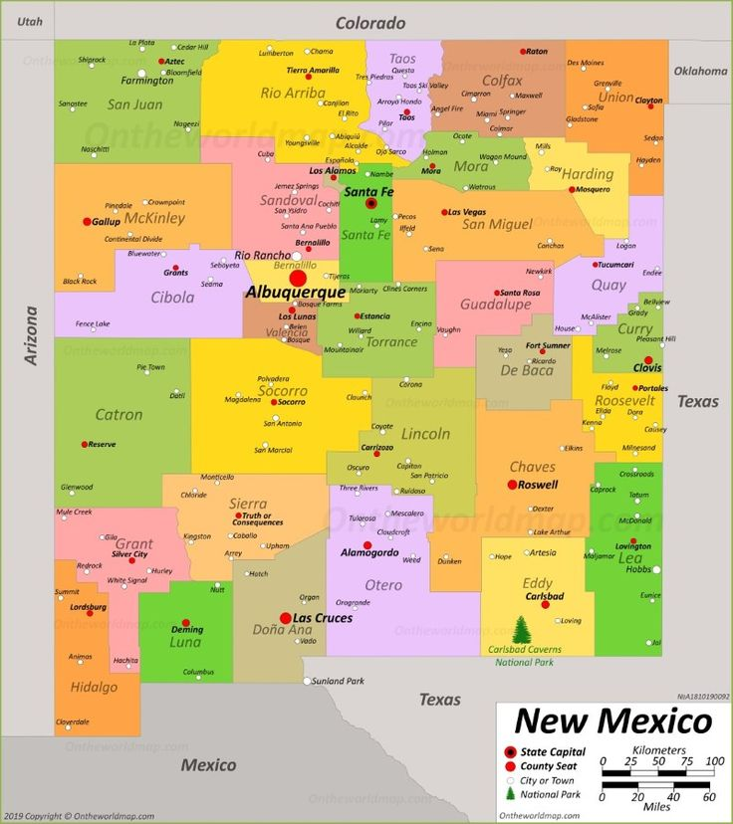
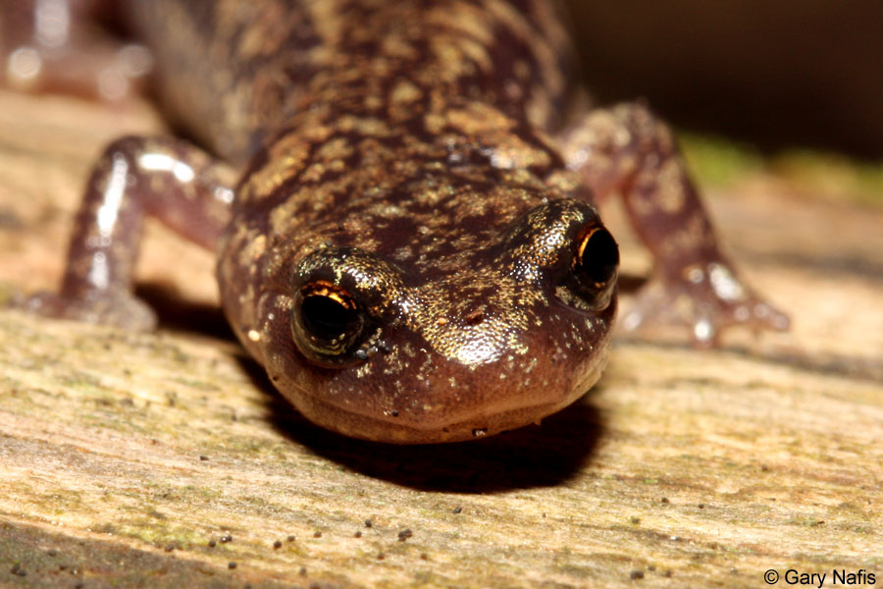
The Sacramento Mountain Salamander
I’m a small amphibian - only about 2-3 inches long.
The only place I’m found is in the Sacramento Mountains of New Mexico.
I live where it’s moist: under fallen tree logs and in leaf litter.
I eat beetles, ants, flies, worms, and other bugs.
Typical Habitat
I’m named a Species of Greatest Conservation Need by the New Mexico Department of Game and Fish.
I could go extinct!

Slide 3
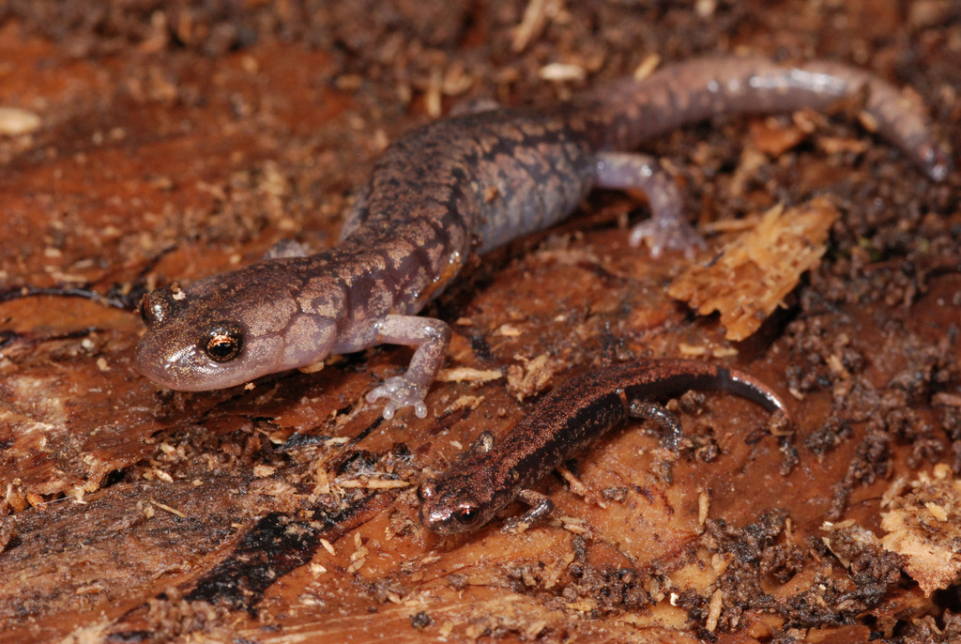
The Sacramento Mountain Salamander
...is like a sponge!
This salamander doesn’t have lungs like other animals.
It breathes through its skin!
For this to work, its skin has to stay moist.
If it dries out, the salamander can’t breathe.
Photo Credit: Robert Dobbs

Slide 4
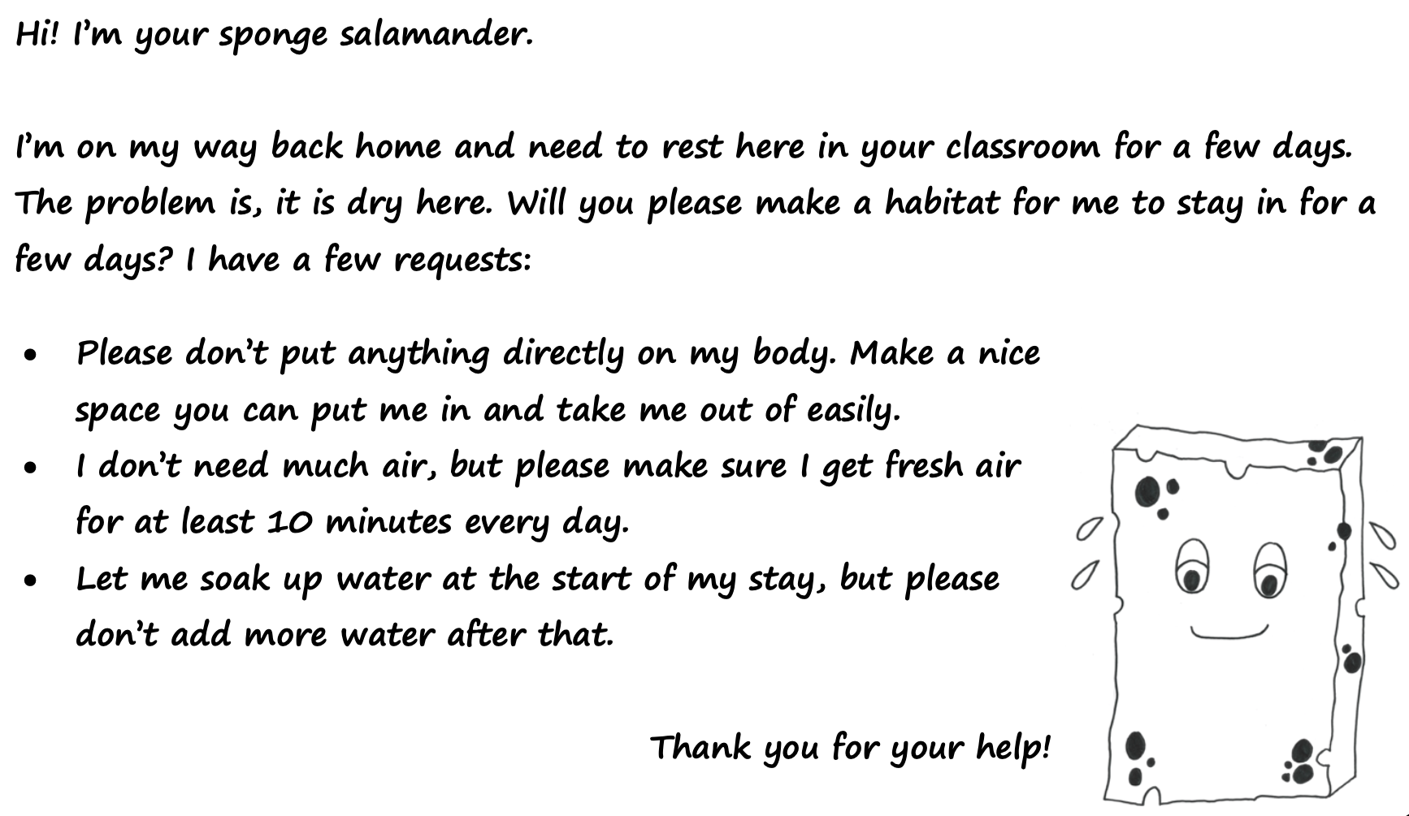
Follow along as we read…
a letter from
a sponge salamander

Slide 5
Let’s Learn from Desert Dwellers
The Chihuahuan Desert receives an average of less than 9 inches of rain per year!
How do animals live in a place with such little water?
They have adaptations!
Behaviors or structures that allow a plant or animal to better survive and reproduce in a particular environment.

Slide 6
How do I live with little water?
Spadefoot Toad
Nocturnal (avoids sun)
Digs a burrow to live underground
Waits (dormant) until rain comes

Slide 7
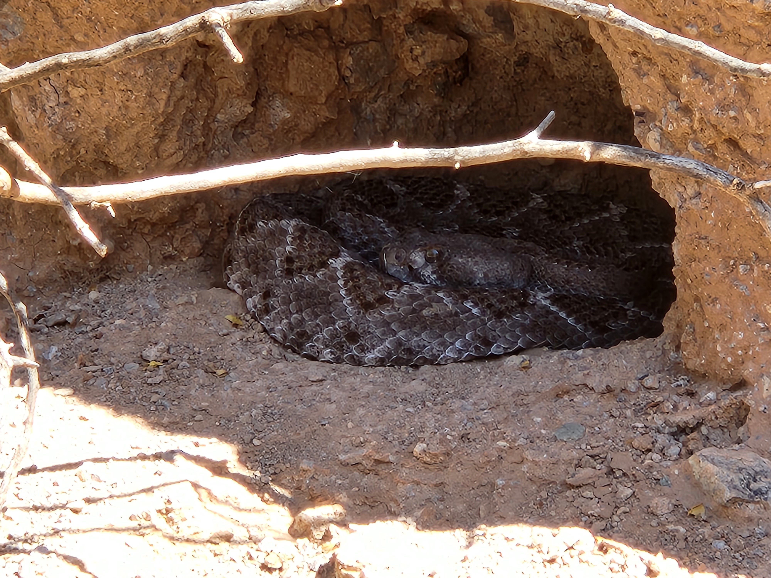
How do I live with little water?
Rattlesnake
Takes advantage of cooler temperatures by hiding in abandoned burrows
Has scaly skin to keep body moisture inside

Slide 8
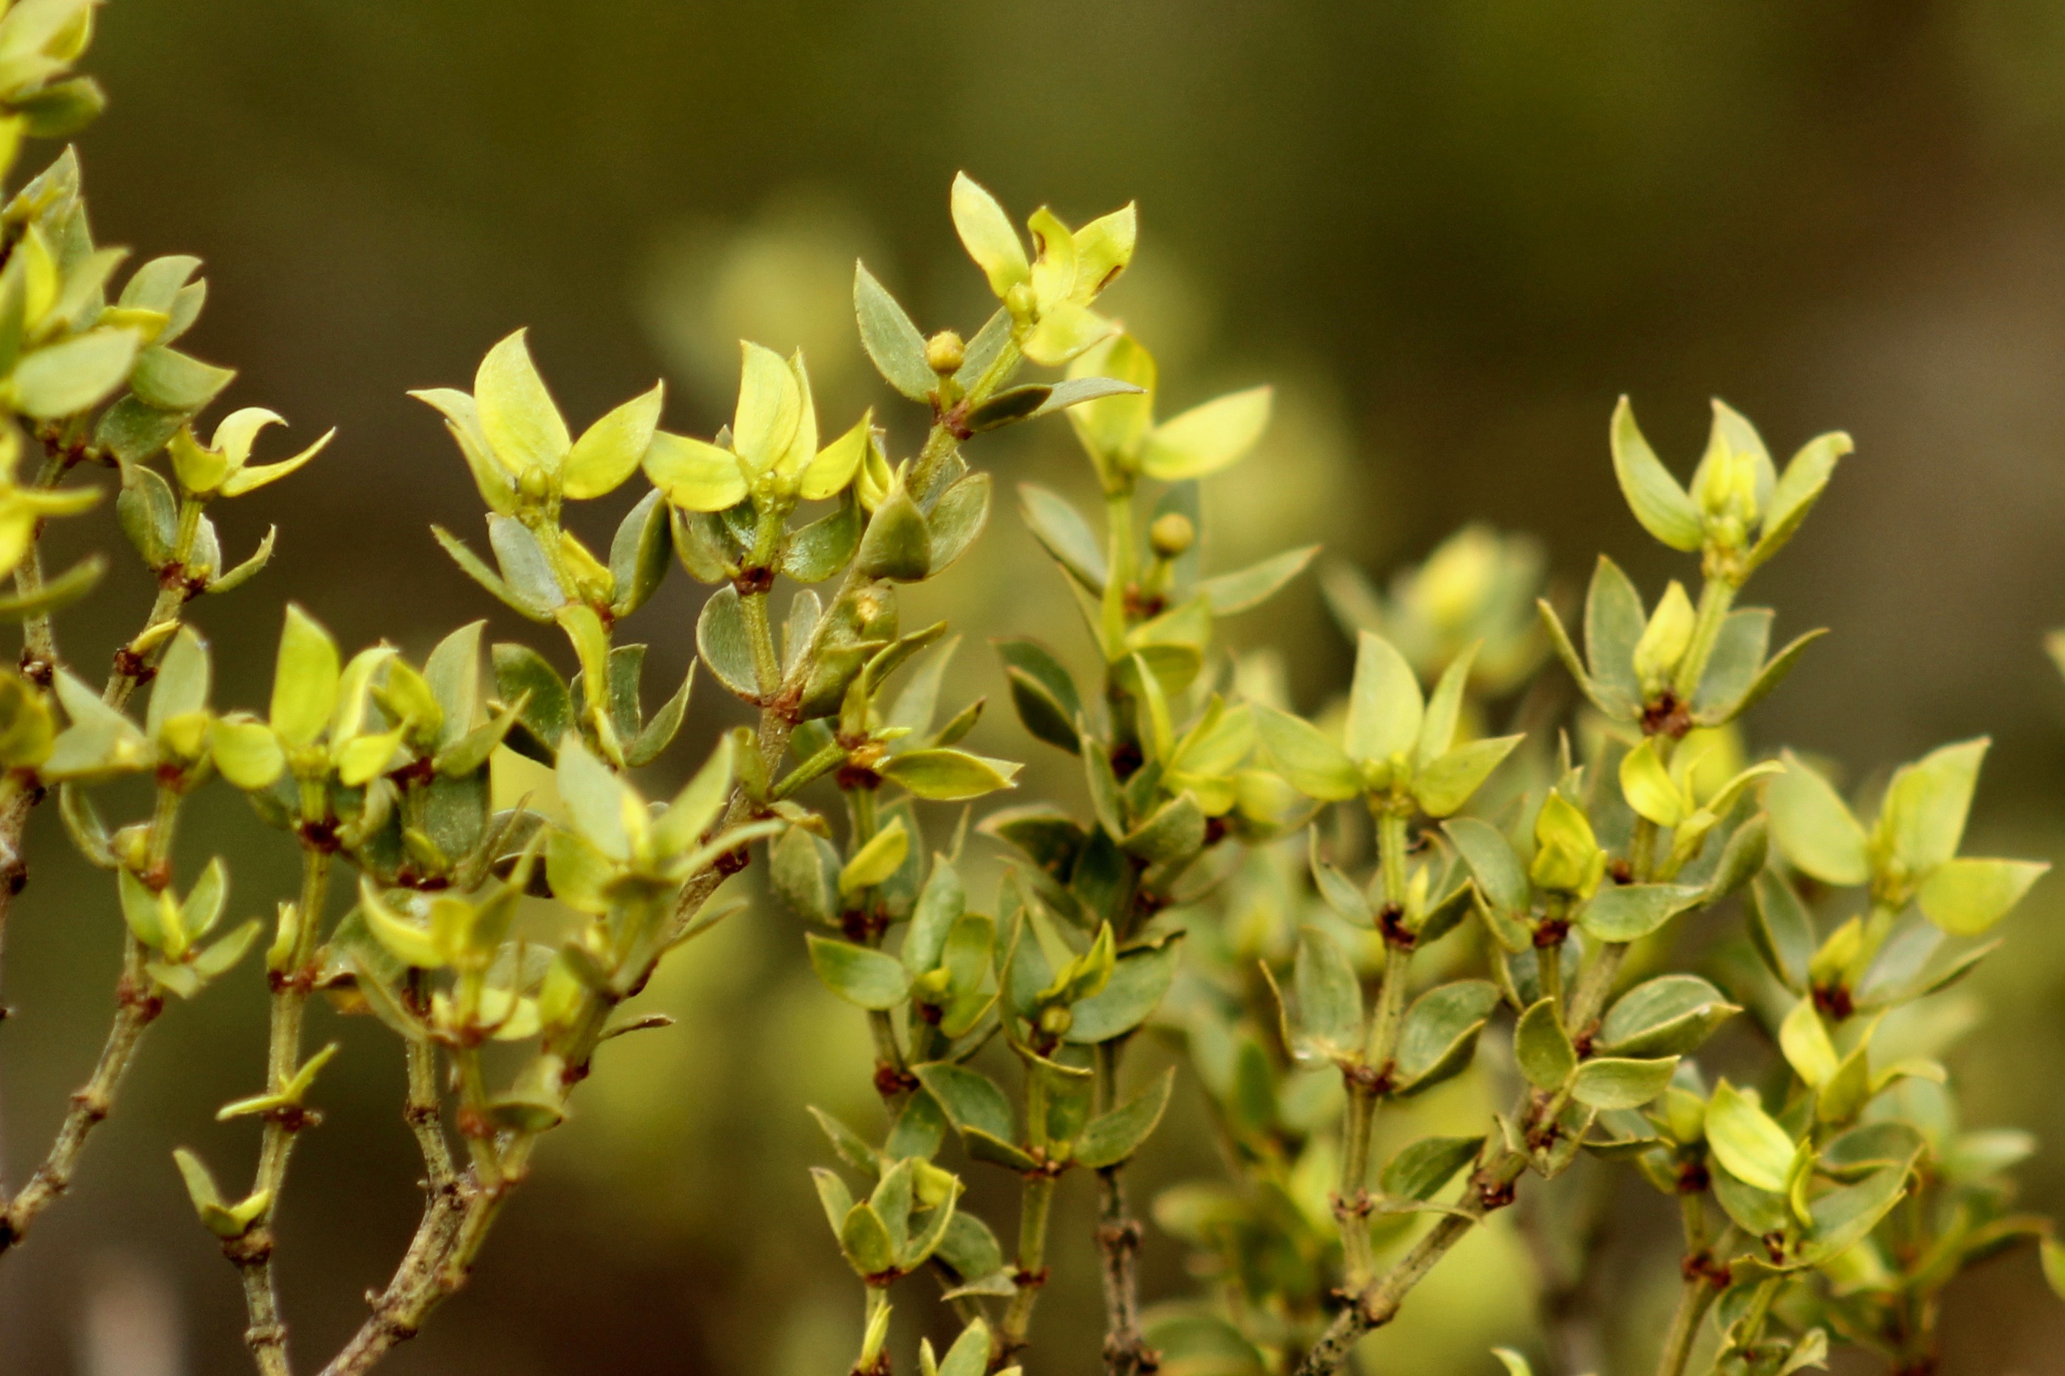
How do I live with little water?
Creosote Bush
Small leaves reduce the surface area exposed to the sun and wind
Waxy coating on leaves reduces water loss
Long, spreading roots

Slide 9
How do I live with little water?
Fishhook Barrel Cactus
Waxy coating
Accordion pleating allows it to expand and store water when it is available

Slide 10
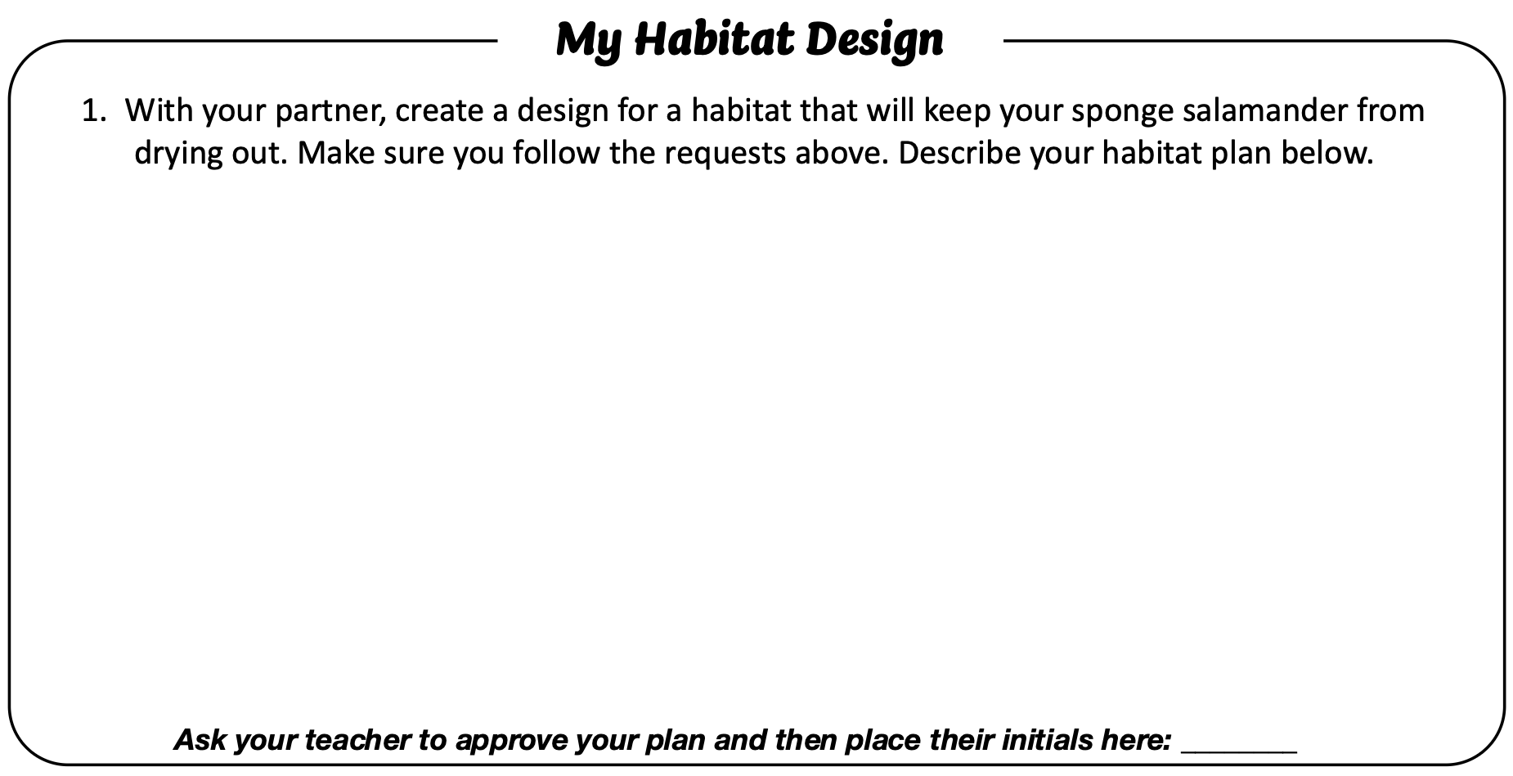
Design Time
Don’t forget my requests!
Describe your habitat on worksheet Question 1.
Done? Raise your hand. Your teacher will initial your worksheet.

Slide 11
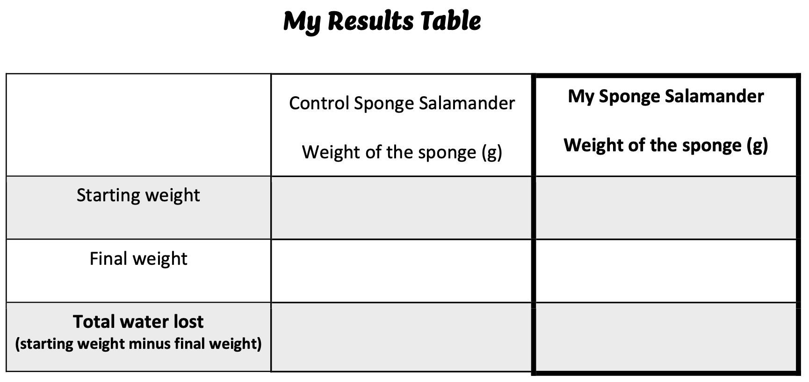
Set up: Class Control
Place the sponge salamander in a tray of water for 10 seconds.
Remove the sponge and turn it over until it stops dripping
Place the sponge on the plate.
Make sure the scale says 0 grams.
5. Place your sponge (without the plate) on the scale and write the starting weight on “My Results Table.”
6. Gently wipe the scale dry.

Slide 12
Your Turn: Group Set Up
Turn & Drip
Weigh & Write
Dip
Plate
Wipe

Slide 13
Now we wait...
Let our experiment run for 1 to 3 days.
We will give our salamanders 10 minutes of air every day.
We do not add water.
Stop here and start on the next slide after the experiment is over.

Slide 14
)
Brought to you by
The Asombro Institute
)
)
)
Sponge Salamanders
)
)
)
)
)
Part 2: Results
)
)
)
)
)
)
)
)
)
© Asombro Institute for Science Education

Slide 15
Results
Carefully remove your sponge salamander and weigh it.
Write the “final weight” on “My Results Table”
Calculate the total water lost.
Write your total water lost on an index card and place it in front of your habitat.

Slide 16
Gallery Walk
Place sticky note with total water loss in front of your habitat.
As a class, put habitats in order from most water loss to least water loss. Place sticky notes in front.
Observe each other’s habitat designs.
Please do not touch other team’s habitats.
Least water loss
Most water loss

Slide 17
Circle the habitat that had the lowest water loss.

Slide 18
Calculate the difference in water loss between your habitat and the control.
- =

Slide 19
How much water did the best habitat lose?
How much water did your habitat lose?
Calculate the difference in water loss between your habitat and the best habitat.
- =

Slide 20
What made a habitat good at reducing water loss?
Let’s Discuss!
Strengths
Weaknesses

Slide 21
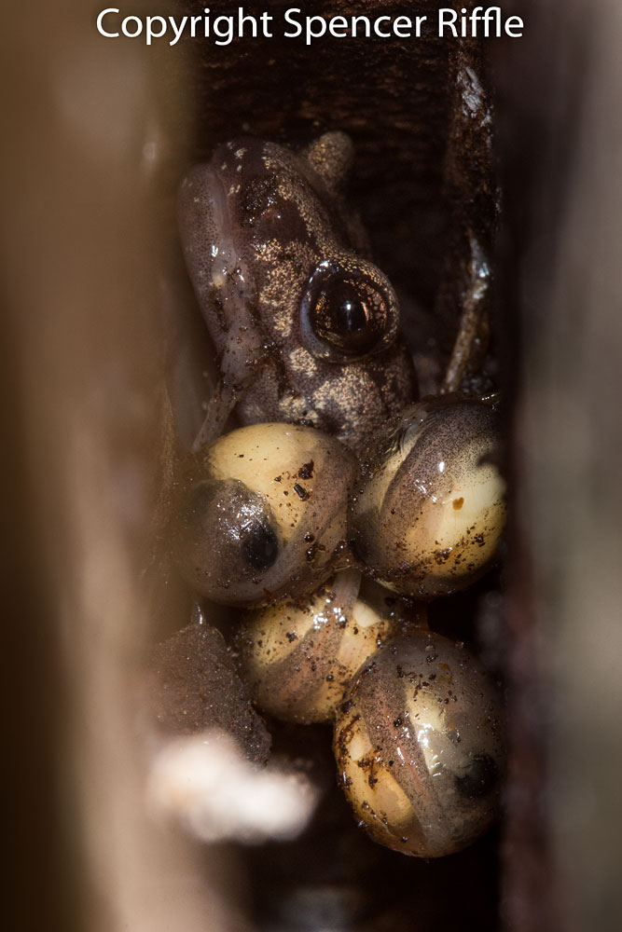
It’s Tricky to Stay Moist
Amphibians (salamanders, frogs, toads, axolotls) depend on adaptations and habitats for survival.
They lay jelly eggs that dry out easily.
They have delicate, breathable skin.
They need places to take cover from the sun or keep cool and moist.

Slide 22
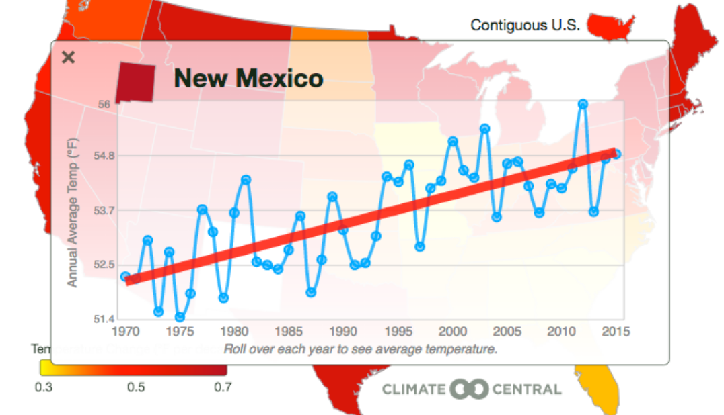
Hot & Dry
Drought is when we get less rain than normal.
Temperatures are rising.
Source: https://theacademyadvocate.com/4342/news/climate-crisis-in-new-mexico
Source: NDMC, NOAA, USDA
Notes:
Link to updated drought data: https://droughtmonitor.unl.edu/CurrentMap/StateDroughtMonitor.aspx?NM

Slide 23
Let’s Discuss!
How would you change your habitat if you were doing this again?
Answer Question 8 on
your worksheet.

Slide 24
Thank you for
your help!
Brought to you by
The Asombro Institute

