Slide 1
DEVELOPED BY THE ASOMBRO INSTITUTE FOR SCIENCE EDUCATION (WWW.ASOMBRO.ORG)
Solar Energy
2025

Slide 2
Solar Engineer
Plans, designs, and implements solar energy projects. They can manage anything from large-scale municipal projects to home rooftop installations.
Qualifications
Bachelor’s degree in mechanical or electrical engineering
Professional license
Average Salary in New Mexico: ~$140,000
Can earn up to: $181,500
Your Job Today:
Conduct tests to determine under what conditions solar panels produce the most electricity
Notes:
Give an overview of the job of a solar engineer.
Explain that students are playing the role of a solar engineer throughout today’s lesson.
A solar engineer plans, designs, and implements solar energy projects. They may manage anything from large-scale municipal projects to home rooftop installations.
Solar engineering is one of many career options related to renewable energy sources.
New Mexico hires an increasing number of solar engineers annually.
Qualifications to be a solar engineer include:
Bachelor’s degree in mechanical or electrical engineering
Professional license
Part of a solar engineer’s job is to report on the efficiency of the solar panels that they are installing. To do this, solar engineers must conduct tests to determine the conditions under which solar panels produce the most electricity.
This is what you will be doing today, conducting tests to determine when solar panels produce the most electricity.
Before we do that, we must review how a solar panel works.
Information and figures: https://data.bls.gov/oes/#/home

Slide 3
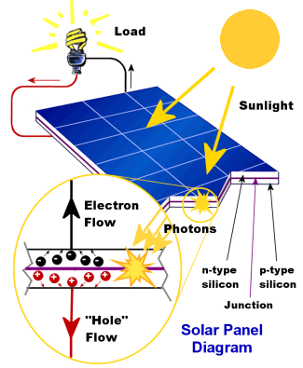
How Solar Panels Work
Sunlight is made of small particles of solar energy, called photons.
When photons hit a solar panel, they dislodge electrons.
Due to special materials in the panel, dislodged electrons migrate towards the surface.
As these free, negatively charged electrons surface, it creates an imbalance with the bottom panel, which is positively charged.
This imbalance creates voltage potential, meaning an electrical flow can occur.
Today, you’ll determine how the angle of sunlight hitting the solar panel and the temperature surrounding the solar panel affect the amount of electricity produced.
Notes:
Give a brief overview of how solar panels work.
Sunlight is made up of photons, tiny particles of solar energy.
Solar panels are comprised of photovoltaic cells, materials that have been designed specifically to convert sunlight into electricity.
When enough sunlight is absorbed in the photovoltaic cell, electrons in the cell are dislodged by the photons.
When the electrons are dislodged and leave their position, a hole is formed in that place.
Due to special materials used in the solar panels, these freed electrons migrate towards the surface of the photovoltaic cell.
When many freed electrons, each carrying a negative charge, migrate towards the front surface of the cell, an imbalance is created with the positively charged back surface. This imbalance creates a voltage potential (which doesn’t mean that solar panels store the energy) like the negative and positive terminals of a battery.
Electrical conductors are placed in the panel to absorb the electrons. When these conductors are placed in an electrical circuit, the electrons can flow through the circuit, powering an external load.
Explain that students will determine how the angle of sunlight hitting the solar panel and the air temperature surrounding the panel affect the electricity produced by the panel.

Slide 4
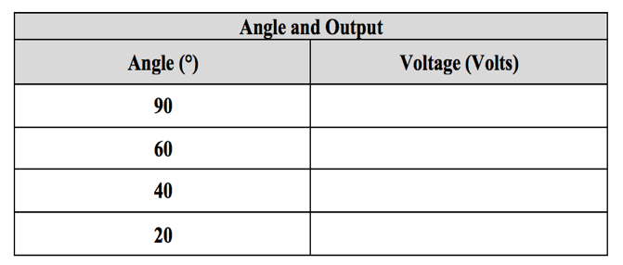
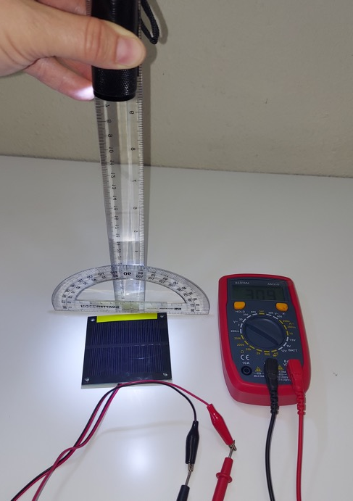
Station: Angle and Output (12 minutes)
What is the best angle for solar panel output?
Read the Task Card for procedures and carefully follow the steps.
Complete the data table and graph.
Answer question 1.
Leave the station the way you found it!
Be sure the protractor is placed along the side with the colored tape!
Notes:
Give an introduction to the angle and output station.
Students will have 12 minutes at each station to complete the procedures on the task card.
This station asks the question: What is the best angle for solar panel output?
Be sure that you move through the procedures exactly as the task card states (see below).
Note: For consistency of results be sure students place the protractor along the side of the solar panel with the colored tape.
Students will fill out the data table and graph and then answer question 1.

Slide 5
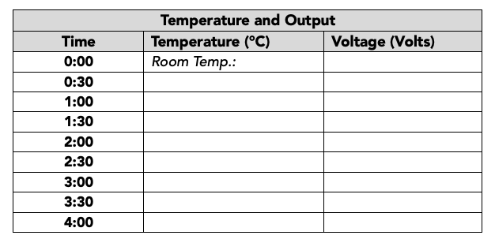
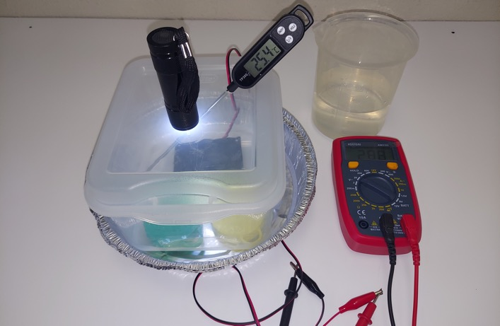
Station: temperature and output (12 minutes)
What is the optimal temperature for solar panel output?
Read the Task Card for procedures and carefully follow the steps.
Complete the data table.
Leave the station the way you found it!
SAFETY: FOLLOW DIRECTIONS CAREFULLY.
DO NOT LET WIRES COME IN CONTACT WITH WATER.
Notes:
Give an introduction to the temperature and output station.
This station asks the question: What is the optimal temperature for solar panel output?
Remind students to follow the procedures exactly as the task card states (see below).
Students will fill out the data table on their worksheet.
Safety note: Practice caution when working with water. Follow directions carefully. Do not let wires come into contact with the water.

Slide 6
Station Reminders
You have 12 minutes at each station.
Each group member must complete the worksheet.
Read task cards carefully and follow directions precisely.
Work together as a team.
Notes:
Have this slide up while students are completing the station activities.

Slide 7
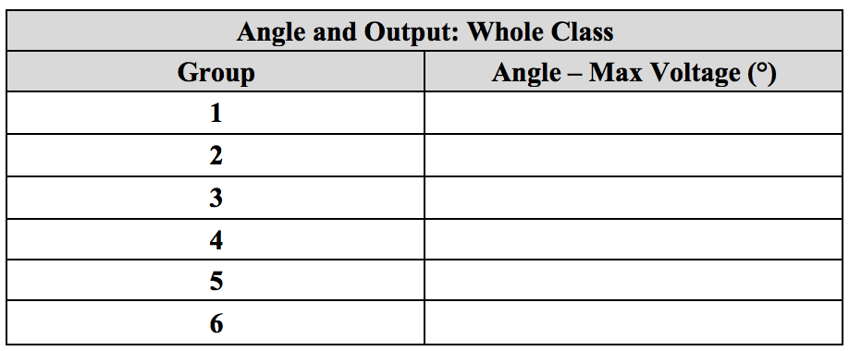
Class Data: Angle and Output
Notes:
Once students have completed both activity stations, have them share their group’s data with the whole class. As students share their data and you write them on the board, students should fill out their whole class data tables on their worksheet (page 2).
For the angle and output whole class data, have each group share the angle that produced the maximum voltage (20°, 40°, 60°, or 90°).

Slide 8
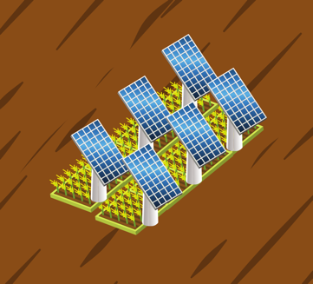
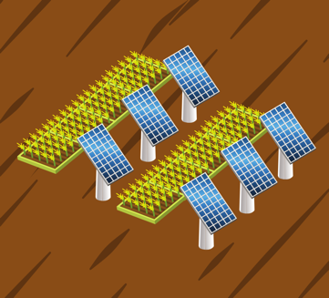
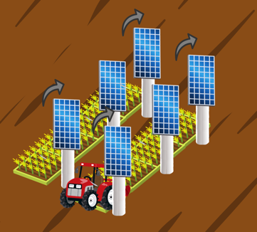
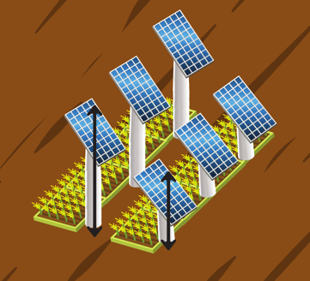
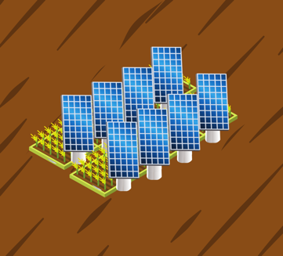
Ways to Install Agrivoltaics
Crops Underneath
Crops Alternating
Rotating Panels
Elevated Frames
Vertical Mounts
Notes:
The effects of the angle of the solar panel on energy production is important in agrivoltaics. This slide shows a variety of ways that solar panels can be installed in agrivoltaics systems. Several of them (e.g., vertical mounts and rotating panels) adjust the angle of the solar panel. There are additional costs associated with some of these installations.

Slide 9
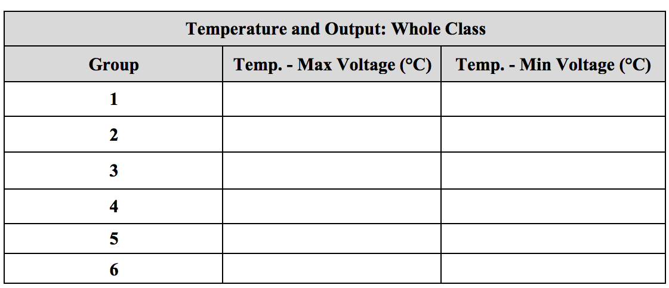
Class Data: Temperature and Output
Notes:
Have students share their group’s temperature and output data.
Have each group find the highest voltage they recorded during their temperature and output trial. Have students circle and write a “Max” next to the temperature associated with that voltage; this is their temperature at maximum voltage.
Next, have each group find the lowest voltage they recorded during their trial. Have students circle and write a “Min” next to the temperature associated with that voltage; this is their temperature at minimum voltage.
Students will share their “Max” temperature value in the first column and their “Min” temperature value in the second column.

Slide 10
2. Based on the results of these studies, what recommendations would you give for setting up solar panels to produce the most energy?
3. How could growing crops under the solar panels affect the amount of energy produced?
Notes:
Have students answer questions 2 and 3 on their worksheet.

