Slide 1
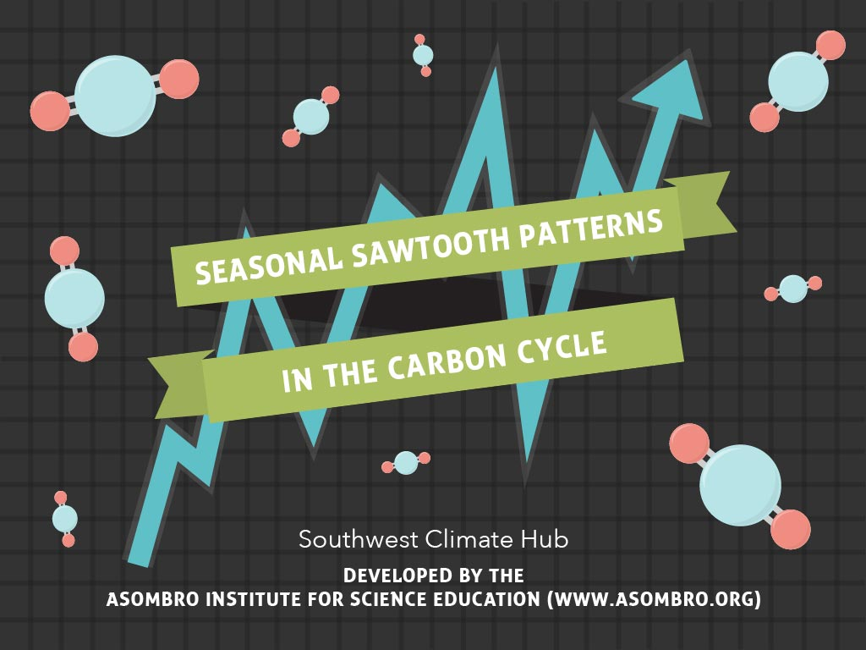

Slide 2
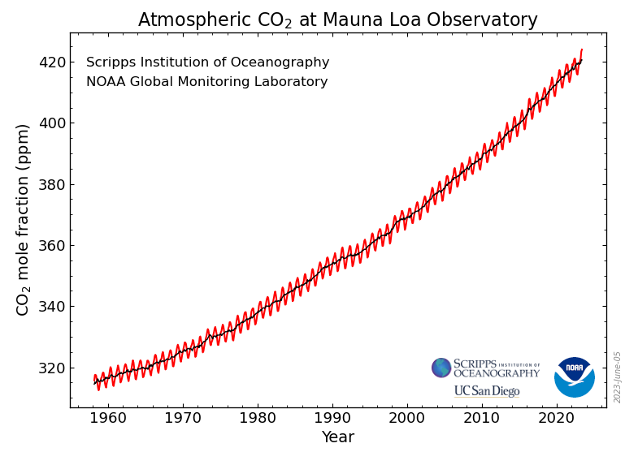
What does this graph tell you?

Slide 3
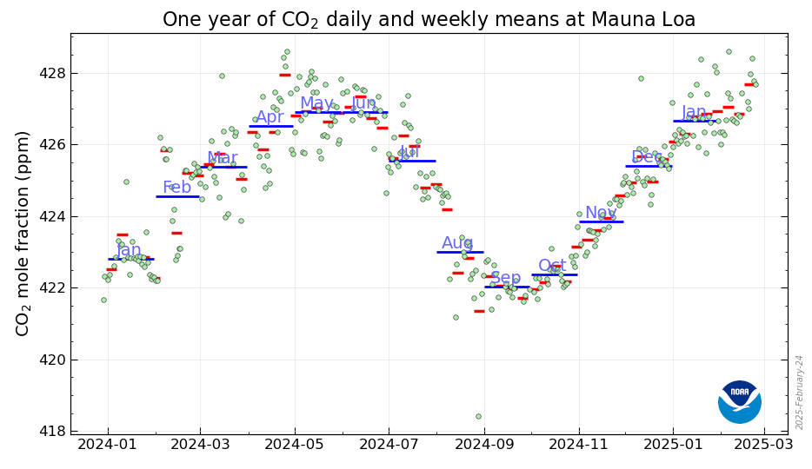
A Closer Look
Daily CO₂ Weekly average Monthly average

Slide 4
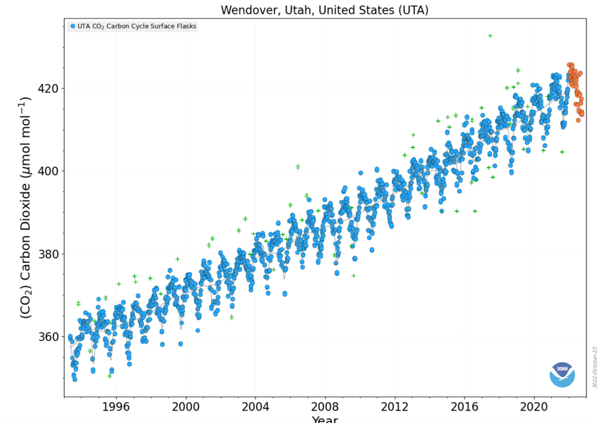
CO₂ on a Local Level
The Mauna Loa graph is a good indicator of global CO₂ because of its location in the middle of the ocean.
What can we see when we zoom in on other locations?

Slide 5
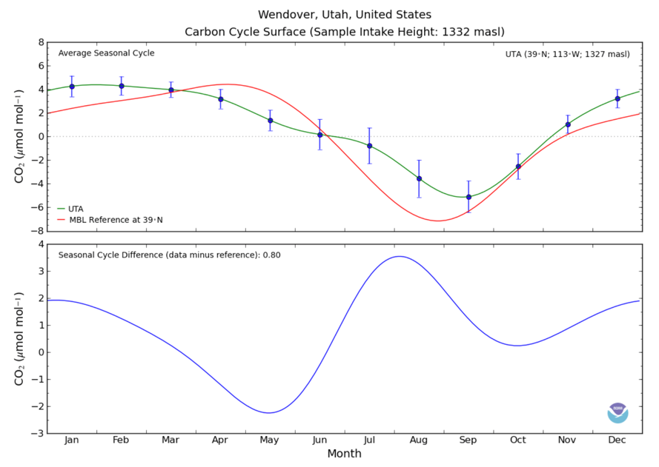
A Closer Look

Slide 6
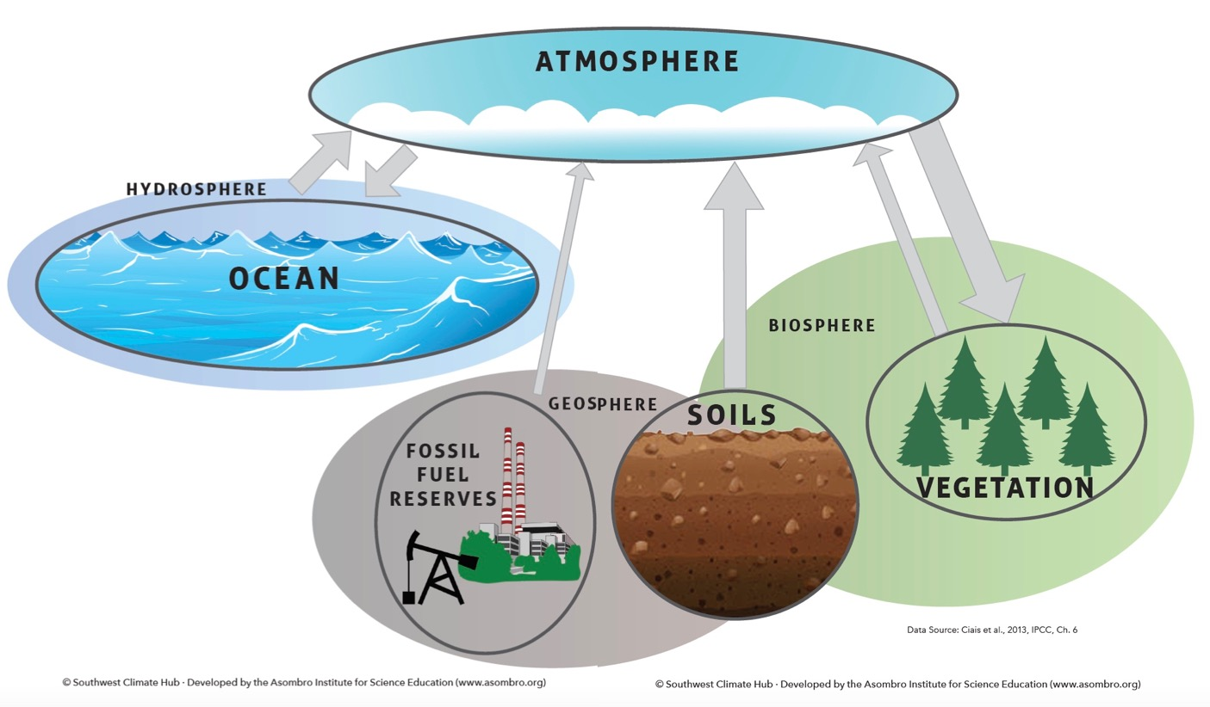
Where does CO₂ go when it leaves the atmosphere?

Slide 7
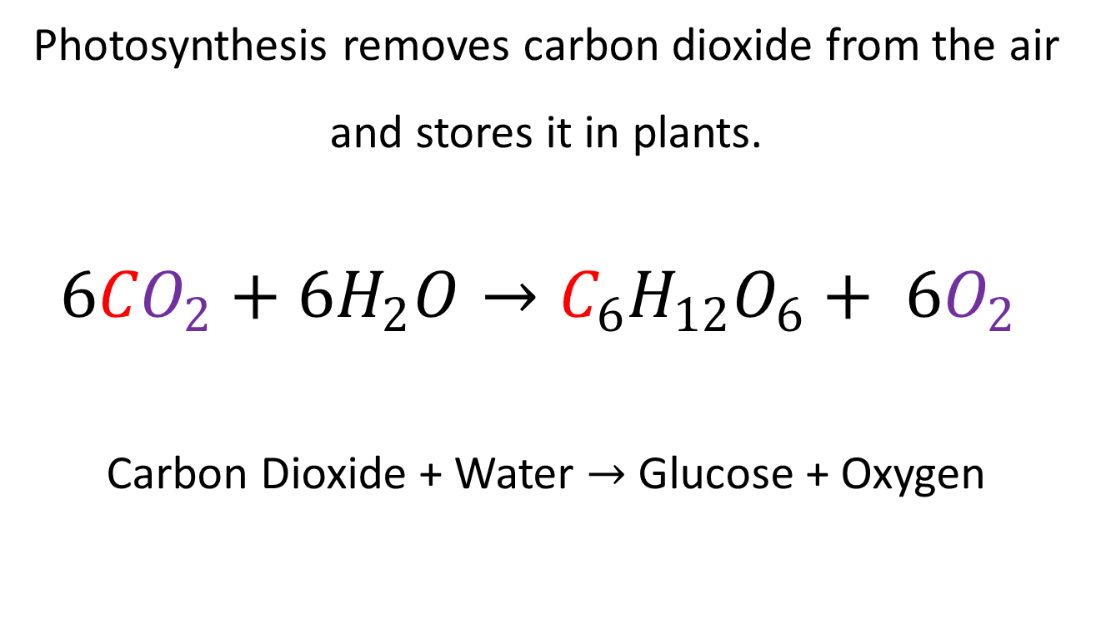
Photosynthesis
Photosynthesis removes carbon dioxide from the air
and stores it in plants.
$${6CO}_{2}+{6H}_{2}O→C_{6}H_{12}O_{6}+ {6O}_{2}$$
Carbon Dioxide + Water $→$ Glucose + Oxygen

Slide 8
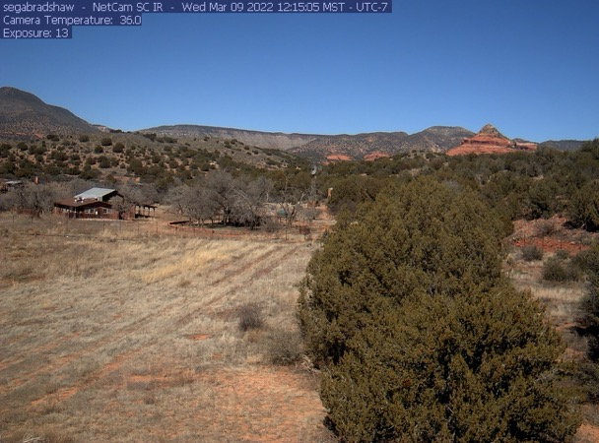
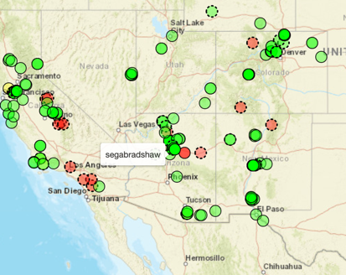
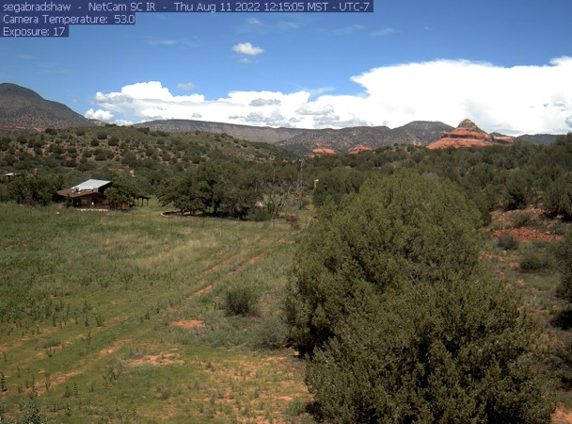
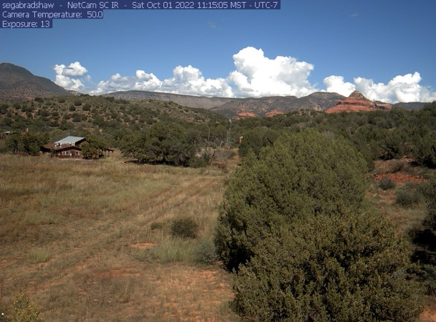
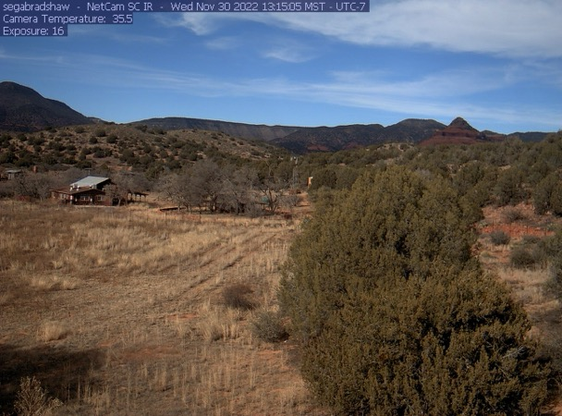
Seasonal Changes in Photosynthesis
March
August
October
November
Phenology:
The study of seasonal patterns in living things.

Slide 9
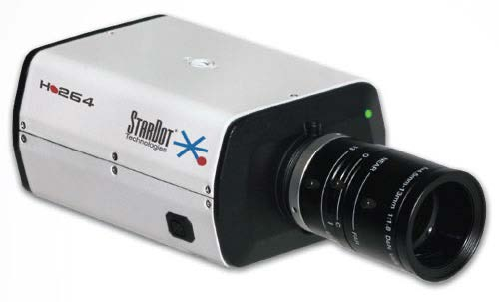
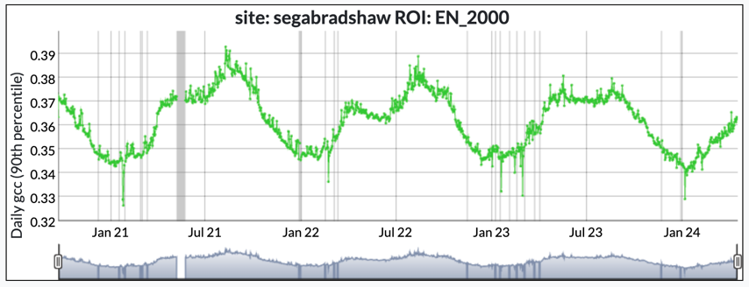
Phenocam
Using technology to monitor phenology
  Takes daily pictures
  Analyzes how green the plants are every day
  Calculates GCC (how green the picture is)
  Network of scientists all over the world uses them

Slide 10
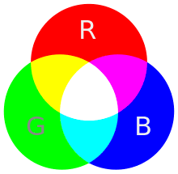


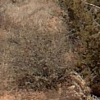
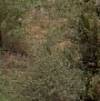
Measuring Greenness
Digital images are made up of pixels. Each pixel is a specific mix of red, green and blue. The Green Chromatic Coordinate (GCC) is a measure of how much green is in each pixel.
The greener the plant, the more chlorophyll is present, increasing its ability for photosynthesis.

Slide 11
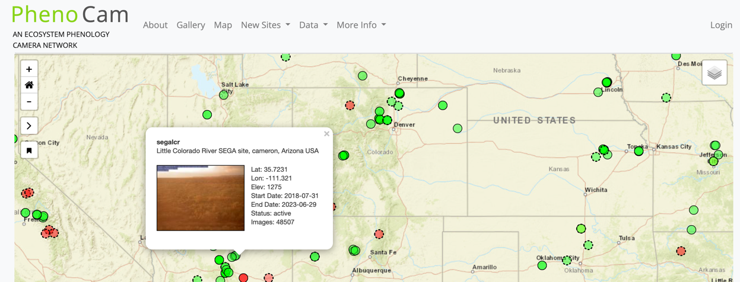
Go To: https://phenocam.nau.edu
Click Map
Add the streets layer
Click on a green dot to see a camera
Click on the picture to see all data from that camera

Slide 12
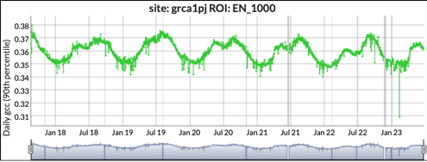
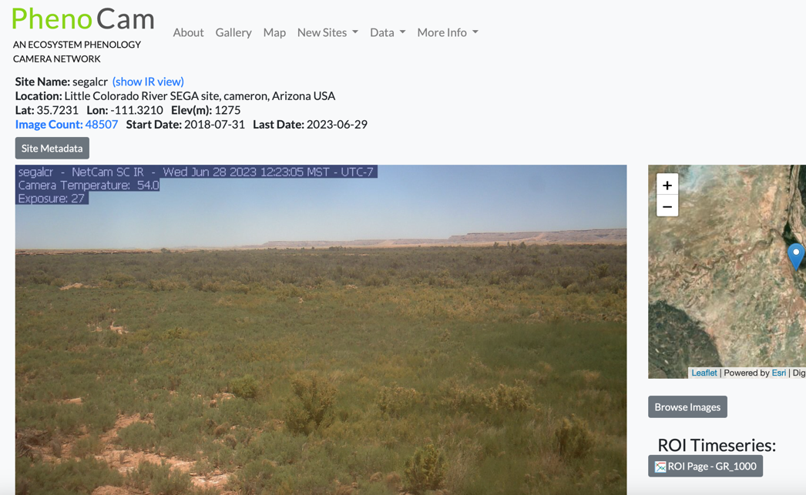
PhenoCam Data
See all images from Phenocam
See graph of Phenocam data

Slide 13
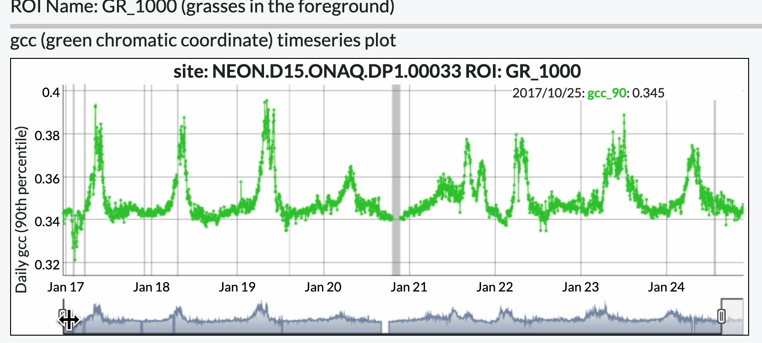
Adjust the dates on the graph
Move the sliders to adjust the dates on the graph.
Set the start date in January and the end date in December (or January of the next year).

Slide 14
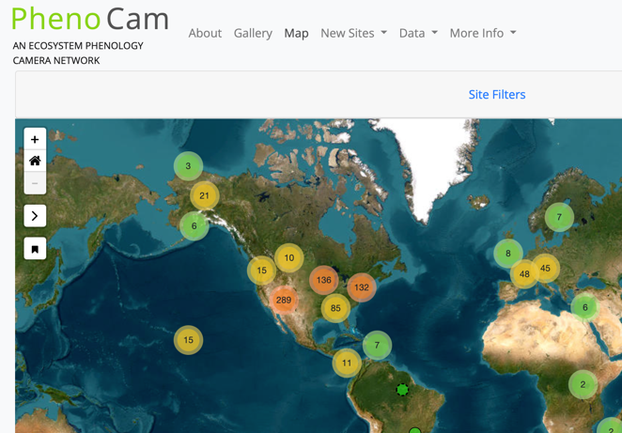
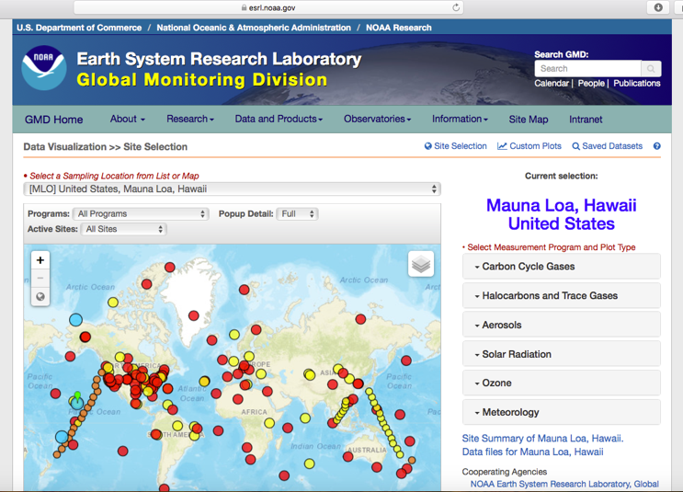
Pair local Phenocam data with local CO₂ data
www.phenocam.nau.edu
https://gml.noaa.gov/dv/iadv/

Slide 15
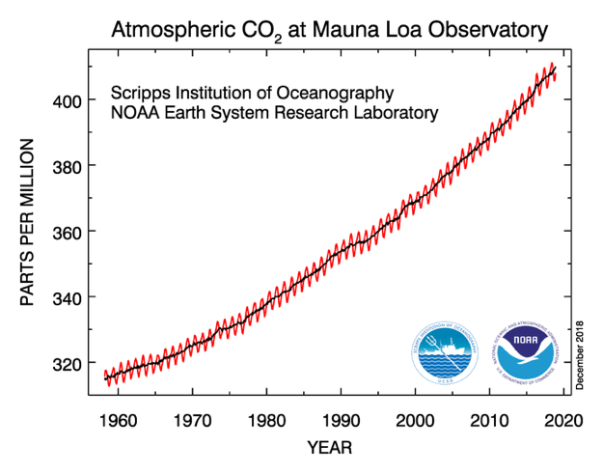
Feedback Loop
Increasing CO₂
Source: esrl.noaa.gov/gmd/ccgg/trends/

Slide 16
Feedback Loop
Increasing CO₂
Increasing Temperature

Slide 17
Feedback Loop
Increasing CO₂
Increasing Evapotranspiration
Increasing Temperature

Slide 18
Positive Feedback Loop
Less Photosynthesis
Increasing CO₂
Increasing Evapotranspiration
Increasing Temperature

Slide 19
Discussion Questions
8. How would a wildfire affect the local CO₂ data?
9. If your hometown decided to plant 100 new trees downtown, how would that affect climate change?

Slide 20
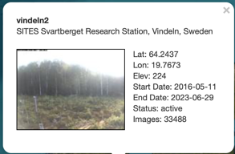
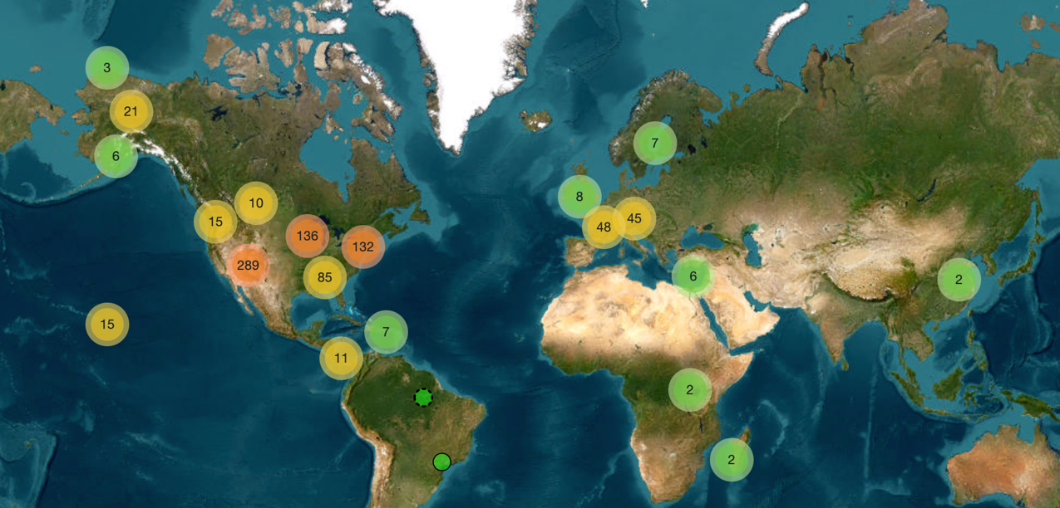
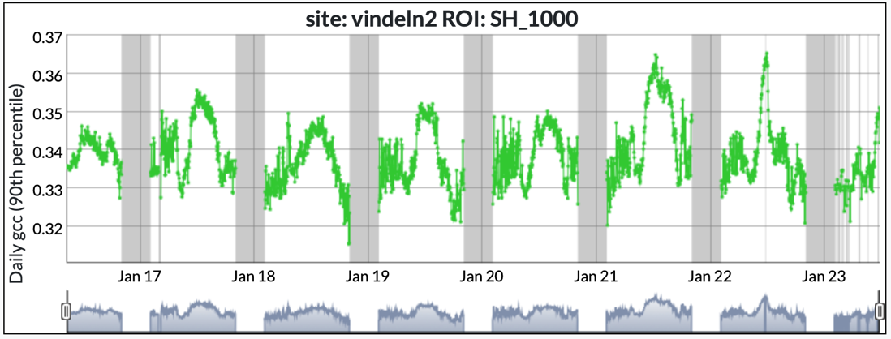
Photosynthesis Increasing?
?

Slide 21
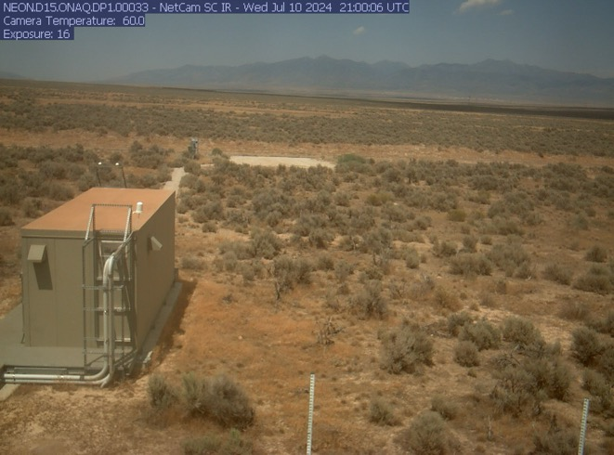
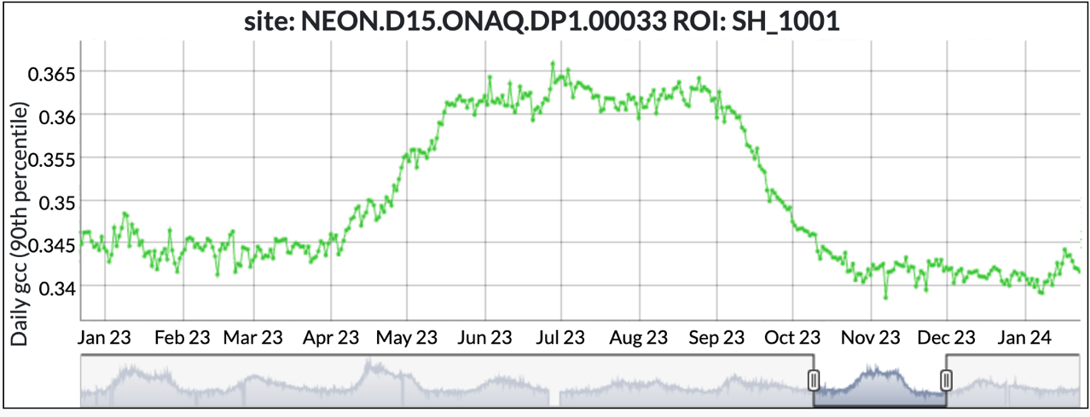
Extra Graphs
Onaqui, Utah

Slide 22
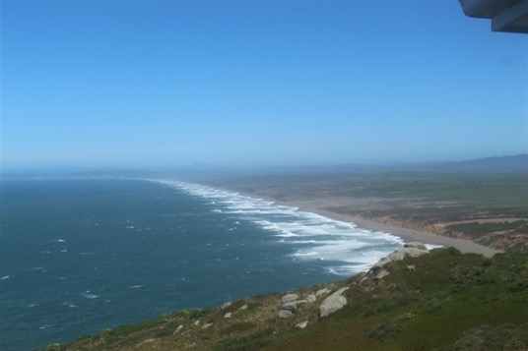
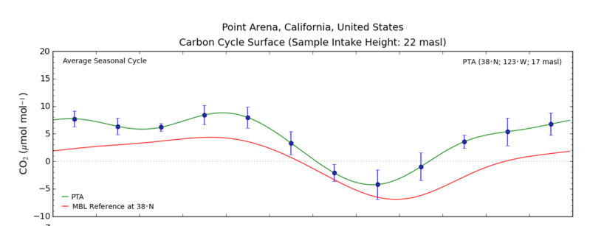
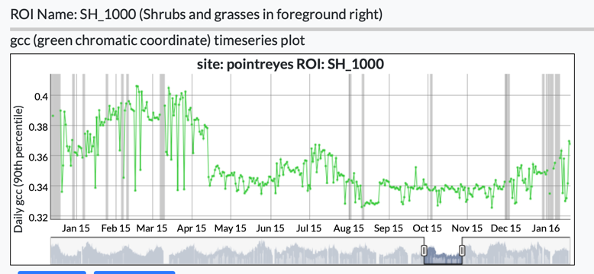
Extra Graphs
Northern California
Point Arena and
Point Reyes
Notes:
Note the two peaks in GCC in the phenocam data (March and July) and the corresponding two dips in CO2.

Slide 23
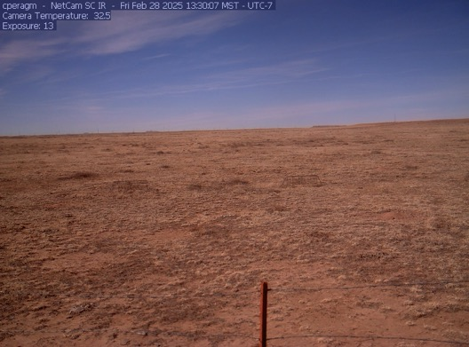
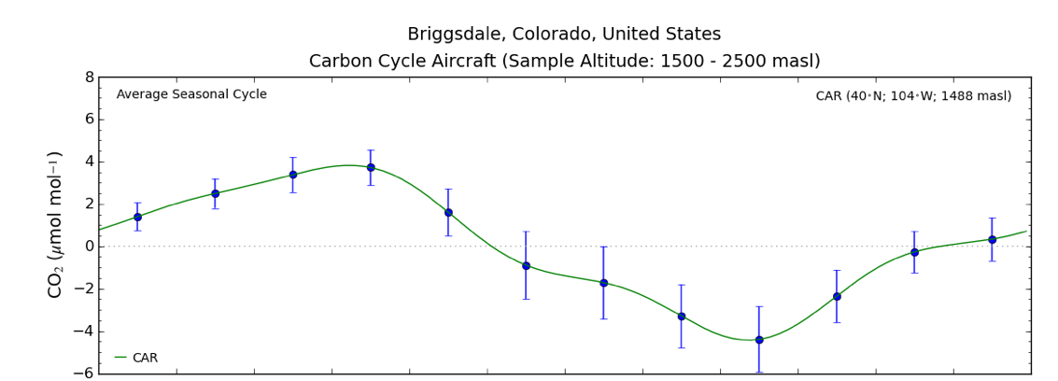
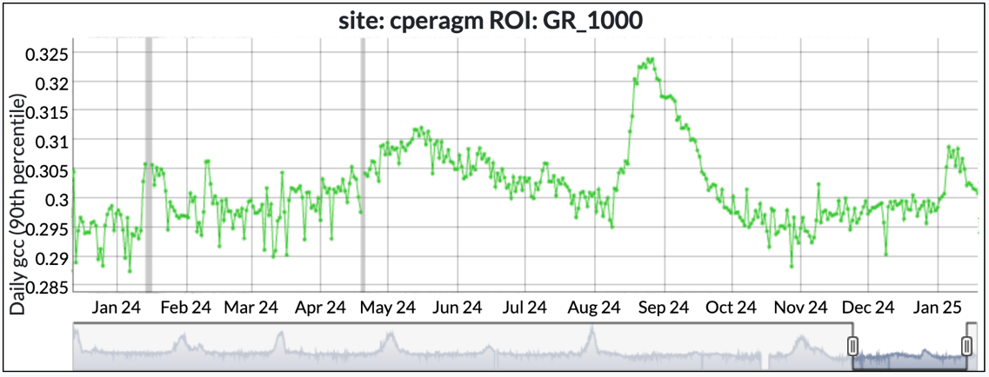
Extra Graphs
Northern Colorado
Briggsdale and
Fort Collins

Slide 24
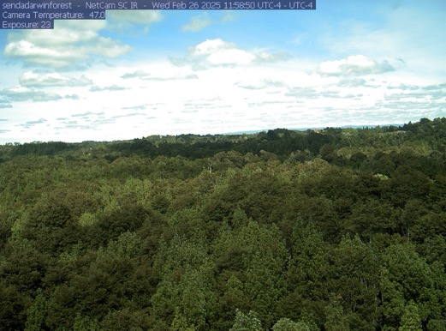
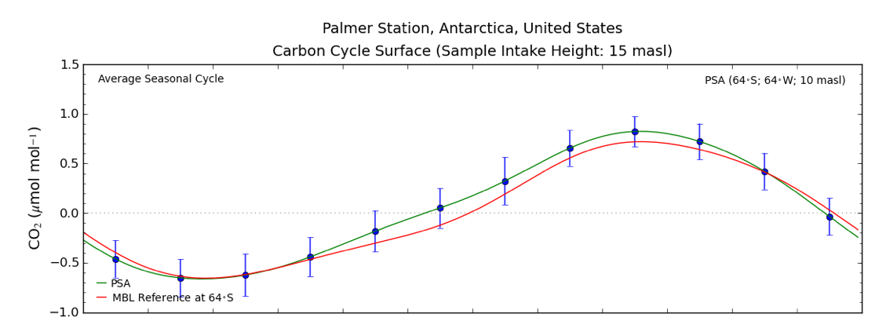
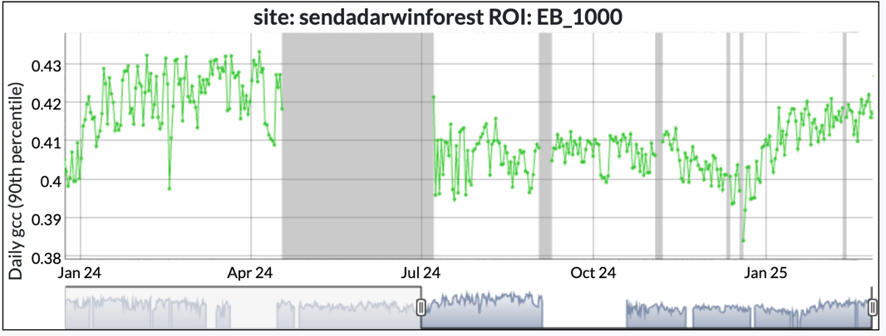
Extra Graphs
Southern Hemisphere
Antarctica and Chiolé, Chile
Notes:
The Southern Hemisphere summer is December-March, so note the opposite pattern from the Northern Hemisphere.

