Slide 1
DEVELOPED BY THE ASOMBRO INSTITUTE FOR SCIENCE EDUCATION (WWW.ASOMBRO.ORG)
Made in the Shade
The Effects of Agrivoltaics on Crops

Slide 2
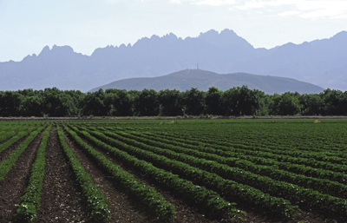
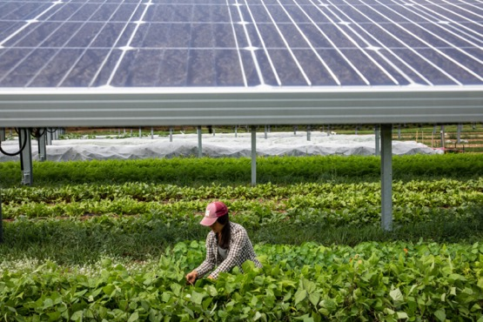
What is Agrivoltaics?
The dual use of land for both agriculture and solar energy production.
Could agrivoltaics help farmers grow more crops?
Notes:
Define Agrivoltaics
The dual use of land for both agriculture and solar energy production.
Agrivoltaics is a relatively new field of study, and research is currently being done to study the advantages and disadvantages.
Show the pictures of solar panels and discuss where the crops would be located.
Could agrivoltaics help farmers grow more crops? In this lesson, we will investigate how the shade from solar panels affects plant transpiration and photosynthesis.

Slide 3
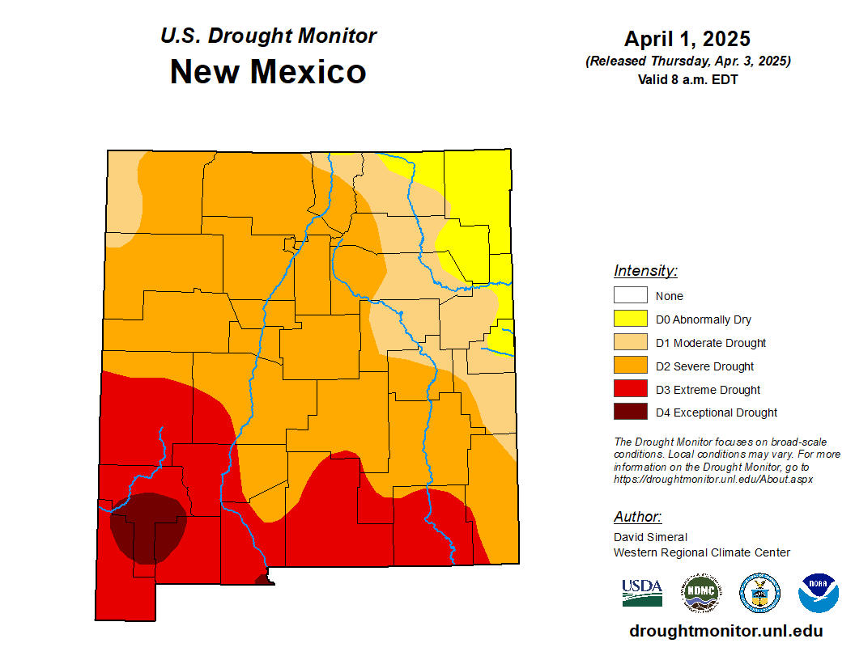
Why Could Agrivoltaics be Helpful?
Average annual temperatures for the contiguous United States from 1895 to 2020 (orange line), along with the warming trend of 0.16˚Fahrenheit per decade (red line). Graph by NOAA Climate.gov, based on data from NCEI Climate at a Glance.
The Southwest is getting hotter and drier because of climate change.
Notes:
Agrivoltaics is an area of interest because climate change is causing higher temperatures and longer and more extreme droughts in the southwestern United States.
This drought map was created by the U.S. Drought Monitor, which releases weekly drought maps for the entire country. You can replace this drought map with the most recent one by visiting https://droughtmonitor.unl.edu/ and clicking on the region or state of your choice.
This graph shows average annual temperatures for the contiguous United States from 1895 to 2020 (orange line), along with the warming trend of 0.16˚F per decade (red line). Graph by NOAA Climate.gov, based on data from NCEI Climate at a Glance.

Slide 4
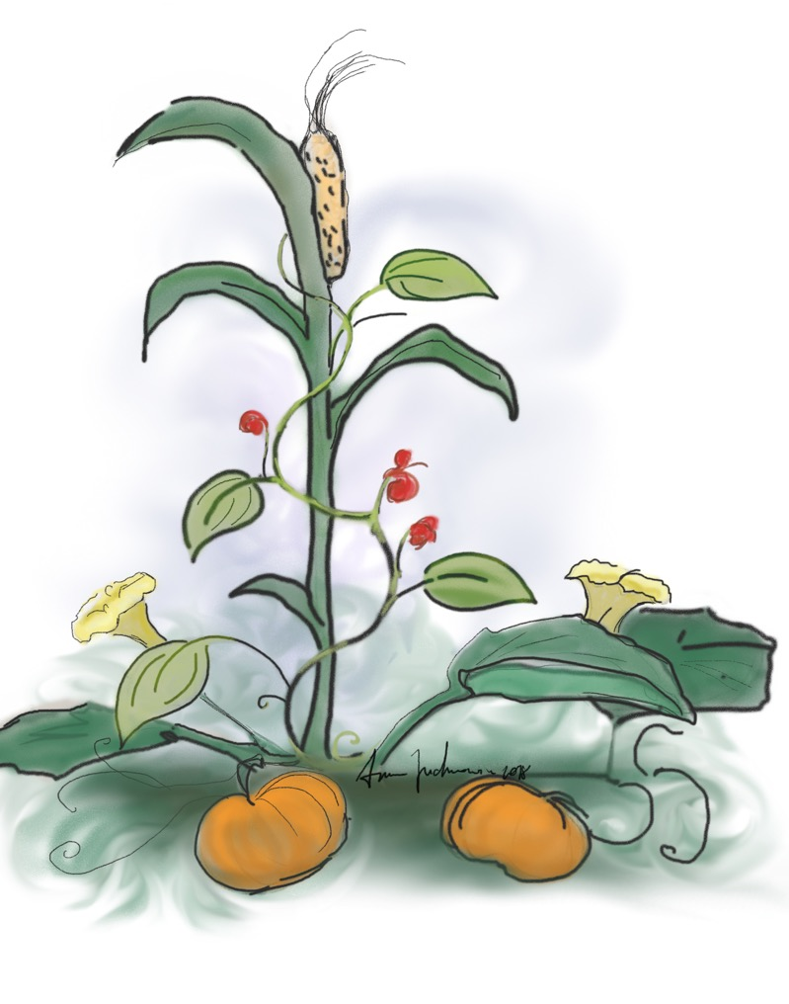
Three Sisters Planting
Native Americans have traditionally planted crops together to support each other in hard environments.
Squash – leaves provide shade and preserve moisture
Corn –stalks provide poles for beans to climb
Beans – Roots fertilize the soil with nitrogen
https://www.nal.usda.gov/collections/stories/three-sisters
Notes:
Using shade to help grow crops isn’t a new concept. Indigenous peoples developed the Three Sisters planting method. The squash leaves provide shade, which helps keep the soil moist. The corn stalk supports the beans, which fertilize the soil.

Slide 5
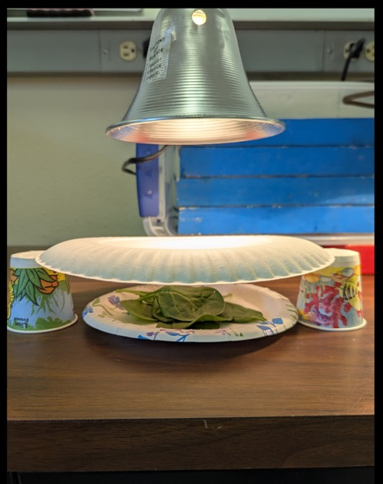
Setting Up the Experiment
Sun
Question: Which spinach do you think will lose more water (under the solar panel or in the sun)?
Make a prediction on question 1.
Solar
Panel
Crop
Notes:
Today, we will conduct an experiment that measures the water loss of spinach “in the sun” versus spinach shaded by a plate that represents solar panels. Show pictures of the experiment and explain how we are modeling the solar panels.
The lamps represent the sun, and the paper dinner plate represents solar panels. The “sun” treatment is shown on the left; there is nothing to block the light. The “under the solar panels” treatment is shown on the right; a paper dinner plate represents a solar panel in an agrivoltaics system. Note that the spinach is the same distance from the light in both treatments.
Which spinach will lose more water (under the solar panel or in the sun)?
Have students record their predictions on their worksheets.

Slide 6
© Asombro Institute for Science Education (www.asombro.org)
Notes:
Show students the task card (shown at right) and read the instructions. Three groups will set up the “sun” treatment, and three groups will set up the “under the solar panels” treatment. Emphasize how to tare the scale; this allows us to record the starting mass of the spinach alone, not the plate and spinach.

Slide 7
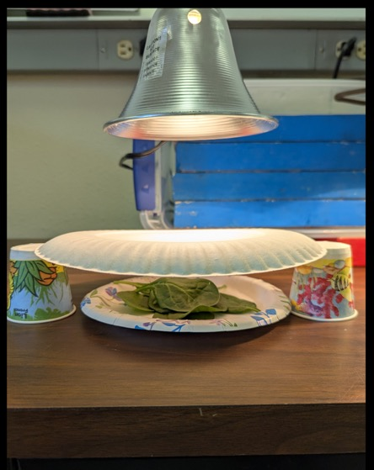
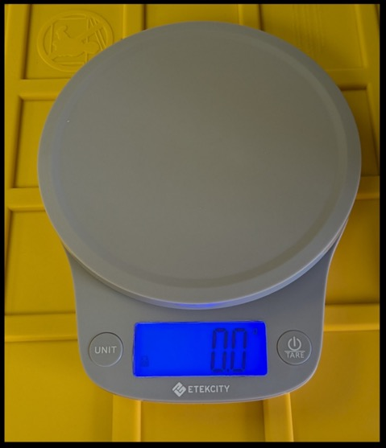
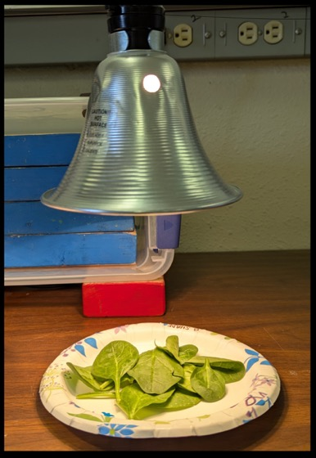
Experiment Time: Transpiration
READ THE TASK CARD
Record the starting mass
Notes:
Divide students into six groups, assign each group to a station, and have them follow the instructions on the task cards.
After all groups have their treatments ready, have everyone turn on the light and set a timer for 25 minutes (Note: if you have time, 30 minutes also works well).
Have students return to their seats and continue the slide presentation and Solar Panel Efficiency activity while the spinach experiment is running.

Slide 8
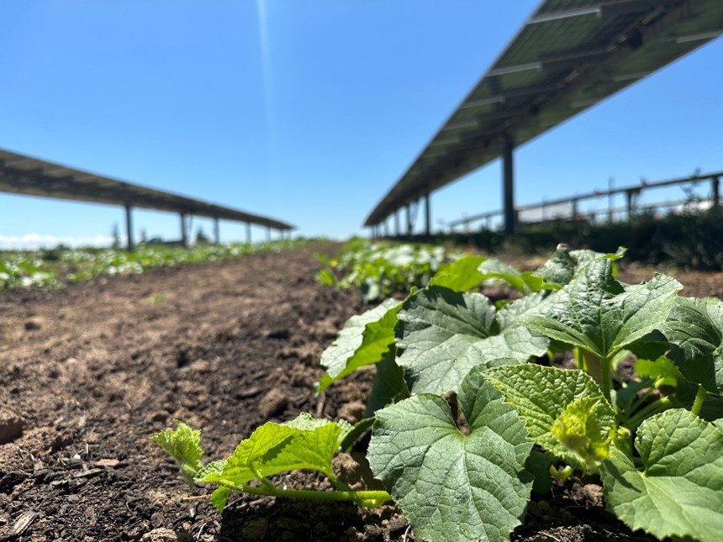
Solar Panels and Crops
How do solar panels affect transpiration?
Notes:
Today we are investigating the phenomenon of how solar panels affect transpiration and photosynthesis in crops, two vital processes that plants must do to survive.

Slide 9
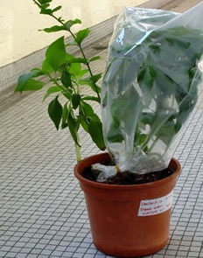
Transpiration
The loss of water from inside plants into the atmosphere
Cools plant
Enables flow of water and nutrients from the soil into the plant.
Notes:
Transpiration is the loss of water from inside plants into the atmosphere. It cools the plant and helps drive water movement through the plant and bring water and nutrients up through the roots and into the stems and leaves. It is an invisible process. If you cover a plant with a bag (like the one shown in the picture), the bag will get foggy with the water that is being transpired.

Slide 10
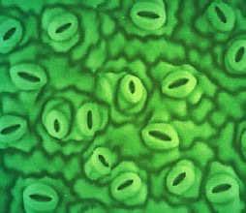
How Does Water Escape?
Through stomata:
Pores on plant structures
Usually microscopic
Open and close to let carbon dioxide in and water and oxygen out
As the water evaporates through the stomata, it cools the plant.
Notes:
Plants have pores on their leaves called stomata that allow them to exchange gases, including water vapor, with the atmosphere. Typically microscopic, these pores open and close in response to environmental conditions. When a stoma opens, carbon dioxide (necessary for photosynthesis) enters, while water and oxygen are released. Roots absorb water from the soil, and leaves release water vapor into the air through their stomata.

Slide 11
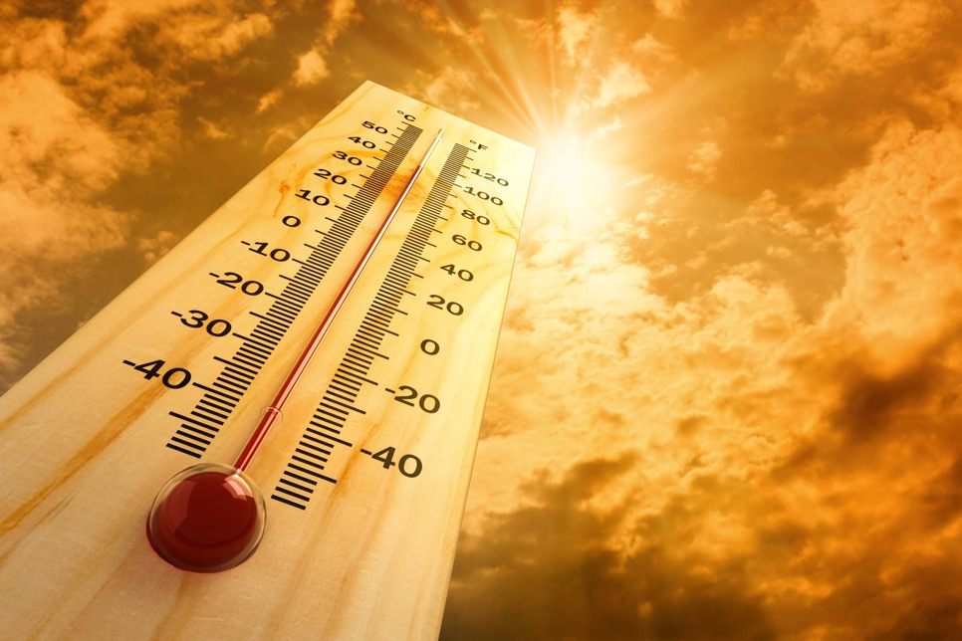
Transpiration
Some factors that affect how fast transpiration happens.
Temperature
Light
Relative humidity
Wind
Carbon dioxide
Soil moisture
Notes:
Environmental variables affect transpiration rates, and here are some of the factors that can slow down or speed up transpiration: temperature, light, relative humidity, wind, carbon dioxide, and soil moisture. In our experiment, we are changing temperature and light.

Slide 12
Photosynthesis
Notes:
Give each group a UV flashlight and beads on felt, but don’t tell them what they are. Ask students to explore for approximately five minutes. What happens to the beads when you shine a flashlight on them. How long do the beads stay colored? What happens when you stop shining the flashlight ono the beads?

Slide 13
How do Solar Panels Affect Photosynthesis?
Photosynthesis:
The process in which plants use sunlight to convert light energy into chemical energy to make food and release oxygen into the air.
Most photosynthesis happens during the daytime when sunlight is most intense.
Notes:
Ask students to put down their UV flashlight and beads for a moment while you give them a few more instructions for the next activity. Photosynthesis is the process through which plants use the energy from the sun to create food. We will be modeling photosynthesis with the use of the solar beads and a flashlight in the next activity.

Slide 14
Solar Panels and Crops
How do solar panels affect photosynthesis in crops?
Notes:
We are going to use solar beads to determine how solar panels affect photosynthesis.

Slide 15
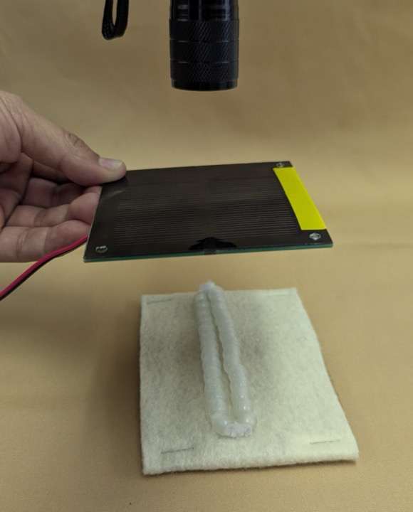
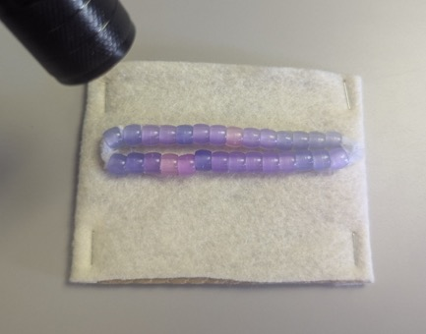
Can Crops Photosynthesize Under Solar Panels?
The Sun
Beads will change color when exposed to UV light. A color change represents photosynthesis in our model.
Solar Panel
Crop
Notes:
Show students the photo of the materials they will use for the next activity. Each group will get a mini solar panel, a multimeter, solar beads, a flashlight, and a task card. The beads represent two rows of crops in your field, and the flashlight represents the sun. As students already discovered, when the UV light shines on the beads, they change color.

Slide 16
solar panel to multimeter – clamp red to red and black to black.
Notes:
Show students how they will attach the multimeters to the solar panels (red to red and black to black – demonstrate). Turn the knob left to voltage range 20 V.

Slide 17
© Asombro Institute for Science Education (www.asombro.org)
Notes:
Show students the task card for this activity (shown at right) and briefly explain the instructions. Students will measure the electricity generated by a flashlight at different angles. They will also monitor the solar beads at each angle to determine when photosynthesis is being maximized (beads will turn darker with more sun). Demonstrate this using the flashlight. Students will answer questions 6 – 9 on their worksheet.

Slide 18
Experiment Results: Photosynthesis
Notes:
Photosynthesis results
Ask students to explain what they found. Refer to the picture and ask students to demonstrate the location of the flashlight when they saw maximum photosynthesis and maximum energy. Was it in the same location?
Did the solar panel reduce photosynthesis?

Slide 19
Experiment Results: Transpiration
Notes:
Transpiration results
Assuming the timer has gone off and at least 25 minutes has passed since the lights were turned on for the spinach experiment, ask students to go weigh their spinach plates again. Make sure they tare the scales again with an empty plate, so they are only recording the weight of the spinach, not the spinach and the plate.
Instruct students to record the ending mass in their data table and calculate the change in mass. Note that this is the ending mass minus the starting mass.
Have students calculate the percent change in mass for their group’s spinach using the formula in question 2.
Collect each group’s data, and have students fill out the Class Data Table on question 3.

Slide 20
How Do Solar Panels Affect Transpiration?
Solar
Energy
RESULTS:
Did the solar panels decrease transpiration and help the spinach save water?
Answer questions 4 and 5
Water Loss
Notes:
Transpiration results continued
Did solar panels decrease transpiration and help the spinach save water?
Have students answer questions 4 and 5. Discuss their answers.

Slide 21
Solar Panels and Crops
How do solar panels affect transpiration and photosynthesis in crops?
Answer question 10.
Notes:
Have students answer question 10 on page 2 of their worksheet: “Based on your experiments, would solar panels be beneficial to farmers? Give evidence from the experiments to back up your claim and explain your reasoning.”

Slide 22
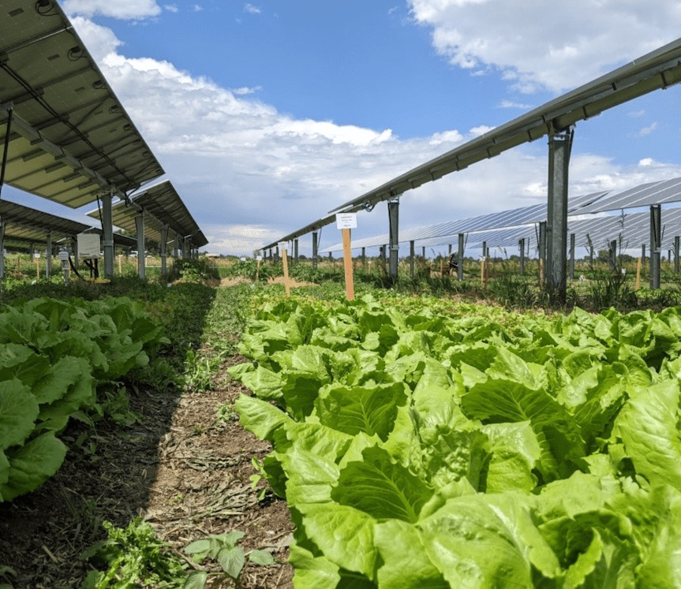
HOW DOES SHADE AFFECT… TRANSPIRATION?
Less transpiration occurs under shade, meaning plants use less water.
Less evaporation occurs under shade, meaning the soil stays wetter.
Less irrigation is needed, and water can stay in the soil longer.
Solar panel angle and spacing is important in determining if plants growing under solar panels get enough sunlight.
PHOTOSYNTHESIS?
Notes:
Recap transpiration and photosynthesis and the possible benefits of using solar panels.

Slide 23
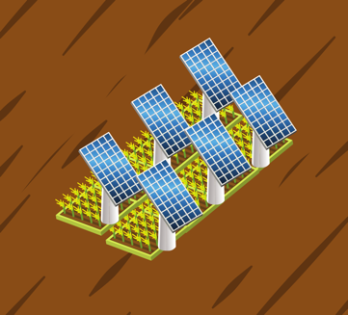
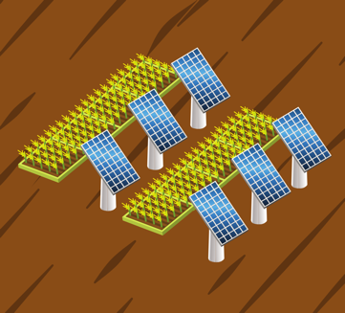
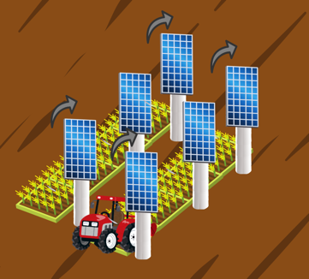
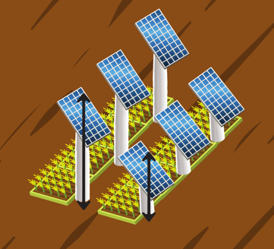
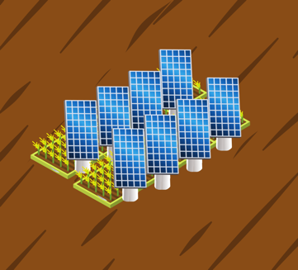
Ways to Install Agrivoltaics
Crops Underneath
Crops Alternating
Rotating Panels
Elevated Frames
Vertical Mounts
Notes:
Solar panels can be installed in various ways in an agrivoltaics system. The examples shown on this slide will have different effects on photosynthesis of the crops growing under and around the solar panels. However, the more complicated designs can take up more space and be more costly to install and maintain.

Slide 24
Bonus: Could animals graze under the panels and would it be beneficial?
Notes:
If there is time, ask students to think about how solar panels might benefit livestock. This lesson focused on growing crops, but could agrivoltaics also work with animals?

