Slide 2
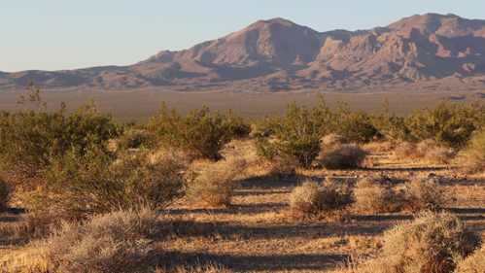
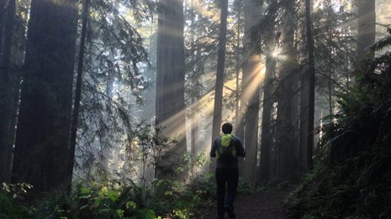
Example: California
Ecologically diverse
  Desert
  Mediterranean
  Forested mountains
  Coastal mountains
Source: 1) www.werc.usgs.gov/ProjectSubWebPage.aspx?SubWebPageID=2&ProjectID=230
2) www.nps.gov/redw/index.htm
Notes:
We are going to use California as a case study to learn about how agricultural actors can react to climate change. California is an ecologically diverse state. Within its borders are desert, Mediterranean, forested mountains, and coastal mountain systems.

Slide 3
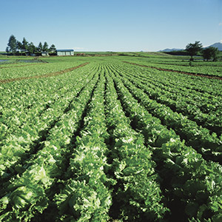
Example: California
Large-scale agriculture producers
  Nearly half of fruit,
  vegetables, & nuts
  in US
  Several crops only
  producible in CA
AND
Small-scale agriculture
producers
Source: www.cdc.gov/foodsafety/challenges/index.html
Notes:
California is also home to many large- and small-scale agricultural producers. Nearly half of the fruit, vegetables, and nuts in the US are produced in California. Several crops are only producible in California because of the diverse ecosystems there.

Slide 4
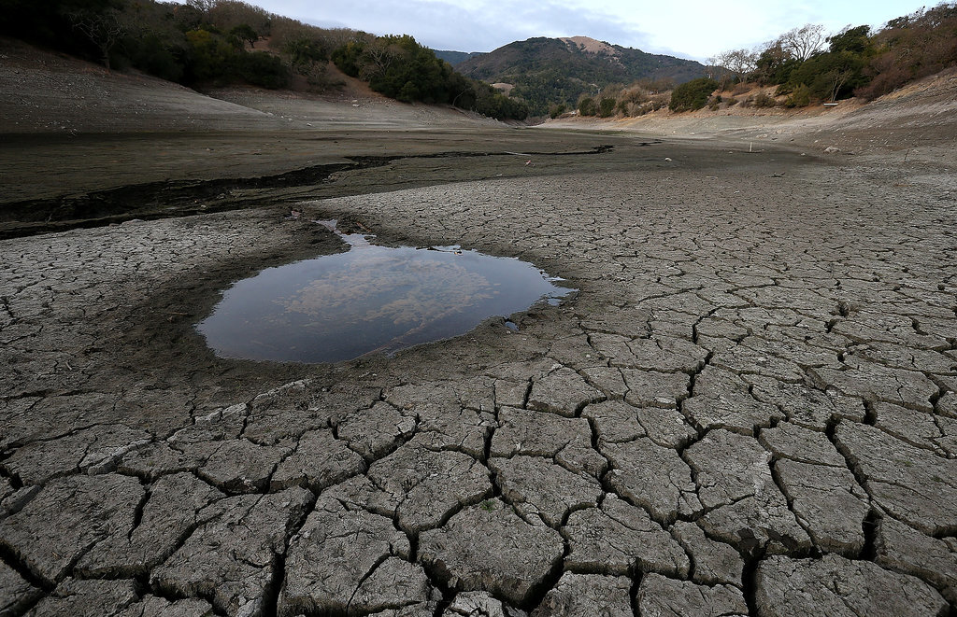
Example: California
Severe drought since 2012
2014 & 2015 water years were warmest on record
Declared state of emergency in 2014 by Governor Jerry Brown
Source: www.fire.ca.gov/blogs/aeu/files/2014/03/California-Drought-2014-Pictures.jpg
Notes:
The state has been in a severe drought since 2012. California’s 2014 and 2015 water years (12 month precipitation totals) were the warmest on record causing Governor Jerry Brown to declare a state of emergency for the state in 2014. What would you do in this situation?

Slide 5
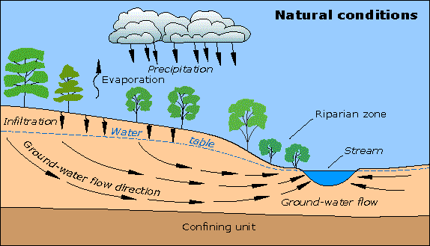
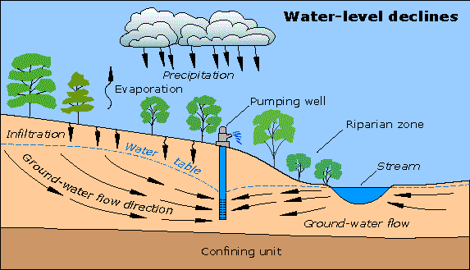
Example: California
Farmers accessing groundwater more frequently
  Tulare County, Central Valley
    New irrigation permits for drilling
    increased by 11 times over 5 years
    (2010-2015)
Source: water.usgs.gov/edu/graphics/gwflowproblems2.gif
Notes:
In response to the drought, some farmers started digging more wells to tap into groundwater supplies to compensate for the decreased amount of surface water. Groundwater is supplied by underground aquifers that are gradually replenished by rain, rivers, streams, and irrigation as it percolates through the soil. This became a popular way for farmers to adapt to sustain their crops through a changing climate. Accessing groundwater became such a popular short-term solution to the drought that many counties saw a dramatic increase in drilling permits over a five-year period.

Slide 6
Adaptation
Some farmers are adjusting methods
Adaptation: an adjustment in human systems as a response to actual or expected climatic effects, which moderates harm or exploits beneficial opportunities (IPCC, 2014).
Notes:
In response to this severe drought, many farmers adjusted their methods to sustain their crops as climate factors changed. When farmers and ranchers alter their practices to meet the needs of a changing climate it is called an adaptation. An adaptation is an adjustment in human systems as a response to actual or expected climatic effects, which moderates harm or exploits beneficial opportunities.

Slide 7
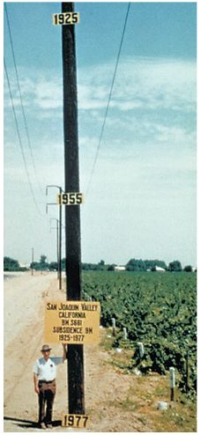
Example: California
What are some of the trade offs?
  Trade-offs: the exchange of one thing in return for another
Source: commons.wikimedia.org/wiki/File:Gwsanjoaquin.jpg
Notes:
Some of these agricultural adaptations will have short-term benefits that allow crops to grow well but will also have long-term effects that can have a greater, potentially negative, effect on future productivity. Accessing groundwater has been a method used by farmers for decades. In this picture, the telephone pole has three numbers on it. The number at the top is 1925; this is where the ground level was in that year. The middle number is 1955, and the number at the bottom is 1977. Tapping into groundwater for irrigation purposes caused this dramatic change in the ground level, called subsidence, because the aquifers underneath this area have been diminished. In addition, it is very expensive to dig the wells that access the groundwater. These are examples of trade-offs. In the short-term, crops are getting watered, but in the long run, it costs a lot of money. Also, the aquifers are not getting replenished as quickly as they are getting used.

Slide 8


Agricultural Adaptations
No quick fixes
Effects of climate change
are interconnected
  Example: decreased
  water availability and
  increased temperature
Adapting can:
  Require more knowledge
  Be costly
Source: water.usgs.gov/edu/earthgwdecline.html
Notes:
There are no quick fixes for farmers to adapt to climate change because the effects can be related. For example, when farmers experience decreased water availability, they are often dealing with increased temperature as well. Adapting to climate change is also going to require knowledge about how the climate will change in the future and of the impacts of various adaptation methods. Many of these methods can be expensive, so adapting to climate change can be financially challenging. These are some of the trade-offs that farmers have to consider.

Slide 9

Agricultural Adaptations
Not only individual farmers (producers)
  Adaptations also needed in the agriculture industry & government
    Adjust practices and policies
Source: www.freespiritresorts.com.au/wp-content/uploads/2014/07/
Notes:
Farmers are not the only ones who need to adapt to climate change; the agricultural industry and government should adjust their practices and policies to support agricultural sustainability because the effects of climate change will affect all three actors.

Slide 10
Part One
Agriculture
Producers:
The person, or group of people, that operate a farm
Agro-industry:
Business connected with agriculture; involves researching technologies and disseminating information to producers
Government:
Agencies responsible for the creation and implementation of programs and policies to support producers and agro-industry
Notes:
For our activity today, we will be exploring the roles of three different agriculture actors (producers, agro-industry, and government) and how they can react to four different pressures placed on agriculture as a result of climate change.
-Producers are farm operators.
-Agro-industry is made up of the businesses associated with agriculture. This can be through researching technologies or disseminating information/products to producers.
-Government consists of the agencies responsible for programs and policies supporting the producers and agro-industry.

Slide 11

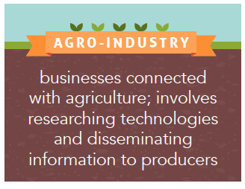
Actor Card
  Producers
  Agro-Industry
  Government
Read description of your actor
Notes:
You will be separated into 12 groups (no more than 3 students per group) and each group will receive an Actor card that describes one of the three agriculture actors.

Slide 12

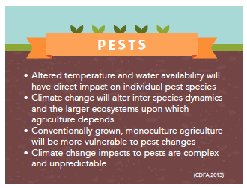
Impact Card
  Temperature
  Water
  Pest
  Pollinator
Read challenges caused by your impact
  Effects of climate change
Notes:
Each group will also draw an Impact card. As a result of climate change, temperature will change, water availability will change, pests will change, and pollinators will change. When you get your Impact card, read aloud the impact climate change will have on your group.

Slide 13
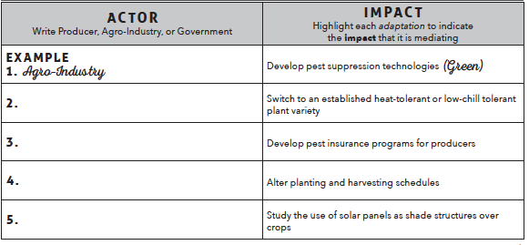
Part Two
Goal
  Research ways for assigned actor to adapt to the assigned impact
Fill in an actor
Color code
  Yellow = Temp.
  Green = Pests
  Blue = Water
  Pink = Pollinators
Notes:
In today’s activity, we will ultimately make posters about our assigned actors and the impacts of climate change and then conduct a gallery walk. First, we will learn more about the actors involved and climate impacts by doing some research. Take a few minutes to read the descriptions of all of the actors and impacts on the Reference Sheet handout.
-On the Actors and Impacts handout is a list of adaptations. You will read through each adaptation and identify which actor is responsible for each. Then color code each adaptation using highlighters: yellow for temperature, green for pests, blue for water, and pink for pollinators. Use the Reference Sheet handout as needed.
-The first one is done for you as an example. Adaptation # 1 should be highlighted green because it has to do with pests. “Agro-industry” is the actor that should be written in the blank because they are involved in researching technology.

Slide 14

Part Three
Create a poster for sharing with classmates
Format
  Top: label with your actor and impact
  List suggested adaptations
Hang poster
Your actor
Your impact
Suggested adaptations
Notes:
Your group will now create a poster for our gallery walk.
-Begin by writing your actor and impact in large print at the top of your poster.
-Look on your Actors and Impacts handout to find the 2-3 adaptations that apply to your actor/impact combination and list them on your poster.
-Once you have finished listing your adaptations, find a spot along the wall to hang your poster.

Slide 15

Part Three
Sticky notes color coded for your impact
Walk around room in your group
  Review suggested adaptations
  Consider how adaptations may apply to your impact
Notes:
Each group will now receive a pad of sticky notes based on their impact: yellow for temperature, green for pests, blue for water, and pink for pollinators. You will walk around the room as a group and review each poster and consider how the adaptations may apply to your impact.

Slide 16
Part Three
If an adaptation would apply to your impact, mark with sticky note
  Positive and negative effects
    Add a plus sign to sticky note
    Add a minus sign to sticky note
  Example: shade structures
+
Notes:
If an adaptation would apply to your impact, mark it with a sticky note. If it would have a positive effect, add a plus sign to the sticky note. If it would have a negative effect, add a minus sign to the sticky note.
-For example, if producers add shade structures to reduce the impact of increased temperature, it will also decrease evaporation from soil and evapotranspiration from plants, increasing water efficiency. This adaptation would affect both temperature and water. The groups that researched water would add a blue sticky note next to that adaptation. It would have a positive impact, so those groups would add a plus sign to their sticky note.

Slide 17


Part Four
Discussion
  What do you notice about the posters around the room?
Notes:
Look around the room at all of the posters. What is something that you notice?

Slide 18
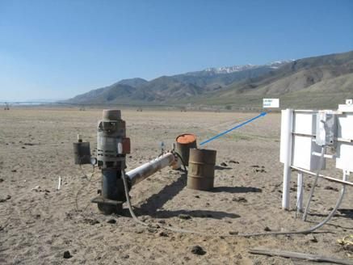
Conclusion
Remember: California farmers using more groundwater
  Tulare County, CA
Source: water.usgs.gov/edu/graphics/gwflowproblems2.gif
Source: nevada.usgs.gov/water/AquiferTests/walkerdata_powerline.cfm?studyname=walkerdata_powerline
Notes:
Remember the California example at the beginning of the today’s activity. Farmers in several areas, such as Tulare County, are digging more wells to tap into the groundwater supply.

