Slide 1

Southwest Regional
Climate Hub
Developed by the
Asombro Institute for Science Education (www.asombro.org)

Slide 2
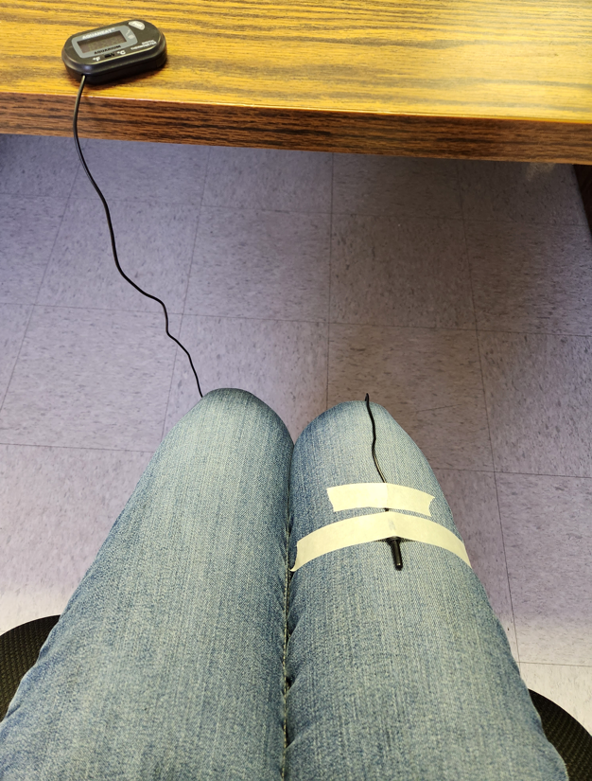

Setting Up the Experiment
Notes:
The test subject will use a binder clip to attach the wire of the meat thermometer to the clothing on their lap. Instruct the student to point the metal probe toward their hip, and attach the binder clip approximately halfway on the length of their thigh. Ensure that the thermometer probe is contacting the student’s thigh as much as possible. The probe should not be pointed sideways or hanging off of the student’s lap.

Slide 3
Greenhouse Gases
Gases that trap heat in the atmosphere
Carbon Dioxide
Water Vapor
Ozone
Methane
Nitrous Oxide
Fluorinated Gases
Source: https://www.epa.gov/ghgemissions/overview-greenhouse-gases
Notes:
We have gases in our atmosphere that trap heat called greenhouse gases, and they are: carbon dioxide, water vapor, ozone, methane, nitrous oxide, and fluorinated gases.
Updated link: August 2025
Slide may vary from Educator Guide.

Slide 4
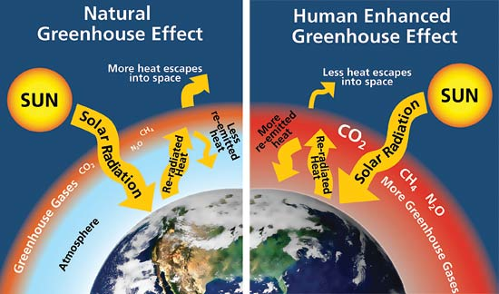
Source: www.nps.gov/goga/naturescience/images/Greenhouse-effect.jpg
Notes:
-Begin with the diagram on the left. The greenhouse effect ensures that Earth is warm enough for us to inhabit. Our atmosphere contains greenhouse gases, like carbon dioxide, methane, and nitrous oxide. Electromagnetic radiation from the sun, mostly at short wavelengths in the form of light, is able to pass through the atmosphere and is absorbed by Earth. Earth re-radiates some of this energy back toward space as heat, which is long-wave radiation. Most of the heat is able to pass through the atmosphere and escape into space, but some is absorbed by the atmosphere and then re-emitted back to Earth.
-Now explain the diagram on the right. This is the enhanced greenhouse effect, which is caused by increased greenhouse gases in our atmosphere. As more greenhouse gases are released into the atmosphere, more of the re-radiated heat from Earth is re-emitted back to Earth instead of escaping to space. This is causing average global temperature to increase.

Slide 5
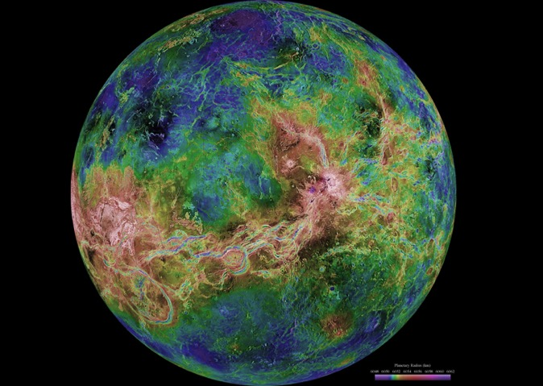
Venus: Runaway Greenhouse Effect
Very thick atmosphere, mostly CO₂
High temps of almost 480°C (900°F)
  Hotter than Mercury
My Very Excellent Mother Just Served Us Noodles
Source: solarsystem.nasa.gov/planets/profile.cfm?Object=Venus
Notes:
Ask students which is the closest planet to the sun in our solar system [answer: Mercury]. Ask students which is the hottest planet in our solar system [answer: Venus]. Ask students if they know why Venus is the hottest planet even though it is not the closest to the sun. Venus has a very thick atmosphere, comprised mostly of carbon dioxide. Carbon dioxide is a greenhouse gas, which effectively traps the heat within the atmosphere of Venus. High temperatures on the surface of Venus can reach almost 900°F. Venus serves as a natural experiment of the runaway greenhouse effect, demonstrating how high levels of greenhouse gases in the atmosphere result in high temperatures.

Slide 6
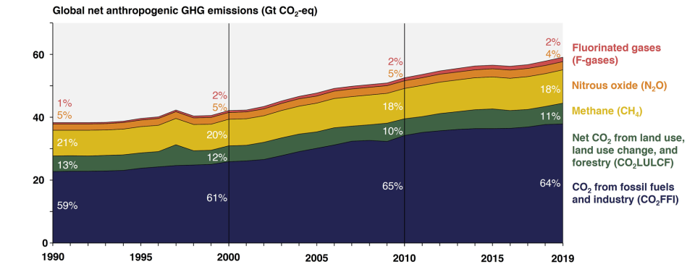
Humans & Greenhouse Gases
Humans produce more carbon dioxide (CO₂) than any other greenhouse gas
Global Greenhouse Gas Emissions by Gas
Source: https://www.epa.gov/ghgemissions/global-greenhouse-gas-overview
Notes:
This pie chart shows the percentage of each of the greenhouse gases that humans emit through our activities. Carbon dioxide accounts for more than 75% of the greenhouse gases that we release.
Updated link and chart: August 2025
Slide may vary from Educator Guide.

Slide 7
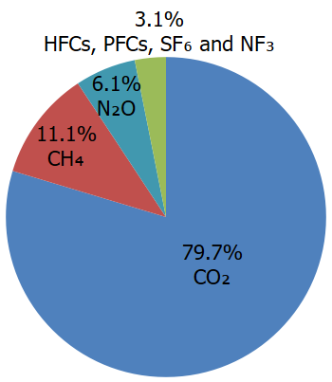
Humans & Greenhouse Gases
Humans produce more carbon dioxide (CO₂) than any other greenhouse gas
Carbon dioxide
Methane
Nitrous oxide
Fluorinated gases
Global Greenhouse Gas Emissions by Gas
Source: https://www.epa.gov/ghgemissions/overview-greenhouse-gases#carbon-dioxide
Notes:
This pie chart shows the percentage of each of the greenhouse gases that humans emit through our activities. Carbon dioxide accounts for more than 75% of the greenhouse gases that we release.
Updated link and chart: August 2025
Slide may vary from Educator Guide.

Slide 8
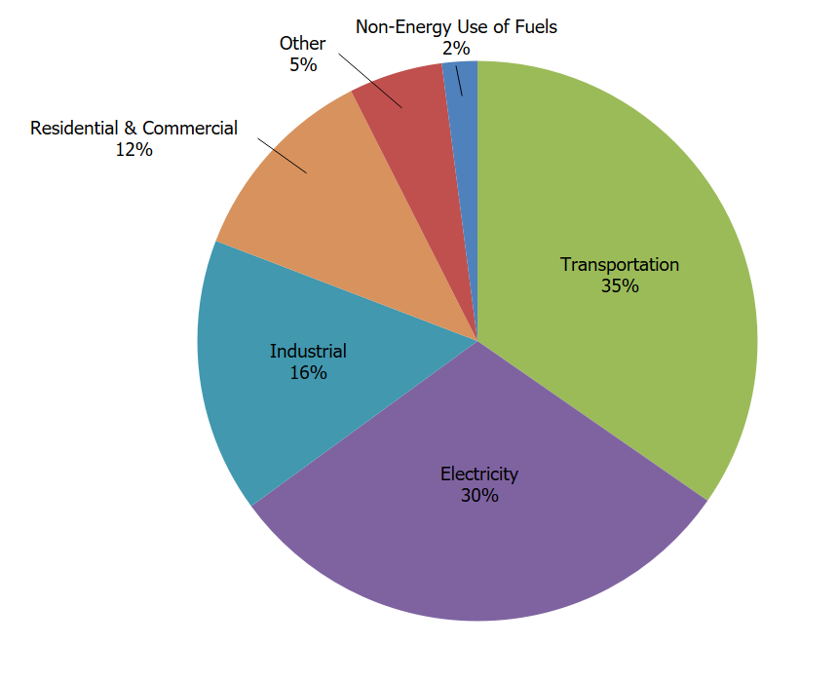
How do humans release CO₂?
Transportation
    Largest source of CO₂ emissions in U.S.
Electricity
Industry
U.S. Carbon Dioxide Emissions, By Source
Source: https://www.epa.gov/ghgemissions/carbon-dioxide-emissions
Notes:
Humans emit carbon dioxide mostly through fossil fuel combustion, i.e. the burning of coal, natural gas, and oil, for the production of electricity and transportation. Many industrial processes rely on fossil fuel combustion as well, and the production of mineral products, such as cement, the production of metals, and the production of chemicals can all result in carbon dioxide emissions.
Updated link and chart: August 2025
Slide may vary from Educator Guide.

Slide 9
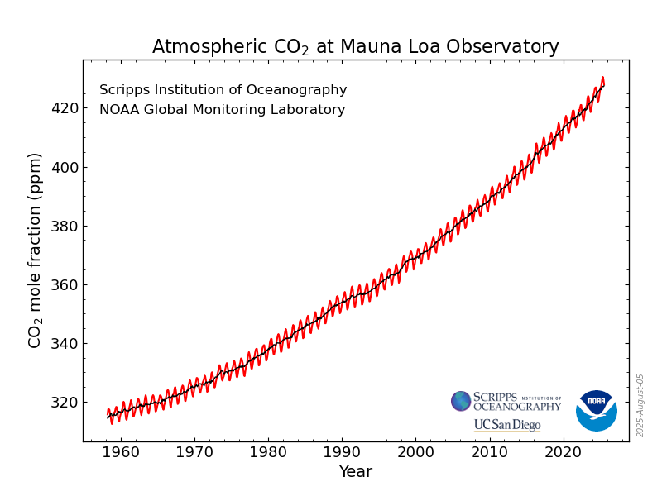
CO₂ in the Atmosphere
Source: www.esrl.noaa.gov/gmd/ccgg/trends/
Notes:
Since 1956, scientists at Mauna Loa, on a Hawaiian island in the North Pacific, have been collecting atmospheric data. This graph shows the concentration of carbon dioxide in the atmosphere as measured at Mauna Loa. Ask students to describe the trend of this graph [answer: carbon dioxide is increasing].
Updated chart: August 2025
Slide may vary from Educator Guide.

Slide 10
Source: www.nps.gov/goga/naturescience/images/Greenhouse-effect.jpg
Notes:
-Quickly review the left and right sides of the diagram, explaining the natural greenhouse effect and the enhanced greenhouse effect.
-The experiment that students just conducted was a model of the natural greenhouse effect and the enhanced greenhouse effect.
-Ask students to determine which item in the experiment modeled the earth and discuss how it is like the earth [answer: the student’s lap modeled the earth because it emits heat].
-Ask students to determine which item in the experiment modeled the atmosphere and discuss how it is like the atmosphere [answer: the towel modeled the atmosphere because the towel absorbed some of the heat and re-emitted it back toward the lap, effectively trapping it and keeping the lap warmer].
-Ask students to determine which item in the experiment modeled the additional greenhouse gases and discuss how it is like additional greenhouse gases [answer: the space blanket because, once it was added, more of the heat from the lap was re-emitted back to the lap instead of escaping to into the room].

Slide 11
Climate
Description of the long-term pattern of weather in a particular area
  Today’s (or even this month’s or this year’s) weather is NOT the same as climate
Source: https://science.nasa.gov/climate-change/what-is-climate-change/
Notes:
The atmosphere influences our climate, and we conducted the experiment to model one aspect of how our climate is changing. Explain that climate is the description of the long-term pattern of weather in a particular area. Long-term usually means approximately 30 years. Make sure that students understand that in order to be considered climate, conditions must be averaged over a long time period. Today’s weather in your area (or even this month’s or this year’s) is not the same as the climate.
Updated link: August 2025
Slide may vary from Educator Guide.

Slide 12
Climate Change
Refers to any significant change in the measures of climate lasting for an extended period of time
Global warming
  Temperature increasing
Precipitation patterns
More severe storms
Source: https://www.epa.gov/climatechange-science/basics-climate-change
Notes:
The climate of Earth is changing. Read the definition for climate change. Tell students that climate change includes global warming (the temperature of Earth is increasing), changes in precipitation patterns, and more severe storms.
Updated link: August 2025
Slide may vary from Educator Guide.

Slide 13
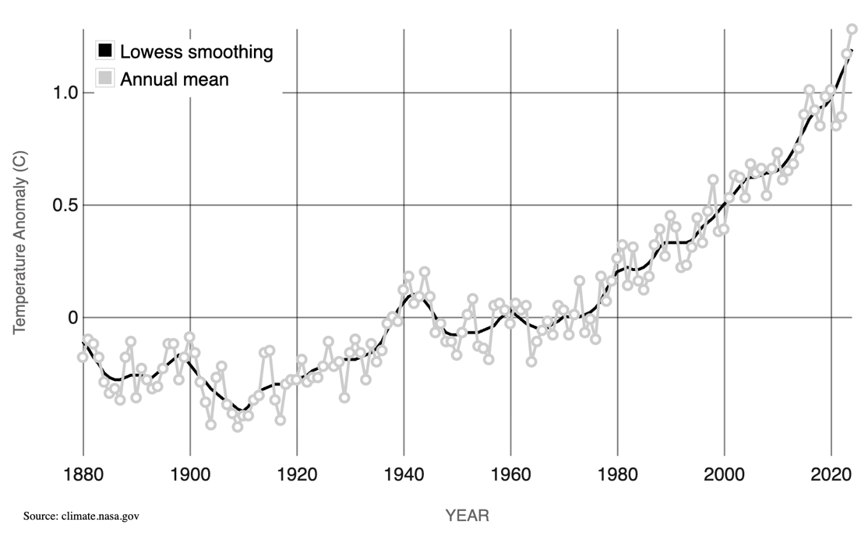
Global Warming
Recorded Data Since 1880
This graph shows the change in global surface temperature compared to the long-term average from 1951 to 1980.
Source: https://climate.nasa.gov/vital-signs/global-temperature/?intent=121
Notes:
We have recorded data on Earth temperatures since 1880. Ask students to describe the trend of this graph [answer: temperature is increasing].
Updated link and chart: August 2025
Slide may vary from Educator Guide.

Slide 14
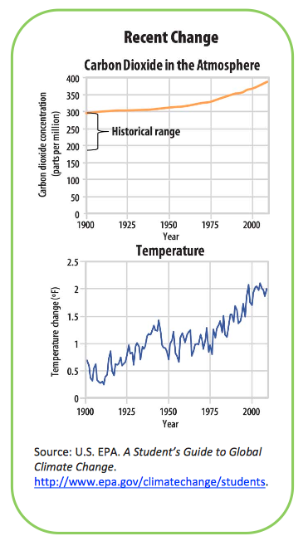
Atmospheric CO₂ and Temperature: What is the Relationship?
Source: https://archive.epa.gov/climatechange/kids/documents/temp-and-co2.pdf
Notes:
Remind students that you discussed carbon dioxide levels in the atmosphere earlier and that these are shown in the top graph. Temperature is shown in the bottom graph. Ask students to describe the relationship between CO₂ and global temperature [answer: as carbon dioxide increases, global temperature increases].
Updated link: August 2025
Slide may vary from Educator Guide.

Slide 15

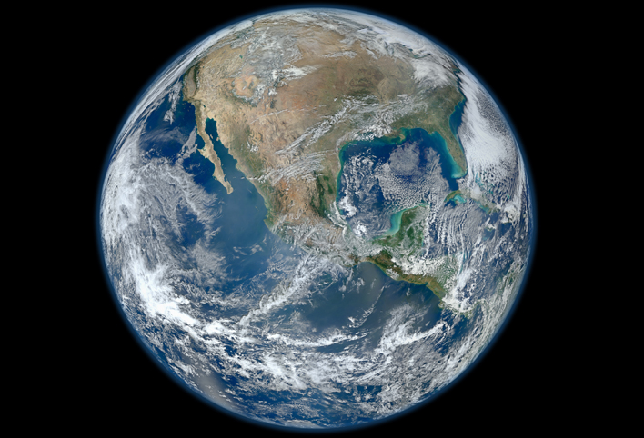
Earth photo source: solarsystem.nasa.gov/planets/profile.cfm?Object=Earth
Notes:
Our atmosphere acts like one blanket around the earth and keeps our planet warm enough for us to inhabit. However, when we add greenhouse gases to our atmosphere, we are putting on an additional blanket (click slide forward to display second blanket). This extra blanket results in temperatures that are too warm for species that are adapted for recent historic local temperatures, and is causing changes to atmospheric conditions and weather patterns, which will have large impacts on humans.

Slide 16
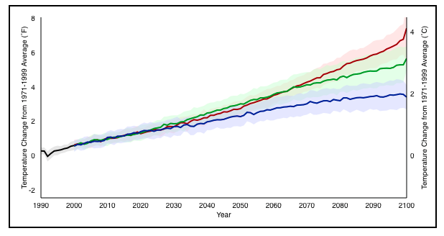
Global Temperature Projections
The graph shows the average of a set of temperature simulations for the 20th century (black line), followed by projected temperatures for the 21st century based on a range of emissions scenarios (colored lines). The shaded areas around each line indicate the statistical spread (one standard deviation) provided by individual model runs.
Source: www.climate.gov/news-features/understanding-climate/climate-change-global-temperature-projections
Notes:
-Scientists used several models to predict global temperatures by the end of the century, in the year 2100. This graph displays three global temperature projections, shown by the colored lines. The three lines represent different scenarios for the amount of warming that will occur, which depends on the activities of humans. The amount that the temperature will increase depends greatly on human population growth and the amount of greenhouse gases emitted in this century.
-Direct students to look at evaluation question 2 and at the scenario with the warmest projected temperatures, shown by the top (red) line of the graph. Emphasize that they should only be considering the top line of the graph. Ask them to estimate the approximate number of degrees Fahrenheit by which the average temperature is projected to increase by 2100 in the warmest scenario [answer: approximately 6 – 8 °F].
-Direct students to look at evaluation question 3 and at the scenario with the lowest projected temperatures, shown by the bottom (blue) line of the graph. Emphasize that they should only be considering the bottom line of the graph. Ask them to estimate the approximate number of degrees Fahrenheit by which the average temperature is projected to increase by 2100 in the lowest temperature scenario [answer: approximately 2 – 4 °F].
-Ask students to consider question 4 and solicit answers. Although temperature increases of 2 – 8 °F may not sound like much, the impacts are likely to be great. We will continue to experience increases in snow and glacial melt; increased sea levels; less rainfall in the Mediterranean, southwest North America, and southern Africa; and more precipitation in Alaska and other high latitudes of the Northern Hemisphere. These changes will impact humans through increased droughts and wildfires in some areas, increased severe storms and flooding in other areas, and reduction in food production.

