Slide 1


Slide 2



What do viral videos and carbon dioxide have in common?
Source: teen.smokefree.gov
MORE PEOPLE SEE IT
VIDEO IS SHARED
Source: ya-webdesign.com
Source: drawception.com

Slide 3
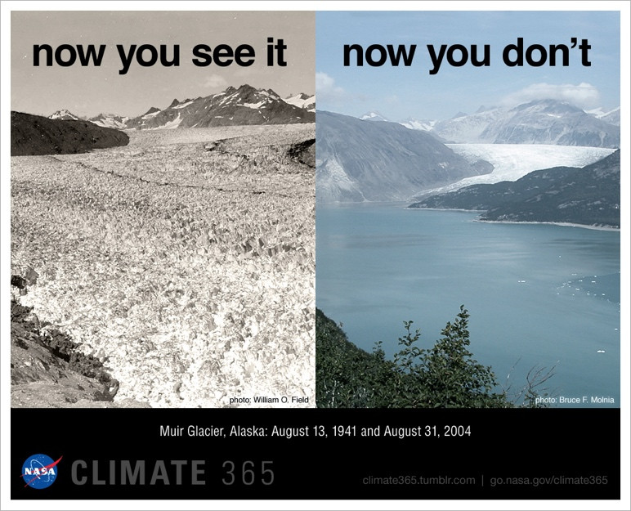
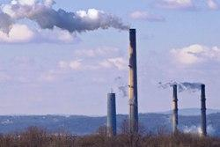
Carbon Dioxide and Global Warming
Phenomenon: carbon dioxide in the atmosphere is affecting temperatures on Earth, resulting in several positive feedback loops
Source: epa.gov/enforcement/national-compliance-initiative-
reducing-air-pollution-largest-sources
Source: climate.nasa.gov/climate_resources/4/graphic-dramatic-glacier-melt/
Notes:
NEED TO ADD NOTES

Slide 4
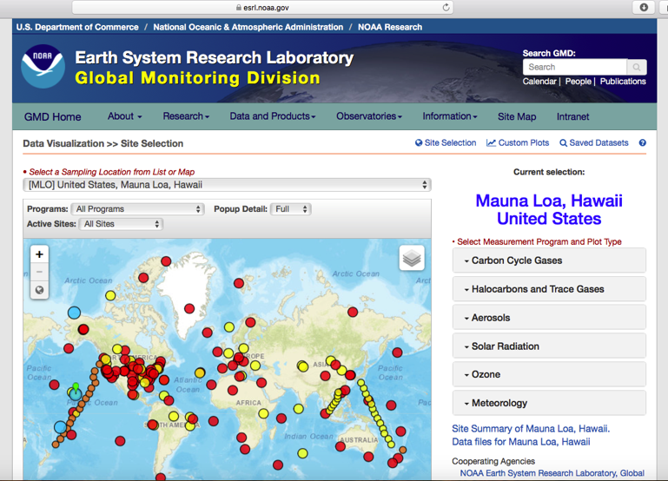
NOAA Interactive Atmospheric Data Visualization
National Oceanic and Atmospheric Administration (NOAA)
Carbon dioxide in atmosphere
Nearby monitoring site
bit.ly/2q4t5Pw

Slide 5
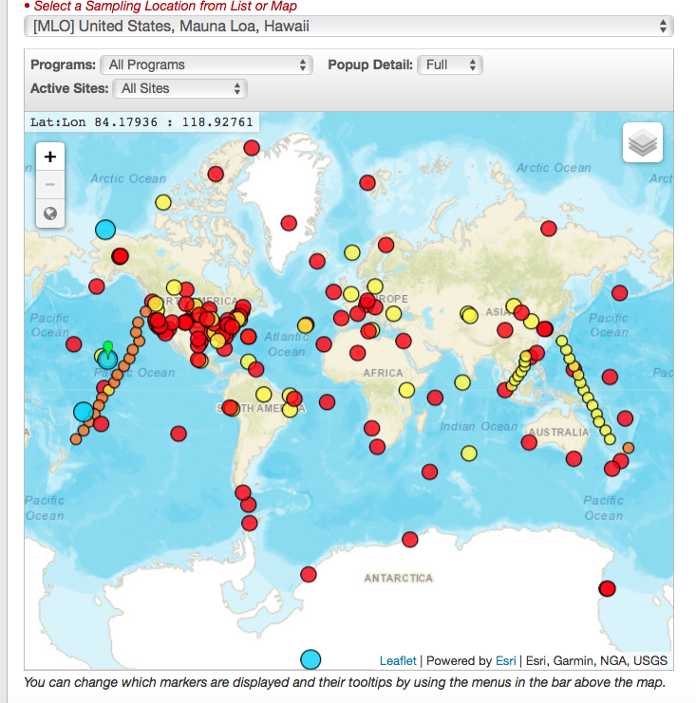
Choose the closest monitoring site from the map

Slide 6
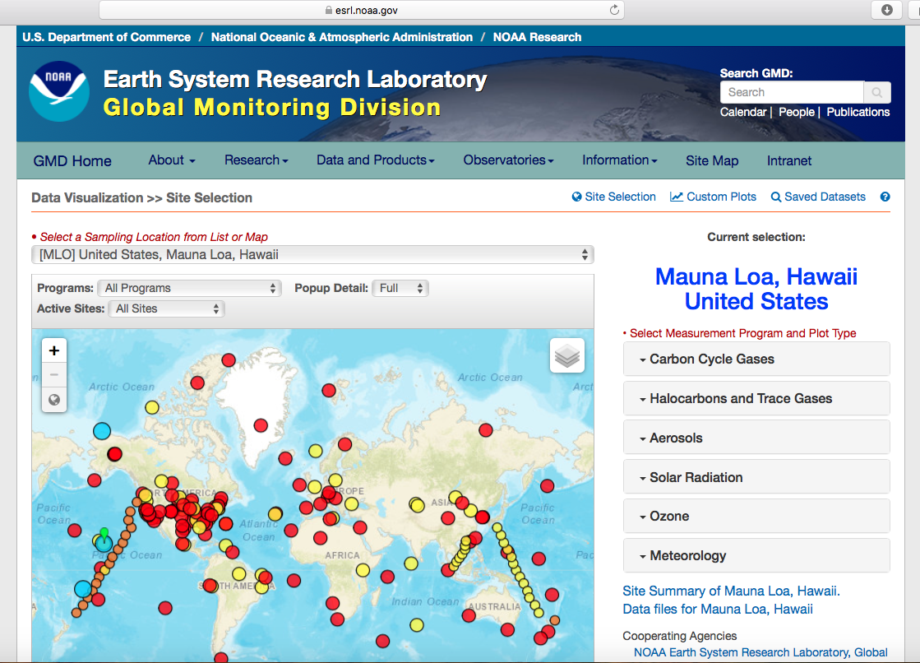
NOAA Interactive Atmospheric Data Visualization
Open the NOAA IADV website:
https://bit.ly/2q4t5Pw

Slide 7
Use the “+” symbol to zoom in on the area of the world where you live.

Slide 8
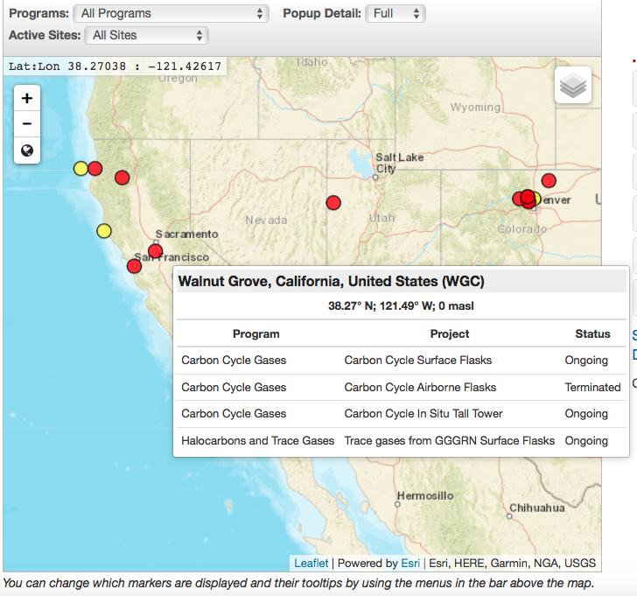
Hover over and then click on the red dot that is closest to where you live. Red dots indicate active sites.

Slide 9
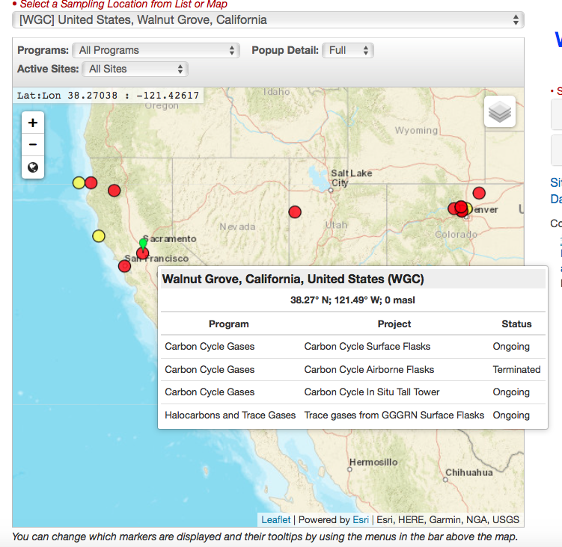
Ensure that the name of the sampling location is listed in the drop down menu at the top of the page.

Slide 10
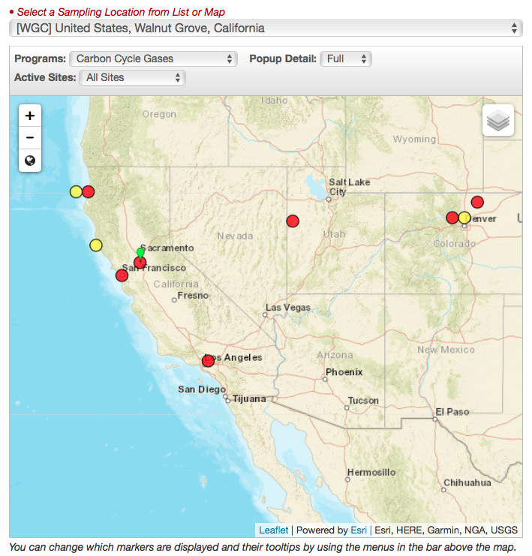
Leave the other two drop down menus on their default settings.
      Popup detail: “Full”
      Active Sites: “All Sites”
In the drop down menus near the top of the page:
  Choose “Carbon Cycle Gases”

Slide 11
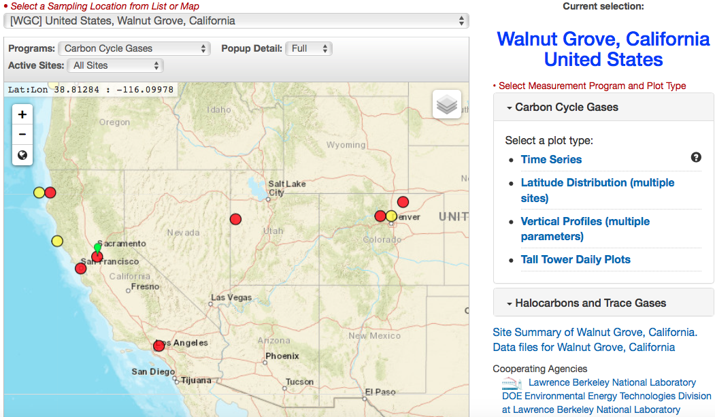
In the right side bar, click on the “Carbon Cycle Gases” button.
  Two or more plot types will appear.
    Click on “Time Series”

Slide 12
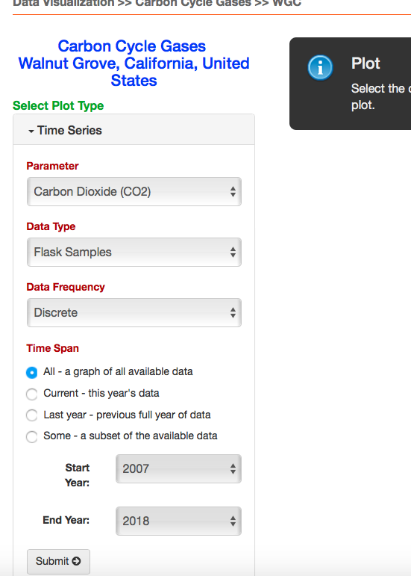
You will be taken to another screen. Leave all options on their default settings.
  Parameter: “Carbon Dioxide”
  Data Type: “Flask Samples” or “Aircraft Data”
  Data Frequency: “Discrete”
  Time Span: “All – a graph of all available data”
  Click the “Submit” button.

Slide 13
NOAA Interactive Atmospheric Data Visualization
Analysis Questions 1 & 2 on handout

Slide 14
Positive Feedback Loop
Phenomenon: carbon dioxide in the atmosphere is affecting temperatures on Earth, resulting in several positive feedback loops
Source: teen.smokefree.gov
VIDEO IS SHARED
MORE PEOPLE SEE IT
Source: ya-webdesign.com
Source: drawception.com

Slide 15
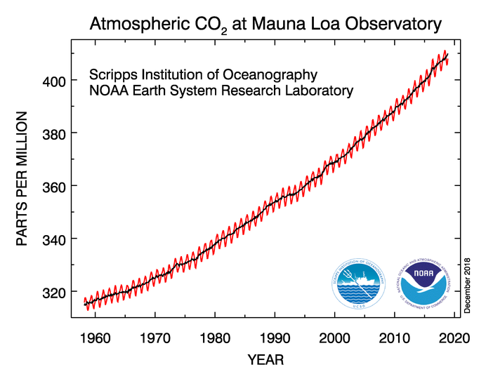
Positive Feedback Loop
Increasing CO₂
Source: esrl.noaa.gov/gmd/ccgg/trends/

Slide 16

Why does it matter?
Carbon dioxide is increasing
Carbon dioxide is a greenhouse gas
Source: epa.gov/enforcement/national-compliance-initiative-
reducing-air-pollution-largest-sources
Source: climate.nasa.gov/climate_resources/4/graphic-dramatic-glacier-melt/

Slide 17
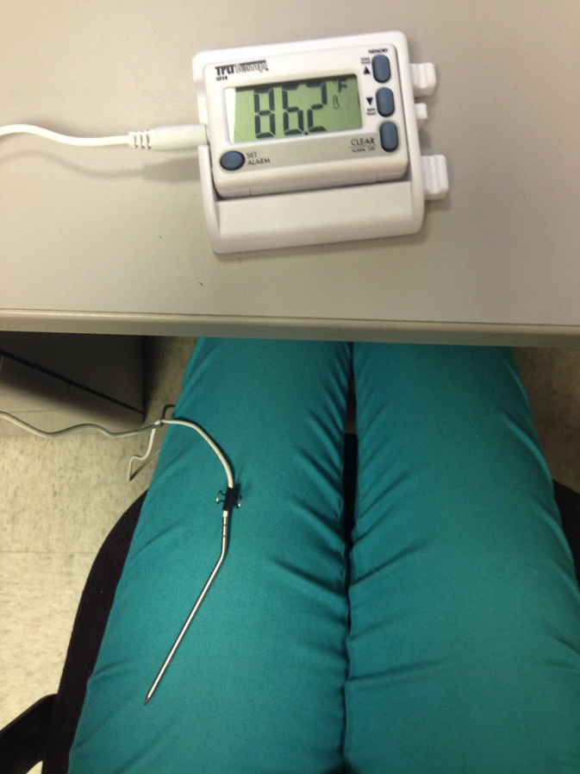
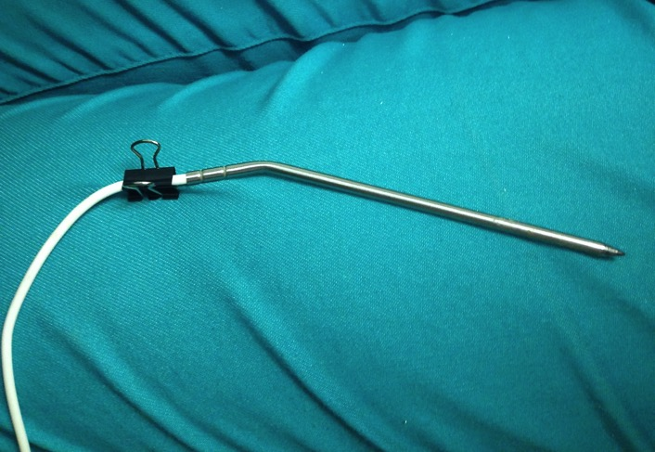
Setting Up the Experiment

Slide 18
Greenhouse Gases
Gases that trap heat in the atmosphere
Carbon Dioxide
Water Vapor
Ozone
Methane
Nitrous Oxide
Fluorinated Gases
Source: www.epa.gov/ghgemissions/overview-greenhouse-gases

Slide 19
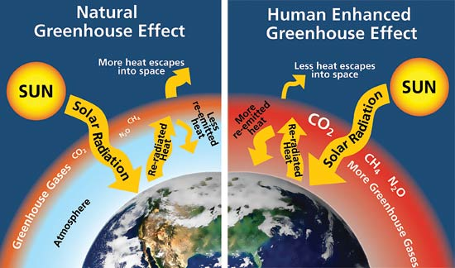
Source: www.nps.gov/goga/naturescience/images/Greenhouse-effect.jpg

Slide 20
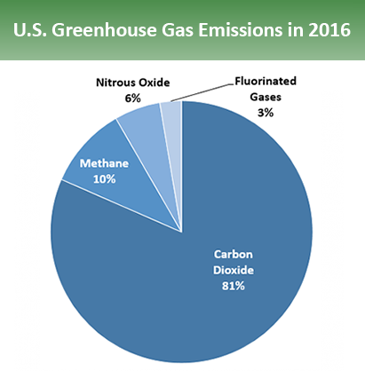
Humans & Greenhouse Gases
Humans produce more carbon dioxide (CO₂) than any other greenhouse gas
US Greenhouse Gas Emissions by Gas
Source: www.epa.gov/ghgemissions/overview-greenhouse-gases

Slide 21
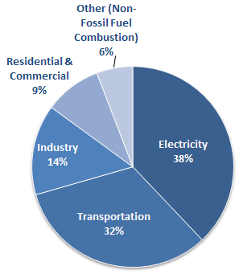
How do humans release CO₂?
Electricity
    Largest source of CO₂ emissions in U.S.
Transportation
Industry
U.S. Carbon Dioxide Emissions, By Source
Source: www.epa.gov/ghgemissions/overview-greenhouse-gases

Slide 22
CO₂ and Global Warming
Phenomenon: carbon dioxide in the atmosphere is affecting temperatures on Earth
Photo Credit: EPA
(epa.gov/enforcement/national-compliance-initiative-
reducing-air-pollution-largest-sources)
Image Credit: NASA
(climate.nasa.gov/climate_resources/4/graphic-dramatic-glacier-melt/)

Slide 23
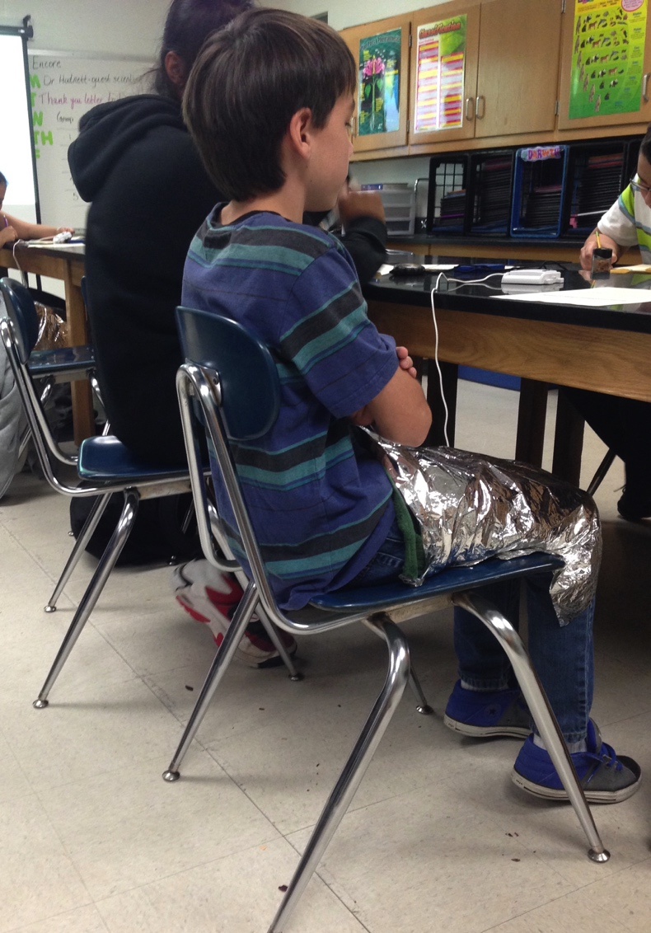
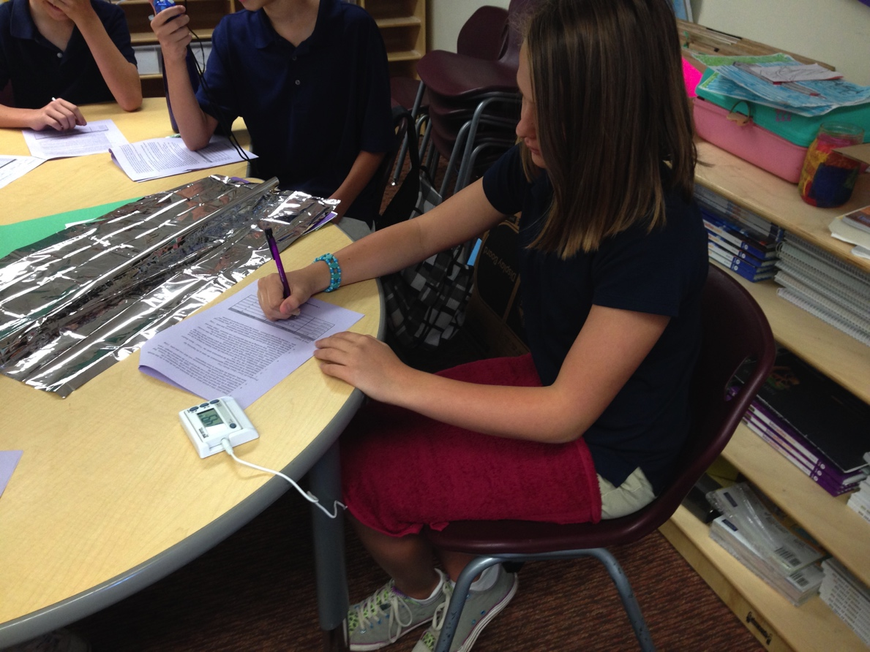
Greenhouse Effect Experiment
Towel Trial
Towel + Space Blanket Trial

Slide 24
Source: www.nps.gov/goga/naturescience/images/Greenhouse-effect.jpg

Slide 25

The Model
Which component in the model was representing:
Earth?
The Atmosphere?
Additional CO₂?
Options:
Lap
Towel
Space Blanket
Lap
Towel
Space Blanket
Source: www.nps.gov/goga/naturescience/images/Greenhouse-effect.jpg

Slide 26
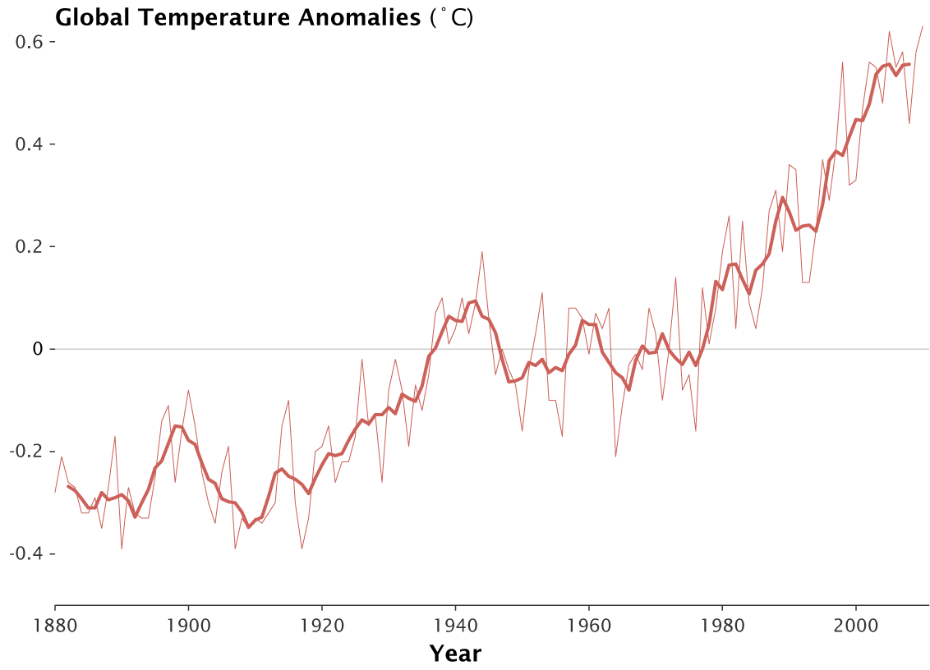
Global Warming
Recorded Data Since 1880
Source: www.giss.nasa.gov/research/news/20110113/

Slide 27
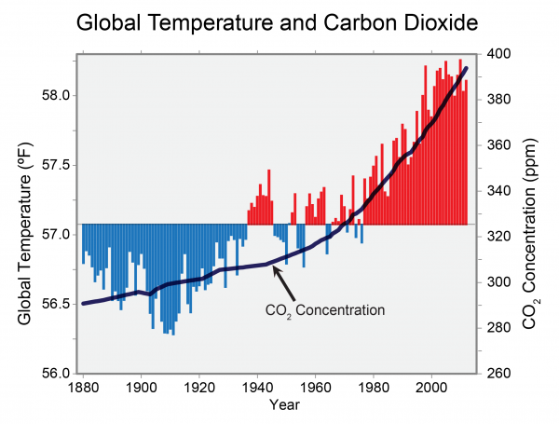
Temperature and Atmospheric CO₂
What is the Relationship?
Source: globalchange.gov/browse/multimedia/global-temperature-and-carbon-dioxide

Slide 28
Positive Feedback Loop
Increasing CO₂
Increasing Temperature

Slide 29
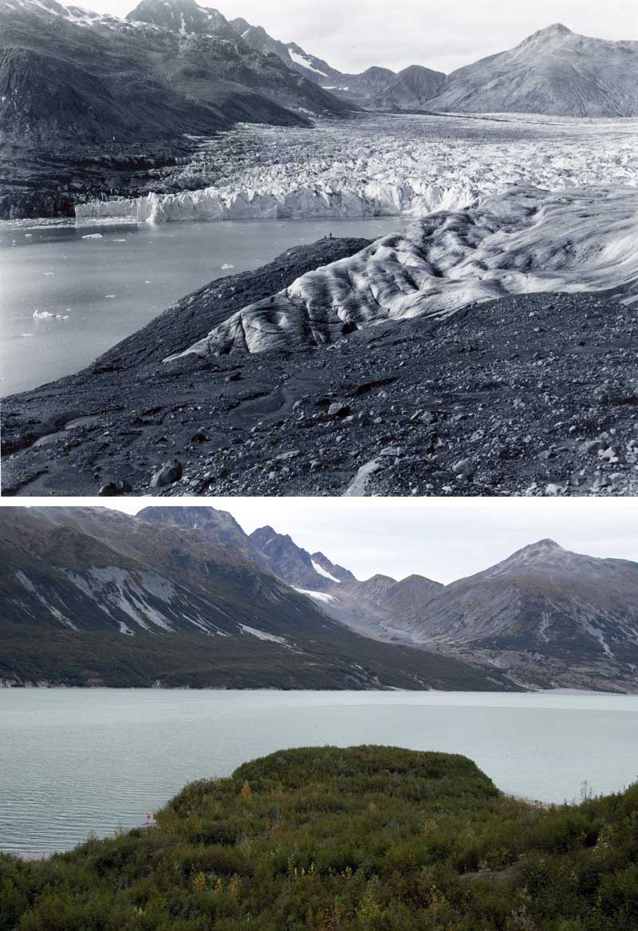
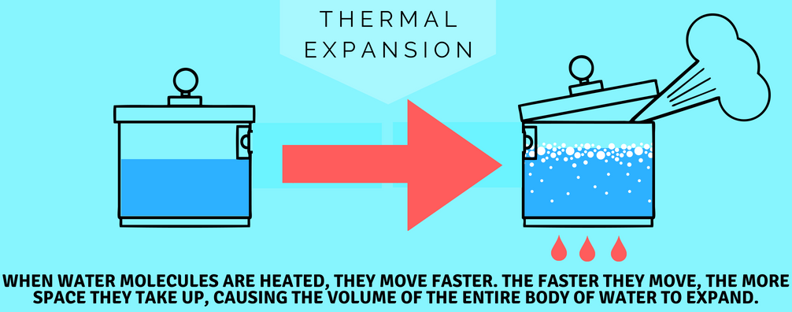
Increasing Temperature & Sea Level
September 1961
Thermal Expansion
Melting ice sheets and
glaciers
Source: www.hayward-ca.gov/your-environment/green-your-community/sea-level-rise
September 2003
Plateau Glacier,
Saint Elias Mountains, Alaska
Source: www2.usgs.gov/climate_landuse/glaciers/repeat_photography.asp

Slide 30
Positive Feedback Loop
Increasing CO₂
Increasing Temperature
Melting Ice & Thermal Expansion

Slide 31
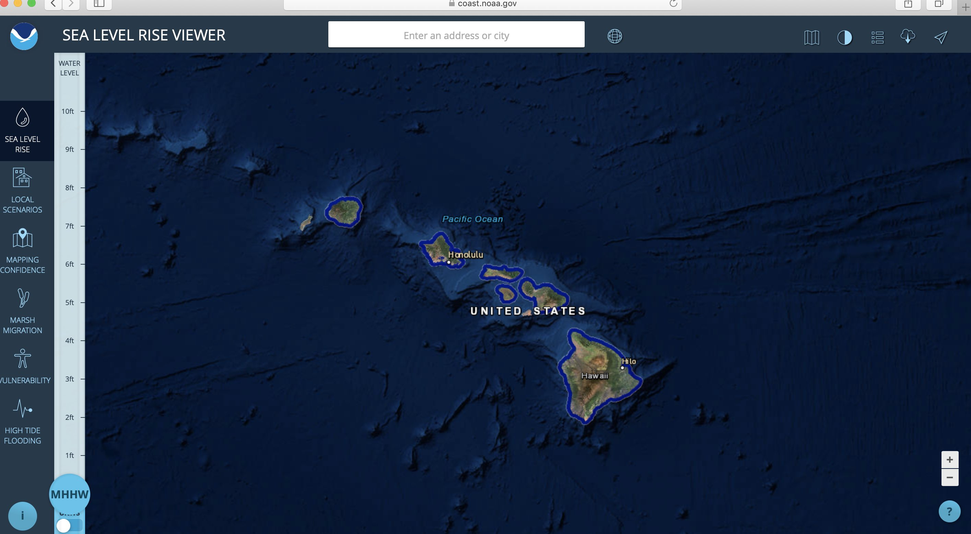
NOAA Sea Level Rise Viewer
  Which city is this?
Honolulu, Hawai’i
Island of O’ahu
State Capital
Largest City
Population: Over 350,000

Slide 32
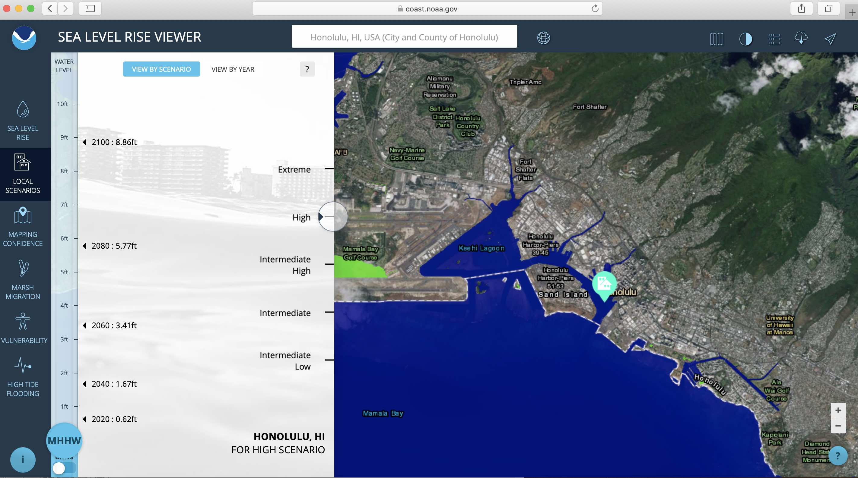
NOAA Sea Level Rise Viewer
  https://coast.noaa.gov/slr/#
  Example Honolulu, HI, Current Sea Level

Slide 33
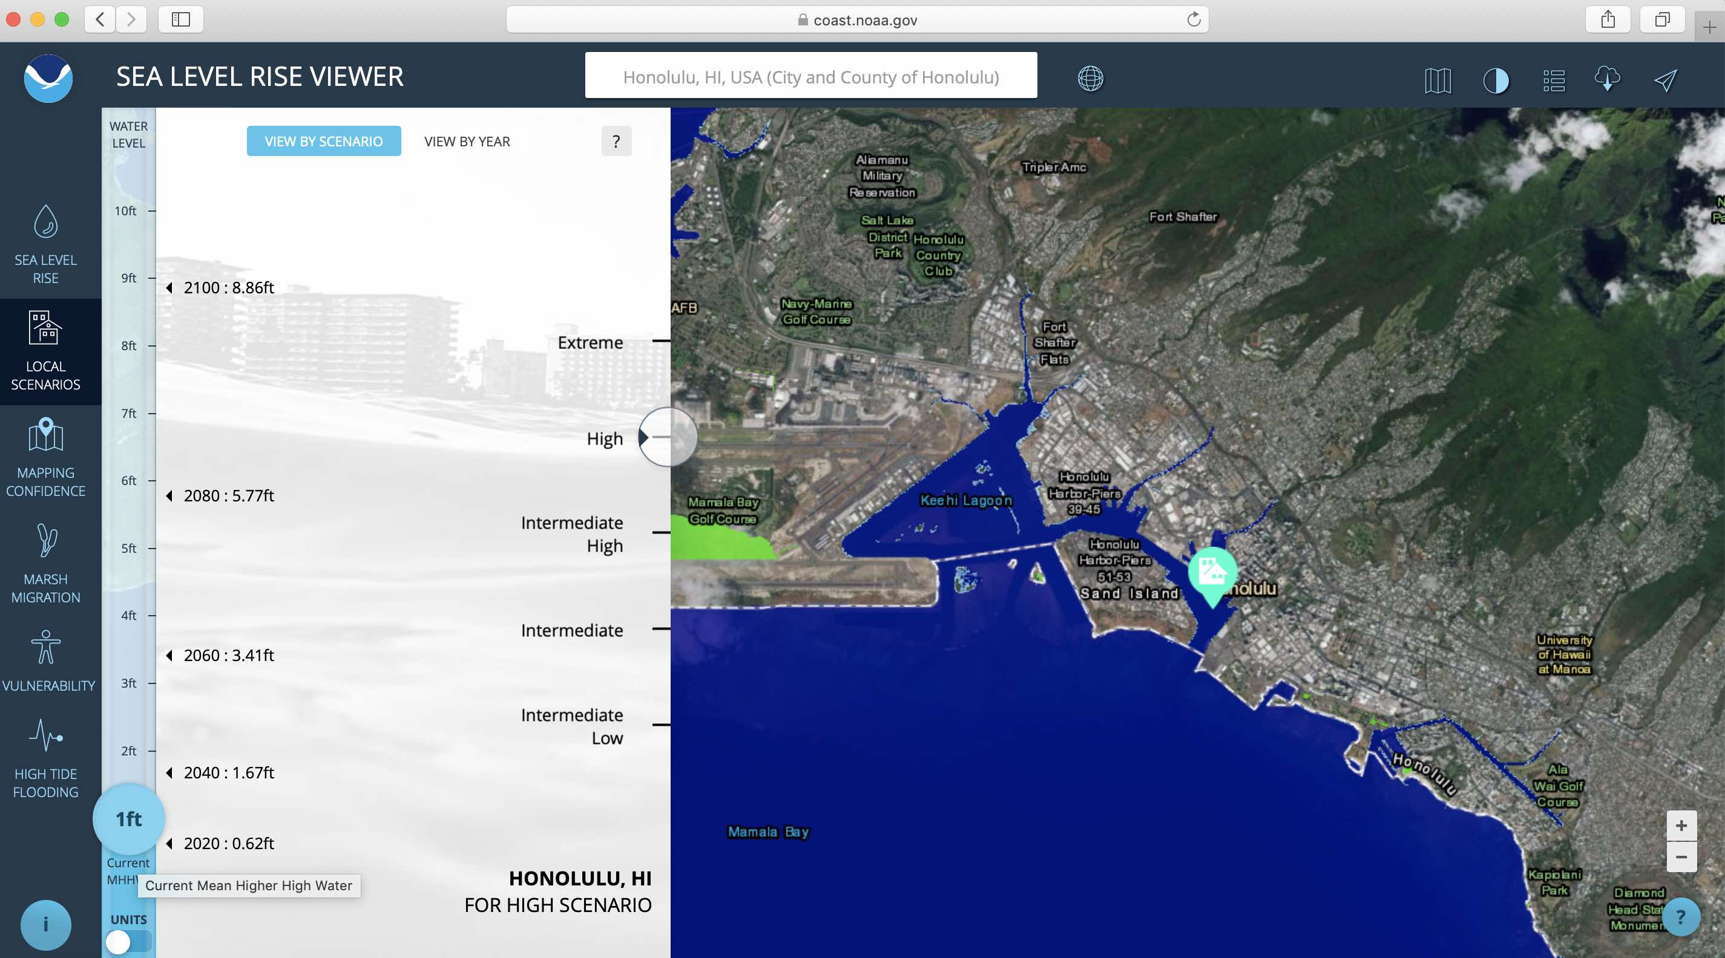
NOAA Sea Level Rise Viewer
2020

Slide 34
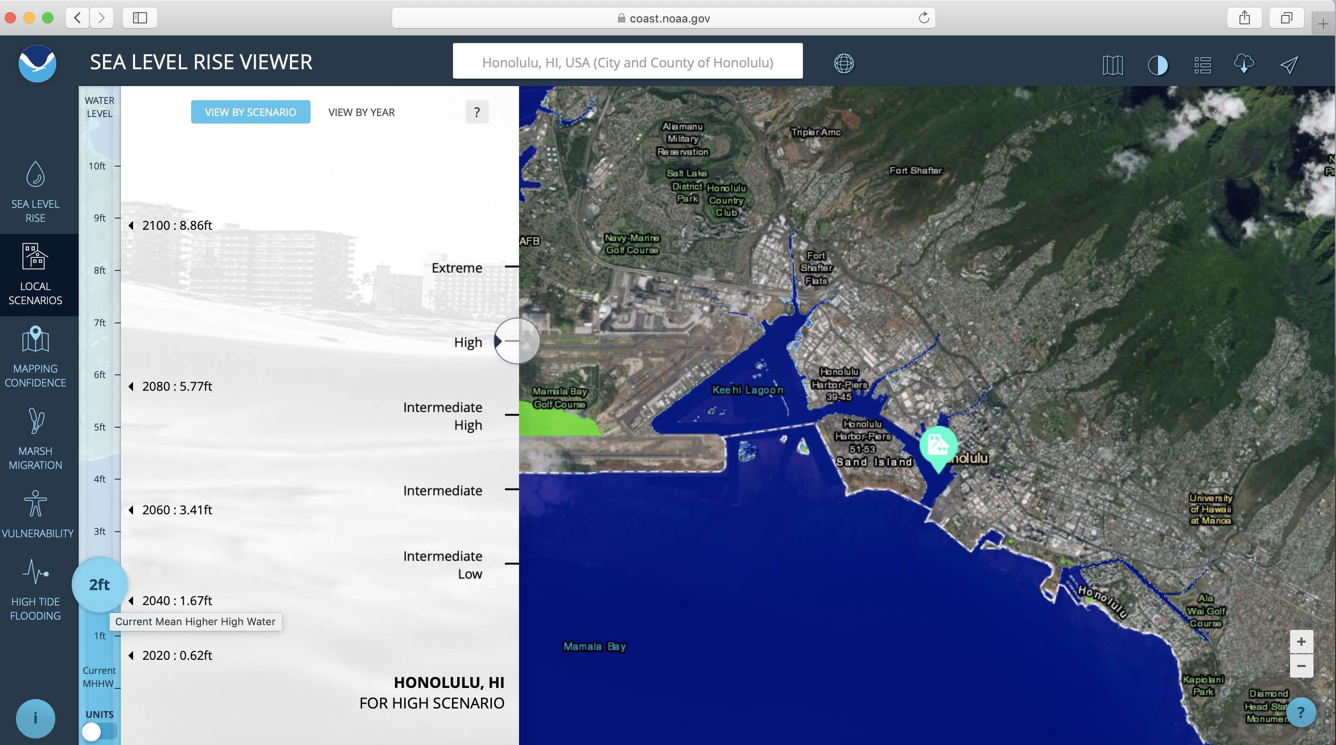
NOAA Sea Level Rise Viewer
2040

Slide 35
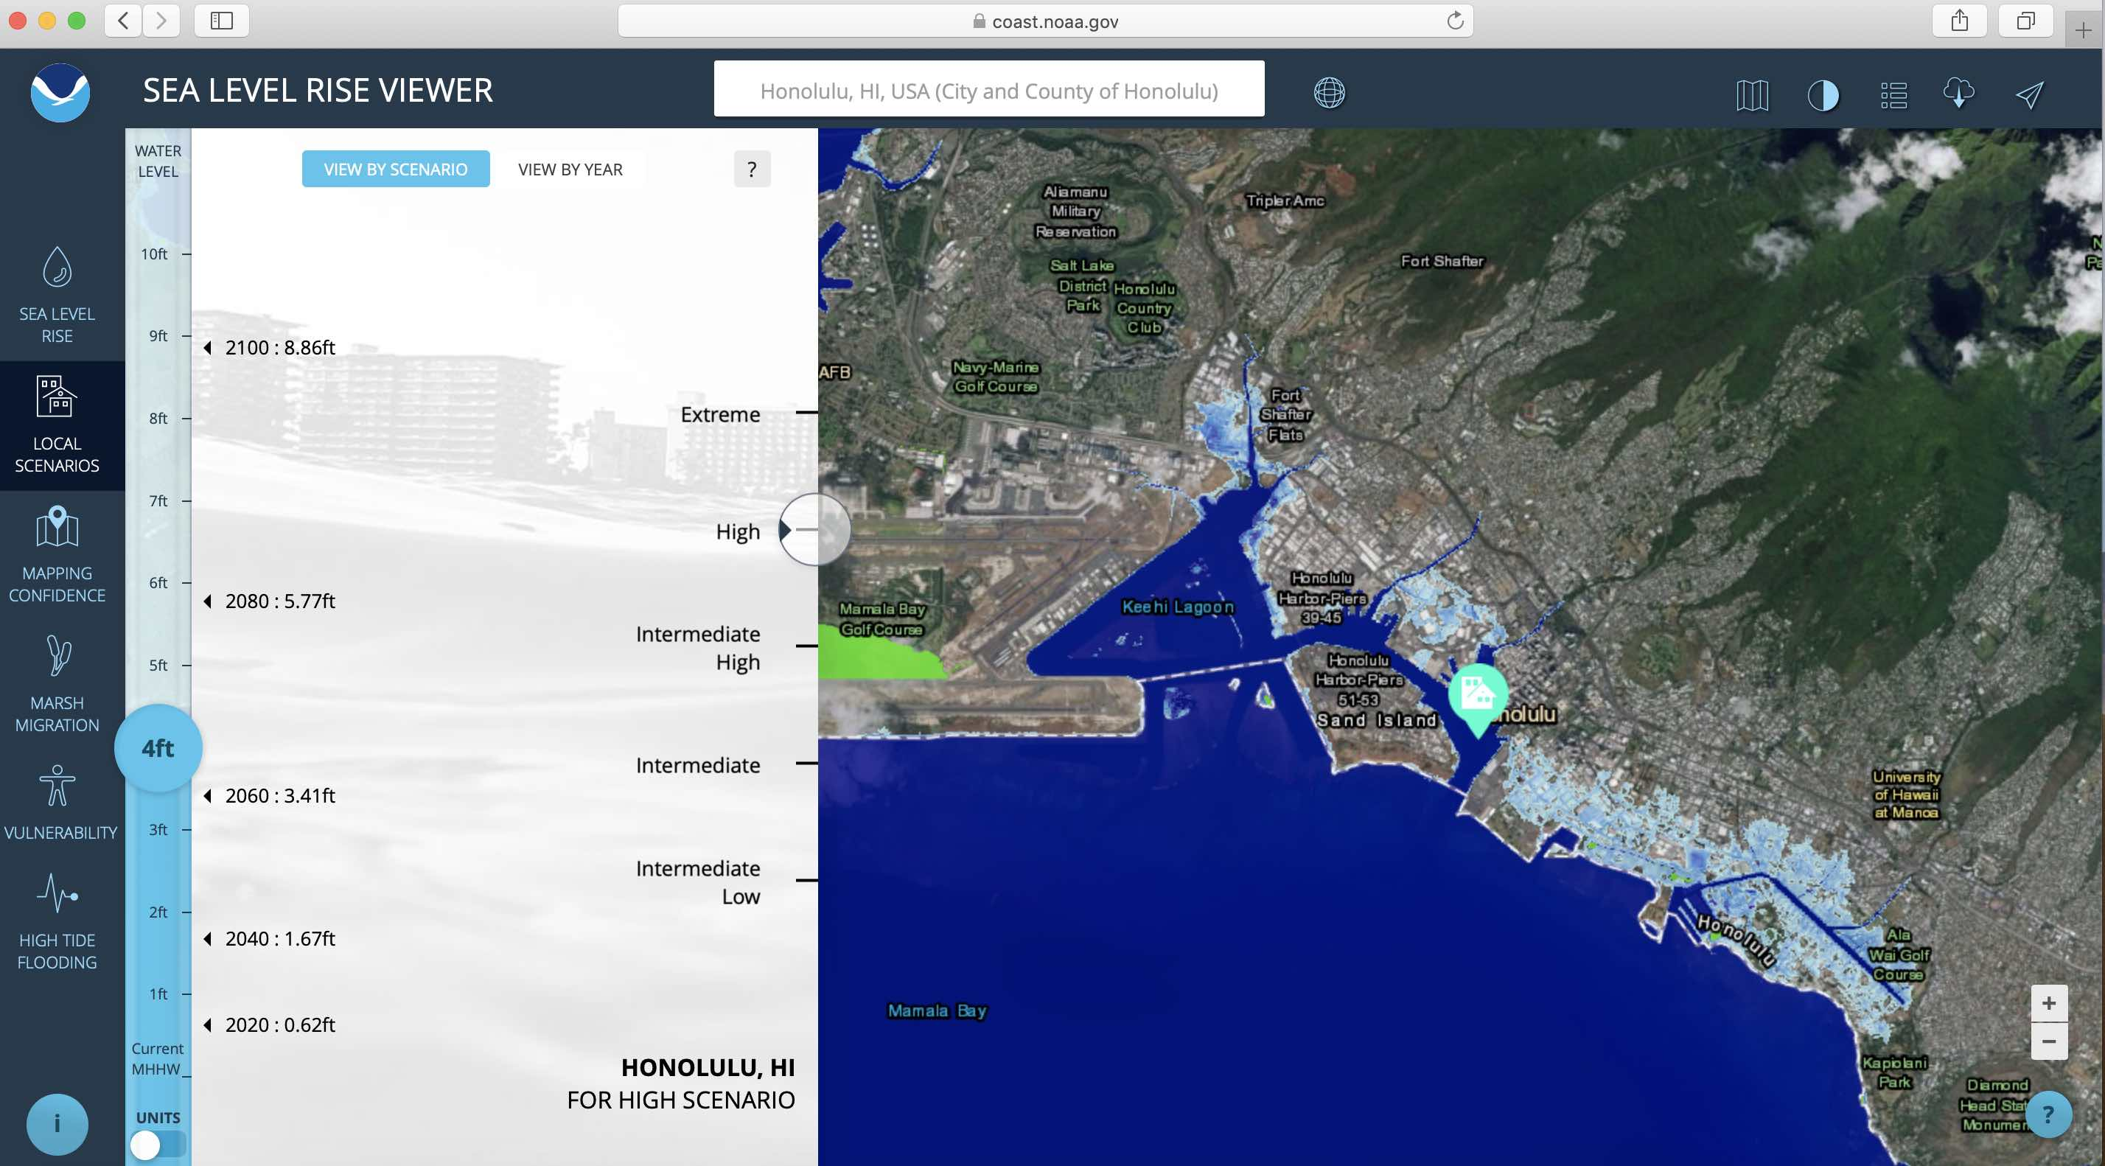
NOAA Sea Level Rise Viewer
2060

Slide 36
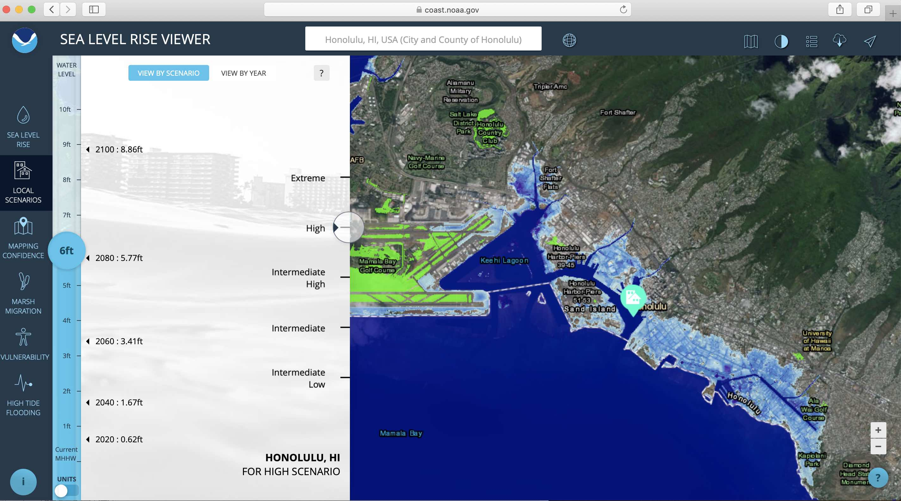
NOAA Sea Level Rise Viewer
2080

Slide 37
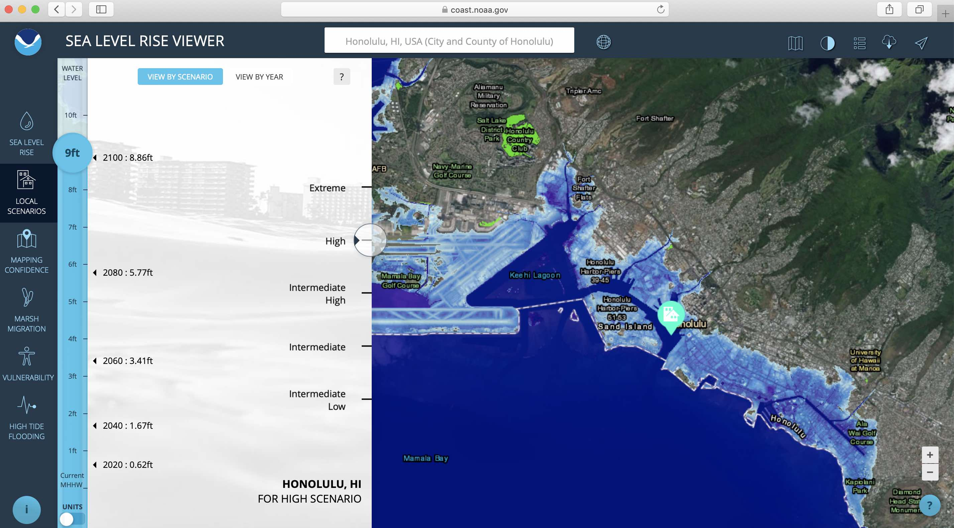
NOAA Sea Level Rise Viewer
2100

Slide 38
Positive Feedback Loop
Increasing CO₂
Sea Level Rise
Increasing Temperature
Melting Ice & Thermal Expansion

Slide 39
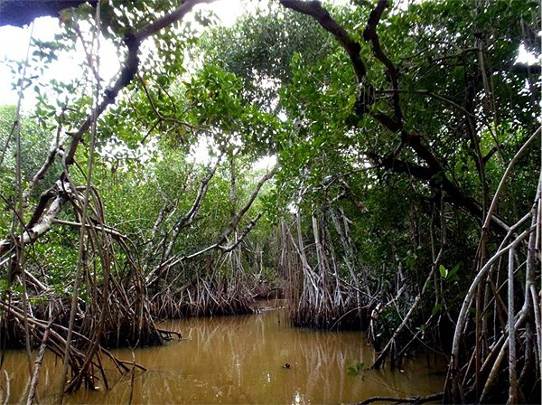
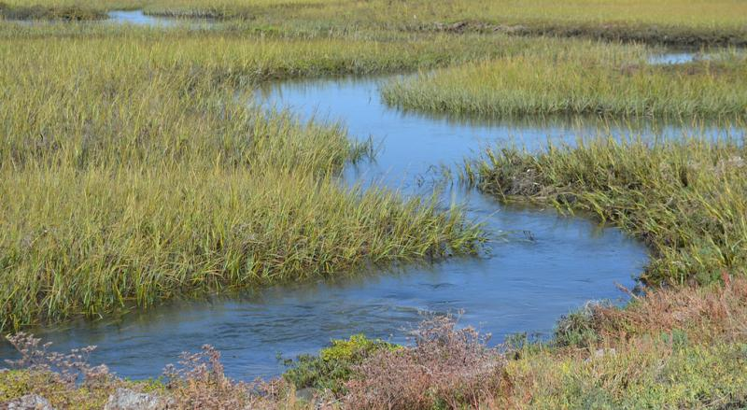
Coastal Wetlands
Tidal Marshes, Mangroves
Take up a large amount of carbon
Sea level rise
Take up more carbon per unit area than any natural system
Source: www.nps.gov/bicy/learn/nature/red-mangrove.htm
Source: toolkit.climate.gov/image/958

Slide 40

Positive Feedback Loop
Destabilizing
Destruction of Coastal Wetlands
Increasing CO₂
Sea Level Rise
Increasing Temperature
Melting Ice & Thermal Expansion

Slide 41
Carbon Dioxide and Global Warming
Phenomenon: carbon dioxide in the atmosphere is affecting temperatures on Earth, resulting in several positive feedback loops
Source: epa.gov/enforcement/national-compliance-initiative-
reducing-air-pollution-largest-sources
Source: climate.nasa.gov/climate_resources/4/graphic-dramatic-glacier-melt/
Notes:
NEED TO ADD NOTES

Slide 42
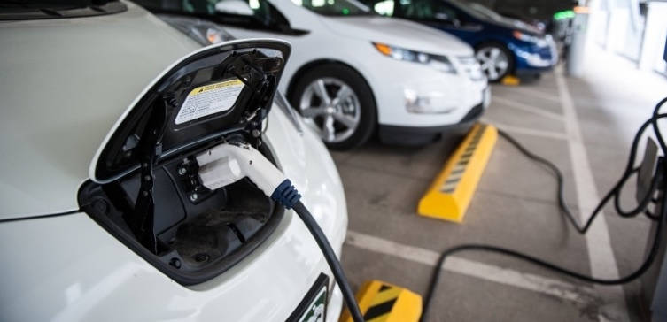
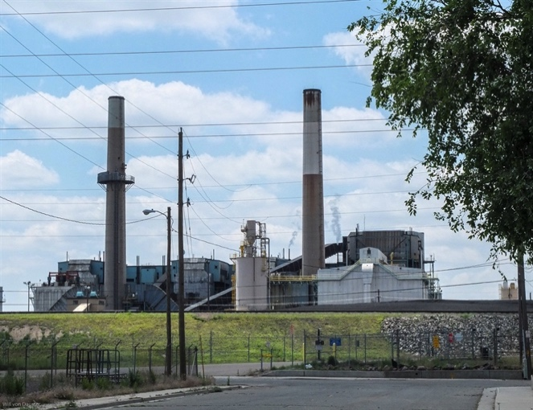
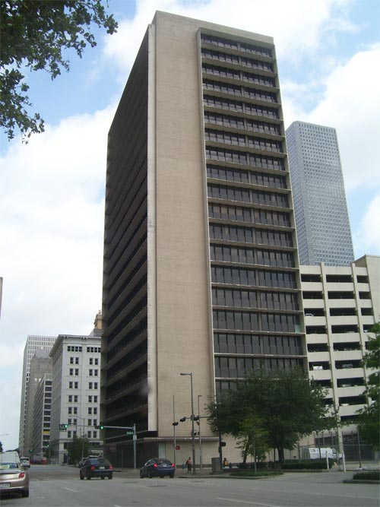
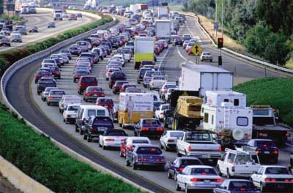
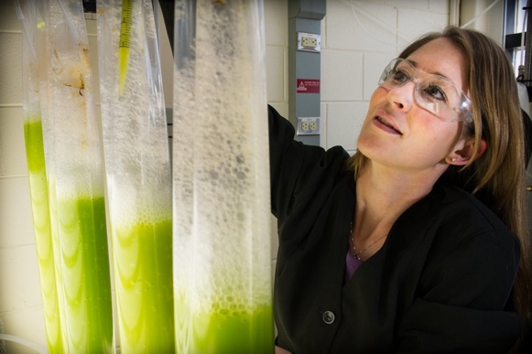
Mitigation = Solution
Photo Source: NOAA
(research.noaa.gov/article/ArtMID/587/ArticleID/1227/New-study-US-power-plant-emissions-down)
Electric Cars
Photo Source: Energy.gov
(energy.gov/eere/vehicles/batteries-charging-and-electric-vehicles)
More Efficient Power Plants
More Efficient Buildings
Drive Less
Biofuels
Photo Source: NPS
(nps.gov/nr/feature/places/14000627.htm)
Photo Source: FHWA
(fhwa.dot.gov/publications/publicroads/04nov/01.cfm)
Photo Source: Energy.gov
(energy.gov/eere/bioenergy/biofuels-basics)

