Slide 1
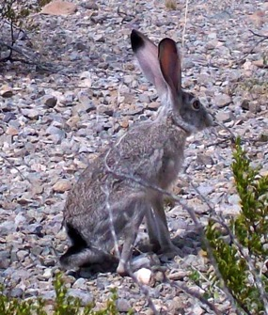
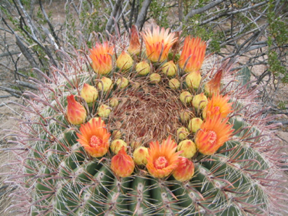
Adaptation
A behavior or structure that allows a plant or animal to better survive and reproduce in a particular environment

Slide 2
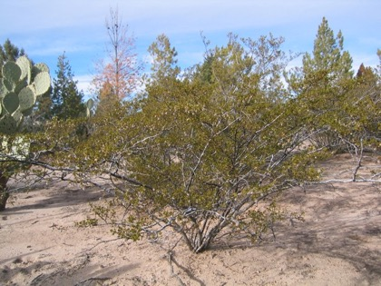
Creosote Bush
Long, spreading roots
Small leaves reduce the surface area exposed to the sun and wind
Waxy coating on leaves reduces water loss

Slide 3
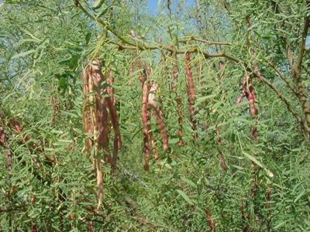
Honey Mesquite
Very deep roots can tap into longer-term water sources
Small leaves

Slide 4
Fishhook Barrel Cactus
Accordion pleating allows it to expand and store water when it is available

Slide 5
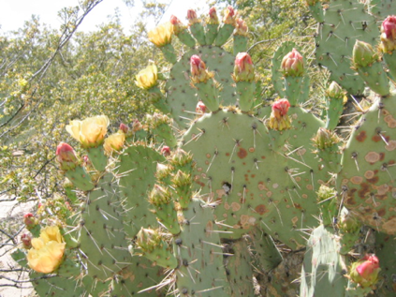
Prickly Pear Cactus
Waxy coating on pads

Slide 6
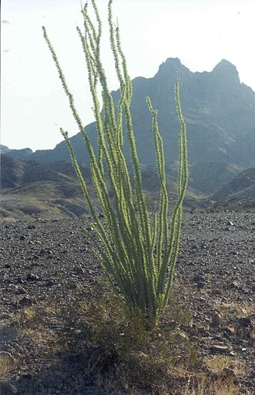
Ocotillo
Goes dormant when it is dry to conserve water
Small leaves

Slide 7
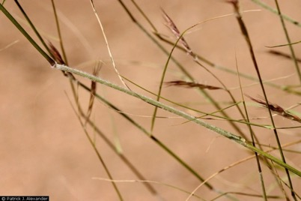
Black Grama Grass
Shallow and dense roots collect water quickly when it rains

Slide 8
Jackrabbit
Large ears provide a large surface area for dissipating heat to the environment
Rests in the shade of shrubs during the day

Slide 9
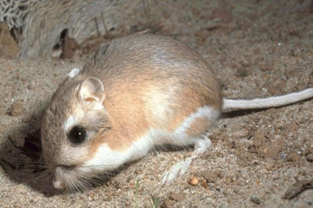
Kangaroo Rat
Nocturnal
Modified kidneys concentrate urine
Special nasal passages minimize water loss when they breathe

Slide 10
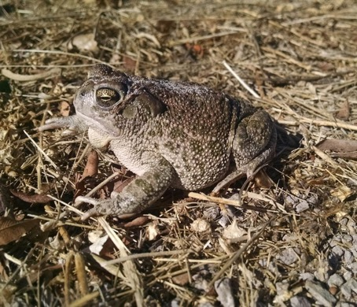
Spadefoot Toad
Lives underground in a state of dormancy until rain comes

Slide 11
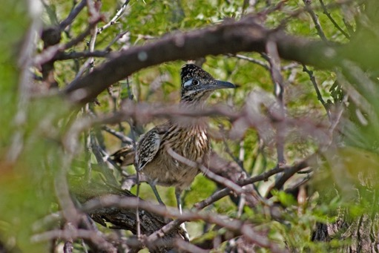
Roadrunner
Gets moisture from its prey - lizards, frogs, and snakes
Reduces its activity during the heat of the day

Slide 12
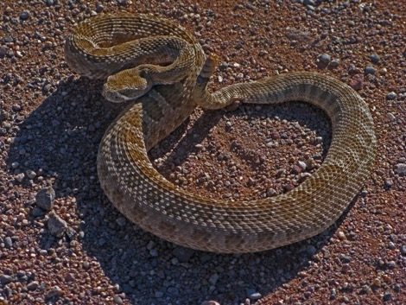
Western Diamondback Rattlesnake
Lives in abandoned burrows to take advantage of cooler temperatures inside

