Slide 1
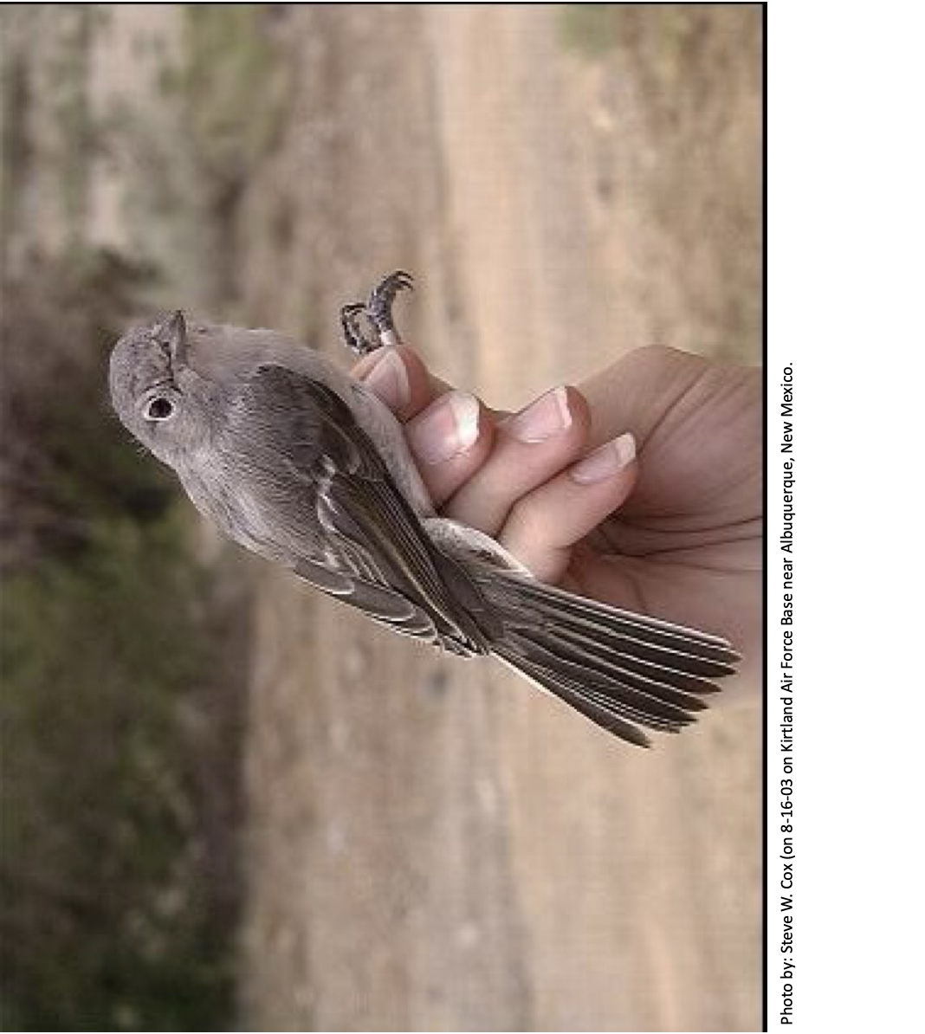
Gray Vireos
Using Science to Protect a Threatened Species
You will play the role of a New Mexico Department of Game & Fish scientist.
Your job is to conserve the Gray Vireo in New Mexico.

Slide 2
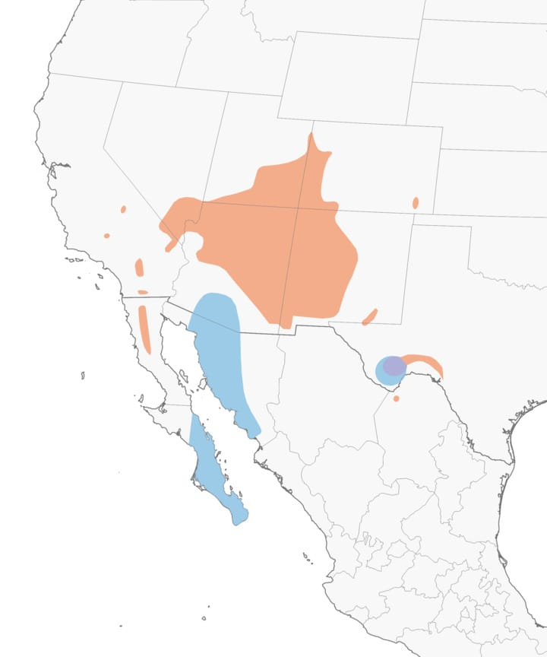
Gray Vireo
A Little Bird that Needs our Help
They migrate to New Mexico in the spring.
Gray Vireo song
recorded in desert foothills in southeast Arizona
Eric Hough, XC283679. Accessible at www.xeno-canto.org/283679.
Range map provided by Birds of the World (via Cornell Lab All About Birds website)

Slide 3
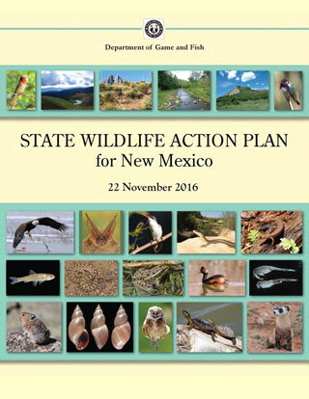
Conservation
Gray Vireos were listed as a threatened species in New Mexico in 1983. They may become endangered in the future.
The Department of Game and Fish develops recovery plans for threatened and endangered species.
There are four steps scientists use to protect species.
We will model these steps today!

Slide 4
Step 1: Count the Gray Vireos
To find out how many Gray Vireos are in a location, scientists conduct a count during the breeding season (usually May and June).
They create a transect line with stops every 200 meters.
At each stop:
Listen and look for Gray Vireos for 2 minutes.
Play the Gray Vireo call for 20 seconds.
Listen again for 2 minutes.
Play the call for 20 seconds.
Listen again for 2 minutes.
Then move to the next survey stop 200 meters away.

Slide 5
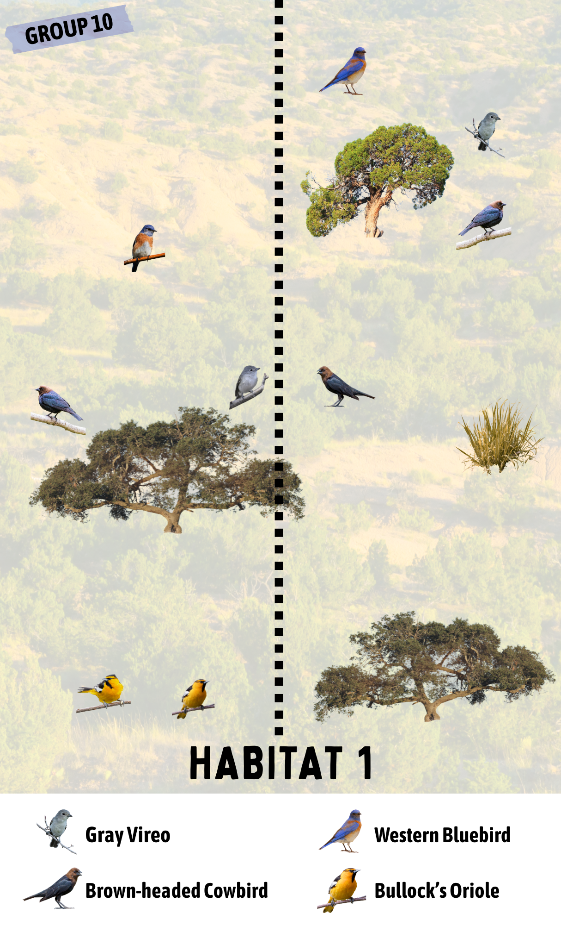
Let’s Model These Gray Vireo Counts!
10
1
You can only see or hear Gray Vireos under the straw.
Any bird not under the straw is too far away to hear or see.
Ready?

Slide 6
Now it’s your turn!
Step 1: Count the Gray Vireos
Count the Gray Vireos along the transect in both habitats.
Complete questions 1, 2, 3, and 4.
We will do the Class Data Table together.

Slide 7
Class Data Table
Why do you think there are more Gray Vireos in one of the habitats?
Let’s learn more about what scientists already know about the Gray Vireo.

Slide 8
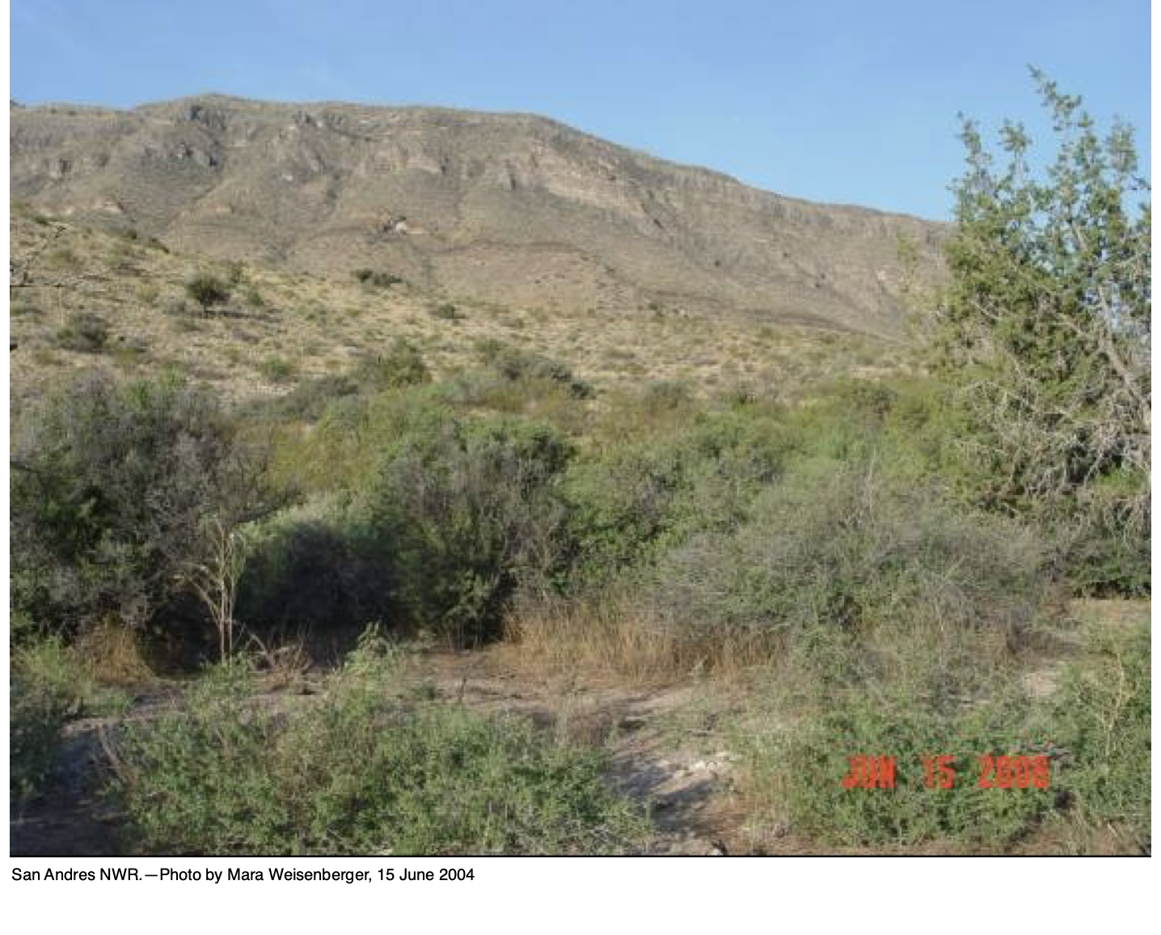
Step 2: Learn what scientists already know about Gray Vireos
Gray Vireos are found in woodlands with juniper trees and oak trees.

Slide 9
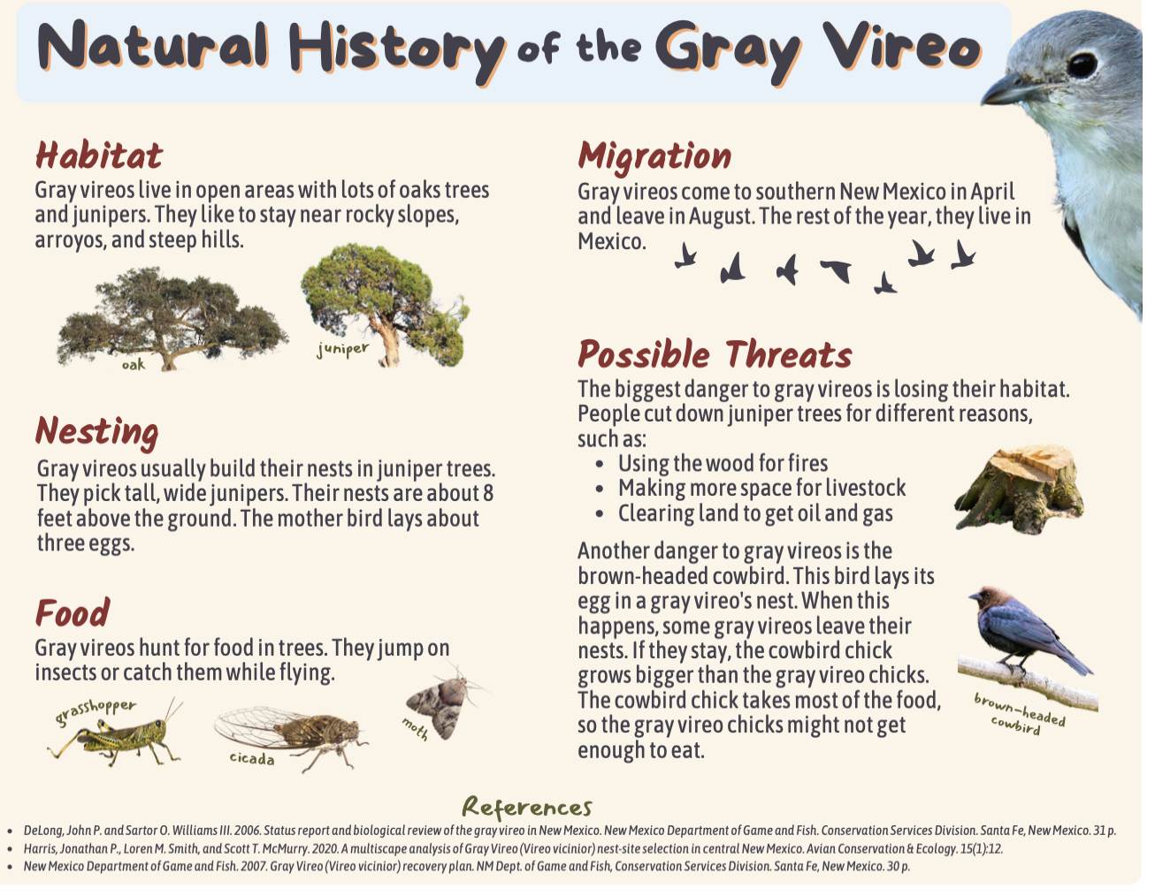
This shows what scientists have already learned about the Gray Vireo.
Use it to answer questions 5-8 on your worksheet.

Slide 10
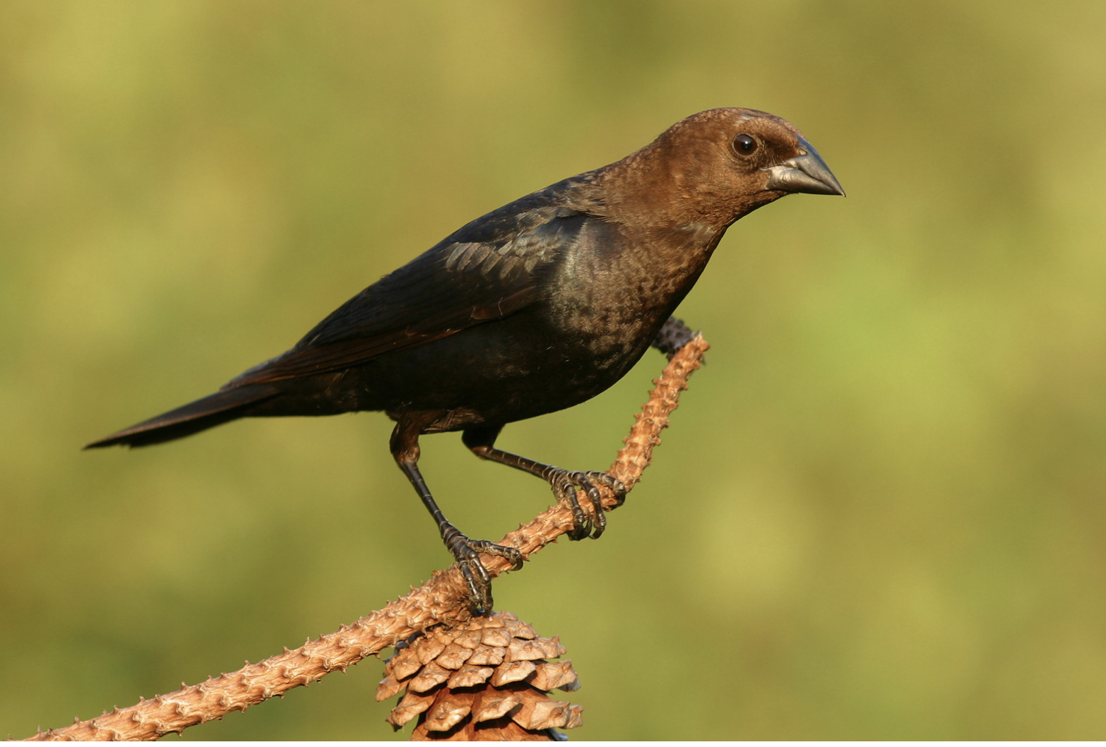
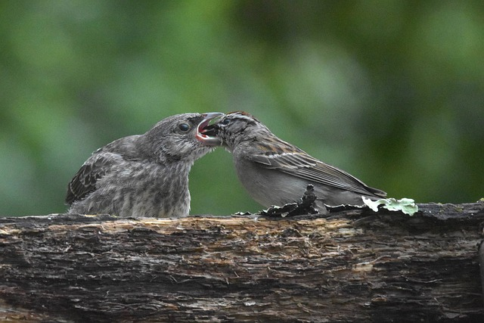
Cowbird Parasitism
Brown-headed Cowbirds are nest parasites.
They lay eggs in other birds’ nests.
The other birds feed and raise the cowbird chick!
Cowbird
chick

Slide 11
Step 3: Create a Recovery Plan
Now you are ready to create a Recovery Plan!
The goal is to make sure that Gray Vireos survive in New Mexico for a very long time.
There are many possible strategies.
But you don’t have the time or money to do them all! These are called constraints.
You need to choose strategies that you think will work best.

Slide 12
The Strategies
Bring some Gray Vireos to the Albuquerque Zoo and try to get them to reproduce.
Trap as many cowbirds as possible and bring them to the zoo to live the rest of their lives.
Do regular counts of the number of Gray Vireos throughout New Mexico.
Conduct more research on the behavior, habitat, and diet of the Gray Vireo.
Conduct more research on the threats to Gray Vireos (habitat loss, cowbirds).
Teach all New Mexico 3rd, 4th, and 5th grade students about Gray Vireos.
Require that Gray Vireo surveys are done before junipers are cut from public land.
Create a Gray Vireo Recovery Team to share information about Gray Vireos.
Give advice to land owners on how to improve their land to make more Gray Vireo habitat.
Create a plan to teach the public about Gray Vireo conservation.

Slide 13
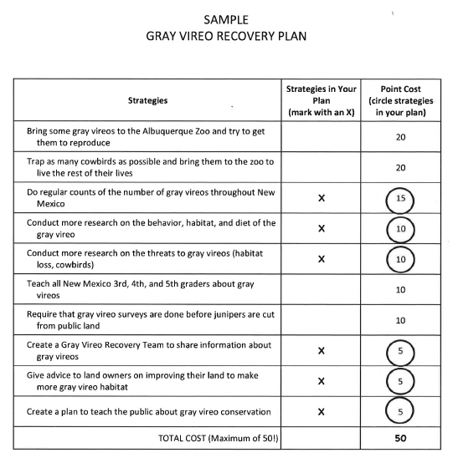
Your Turn!
Step 3: Create your recovery plan
Use the cards to plan which strategies will go in your recovery plan.
Each strategy costs a different number of points.
You can only use 50 points total.
Once you have chosen the strategies, fill out the table on your worksheet.

Slide 14
Step 4: Compare Your Plan with Others
Which strategies did your team choose?
Why?
Was it difficult to only have 50 points?

Slide 15
The sample is the plan developed by the
New Mexico Department of Game & Fish!
Compare your plan to this one.

Slide 16
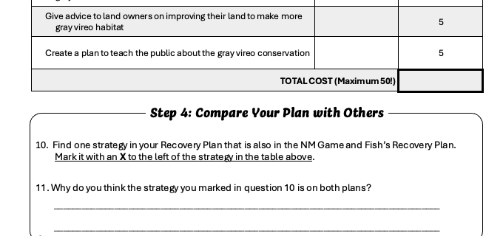
Step 4: Compare your plan with others
X
Follow directions on question 10.
Answer question 11.
Example

Slide 17
Choose one strategy in your plan and the
New Mexico Department of Game & Fish!
Answer questions 10 and 11 on your worksheet.

Slide 18
How Will We Know the Plan Worked?
Gray Vireos survive in New Mexico for a very long time.
Thank you,
young scientists!
Brought to you by
The Asombro Institute

