Slide 2
Patterns in Nature
Put your cards in order from first thing that happens to the last thing that happens.
…
1
2
3

Slide 3
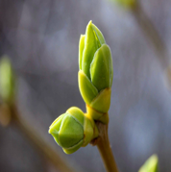
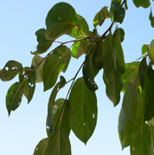
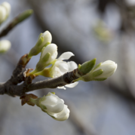
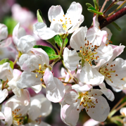
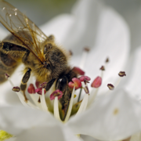
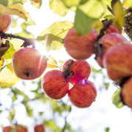
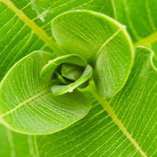
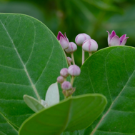
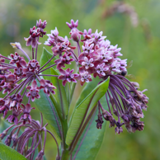
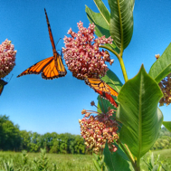
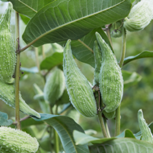
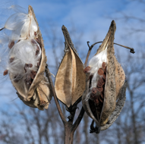
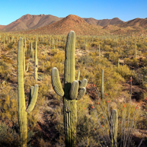
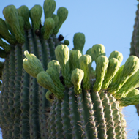
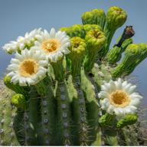
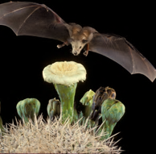
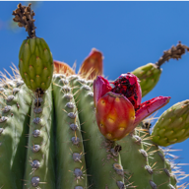
Patterns in Nature
Apple Tree
Milkweed
Saguaro Cactus

Slide 4
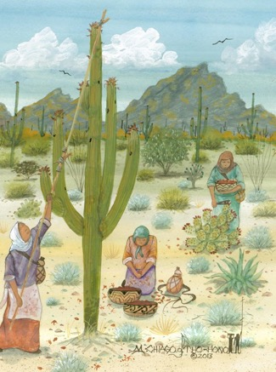
Patterns in Nature
Phenology: The study of seasonal patterns, events and cycles in nature
Life Cycles
Growth
Migration
Hibernation
People pay attention to phenology:
Farming/Harvesting
Hunting
Allergies
What phenological
changes do you notice
throughout the year?

Slide 5
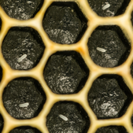
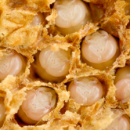
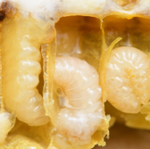
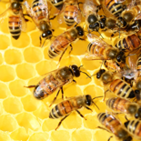
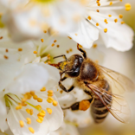
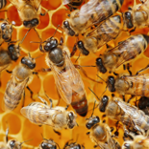
Timing is Important
Winter Spring Summer Fall
Early flowers → No pollination → Hungry bees
No apples

Slide 6
What controls timing?
Phenology is controlled by factors like temperature, precipitation, day length.
Climate change is changing patterns of some these things, which changes the timing of phenological events.

Slide 7
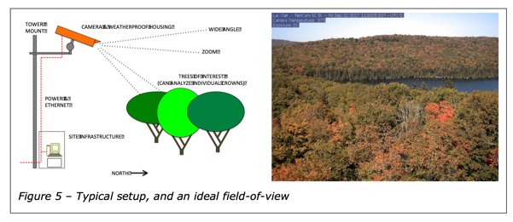
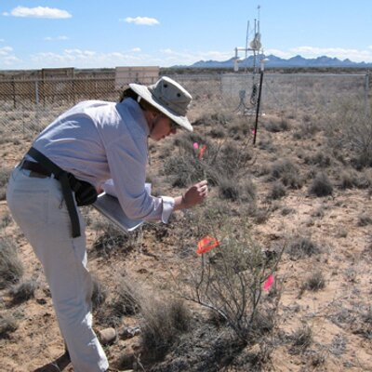
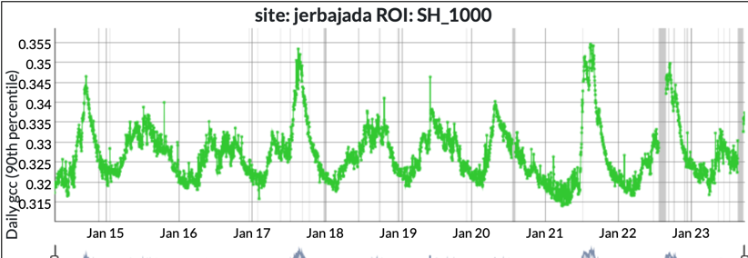
Monitoring Phenology
Plant phenology data comes from careful observations:
Scientists observing plants directly
Cameras taking pictures for computers to analyze.
Daily “Greenness”
Dawn Browning, scientist at USDA-ARS Jornada Experimental Range
Jan
2015
Jan
2016
Jan
2017
Jan
2018
Jan
2019
Jan
2020
Jan
2021
Jan
2022
Jan
2023

Slide 8
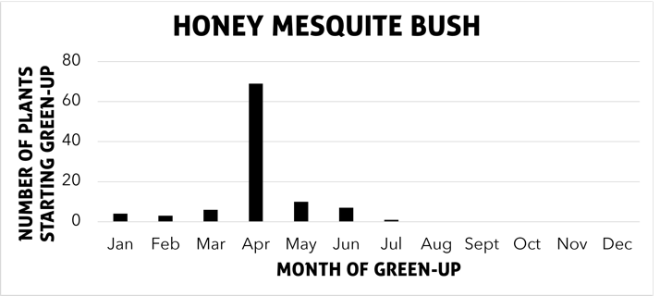
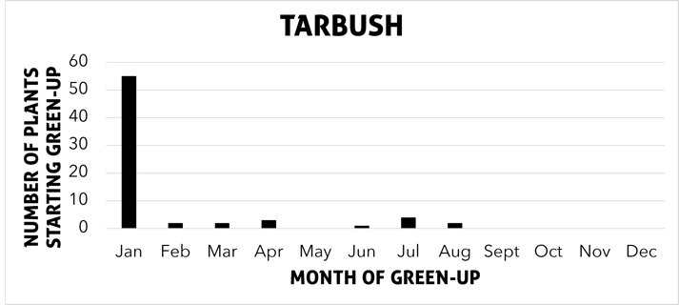
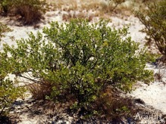
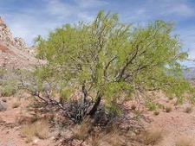
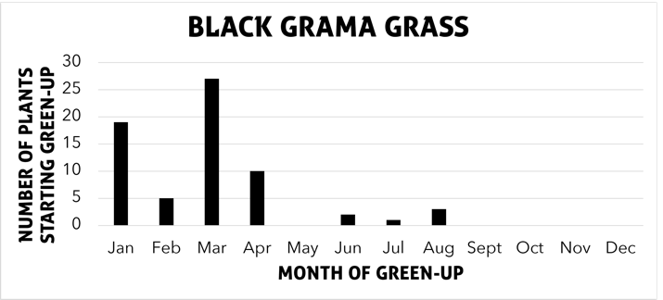
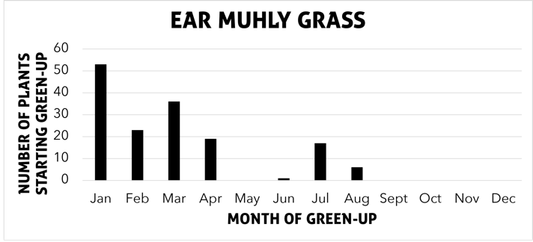
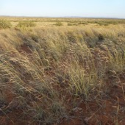
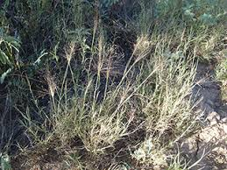
Describe the phenological pattern of each plant
Each year, scientists record when the plants first started to produce green leaves. The graphs show how many plants greened-up each month. The data comes from watching the same plants from 1993 to 2015.
Browning et. al, 2018.
Ecosphere

Slide 9
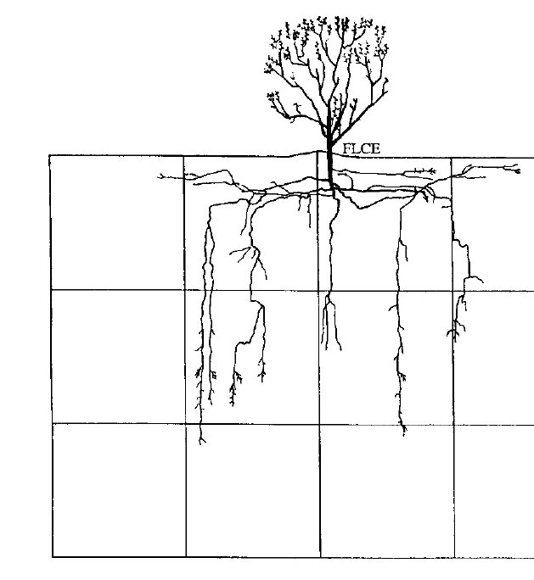
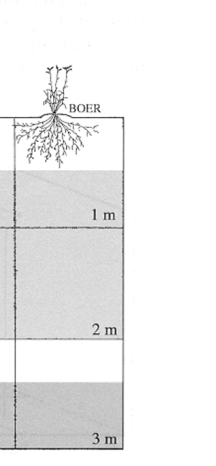
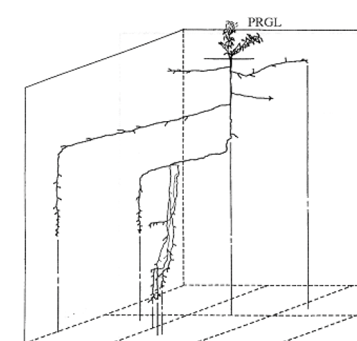
Plant Roots and Phenology
Black Grama Grass
Ear Muhly Grass
Honey Mesquite Bush
Tarbush
Hypothesis: Plant roots play a role in when they green up.
Adapted from Gibbens and Lenz, 2001. Journal of Arid Environments

Slide 10
Can we model the effects of root length on phenology?
Plant
Groundwater
Water stored more than 1m deep
Plant
roots
Time

Slide 11
How is plant root length related to green-up dates?
Use your straw to get water from the bottle (groundwater) to your cup (plant).
When you reach the black line on your cup, you have enough water to green up.
Note the number on the screen when you reach the line.
8

Slide 12
When will you green-up?
25
24
22
23
21
Ready?
Set
Go!
1
2
3
4
5
6
7
9
10
11
12
13
14
15
16
17
18
19
20

Slide 13
Graph the results of your game
?
?
When did long-rooted bushes green up?
When did short-rooted grasses green up?

Slide 14
Plant Roots and Phenology
Black Grama Grass
Ear Muhly Grass
Honey Mesquite Bush
Tarbush
Plants can access water that’s stored deeper underground all the time AND water in the top layer of soil after rain.
Adapted from Gibbens and Lenz, 2001. Journal of Arid Environments

Slide 15
In the future…
What will be the impact of climate change?
Climate change is changing:
When rain falls
How much rain falls
How much and how fast water evaporates
Answer question 5.

Slide 16
Round 2: Rain and Drought
25
24
22
23
21
Ready?
Set
Go!
1
2
3
4
5
6
7
9
10
11
12
13
14
15
16
17
18
19
20

Slide 17
Add your new results to the graph
?
?
When did long-rooted bushes green up?
When did short-rooted grasses green up?
Did drought and rain impact one group of plants more than the other?

