Slide 2
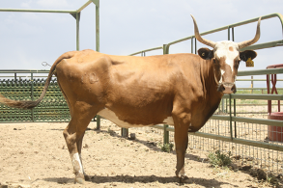
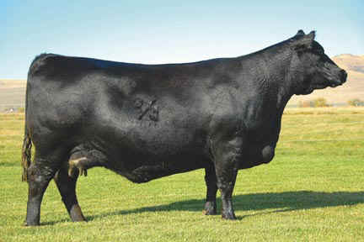
Compare and Contrast
Criollo
(pronounced krē-ō-yō)
Angus
Bos taurus
800 pounds
Bloodlines from Spain
Bos taurus
1,100 pounds
Bloodlines from Europe
Notes:
We will be playing a game related to cattle foraging patterns on the range. The two cattle breeds pictured will be involved in our game; they are called Criollo (pronounced krē-ō-yō) and Angus.
Examine these two photos and answer questions 1-3 on the Compare and Contrast handout. [Ask students to share their answers, and lead a discussion of the similarities and differences of the two breeds. Similarities may include: they are the same species (or both cattle) and they have all of the same main body parts. Differences may include: Criollo is much smaller/weighs much less, Criollo is skinnier/Angus is bulkier, Angus does not have horns, Criollo originated in Spain/Angus originated in Europe.]

Slide 3
Grazing Game: Assign Roles
5 Angus cows
5 Criollo cows
2-4 food distributors
1-2 location mappers
1-2 data collectors
Note: There are more roles available later for scenario 2.
Notes:
We will play a game in which you will play the roles of two different types of cattle. We will start by assigning roles, and then we will talk about how to play the game [assign students to roles].
Five students – Angus for scenario 1
Five students – Criollo for scenario 1
Up to four students - Food distributors
One or two students – Location mappers
One or two students – Data collectors

Slide 4
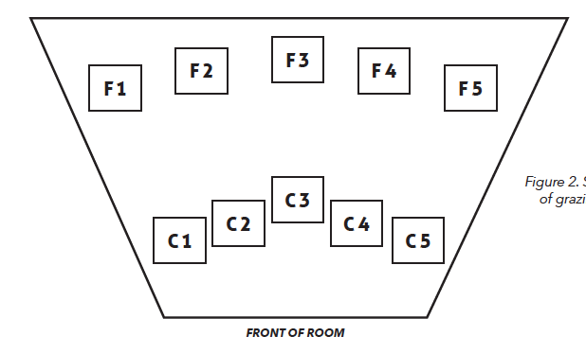
Grazing Game – The Set Up
10 grazing sites
  5 close to water (C)
  5 far from water (F)
Scenario 1 (Abundant Food)
  50 food resources randomly divided among 5 close grazing sites
  50 food resources randomly divided among 5 far grazing sites
Notes:
In this first part of the game, five students will play the role of Angus cows grazing on a rangeland. There are 10 grazing sites total: five grazing sites close to the water station, near the front of the room, and five grazing sites far from the water station. The food resources in the game are represented by pennies. The five close grazing sites have a total of 50 food resources (pennies) divided randomly between feeding sites. The five far grazing sites also have 50 food resources divided randomly between feeding sites.

Slide 5
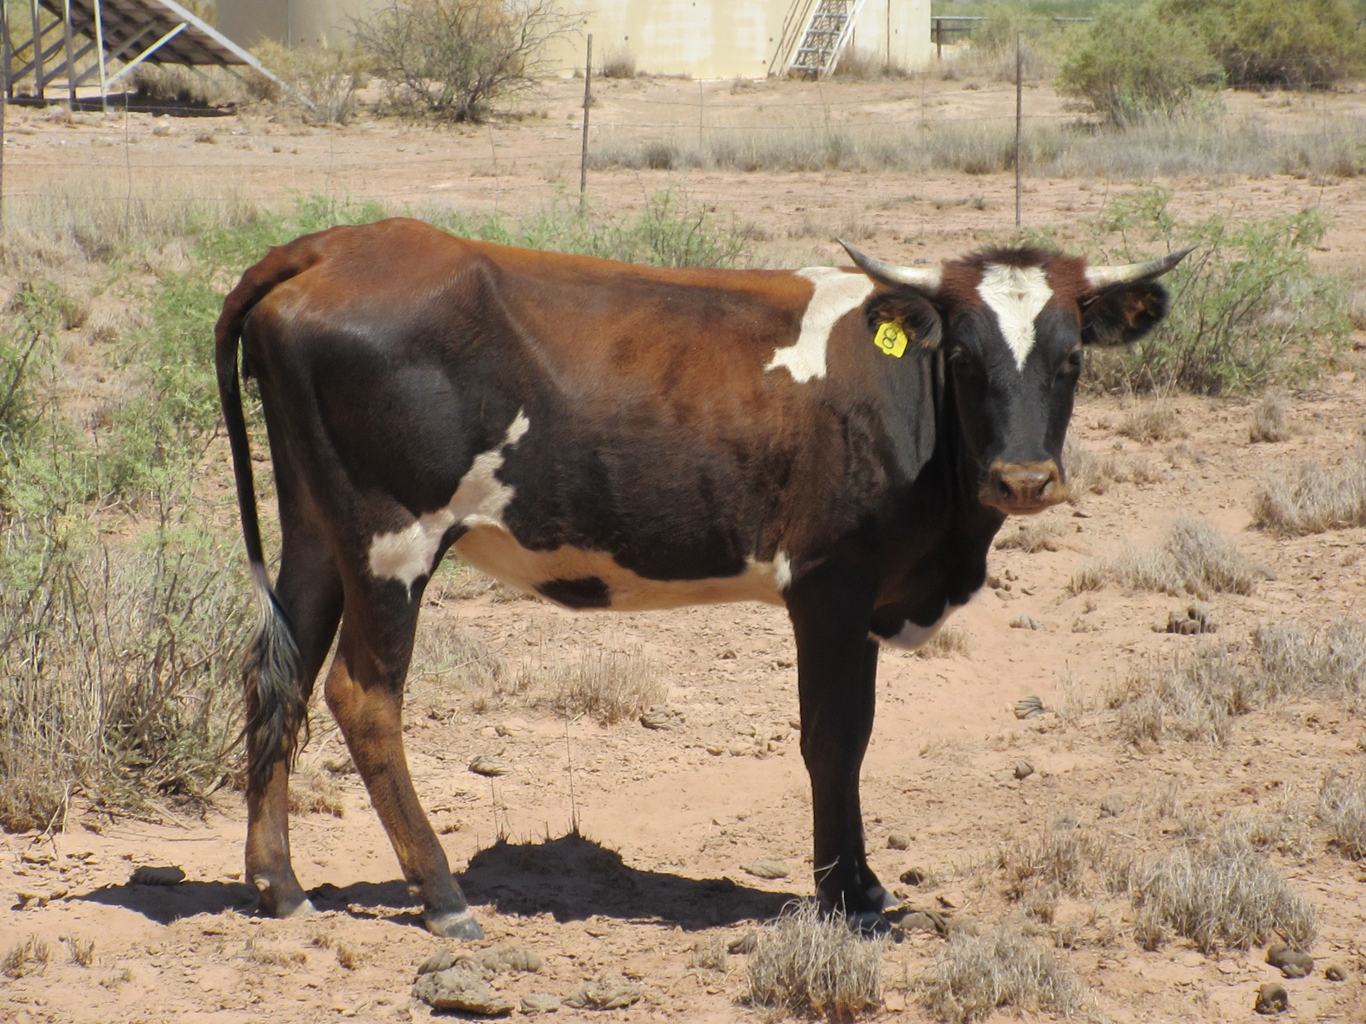
Grazing Game –
Angus vs. Criollo
First Trial
Angus
Criollo
  - Reliant on nearby water
  - Can ONLY graze at close grazing sites
  - Less reliant on nearby water
  - Can graze at close and far grazing sites
Notes:
Angus are reliant on nearby water, so for the purposes of our game, they are unable to travel to the far grazing sites to collect food. They can only travel to the close grazing sites in our game because research shows that they prefer to stay close to water. The first trial of the game will focus on Angus. The second trial will involve Criollo, which are less reliant on water and can graze at both close and far grazing sites.

Slide 6
Grazing Game – Procedures
Part 1
  In each of six rounds:
  1) Cows move to a grazing site (not a race!)
  2) Collect the proper number of food resources for that site
  THREE for close grazing sites
  TWO for far grazing sites (there is a cost of energy to travel to the farther sites)
  3) More than one cow can go to a grazing site at the same time, but they must take turns getting food resources one at a time.
Notes:
There will be six rounds in the Angus trial. It is not a race; each cow will have time to graze at the grazing site s/he visits. In each round, cows move to a grazing site and collect the appropriate number of food resources for that location. Cows at CLOSE grazing sites can get a maximum of THREE food resources per round. More than one cow is allowed to visit a grazing site during a round. If there are two or more cows at a site, they must take turns getting food resources, up to the maximum allowed at that site (three or two). We will note the number of Angus cows that do not collect at least 10 food resources at the end of the trial. Cows that do not collect at least 10 food resources will have to be supplemented with additional hay and cottonseed cakes, which results in increased expenses for the rancher.

Slide 7
Grazing Game – Procedures
Part 2
  4) If there are no resources at the site, wait patiently for the next round.
  5) After collecting resources, place a dot on the map section next to that grazing site.
  Blue = Angus Green = Criollo
  6) Each cow must move to a different grazing site each round (they may return after they have left for at least one round).
  7) After 6 rounds, we will count number of resources per cow to see how each cow and the whole herd has done.
Notes:
If there are no more food resources at a grazing site, the cow must wait patiently until it is time to switch to a new grazing site. After the cow has collected food resources, s/he will mark a dot on the paper near the grazing site showing they were there. Angus cows will use blue markers, and Criollo will use green markers. Cows must move to a different grazing site each round, but they may return to a grazing site once they have left it for at least one round. We will conduct a total of six rounds. At the end of all six rounds, each cow will count the number of resources s/he was able to collect. We will examine how the herd did as well as how each cow did throughout the grazing cycle.

Slide 8
Grazing Game –
Angus vs. Criollo
Second Trial
Angus
Criollo
  - Reliant on nearby water
  - Can ONLY graze at close grazing sites
  - Less reliant on nearby water
  - Can graze at close and far grazing sites
Notes:
In the second part of the game, five students will play the role of Criollo cows grazing on a rangeland. Criollo are able to travel further from water, so they can go to either the close grazing sites or the far grazing sites. Remember, there is a cost of both time and energy for a cow to move to far grazing sites, so cows at FAR grazing sites can get a maximum of TWO food resources per round. The five close grazing sites have a total of 50 food resources (pennies) divided randomly between feeding sites. The five far grazing sites have a total of 50 food resources divided randomly between feeding sites. We will note the number of Criollo cows that do not collect at least 7 food resources at the end of the trial. Criollo cattle are smaller than Angus and need fewer food resources to fuel their lighter bodies. Cows that do not collect at least 7 food resources will have to be supplemented with additional hay and cottonseed cakes, which results in increased expenses for the rancher. The rest of the rules from the Angus trial also apply to the Criollo trial.

Slide 9
Make Predictions
Scenario 1 (abundant food)
Angus
Criollo
Notes:
Fill out the predictions box at the top of page 1 of the Get Out and Graze handout. Predict which cattle breed will need more supplemental feed because they will not collect enough food resources during the game, and then predict which breed will consume a greater percentage of the total resources available.

Slide 10
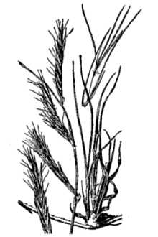
Let’s Graze!
Scenario 1 - Angus
Can only travel to close grazing sites
Notes:
Using the rules and procedures explained before, the five Angus cows will now play the game. Remember that Angus cows are reliant on nearby water, so for the purposes of our game, they are unable to travel to the far grazing sites to collect food. In our game, they can only travel to the close grazing sites because research shows that they prefer to stay close to water.

Slide 11
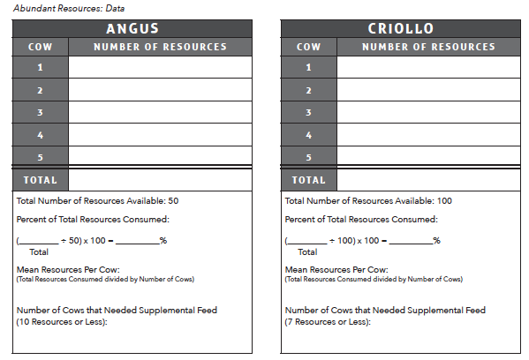
Fill in Angus Data Table
Notes:
As the data collector(s) fill in the table on the board, you will fill in the Angus portion of the Abundant Resources data table on page 1 of the handout.

Slide 12
Let’s Graze!
Scenario 1 - Criollo
Can travel to close and far grazing sites
Can collect:
  3 per close site
  2 per far site (energy cost to travel)
Notes:
Using the rules and procedures explained before, the five Criollo cows will now play the game. Remember that Criollo are more likely to travel further from water, so they can go to either the close grazing sites or the far grazing sites. They may collect TWO food resources from far grazing sites and THREE food resources from close grazing sites.

Slide 13
Fill in Criollo Data Table
Notes:
As the data collector(s) fill in the table on the board, you will fill in the Criollo portion of the Abundant Resources data table on page 1 of the handout

Slide 14
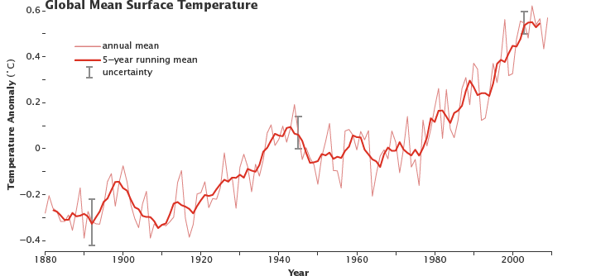
Global Warming
Recorded Data Since 1880
Source: earthobservatory.nasa.gov/Features/GlobalWarming/page2.phpv
Notes:
In Scenario 2, average global surface temperatures continue to increase. Because Earth is warming, climate change is expected to increase the length and severity of drought in many rangelands in the semiarid western United States. Drought and increased evaporation will result in reduced water for plants. Therefore, our cows in Scenario 2 will encounter fewer and smaller grasses.

Slide 15
Make Predictions
Scenario 2 (fewer resources due to drought and increased temperature)
* Half as many resources as in Scenario 1 (25 in close and 25 in far)
Angus
Criollo
Notes:
Fill out the predictions box at the top of page 2 of the Get Out and Graze handout. Under limited resources conditions (half as many resources as Scenario 1), predict which cattle breed will need more supplemental feed because they will not collect enough food resources during the game, and then predict which breed will consume a greater percentage of the resources available.

Slide 16
Grazing Game: Assign Roles
Scenario 2
Limited Resources
5 Angus cows
5 Criollo cows
Notes:
We will assign new students to the roles of the two types of cattle so that as many people as possible get to participate [assign students to roles].
Five students – Angus for scenario 2
Five students – Criollo for scenario 2

Slide 17
Let’s Graze!
Scenario 2 - Angus
Can only travel to close grazing sites
Notes:
The Angus trial and the Criollo trial are played using the same rules as in Scenario 1 except that in these trials there are only 25 food resources scattered among the close grazing sites and 25 food resources scattered among the far grazing sites. Angus may still travel only to the close grazing sites while Criollo may travel to either the close or the far grazing sites. A cow may only collect THREE food resources at the close grazing sites and TWO at the far grazing sites.

Slide 18
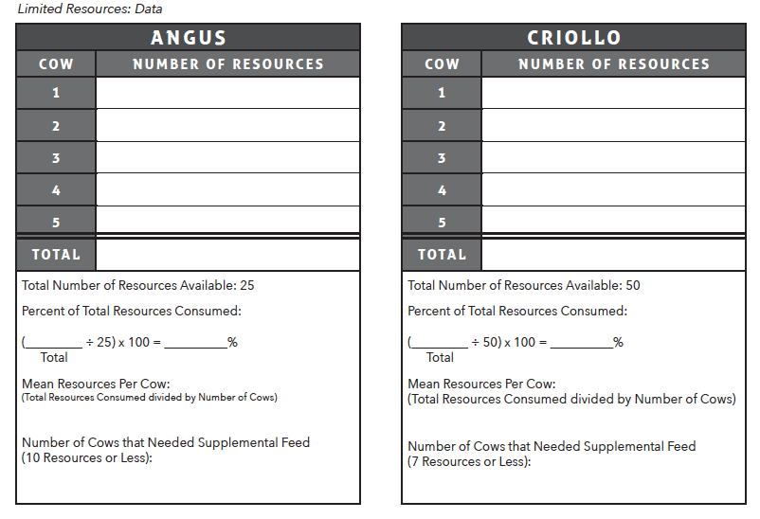
Fill in Angus Data Table
Notes:
As the data collector(s) fill in the table on the board, you will fill in the Angus portion of the Limited Resources data table on page 2 of the handout.

Slide 19
Let’s Graze!
Scenario 2 - Criollo
Can travel to close and far grazing sites
Can collect:
  3 per close site
  2 per far site (energy cost to travel)
Notes:
Using the rules and procedures explained before, the five Criollo cows will now play the game. Remember that Criollo will travel further from water, so they can go to either the close grazing sites or the far grazing sites. They may collect TWO food resources from far grazing sites and THREE food resources from close grazing sites.

Slide 20
Fill in Criollo Data Table
Notes:
As the data collector(s) fill in the table on the board, you will fill in the Criollo portion of the Limited Resources data table on page 2 of the handout.

Slide 21
Mapping Our Results
F1
F2
F3
F4
F5
C1
C2
C3
C4
C5
Notes:
The location mapper(s) will collect all 10 of the location map strips and put them in the correct order as shown here.

Slide 22
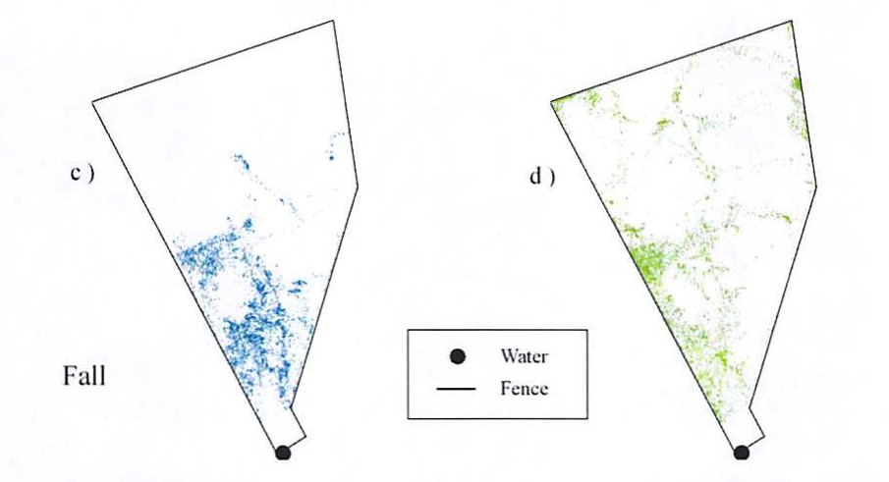
Map of Live Cow Movements
Angus
Criollo
Source: Peinetti, H. Raul; Fredrickson, Ed L.; Peters, Debra P.C.; Cibils, A.F.; Roacho-Estrada, J. Octavio; and Laliberte, Andrea S. 2011. Foraging behavior of heritage versus recently introduced herbivores on desert landscapes of the American Southwest. Ecosphere 2(5): 1-14.
Notes:
This figure is from a research paper. The researchers conducted a study on the movement of Angus and Criollo cows in relation to a water source, and the movement of cows is shown on these maps. Angus cows are represented by blue, and Criollo cows are represented by green. The dot at the bottom of the map shows the location of the water source. Did Angus cows tend to get as far away from the water source as Criollo? [Answer: no, because there are green marks that are further away from the water source in the map on the right. Remember, Criollo are well adapted for dry landscapes and are able to move further away from water to take advantage of food resources in more remote locations.]

