Slide 1
Notes:
We are going to play a game that will introduce the effects of climate change on agriculture and why it is important to understand these effects.

Slide 2
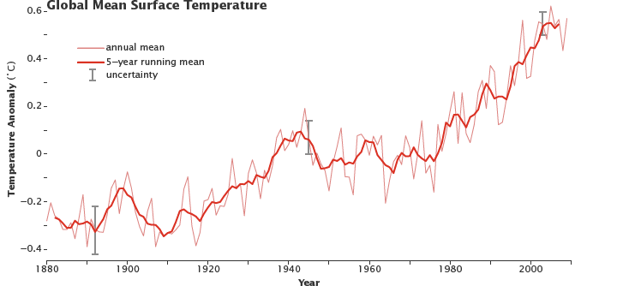
Global Warming vs Climate Change
Global Warming: increase in Earth’s average temperature
Climate Change: long term-change in Earth’s climate or the climate of a region
  Warming AND changes besides temperature (precipitation)
Source: earthobservatory.nasa.gov/Features/GlobalWarming/page2.phpv
Notes:
Global warming is the increase in Earth’s average temperature. Climate change is the long-term change in Earth’s climate or the climate of a region. Climate change encompasses global warming because it includes temperature changes, but it also incudes other long-term atmospheric conditions such as precipitation changes. What is the trend of this graph? [Answer: Earth’s average surface temperature has been increasing since 1880.]

Slide 3
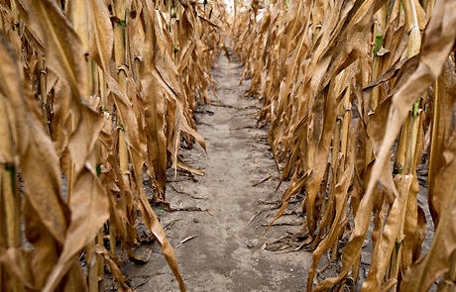
Climate Change & the Southwest
Longer and hotter heat waves
More severe and sustained droughts
Frequency and intensity of extreme precipitation likely to increase
Insect and pest outbreaks
Wildfires
Source: texasagriculture.gov/portals/0/forms/ER/dry%20corn.jpg
Notes:
Many climate change models predict more extreme weather events. Some models might predict that an area will receive more rainfall in the future, but this often translates into fewer, larger rainfall events with longer periods without rainfall in between. In the Southwest, researchers predict: more heat waves, longer and more severe droughts, more extreme precipitation events, insect and pest outbreaks, and more wildfires. All of these issues will degrade soil quality and negatively affect crop production.

Slide 4
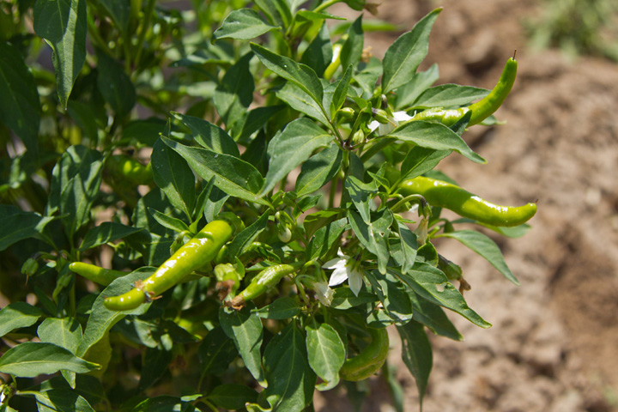
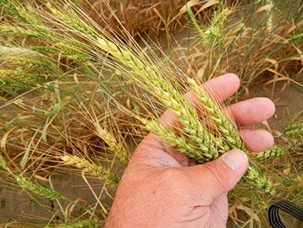
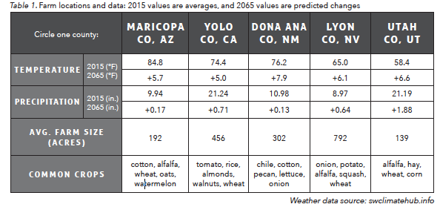
Farms on the Table
You are a farmer
Goal: stay in the black
Circle one of the counties in Table 1
Source: www.climate.gov/sites/default/files/Chili_720.jpg
Source: wbc.agr.mt.gov/portals/149/Images/Homepage/itk_farmer_358x270.jpg
Notes:
In this game, you will play the role of a farmer dealing with the effects of climate change on your farm. You will make decisions about how your farm will be managed on a year-to-year basis with the goal of staying in the black. In finance, staying in the black means that you are making money, and being in the red means that you are losing money.
-Each farm will start off with an output rating of 100. During the course of the game, if you stay at ≥100 you are in the black; if you drop to ≤99 you are now considered to be in the red. The goal of the game is to make choices that will help you stay in the black or help you get back to black.
-Look at page 1 of the handout. Choose one of the counties listed in table 1, and circle it. Most students like to choose the county that is closest to their location. This is the location of your new farm.
-The first thing you will do is customize your farm by choosing climate-mitigating adaptations. You will be able to choose to take as many, or as few, of these actions as you would like on your farm. In this case, a mitigating adaptation is something you can do that will help to lessen the impacts that your farm will experience from climate change and also to reduce the impacts that your farm has on the environment.

Slide 5
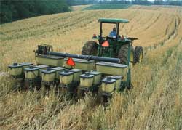
No-till Planting
A type of planting where the seeds are inserted directly into the soil, instead of turning the soil over before inserting the seeds into the soil
Pros:
  Lower labor, equipment, and fuel costs
  Reduces water runoff from precipitation and irrigation
  Limits wind erosion and compaction, and increases organic material
Cons:
  High upfront equipment costs
  May require more herbicide and fungicide
Source: www.nrcs.usda.gov/wps/portal/nrcs/detail/in/programs/?cid=nrcs144p2_027311
Notes:
The first option is no-till planting. It is a type of planting where the seeds are inserted directly into the soil, instead of the traditional planting style of turning over the soil before inserting the seeds. This style of planting can be advantageous because it has lower labor, equipment, and fuel costs. A tractor only has to go over a field once to plant the seeds (versus multiple times with traditional planting). It also reduces water runoff from precipitation and irrigation because it slows down the water, allowing it to soak into the ground. This decreases the likelihood of chemical crop treatments contaminating groundwater and streams as well. This method promotes healthier soil by limiting wind erosion of soil, increasing the organic matter layer in the soil, and limiting soil compaction. The biggest drawbacks to this method are the high upfront equipment costs and that it may require the use of herbicides and fungicides due to higher soil moisture.

Slide 6
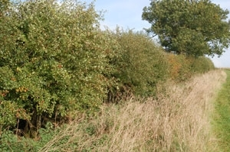
Hedgerows
A row of wild shrubs and trees bordering a road or field
Pros:
  Helps prevent some wind and water erosion of the soil
  Can help prevent the spread of insect and fungal diseases
  Can create pollinator habitat
Cons:
  Fewer rows for crops
  Needs watering and maintenance
Source: nrcs.usda.gov/wps/portal/nrcs/detail/il/newsroom/factsheets/?cid=stelprdb1265079
Notes:
Hedgerows are rows of wild shrubs bordering a road or field. Hedgerows create a barrier around the field, helping with the effects of wind and water erosion. They create not only pollinator habitat but also predator habitat (for example, birds and lizards), which will help prevent some of the spread of insect and fungal diseases. The major drawback to this action is that the hedgerows will require some year round watering and maintenance and reduce space for planting crops.

Slide 7
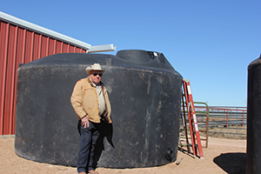
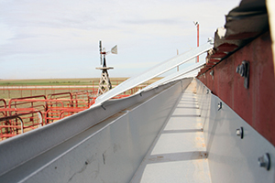
Water Collection and Storage Unit
Collects rainfall from roofs or runoff from fields to be used for irrigation
Pros:
  Water source available during droughts
Cons:
  Can take a few years to gather enough water to help mitigate effects
  Requires space
Source: nrcs.usda.gov/wps/portal/nrcs/detail/tx/newsroom/stories/?cid=nrcseprd882030
Notes:
Water collection and storage units collect rainfall from roofs or runoff from fields to be used at a later date for irrigation of crops. By collecting this water, a farmer will have a water source available during droughts for irrigation purposes. Installation can be expensive and water storage units can take up a large amount of space. It can take a few years to gather enough water to help mitigate the effects of a serious drought, but once the water is collected, it will be available for use.

Slide 8
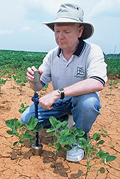
Soil Moisture Monitoring
Pros:
  Helps farmers know the best time to irrigate crops, saving on water cost
  Inexpensive equipment
Cons:
  Biggest expense is labor
Source: agresearchmag.ars.usda.gov/2013/aug/soil
Notes:
Monitoring soil moisture in a field can help a farmer determine the best time to irrigate crops, thus allowing them to eliminate unnecessary watering. The equipment can range from relatively inexpensive to very expensive. The cost of equipment is related to the amount of labor that is needed. Less expensive equipment tends to require more labor.

Slide 9
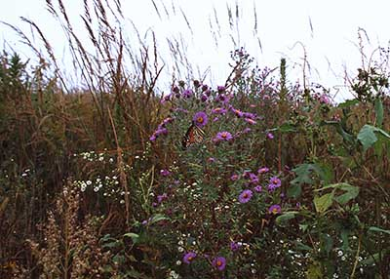
Beehives and Flower Strips
Pros:
  Reliable pollination of crops
  Can provide habitat for native pollinators other than bees
Cons:
  Cannot use insecticides due on harm inflicted to colonies
Source: http://www.nrcs.usda.gov/wps/portal/nrcs/detail/il/newsroom/factsheets/?cid=stelprdb1265079
Notes:
Many species of bees are declining because of loss of habitat, increased temperatures, changes in growing seasons, and insecticide use. Farmers rely on bees to pollinate their crops, and without them, many crops would not be able to fruit. If you choose to have beehives and plant flower strips among your crops, you help to ensure that you have reliable pollination of your crops by bees and other pollinators. The major drawback to this action is that you will not be able to use insecticides on your crops due to the harm they inflict on bee colonies.

Slide 10
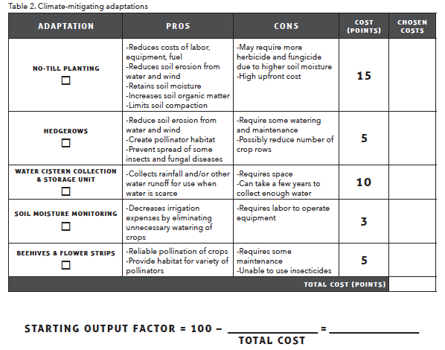
Customize your farm!
1. Add up all chosen adaptations and record in the “Total Cost” blank.
2. Then calculate the “Starting Output Factor“
Notes:
Take a moment to decide what adaptations you would like to implement on your farm. You may choose as many adaptations as you would like. There is a cost associated with each, but they may save you money in the long term, depending on the weather conditions that year. In table 2 on page 2 of the handout, place a checkmark under each of your selected adaptions, and write the cost of each in the last column of the table. Once you have finished, add up the cost of all the adaptations you have chosen and enter the Total Cost at the bottom of table 2. Then, subtract your Total Cost from 100 to calculate the Starting Output Factor, which will be needed for the next part of the game.

Slide 11
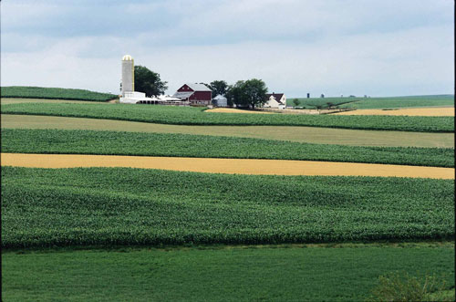
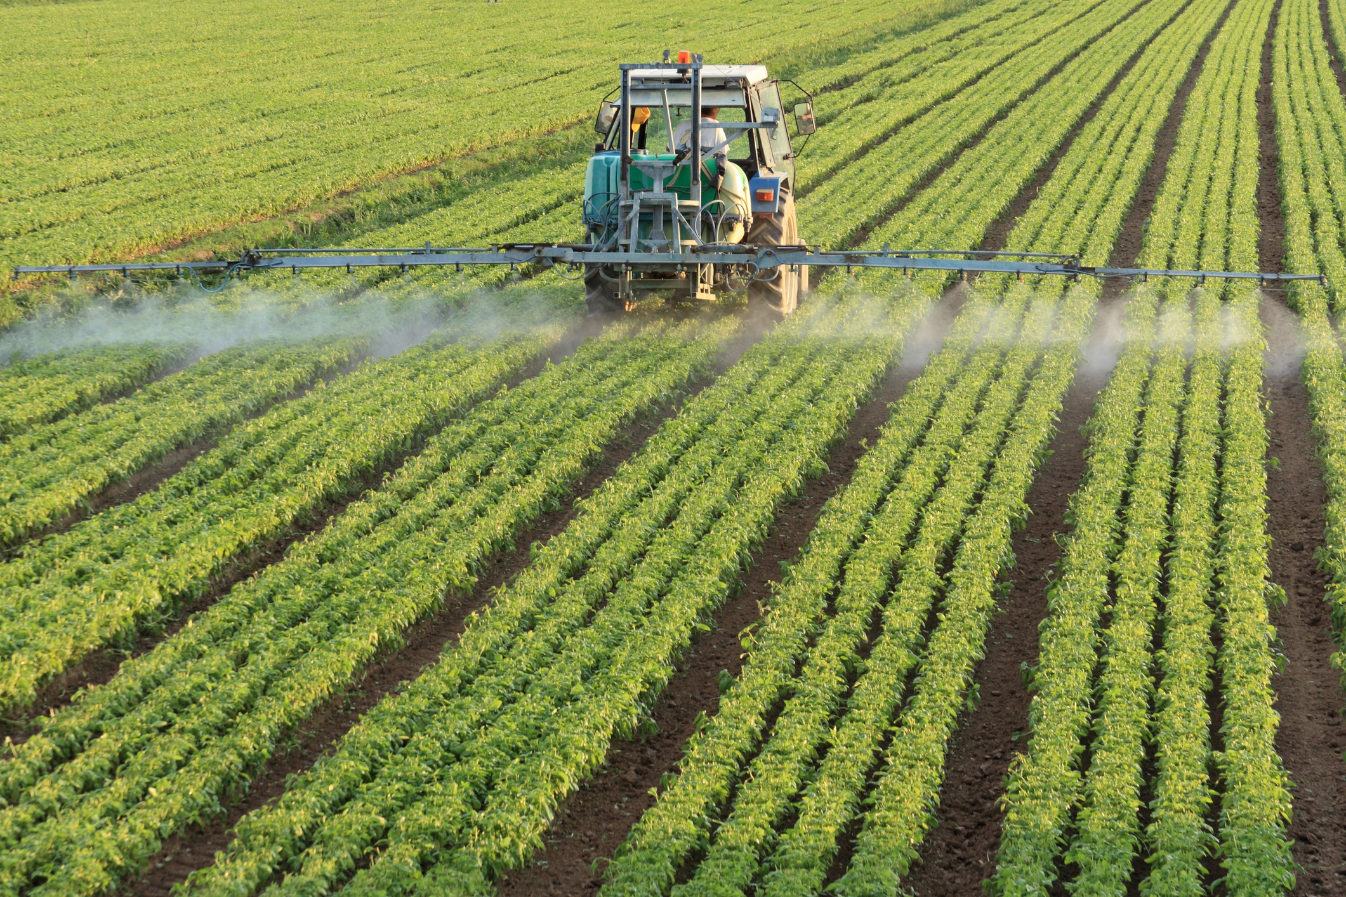
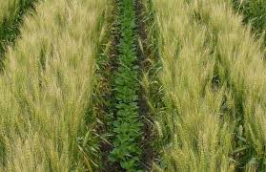
Practices and Treatments – YR 1
Choose at least two of the nine options
Success will be dependent on weather
Will play for 6 years (rounds)
Sources: nrcs.usda.gov/wps/portal/nrcs/detail/national/programs/financial/csp/?cid=nrcseprd546806
nrcs.usda.gov/wps/portal/nrcs/detail/ia/technical/?cid=nrcs142p2_008509
bls.gov/opub/btn/volume-2/growing-demand-for-fertilizer-keeps-prices-high.htm
Notes:
In year 1, you will choose at least two of nine planting practices and crop treatments, which we will discuss momentarily. As in real life, the success of your farm will be partially based on chance because you are choosing your options before knowing how the weather will be this year. The weather conditions will be revealed at the end of the year, and the success of your choices will be dependent on the conditions that you experienced. Remember, you are trying to stay in the black, which means having an Output Factor that is ≥100. Each option has an associated cost, but you may be rewarded for your investment. The impact of each option can be positive or negative, depending on the conditions this year, especially the weather. After the first year, you will then have the option to invest in any of these practices and treatments each year for the six total years that we will play this game.

Slide 12
Crop Seed Varieties
Drought resistant variety pros:
  Can produce a more reliable yield/acre during periods of prolonged drought
Flood resistant variety pros:
  Can tolerate being submerged for longer periods of time or multiple times/year
Cons:
  Seeds need to be repurchased every year
Notes:
Your first options are two different crop varieties. Over many years, farmers and researchers have been able to breed crops that grow more successfully in certain environments. For example, there are different varieties of wheat that grow well in drier or wetter than average conditions and varieties that are immune to insect and fungal diseases. For our game, you have the option to choose between drought resistant or flood resistant varieties of crops.

Slide 13
Interplanting
Planting a crop together with another in alternating rows
Pros:
  Decreased need for crop treatments
  Less economic risk in case of a crop fail year
Cons:
  Requires more planning
Source: nrcs.usda.gov/wps/portal/nrcs/detail/national/programs/financial/csp/?cid=nrcseprd546806
Notes:
Interplanting is planting two crops together in a field in alternating rows. By using this method, you can decrease the need for crop treatments, such as pesticides and herbicides. This option also creates less economic risk for you in case there is a crop fail year. You may have to spend more time planning up front in order to carry out this practice.

Slide 14
Crop Rotation
A system of varying crops in the same field year after year
Pros:
  Avoid depleting the soil of nutrients
  Helps control weeds, disease, and other pests
Cons:
  Requires more planning
Source: nrcs.usda.gov/wps/portal/nrcs/detail/ia/technical/?cid=nrcs142p2_008509
Notes:
Crop rotation is a planting system where varying crops are planted in the same field year after year. This style of planting has been used since the 1600s because it helps preserve soil nutrients. It will also help control weeds, disease, and other pests. Many pests are plant specific, so by moving the plants to a different field every year, it will reduce the chance that the pest will be able to follow them. You may have to spend more time planning up front in order to carry out this practice.

Slide 15
Spread Spacing
Increasing the amount of space between planted rows of crops
Pros:
  Can reduce the need for crop treatments
  Less competition for resources by plants
Cons:
  Lower crop yield per acre
Notes:
Spread spacing is increasing the amount of space between the planted rows of crops. This practice can reduce the need for crop treatments because there is less competition for resources from the plants. There will be a lower crop yield per acre because of fewer rows in a single field.

Slide 16
Fertilizing
The process of making the soil more fertile or productive by adding nutrients or organic matter to the soil
Pros:
  Can make crops grow larger, faster
Cons:
  Depletes natural soil fertility causing an annual reliance
Source: bls.gov/opub/btn/volume-2/growing-demand-for-fertilizer-keeps-prices-high.htm
Notes:
Most fertilizer contains nitrogen, phosphorus, and potassium. By adding more of these nutrients to what already occurs naturally in the soil, crops will grow larger, faster. Annual application of fertilizer has been shown to deplete the natural soil fertility, causing an annual reliance on it, however. If you choose to do this on your farm, you will have to reapply it every year.

Slide 17
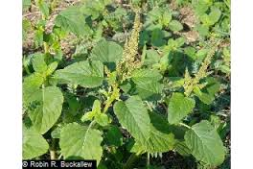
Herbicide
Spraying a substance that targets unwanted vegetation
Pros:
  Can greatly reduce loss from plant pests
Cons:
  Becomes less effective with continual use
Pigweed
Amaranthus spp.
Source: plants.usda.gov/core/profile?symbol=amal
Notes:
Herbicide sprays destroy unwanted vegetation (non-crops) in a field. Spraying a field with herbicide can greatly reduce loss from plant pests, but the herbicide becomes less effective with continual use. For example, this is a common agricultural weed called pigweed. For many years, the standard way of removing pigweed was to spray it with herbicides. Now, after many years of this, pigweed is resistant to herbicides in some areas, and the only way to remove it from agriculture fields in these areas is by manual removal (typically pulling it out by hand).

Slide 18
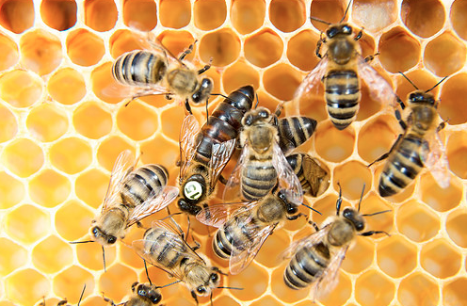
Insecticide
Spraying a substance that targets insect pests
Pros:
  Can greatly reduce loss from insect pests
Cons:
  Will harm natural pollinators
    Should not choose if you have beehives and flower strips
  Becomes less effective with continual use
Source: blogs.usda.gov/2016/06/24/reversing-pollinator-decline-is-key-to-feeding-the-future/
Notes:
Insecticide sprays are designed to stop herbivorous insects, and they can greatly reduce loss from insect pests, but they will harm natural pollinators and insect predators. You should not choose this option if you have beehives and flower strips on your farm. Like herbicides, they will also become less effective with continual use.

Slide 19
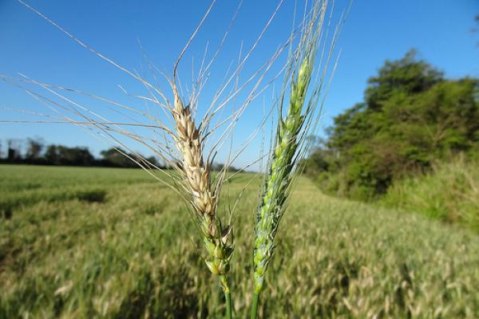
Fungicide
Spraying a substance that targets unwanted fungal pathogens
Pros:
  Can greatly reduces loss from fungal pathogens
Cons:
  Needs to be applied before infection to be effective
Source: nifa.usda.gov/sites/default/files/styles/nifa_large/public/blog/26189134073_f4180bcec6.jpg?itok=f_9vBT9I
Notes:
Fungicide sprays are designed to destroy unwanted fungal pathogens, and just like all the other crop treatments, fungicide can reduce the loss from pathogens. Unlike other treatments, you cannot use a wait-and-see approach because if the fungicide is not applied before infection, it will not be effective.

Slide 20
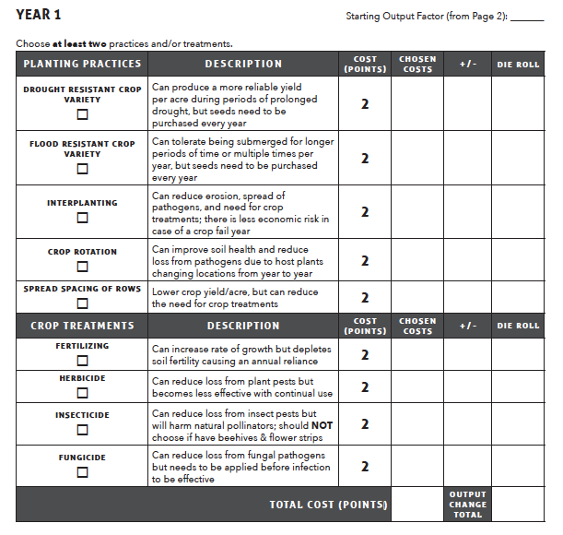

YEAR 1 PRACTICES AND TREATMENTS
2. Add up the cost of the practices and treatments and insert the total into the appropriate blank.
1. Insert “Starting Output Factor” from page 2.
Notes:
Write your Starting Output Factor into the first blank at the bottom of the page. Then calculate the cost of your planting practices and crop treatments, and write the Total Cost at the bottom of the table and in the second blank at the bottom of page 3 of the handout.

Slide 21
YEAR 1: Roll the Die
Notes:
Roll the die once for each checked item that you selected. Roll the die and assign the number rolled to the first checked item in the table. Roll the die again and assign that number to the second checked item, and repeat this for all of the items you selected.
-You may not roll the die and assign that number to whichever checked item you would like, and you may not roll the die until you get a number that you like. The purpose of the die is to be random, so that some practices and treatments will affect your farm more positively or negatively than others, that the effect varies year to year, and different farms are affected in different ways. This is similar to the way it works in the real world.

Slide 22
Year 1 Weather – Historically Normal
Positive investments (“+”)
  Interplanting
  Crop rotation
  Spread spacing of rows
  Fertilizing
  Herbicide
  Insecticide
  Fungicide
Negative investments (“-”)
  Drought resistant crop varieties
  Flood resistant crop varieties
Add 3 points for each of the following farm adaptations implemented:
No-till planting
Hedgerows
Water collection and storage
Soil moisture monitoring
Beehives and flower strips
Notes:
The weather for year 1 was historically normal. Record the weather in the blank near the bottom of page 3 of your handout.
-During historically normal weather, some of the practices and treatments that you chose will give you a positive return, and some will give you a negative return. The list on the left is positive investments. The practices on this list were helpful during the weather that we had this year, and they resulted in increased profits. Place a plus sign next to the die roll number for the practices and treatments from this list that you chose (and only the practices and treatments that you chose).
-The list on the right is negative investments. The practices on this list were not helpful during the weather that we had this year, and they did not result in increased profits to offset their costs. Place a minus sign next to the die roll number for the practices and treatments from the list that you chose.
-When you customized your farm, you may have chosen one or more of the options in table 2 on page 2 of the handout. Turn back to table 2 on page 2 for reference. If you chose any of the farm adaptations listed at the bottom of the slide, your investments paid off this year. The adaptations on this list were helpful during the weather that we experienced. For each adaptation that you chose from this list, you will receive three Farm Adaptation Bonus points. For example, if you implemented two of the five adaptations that helped mitigate the effects of the weather, you would receive three points for each, for a total bonus of six points.
-Add up how many Farm Adaptation Bonus points you received and write that number in the appropriate blank at the bottom of page 3.

Slide 23
Year 1 Handout
3. Add up the positive and negative investments and insert the total into the appropriate blank.
5. Add up all of the blanks to calculate the “Starting Output Factor” for the next year (be sure to pay attention to the sign).
4. Insert total adaptation bonus (bottom of previous slide).
6. Repeat for each year.
Notes:
Add up all of the positive and negative investments to calculate the Output Change Total. Be sure to pay attention to the sign. Most players will be adding positive and negative numbers; do not just add them all up as if they were all positive. Once you have the total, write it at the bottom of the table and in the Output Change Total blank at the bottom of the page. This number may be negative.
-Finally, combine all of the blanks to calculate your new Starting Output Factor. Be sure to pay attention to the sign.

Slide 24
Practices and Treatments – YR 2
Choose at least two of the nine options
Success will be dependent on weather
Sources: nrcs.usda.gov/wps/portal/nrcs/detail/national/programs/financial/csp/?cid=nrcseprd546806
nrcs.usda.gov/wps/portal/nrcs/detail/ia/technical/?cid=nrcs142p2_008509
bls.gov/opub/btn/volume-2/growing-demand-for-fertilizer-keeps-prices-high.htm
Notes:
-In year 2, you will again choose at least two of the nine practices and treatments. I will reveal the weather conditions at the end of the year, and the success of your choices will be dependent on the conditions that you experienced. Remember, you are trying to stay in the black. Take a moment to place checkmarks under at least two options in the table, and write the cost of each in the Chosen Costs column of the table.
-Write your Starting Output Factor into the first blank at the bottom of page 4 of the handout. Then calculate the cost of your planting practices and crop treatments, and write the Total Cost at the bottom of the table and in the second blank at the bottom of the page.
-Roll the die once for each checked item that you selected. Assign the number rolled to the first checked item in the table, and roll it again until you have written a die roll number in the table for every practice and treatment that you selected.

Slide 25
Year 2 Weather - Drought
Positive investments (“+”)
  Drought resistant crop varieties
  Interplanting
  Crop rotation
  Fertilizer
  Insecticide
Negative investments (“-”)
  Flood resistant crop varieties
  Spread spacing
  Herbicide
  Fungicide
Add 3 points for each of the following farm adaptations implemented:
No-till planting
Water collection and storage
Soil moisture monitoring
Beehives and flower strips
Notes:
The weather for year 2 was a drought. Record the weather in the blank near the bottom of page 4 of your handout.
-Look at the list of positive investments, and place a plus sign next to the die roll number for the practices and treatments from this list that you chose.
-Look at the list of negative investments, and place a minus sign next to the die roll number for the practices and treatments from this list that you chose.
-Add up all of the positive and negative investments to calculate the Output Change Total. Be sure to pay attention to the sign. Write it in the Output Change Total space in the table and the blank at the bottom of the page.
-Look back at the selections that you made when customizing your farm in table 2 on page 2 of the handout; for each adaptation that you chose from the list at the bottom of this slide, you will receive three Farm Adaptation Bonus points. Add up how many Farm Adaptation Bonus points you received and write that number in the appropriate blank at the bottom of page 4.
-Finally, combine all of the blanks to calculate your new Starting Output Factor. Be sure to pay attention to the sign.
-Turn to page 5 of the handout, and transfer the new Starting Output Factor from Year 2 (calculated on the previous page) into the blank in the top right corner.

Slide 26
Practices and Treatments – YR 3
Choose at least two of the nine options
Success will be dependent on weather
Sources: nrcs.usda.gov/wps/portal/nrcs/detail/national/programs/financial/csp/?cid=nrcseprd546806
nrcs.usda.gov/wps/portal/nrcs/detail/ia/technical/?cid=nrcs142p2_008509
bls.gov/opub/btn/volume-2/growing-demand-for-fertilizer-keeps-prices-high.htm
Notes:
In year 3, you will again choose at least two of the nine practices and treatments. I will reveal the weather conditions at the end of the year, and the success of your choices will be dependent on the conditions that you experienced. Remember, you are trying to stay in the black. Take a moment to place checkmarks under at least two options in the table, and write the cost of each in the Chosen Costs column of the table.
-Write your Starting Output Factor into the first blank at the bottom of page 5 of the handout. Then calculate the cost of your planting practices and crop treatments, and write the Total Cost at the bottom of the table and in the second blank at the bottom of the page.
-Roll the die once for each checked item that you selected. Assign the number rolled to the first checked item in the table, and roll it again until you have written a die roll number in the table for every practice and treatment that you selected.

Slide 27
Year 3 Weather – Heat Wave
Positive investments (“+”)
  Interplanting
  Crop rotation
  Spread spacing of rows
  Insecticide
Negative investments (“-”)
  Drought resistant crop varieties
  Flood resistant crop varieties
  Fertilizer
  Herbicide
  Fungicide
Add 3 points for each of the following farm adaptations implemented:
No-till planting
Water collection and storage
Soil moisture monitoring
Notes:
The weather for year 3 was a heat wave. Record the weather in the blank near the bottom of page 5 of your handout.
-Look at the list of positive investments, and place a plus sign next to the die roll number for the practices and treatments from this list that you chose.
-Look at the list of negative investments, and place a minus sign next to the die roll number for the practices and treatments from this list that you chose.
-Add up all of the positive and negative investments to calculate the Output Change Total. Be sure to pay attention to the sign. Write it in the Output Change Total space in the table and the blank at the bottom of the page.
-Look back at the selections that you made when customizing your farm in table 2 on page 2 of the handout; for each adaptation that you chose from the list at the bottom of this slide, you will receive three Farm Adaptation Bonus points. Add up how many Farm Adaptation Bonus points you received and write that number in the appropriate blank at the bottom of page 5.

Slide 28
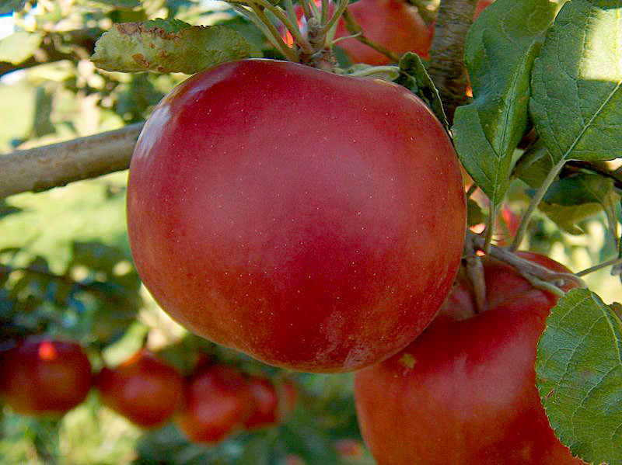
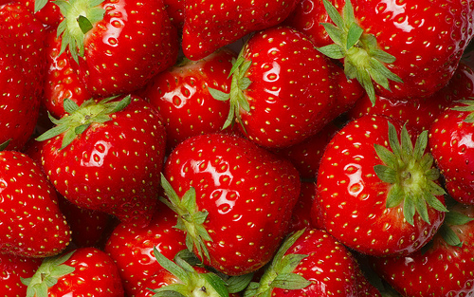
Year 3 – Subsidy Announcement
Beehives
Pollination from bees in the US is worth over $14 billion
Many crops would not exist, or be less productive without bees
*Add 10 points in the Subsidy Bonus blank if you have invested in beehives*
Important crops pollinated by bees
  Kiwi
  Peppers – red, green, bell, chile
  Watermelon
  Cucumber
  Pumpkin
  Strawberry
  Cotton
  Apple
  Mango
  Alfalfa
  Avocado
  Cherry
  Almond
  Peach
  Pear
  Raspberry/Blackberry
  Blueberry
  And many, many more
Sources:
www.dos.ny.gov/kids_room/web_images/reality_images/800px-McIntosh.jpg
www.usda.gov/media/blog/2015/01/6/spraying-smarter-strengthens-strawberry-production
Notes:
-This year, the government issued a subsidy for agricultural producers who installed beehives on their farms. A subsidy is a cash rebate or tax reduction given by the government to incentivize an action or help an economic sector. As mentioned earlier, many bee species populations are in decline. Pollination of crops by bees has been estimated to be worth $14 billion per year, and without them, many of our favorite foods would not exist. Look at the list on the right side of the slide. Does it include any foods that you like to eat?
-If you chose to invest in beehives and flower strips at the beginning of the game, you will receive 10 Subsidy Bonus points for doing so. If you did, write a 10 in the Subsidy Bonus blank at the bottom of page 5 of the handout, if you did not, write a 0 in that blank.
-Combine all of the blanks to calculate your new Starting Output Factor. Be sure to pay attention to the sign.
-Turn to page 6 of the handout, and transfer the new Starting Output Factor from Year 3 (calculated on the previous page) into the blank in the top right corner.

Slide 29
Practices and Treatments – YR 4
Choose at least two of the nine options
Success will be dependent on weather
Sources: nrcs.usda.gov/wps/portal/nrcs/detail/national/programs/financial/csp/?cid=nrcseprd546806
nrcs.usda.gov/wps/portal/nrcs/detail/ia/technical/?cid=nrcs142p2_008509
bls.gov/opub/btn/volume-2/growing-demand-for-fertilizer-keeps-prices-high.htm
Notes:
-In year 4, you will again choose at least two of the nine practices and treatments. I will reveal the weather conditions at the end of the year, and the success of your choices will be dependent on the conditions that you experienced. Remember, you are trying to stay in the black. Take a moment to place checkmarks under at least two options in the table, and write the cost of each in the Chosen Costs column of the table.
-Write your Starting Output Factor into the first blank at the bottom of page 6 of the handout. Then calculate the cost of your planting practices and crop treatments, and write the Total Cost at the bottom of the table and in the second blank at the bottom of the page.
-Roll the die once for each checked item that you selected. Assign the number rolled to the first checked item in the table, and roll it again until you have written a die roll number in the table for every practice and treatment that you selected.

Slide 30
Year 4 Weather - Wind
Positive investments (“+”)
  Interplanting
  Crop rotation
  Spread spacing of rows
Negative investments (“-”)
  Drought resistant crop varieties
  Flood resistant crop varieties
  Fertilizer
  Herbicide
  Insecticide
  Fungicide
Add 3 points for each of the following farm adaptations implemented:
No-till planting
Hedgerows
Notes:
The weather for year 4 was windy. Record the weather in the blank near the bottom of page 6 of your handout.
-Look at the list of positive investments, and place a plus sign next to the die roll number for the practices and treatments from this list that you chose.
-Look at the list of negative investments, and place a minus sign next to the die roll number for the practices and treatments from this list that you chose.
-Add up all of the positive and negative investments to calculate the Output Change Total. Be sure to pay attention to the sign. Write it in the Output Change Total space in the table and the blank at the bottom of the page.
-Look back at the selections that you made when customizing your farm in table 2 on page 2 of the handout; for each adaptation that you chose from the list at the bottom of this slide, you will receive three Farm Adaptation Bonus points. Add up how many Farm Adaptation Bonus points you received and write that number in the appropriate blank at the bottom of page 6.
-Finally, combine all of the blanks to calculate your new Starting Output Factor. Be sure to pay attention to the sign.
-Turn to page 7 of the handout, and transfer the new Starting Output Factor from Year 4 (calculated on the previous page) into the blank in the top right corner.

Slide 31
Practices and Treatments – YR 5
Choose at least two of the nine options
Success will be dependent on weather
Sources: nrcs.usda.gov/wps/portal/nrcs/detail/national/programs/financial/csp/?cid=nrcseprd546806
nrcs.usda.gov/wps/portal/nrcs/detail/ia/technical/?cid=nrcs142p2_008509
bls.gov/opub/btn/volume-2/growing-demand-for-fertilizer-keeps-prices-high.htm
Notes:
In year 5, you will again choose at least two of the nine practices and treatments. I will reveal the weather conditions at the end of the year, and the success of your choices will be dependent on the conditions that you experienced. Remember, you are trying to stay in the black. Take a moment to place checkmarks under at least two options in the table, and write the cost of each in the Chosen Costs column of the table.
-Write your Starting Output Factor into the first blank at the bottom of page 7 of the handout. Then calculate the cost of your planting practices and crop treatments, and write the Total Cost at the bottom of the table and in the second blank at the bottom of the page.
-Roll the die once for each checked item that you selected. Assign the number rolled to the first checked item in the table, and roll it again until you have written a die roll number in the table for every practice and treatment that you selected.

Slide 32
Year 5 Weather – Increased Precipitation
Positive investments (“+”)
  Flood resistant crop varieties
  Interplanting
  Crop rotation
  Spread spacing of rows
  Fungicide
Negative investments (“-”)
  Drought resistant crop varieties
  Fertilizer
  Herbicide
  Insecticide
Add 3 points for each of the following farm adaptations implemented:
No-till planting
Hedgerows
Notes:
The weather for year 5 included increased precipitation. Record the weather in the blank near the bottom of page 7 of your handout.
-Look at the list of positive investments, and place a plus sign next to the die roll number for the practices and treatments from this list that you chose.
-Look at the list of negative investments, and place a minus sign next to the die roll number for the practices and treatments from this list that you chose.
-Add up all of the positive and negative investments to calculate the Output Change Total. Be sure to pay attention to the sign. Write it in the Output Change Total space in the table and the blank at the bottom of the page.
-Look back at the selections that you made when customizing your farm in table 2 on page 2 of the handout; for each adaptation that you chose from the list at the bottom of this slide, you will receive three Farm Adaptation Bonus points. Add up how many Farm Adaptation Bonus points you received and write that number in the appropriate blank at the bottom of page 7.
-Finally, combine all of the blanks to calculate your new Starting Output Factor. Be sure to pay attention to the sign.
-Turn to page 8 of the handout, and transfer the new Starting Output Factor from Year 5 (calculated on the previous page) into the blank in the top right corner.

Slide 33
Practices and Treatments – YR 6
Choose at least two of the nine options
Success will be dependent on weather
Sources: nrcs.usda.gov/wps/portal/nrcs/detail/national/programs/financial/csp/?cid=nrcseprd546806
nrcs.usda.gov/wps/portal/nrcs/detail/ia/technical/?cid=nrcs142p2_008509
bls.gov/opub/btn/volume-2/growing-demand-for-fertilizer-keeps-prices-high.htm
Notes:
In year 6, our final year, you will again choose at least two of the nine practices and treatments. I will reveal the weather conditions at the end of the year, and the success of your choices will be dependent on the conditions that you experienced. Remember, you are trying to stay in the black. Take a moment to place checkmarks under at least two options in the table, and write the cost of each in the Chosen Costs column of the table.
-Write your Starting Output Factor into the first blank at the bottom of page 8 of the handout. Then calculate the cost of your planting practices and crop treatments, and write the Total Cost at the bottom of the table and in the second blank at the bottom of the page.
-Roll the die once for each checked item that you selected. Assign the number rolled to the first checked item in the table, and roll it again until you have written a die roll number in the table for every practice and treatment that you selected.

Slide 34
Year 6 Weather – Heat Wave
Positive investments (“+”)
  Interplanting
  Crop rotation
  Spread spacing of rows
  Insecticide
Negative investments (“-”)
  Drought resistant crop varieties
  Flood resistant crop varieties
  Fertilizer
  Herbicide
  Fungicide
Add 3 points for each of the following farm adaptations implemented:
No-till planting
Water collection and storage
Soil moisture monitoring
Notes:
The weather for year 6 was another heat wave. Record the weather in the blank near the bottom of page 8 of your handout.
-Look at the list of positive investments, and place a plus sign next to the die roll number for the practices and treatments from this list that you chose.
-Look at the list of negative investments, and place a minus sign next to the die roll number for the practices and treatments from this list that you chose.
-Add up all of the positive and negative investments to calculate the Output Change Total. Be sure to pay attention to the sign. Write it in the Output Change Total space in the table and the blank at the bottom of the page.
-Look back at the selections that you made when customizing your farm in table 2 on page 2 of the handout; for each adaptation that you chose from the list at the bottom of this slide, you will receive three Farm Adaptation Bonus points. Add up how many Farm Adaptation Bonus points you received and write that number in the appropriate blank at the bottom of page 8.

Slide 35
Year 6 – Subsidy Announcement
Water conservation includes using water resources responsibly (not overwatering) and only watering when necessary.
Extreme droughts are predicted to happen more often as a result of global climate change.
*Add 5 points in the subsidy bonus blank if you invested in soil moisture monitoring*
*Add 10 points in the subsidy bonus blank if you invested in water collection and storage*
*If you invested in both, add 15 points total*
Notes:
The government issued another subsidy this year; this time, it is for water conservation. Water conservation involves using only the water needed for crops. Due to the more prolonged and intense droughts resulting from climate change, smart water usage by agriculture has become imperative.
-If you invested in soil moisture monitoring you will receive a 5 point Subsidy Bonus. If you invested in water collection and storage you will receive a 10 point Subsidy Bonus. If you invested in both, you will receive a 15 point Subsidy Bonus.
-Combine all of the blanks to calculate your final output factor. Be sure to pay attention to the sign.

