Slide 1


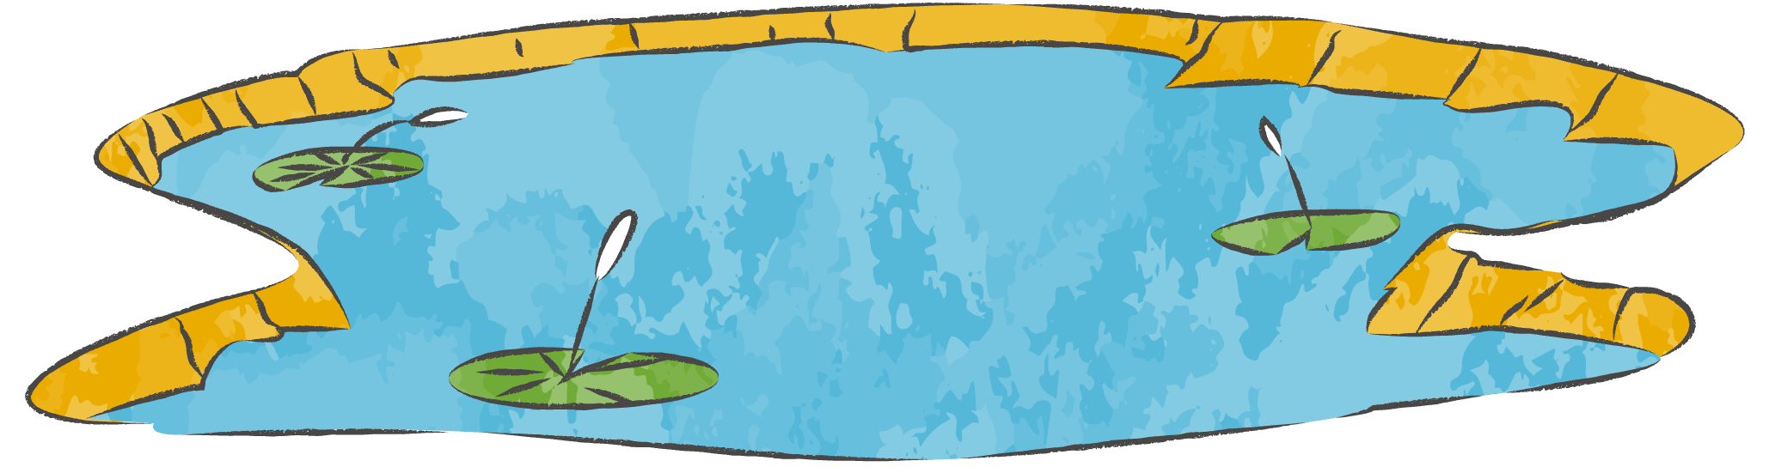
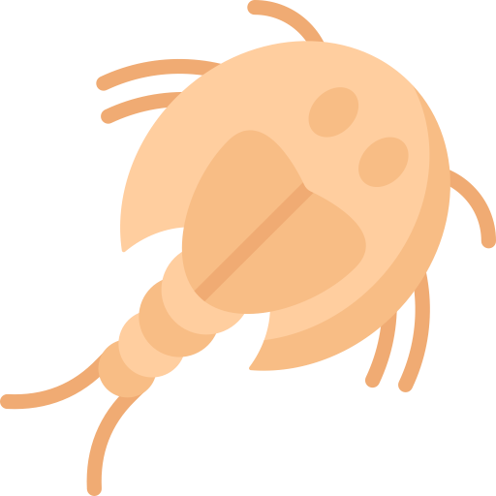
)
Brought to you by
The Asombro Institute
)
)
)
Desert Shrimp
)
)
)
)
Using Science to Protect Playa Shrimp and Their Habitats
)
)
)
)
)
)
)
)
)
)
© Asombro Institute for Science Education

Slide 2


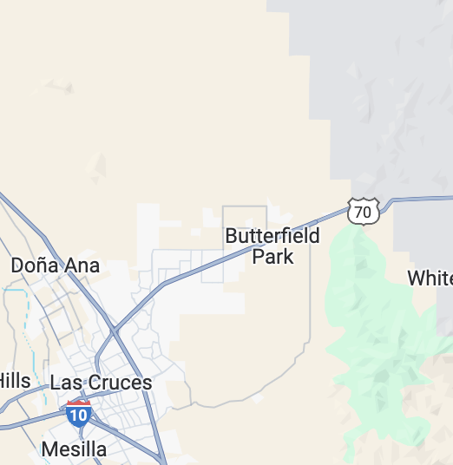
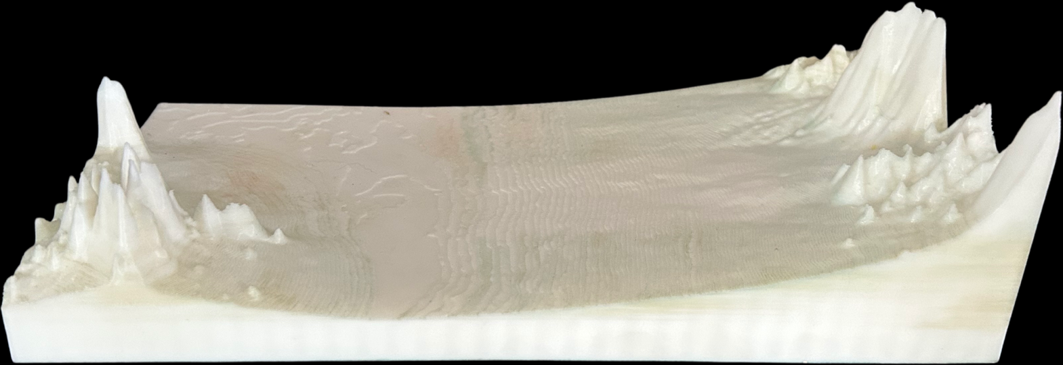
What is a
Model Area
Playa?
10 miles

Slide 3
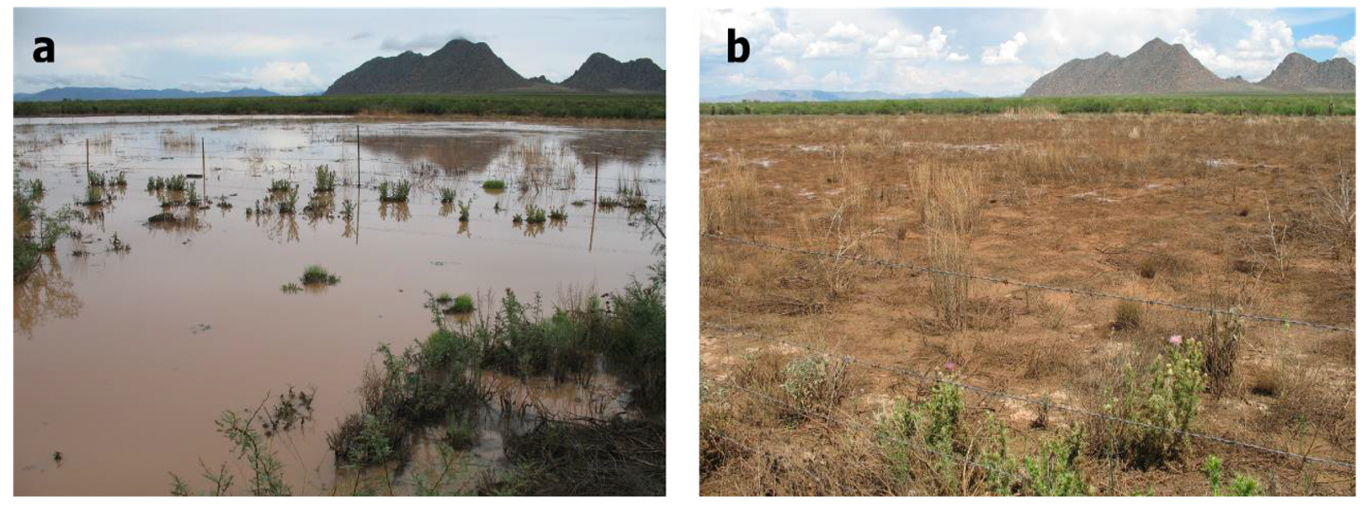

What is a
Playa?
A temporary lake that fills with water after a rainstorm, then dries out again.

Slide 4

What lives in a Playa?
Have you ever found something living in a puddle?

Slide 5
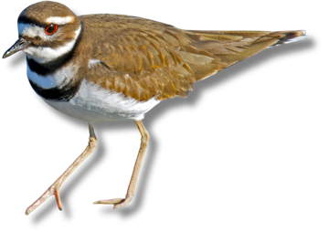
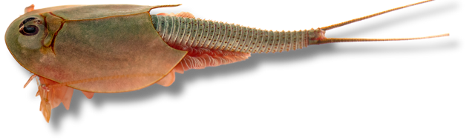
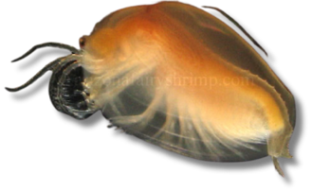
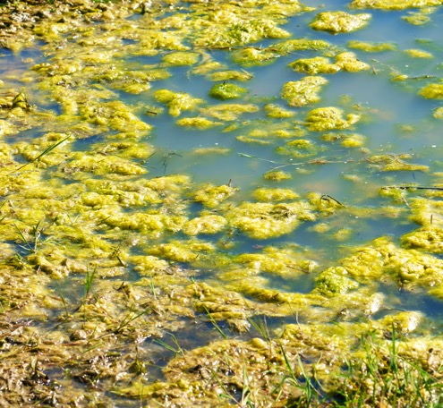
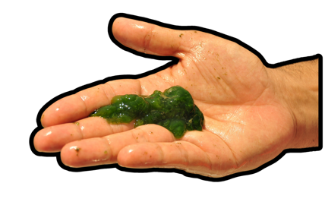
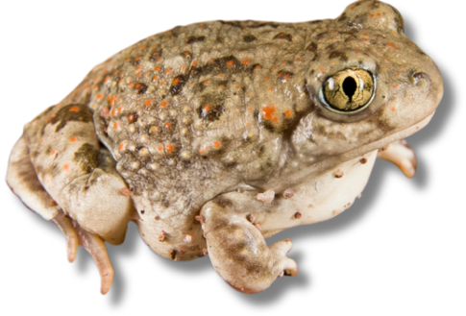
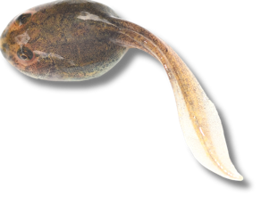
What lives in a Playa?
Wading birds walk in the playa looking for food.
Killdeer
Tadpole Shrimp
Texas Clam Shrimp
Shrimp lay their eggs in the mud of the playa before it dries. When the playa fills again, the eggs hatch.
Spadefoot toads stay buried underground until the rain comes, then they lay their eggs in the playa. Tadpoles grow in the playa.
Algae
Spadefoot Toad and Tadpole
Algae is a photosynthetic organism that floats on water. It provides food and shelter.

Slide 6
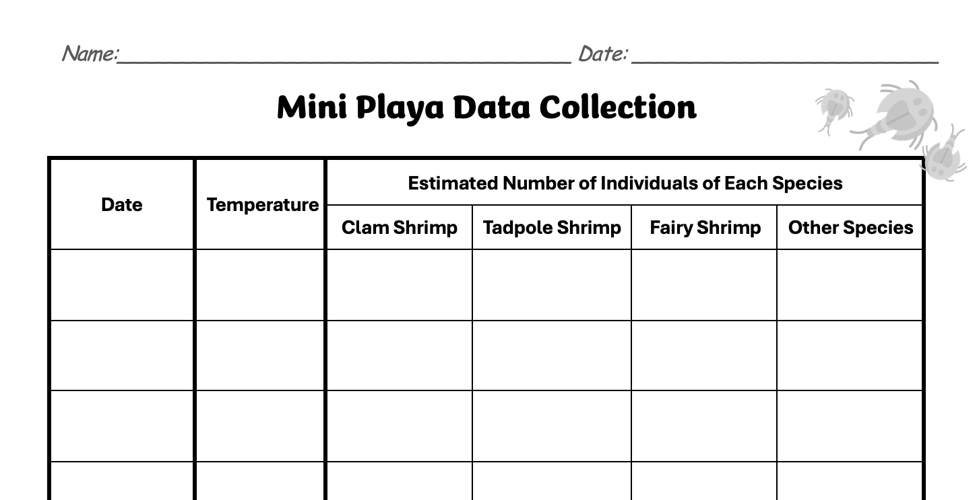
Mini Playa Data
Each day, we will keep track of the animals living in our mini playa.

Slide 7

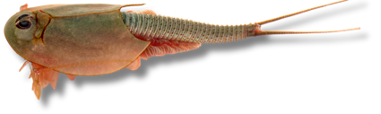
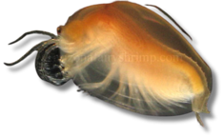
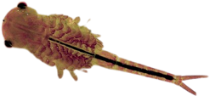




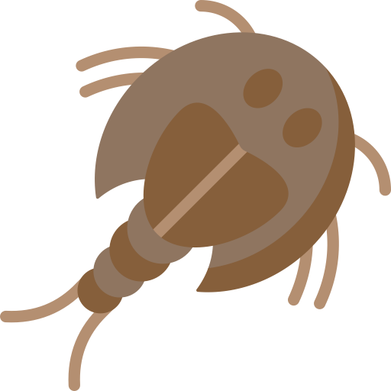



Many species of shrimp in New Mexico are Species of Greatest Conservation Need.
Playa Shrimp Facts
Tadpole Shrimp
Texas Clam Shrimp
Fairy Shimp
Eggs stay
dormant in soil
Playa dries
and shrimp die
Diet
Life Span:
Life
Cycle
with water
Playa fills
  Algae
  Bacteria
  Decomposing materials
  Other shrimp
2-12 Weeks
Eggs can survive 30 years in dry soil!
Shrimp mate and
lay eggs in mud
Eggs hatch

Slide 8
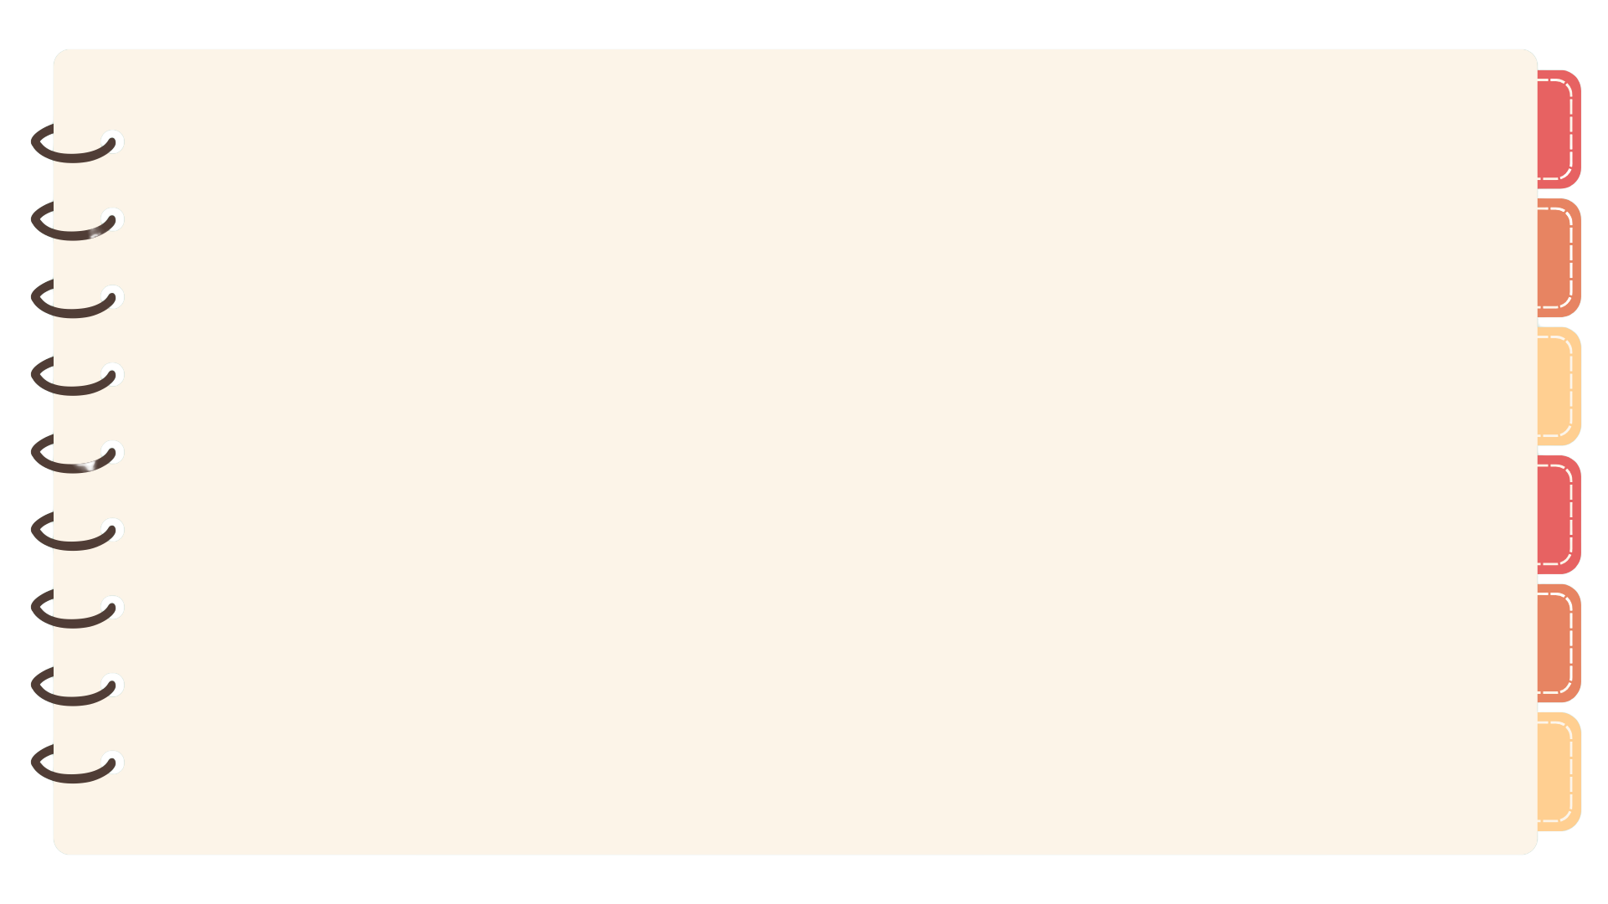
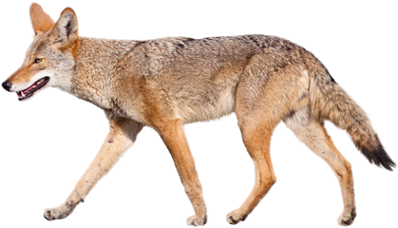
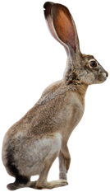
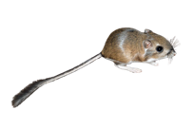
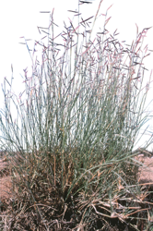
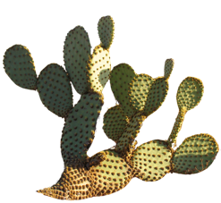
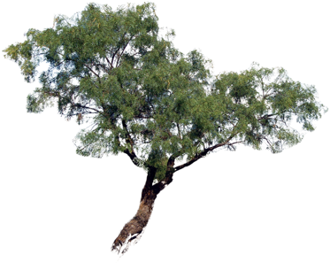

A Desert Food Web
This is just part of a desert food web. Can you think of other plants and animals that live in the desert? Where would they go in the food web?
Coyote
Kangaroo Rat
Jackrabbit
Black Grama Grass
Prickly Pear Cactus
Honey Mesquite
Movement of Energy
Movement of Matter
Only plants can take water and carbon dioxide and create food using energy from the sun.
Sun

Slide 9
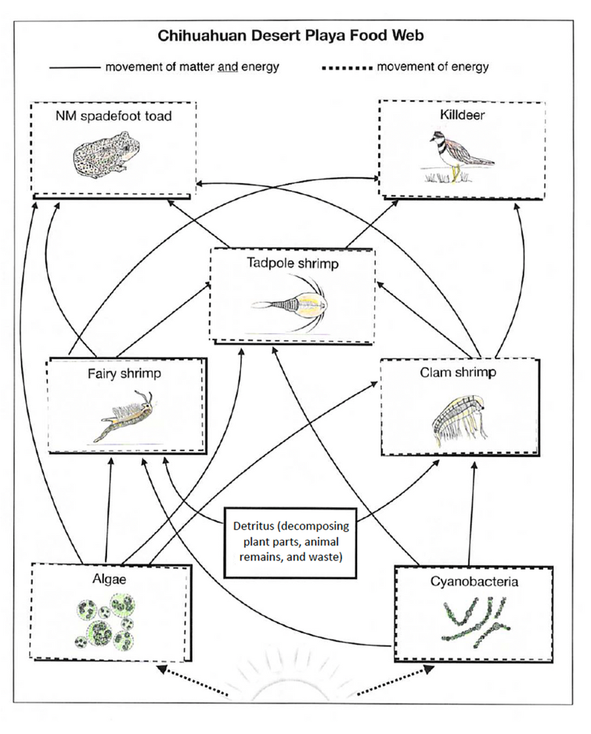
A Desert Food Web
1. A tadpole shrimp uses a lot of energy to move throughout the playa looking for food. What is the original source of this energy?
2. Which organism(s) in the playa food web create the food for the rest of the organisms by converting carbon dioxide from the air and water into food?
3. What do you think would happen if someone put three large fish in the playa that eat fairy shrimp, clam shrimp, and tadpole shrimp? Use the food web to explain your answer.

Slide 10
)
Brought to you by
The Asombro Institute
)
)
)
)
Desert Shrimp
)
)
)
Part 3: Understanding Playa Pollution
)
)
)
)
)
)
)
)
)
)
© Asombro Institute for Science Education

Slide 11
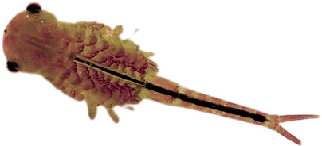
Playa Shrimp
Tadpole Shrimp
Texas Clam Shrimp
Fairy Shrimp
Some types of shrimp are Species of Greatest Conservation Need. They could disappear without humans taking action to protect them.
Shrimp lay eggs that stay in the soil when it dries. So even if there is no water, their habitat needs protection.
Threats to playa shrimp include:
  Water Pollution
  Drought
  Construction

Slide 12
Playa Pollution
Model Area
10 miles

Slide 13
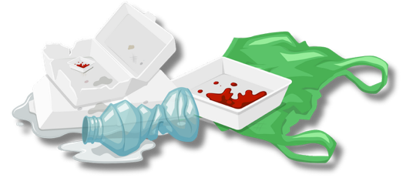


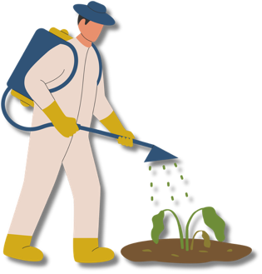
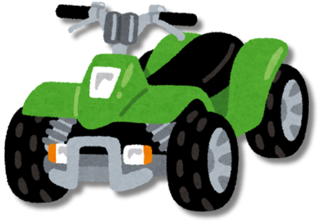
What pollutes water of the playa?
Litter
Bacteria from animal poop
Off-road driving kicks up dust and can harm desert plants. Loose dirt washes into the playa and fills it in.
Chemicals like insect and weed killers
Buildings, roads, and human activity in places that used to be desert

Slide 14

Designing Solutions to Problems
Step 1:
Identifying the Problem and Challenges
Step 4:
Evaluate your progress and look for ways to improve your work
Step 2:
Brainstorming Solutions
Step 3:
Carry out your plan
Merlin Tuttle, batcon.org

Slide 15
Designing Solutions to Problems
Step 1: Identifying the Problem and Challenges
We are trying to solve the problem of
water pollution in playas.
What challenges will we face?

Slide 16
Designing Solutions to Problems
Your Task:
Create a poster that informs someone how they can prevent water pollution to protect playa shrimp.
What constraints do we have?
Time? Materials?

Slide 17
Designing Solutions to Problems
Step 2: Brainstorming Solutions
What can you tell people or ask them to do to help solve the problem of water pollution?

Slide 18
Designing Solutions to Problems
Step 3: Carry Out Your Plan
Create your posters!
When we are done, we will share them with the class.

Slide 19
Designing Solutions to Problems
Step 4: Evaluate your progress and look for ways to improve your work
Which project do you think will work the best to solve the problem of water pollution in playas? Why?
Now that you’ve seen lots of other people’s ideas, what is one way you could improve your project?

