Slide 1
Southwest Regional
Climate Hub
Developed by the
Asombro Institute for Science Education (www.asombro.org)

Slide 2
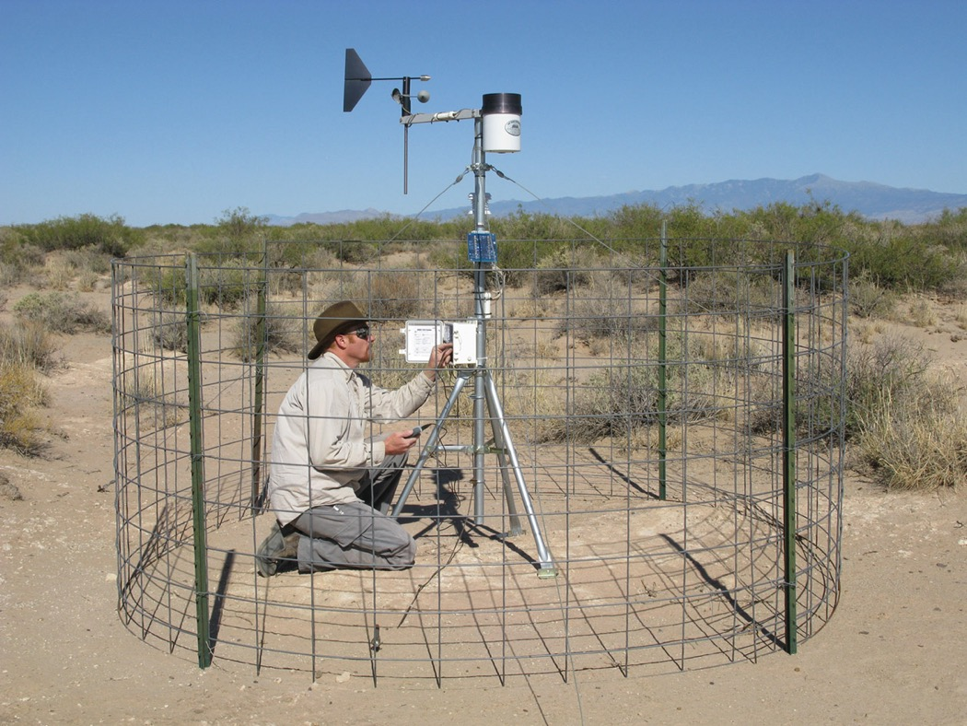
Vast Amounts of Data
Source: jornada.nmsu.edu/monit-assess/data-collection/automated
Notes:
Scientists around the world are collecting vast amounts of data every day. However, the general public often learns very little, if anything, about the information that scientists have amassed. There is a gap in the communication of scientific information to nonscientists.

Slide 3
Climate Data Jam
Goal:
Design a creative project and presentation (maximum 5 minutes) that explains local precipitation and temperature data to an audience not familiar with this information
Notes:
Students will be creating a Climate Data Jam project over the next two days. The goal is to design a creative project and presentation that explains local precipitation and temperature data to an audience not familiar with this information.

Slide 4
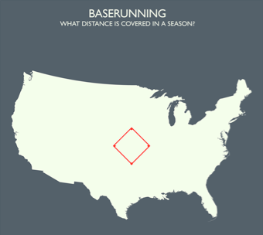
Inspiration: Infographic
In the 2006 season, MLB players ran a total of 1,245 miles around bases (73,080 bases x 90 feet between bases).
Craig Robinson
www.flipflopflyball.com
Notes:
Here is an example of an effective way to communicate data. This infographic is interesting and easy to understand because it puts data into a context to which most people in the continental United States can relate. Simply stating that MLB players ran a total of 1,245 miles in 2006 may be considered by some to be a dry statistic. However, scaling a baseball diamond to represent 1,245 miles and overlaying it on a map of the continental United States may help people understand how large the distance is and inspire them to take an interest in the statistic.

Slide 5
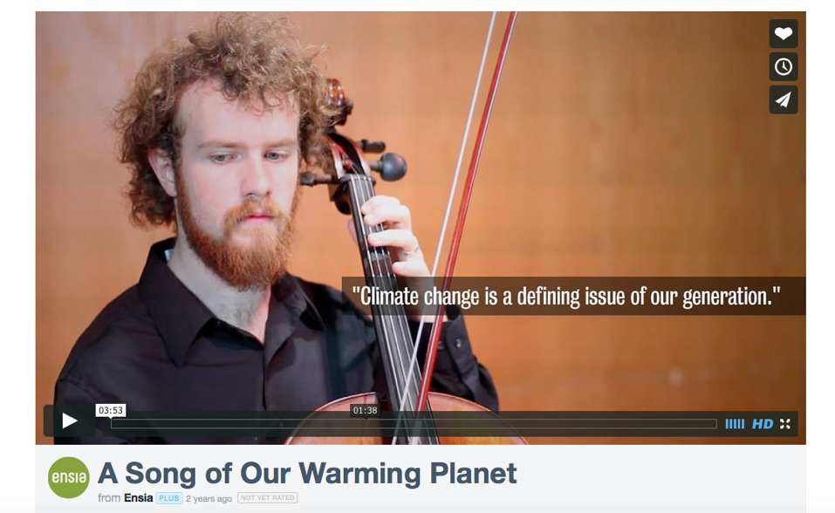
Inspiration: Music & Video
A Song of Our Warming Planet
http://vimeo.com/m/69122809
Notes:
This is an example of using music to communicate data. A University of Minnesota student, Daniel Crawford, created a song to represent the increase in average global temperatures since 1880. He was looking for a method to communicate scientific data in a way that would be more appealing to nonscientists and “people who would get more out of [a song] than maps, graphs, and numbers.”

Slide 6
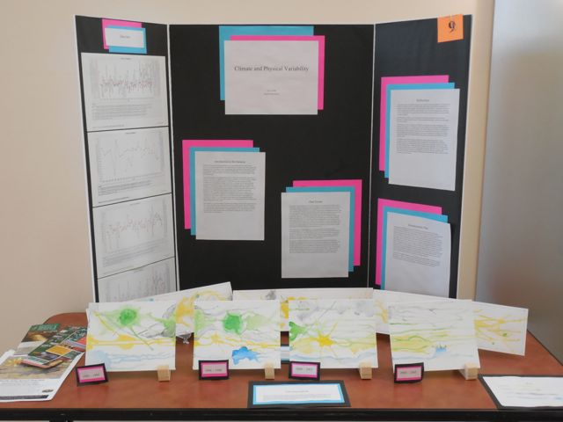
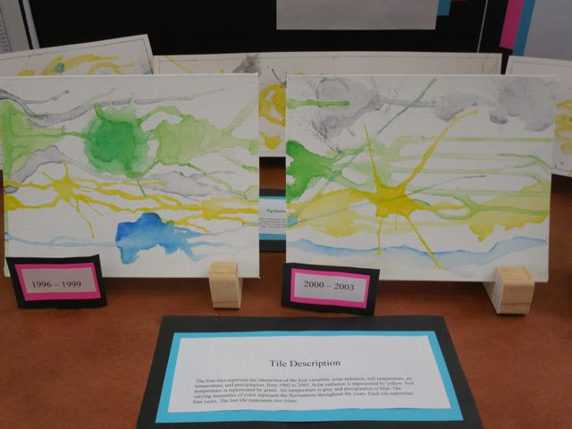
Inspiration: Painting
Notes:
Here is an example of a student using painting to communicate data. The different colored paint splatters were scaled to reflect the amounts of solar radiation, soil temperature, air temperature, and precipitation over several 4-year periods in Las Cruces, New Mexico.

Slide 7
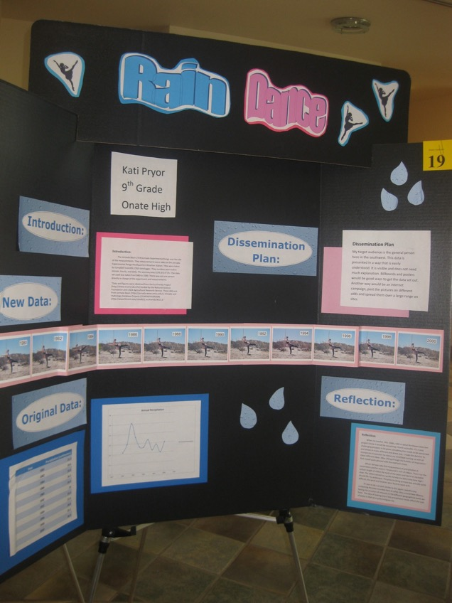
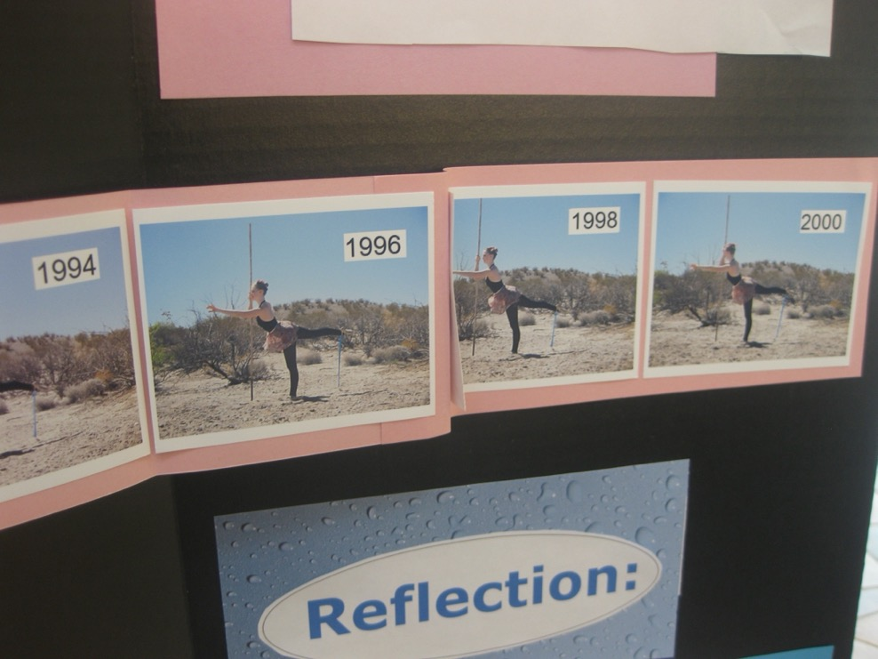
Inspiration: Dance
Notes:
This is an example of a student using dance to communicate data. The height of the student’s foot was scaled to represent the amount of precipitation received each year in Las Cruces, New Mexico. The ribbon tied to her foot helps visualize the differences each year.

Slide 8
Climate Data Jam
Teams of 1-3 students
Creative, non-traditional product (e.g., song, demonstration, poem, children’s story, newscast, etc.)
Must be scaled to represent a trend or trends in the data accurately
MAY also examine implications of data, but MUST include data trend
Notes:
Students may work individually or in teams of up to three students. Larger groups are not recommended for this project because of the difficulties of ensuring that all group members are equally involved. Students should develop a very creative project to represent the data and appeal to nonscientists. The project should not be a graph or table. Instruct students to use their imaginations to design a project that will be attention grabbing and appealing. Example products could include songs, demonstrations, poems, children’s stories, newscasts, physical models, infographics, and skits. Representations of the data trend or trends must be scaled accurately.
-Emphasize that students should represent a trend or trends in the data in a creative way rather than using the data directly in their projects. For example, the amount of annual precipitation could be represented in a physical model with cardboard cutout raindrops that represent 100 mm of water instead of simply stating that the county received 278.8 mm.
-Ensure that students understand the word trend by asking for a volunteer to define it [answer: the general direction in which something is changing. For example, in the future, our county is predicted to receive less annual total precipitation than we did historically.]
Students may go beyond the data and begin to examine the implications; however, their projects must also include representations of the data trends. For example, a student could write a rap song that includes a hypothesis about how increased temperatures in their county may lead to increase evapotranspiration, but they must incorporate a clear, accurately scaled description of the trend in the data as well.

Slide 9
A Good Data Jam Project is:
Clear: represent the data accurately and in a way that is understandable to non-scientists.
Include a legend
Creative: Use your imagination!
Concise: Focus on one (maybe two) important trends in the data.
Notes:
Direct students to look at the top of page 1 of their handout. A good Data Jam project is clear in that it accurately represents the data in a way that is understandable to nonscientists. The data must be scaled correctly, and a legend explaining how the data are represented must be included. The project should also be creative. Think of an imaginative way to get the attention of nonscientists. Finally, the project should be concise. Focus on one or two important trends, and explain them well.

Slide 10
Timeline
Today: introduction to the project, start examining data
Next two days: create project and 5-minute (maximum) presentation
Day 4: present project to the group
Notes:
Today, students will be introduced to the project and start examining local precipitation and temperature data. Over the next two days, students will create a project and develop a 5-minute (maximum) presentation to explain their project to the rest of the group. On day 4, students will present their projects to the group.

Slide 11
Suggested Steps
Decide if you would like to work alone or with others.
Use the online Precipitation and Temperature maps to acquire the needed data from your county.
Examine the precipitation and temperature data.
Read the Scoring Rubric.
Brainstorm and fill out the brainstorming notes section.
Create your Data Jam project (infographic, etc.).
Fill out the Climate Data Jam Summary.
Practice your presentation.
Notes:
Direct students to look at the project directions on page 1 of their handout.
-Students should decide if they would like to work alone or with one or two other students to complete their Climate Data Jam project.
-Use the online USDA Southwest Regional Climate Hub Precipitation and Maximum Temperature maps to acquire the needed data from your county. Fill in the data tables on page 3 of the handout.
-Examine the data and find one or two trends of interest.
-Read the Scoring Rubric so you know how the presentation and project will be evaluated.
-Brainstorm and fill out the brainstorming notes section.
-Create the Climate Data Jam project (infographic, skit, etc.).
-Fill out the Climate Data Jam Summary.
-Practice the presentation.

Slide 12
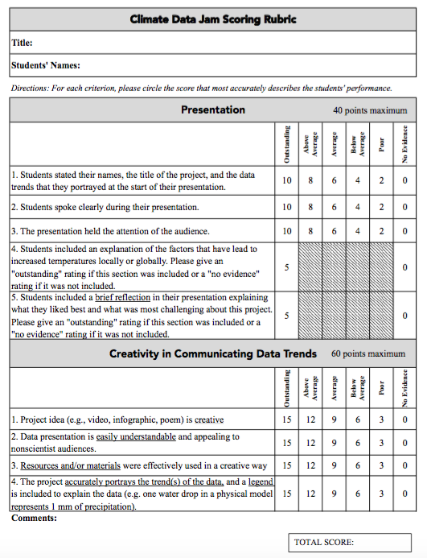
Scoring
40% presentation
60% creativity in communicating data trends
Notes:
Direct students to look at the Climate Data Jam Scoring Rubric.
-Students will use this rubric to score each other’s projects.
-Forty percent of students’ total score will be based on their presentation.
--At the start of their presentation, students must state their names, the title of the project, and the data trends that they portrayed.
--Speak clearly.
--Hold the attention of the audience.
--Include an explanation of the factors leading to increased temperatures.
--Include a brief reflection of the presentation explaining what they liked best and what was most challenging about this project.
-Sixty percent of students’ total score will be based on creativity in communicating data trends.
--The project idea must be creative.
--The data presentation must be easily understandable and appealing to nonscientist audiences.
--Resources and/or materials must be used effectively in a creative way.
--The project must accurately portray the trend or trends of the data, and a legend must be included.

Slide 13
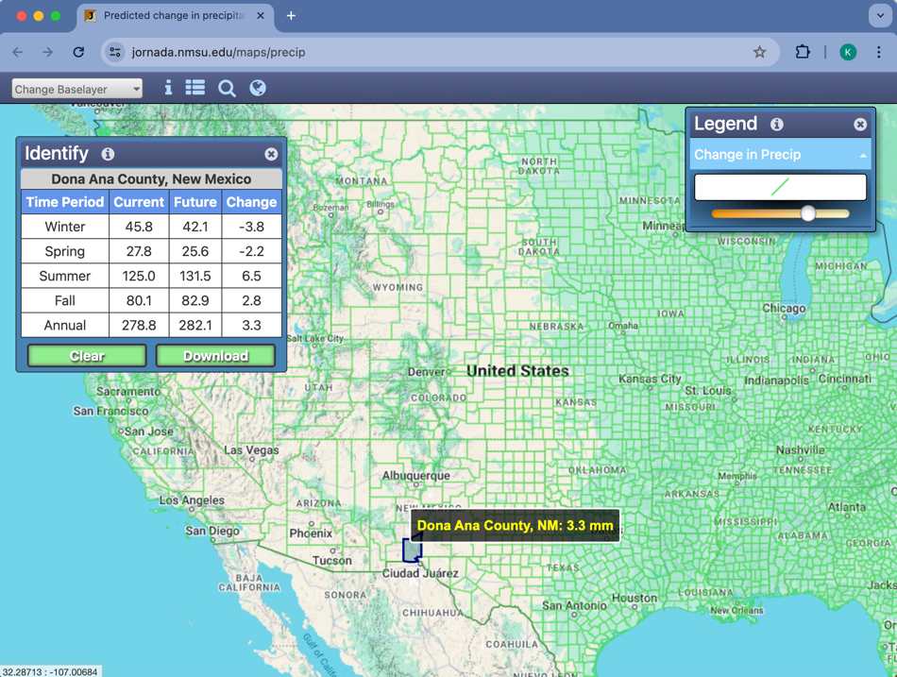
Precipitation Map
https://jornada.nmsu.edu/maps/precip
Notes:
Students will first acquire the precipitation data from their county by using the USDA Southwest Regional Climate Hub Precipitation map. Direct students to look at the data directions on page 2 of the handout and open the URL. It may be helpful to display the map and provide a tutorial.

Slide 14
Record Precipitation Data
Click and drag on the map to find your state, or click on the magnifying glass to search for a city.
Locate your county and click on it.
A data box will appear. Check that you have clicked on the correct county by reading the county name in the data box.
In table 1, record the following current (1971-2000) mean precipitation data: Annual Total, Winter Total, Spring Total, Summer Total, and Fall Total.
Also in table 1, record the following mean future future (2040-2069) precipitation data: Annual Total, Winter Total, Spring Total, Summer Total, and Fall Total.
Notes:
Direct students to locate and record precipitation data for their county in table 1 on page 3 of the handout.
-Use the zoom and pan buttons on the left to zoom in to your state.
-Locate your county and click on it.
-A data box with a scroll bar will appear. Check that you have clicked on the correct county by reading the county name in the data box.
-In table 1 on page 3 of the handout, record the following historic (1971-2000) mean precipitation data in mm: Annual Total, Winter Total, Spring Total, Summer Total, and Fall Total. These seasonal mean precipitation data were derived from PRISM data, up-scaled (or generalized) to the county level, and represent the average mean seasonal precipitation for the county.
-In addition to historic values, this map provides predicted average annual and seasonal precipitation amounts for the future, 2040-2069. These values were derived from the Multivariate Adaptive Constructed Analogs (MACA, http://maca.northwestknowledge.net/) statistically downscaled data. They are based upon the mean of the 20 Coupled Model Intercomparison Project (CMIP) 5 general circulation models. In addition to averaging over models, means were derived over seasons to obtain an estimated change in precipitation up-scaled to the county level for the 2040-2069 time frame. Data are intended to provide a general estimate of broad seasonal changes in average precipitation at the county scale.
-Scroll down to the predicted data for your county. Also in table 1, record the following mean predicted future (2040-2069) precipitation data: Annual Total, Winter Total, Spring Total, Summer Total, and Fall Total.
-Students may notice that a delta value is also available in the data box. Delta (Δ) is a Greek letter used to denote a change in quantity in science and mathematics. In this case, the delta value is future precipitation minus historic precipitation, or the change in mean future precipitation and annual precipitation (mm).

Slide 15
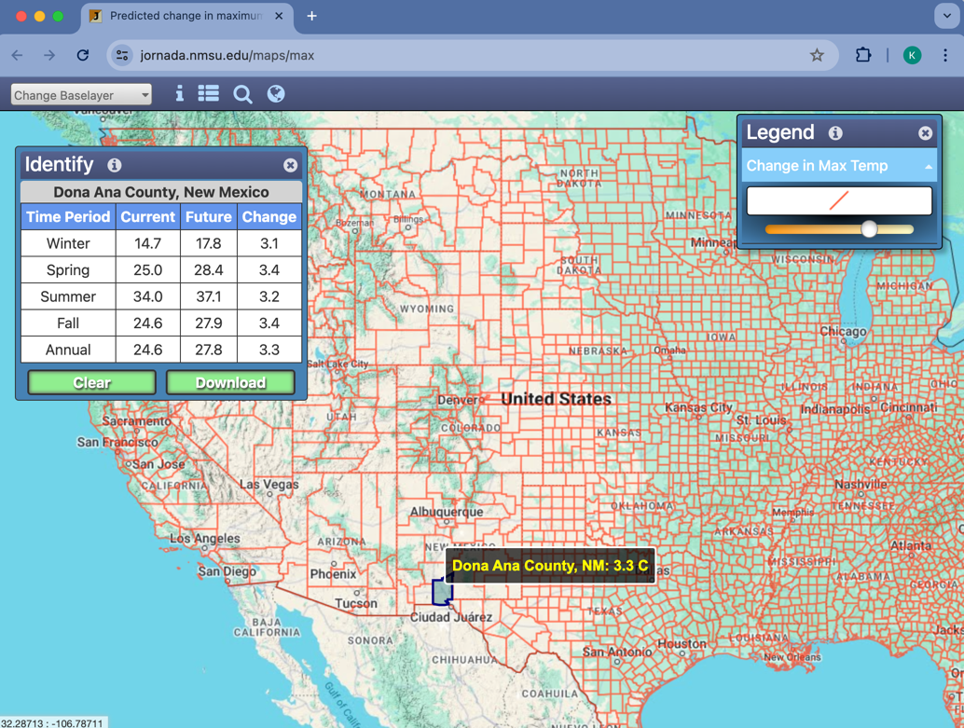
Maximum Temperature Map
https://jornada.nmsu.edu/maps/max
Notes:
Students will then acquire the maximum temperature data from their county by using the USDA Southwest Regional Climate Hub Maximum Temperature map. Direct students to look at the data directions on page 2 of the handout and open the URL. It may be helpful to display the map and provide a tutorial.

Slide 16
Record Temperature Data
Click and drag on the map to find your state, or click on the magnifying glass to search for a city.
Locate your county and click on it.
A data box will appear. Check that you have clicked on the correct county by reading the county name in the data box.
In table 2, record the following historic (1971-2000) mean maximum temperature data: Annual Max, Winter Max, Spring Max, Summer Max, and Fall Max.
Also in table 2, record the following mean future (2040-2069) data: Annual Max, Winter Max, Spring Max, Summer Max, and Fall Max.
Notes:
Direct students to locate and record temperature data for their county in table 2 on page 3 of the handout.
-Use the zoom and pan buttons on the left to zoom in to your state.
-Locate your county and click on it.
-A data box with a scroll bar will appear. Verify that you have clicked on the correct county by reading the county name in the data box.
-In table 2 on page 3 of the handout, record the following historic (1971-2000) mean maximum temperature data in °C: Annual Max, Winter Max, Spring Max, Summer Max, and Fall Max. These seasonal mean maximum temperature data were derived from PRISM data, up-scaled (or generalized) to the county level, and represent the average mean seasonal maximum temperature for the county.
-In addition to historic values, this map provides predicted average annual and seasonal temperatures for the future, 2040-2069. These values were derived from the Multivariate Adaptive Constructed Analogs (MACA, http://maca.northwestknowledge.net/) statistically downscaled data. They are based upon the mean of the 20 Coupled Model Intercomparison Project (CMIP) 5 general circulation models. In addition to averaging over models, means were derived over seasons to obtain an estimated change in temperature up-scaled to the county level for the 2040-2069 time frame. Data are intended to provide a general estimate of broad seasonal changes in average maximum temperature at the county scale.
-Scroll down to the predicted data for your county. Also in table 2, record the following mean predicted future (2040-2069) data in °C: Annual Max, Winter Max, Spring Max, Summer Max, and Fall Max.
-Because many students may be unaccustomed to thinking about temperature in Celsius, you may want to instruct students to convert temperatures to Fahrenheit for their own use. Students can convert temperatures manually or by using an online calculator such as: http://www.onlineconversion.com/temperature.htm
-Students may notice that a delta value is also available in the data box. Delta (Δ) is a Greek letter used to denote a change in quantity in science and mathematics. In this case, the delta value is future temperature minus historic temperature, or the change in mean future temperature and annual temperature (°C).

