Slide 1
)
Brought to you by
The Asombro Institute
)
)
)
Bats & Agave
)
)
)
)
)
Using science to protect the Lesser Long-Nosed Bat
)
)
)
)
)
)
)
)
)
© Asombro Institute for Science Education

Slide 2
Reasons to love
the Lesser Long-Nosed Bat
small bat (about 3 inches long) found in the southwest U.S. and Mexico
pollinates plants while it stuffs its face into flowers to feed on nectar (its tongue is as long as its body!)
considered a
Species of Greatest
Conservation Need
in New Mexico
also has
a cute
thing on
its nose
J. Scott Altenbach, batcon.org
José G. Martínez-Fonseca

Slide 3
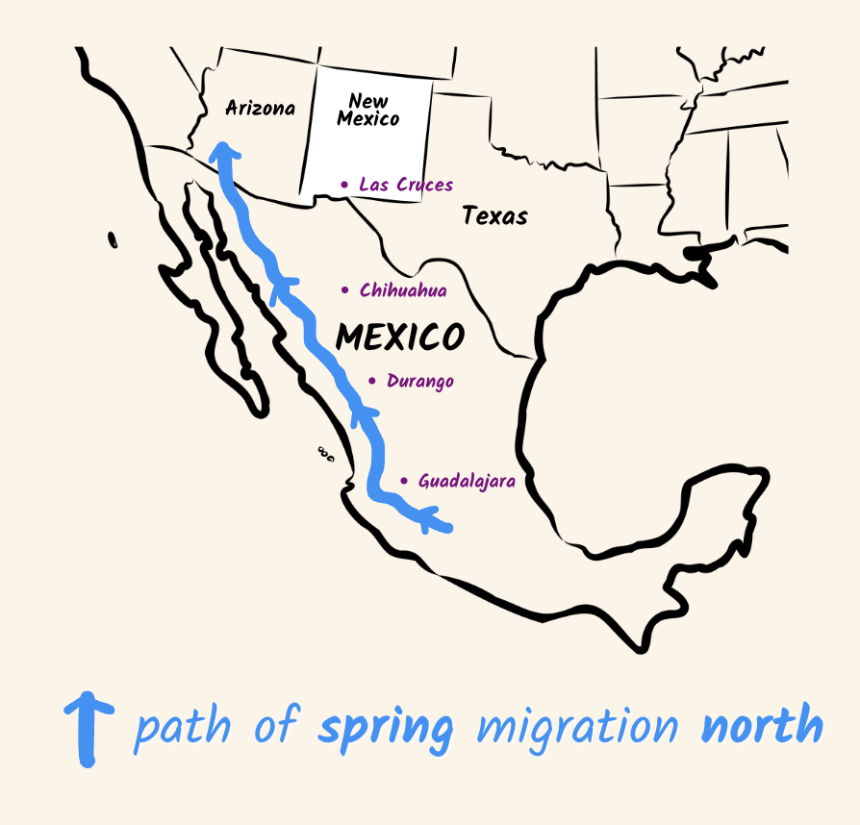
Yearly Migration
Did you know that many bat species migrate
in order to find food, warmer weather,
and to raise young?
When the Lesser Long-Nosed Bat
migrates north from Mexico in the spring,
it feeds on cactus flowers.
batcon.org

Slide 4
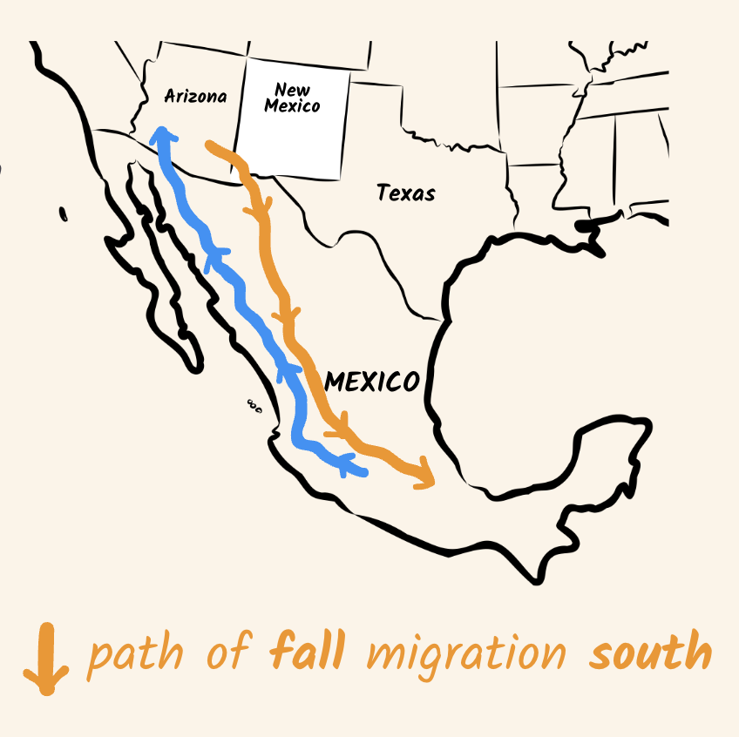
Yearly Migration
When these bats migrate south in the fall, they feed on agave flowers.
The beginning of this journey takes them through part of New Mexico! (look at the map)

Slide 5
Activity:
Help the Balloon-Bat
migrate!
ARIZONA
NEW MEXICO
Setup
Students stand in two lines stretching across the whole room, facing each other, with space between each person.
The students at the very end of each line wear a sign as shown.
MEXICO
MEXICO
Students in the Mexico-Arizona line are saguaro cacti and hold their arms up with elbows bent like a saguaro.
This line stands like this
This line stands like this
Students in the Mexico-New Mexico line are agaves and hold their arms straight and at an angle like the agave leaves.
Ready? Next Slide
SAGUAROS
AGAVES

Slide 6
The balloon is a Lesser Long-Nosed Bat in Mexico, ready to fly north in the spring.
Which plant has flowers for the bat to feed on?
Photo: CK Kelly
Saguaro
Agave
Starting in Mexico, use a one-handed tap to pass the balloon-bat up the line of students who are this plant.
Don’t skip anyone, and don’t let it hit the ground!
Done? Next Slide ->

Slide 7
The balloon-bat spends the summer in Arizona. Then fall arrives...
Which plant has flowers for the bat to feed on now?
Photo: CK Kelly
Saguaro
Agave
Starting in New Mexico, pass the balloon-bat down the line of students who are this plant.
Done? Next Slide ->

Slide 8
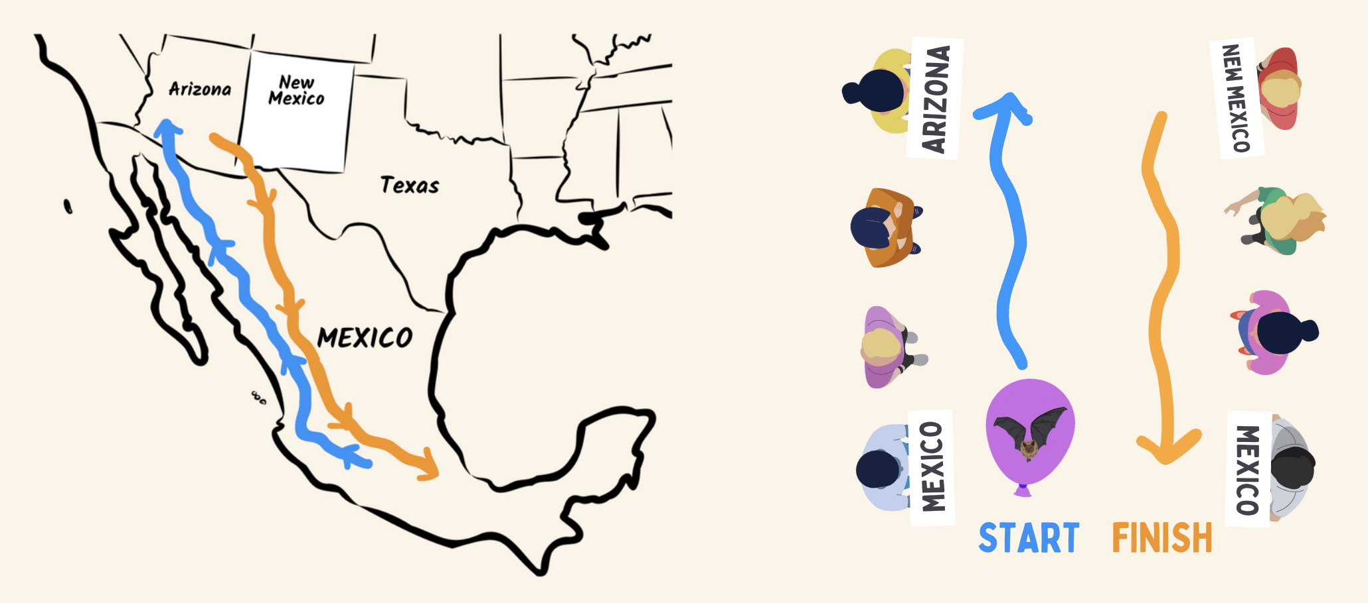
Great job!
You modeled the real migration of the Lesser Long-Nosed Bat
Next: Your teacher will divide you into groups of 2 or 3 and give you a worksheet.
Question: Can the Lesser Long-Nosed Bat migrate without agave?

Slide 9
Bats Need Agave
In order to protect these amazing bats, we need to protect the agave habitats they rely on.
Agave is currently threatened by drought, land development, and overgrazing.
Protecting agave helps humans too. There is a long history of harvesting agave for use in spirits like tequila, for fiber, for soap, and for livestock feed. Bats pollinate this agave.
Bat Conservation International’s Agave Restoration Project aims to protect and restore agave along the migration routes of bats like the Lesser Long-Nosed Bat.

Slide 10
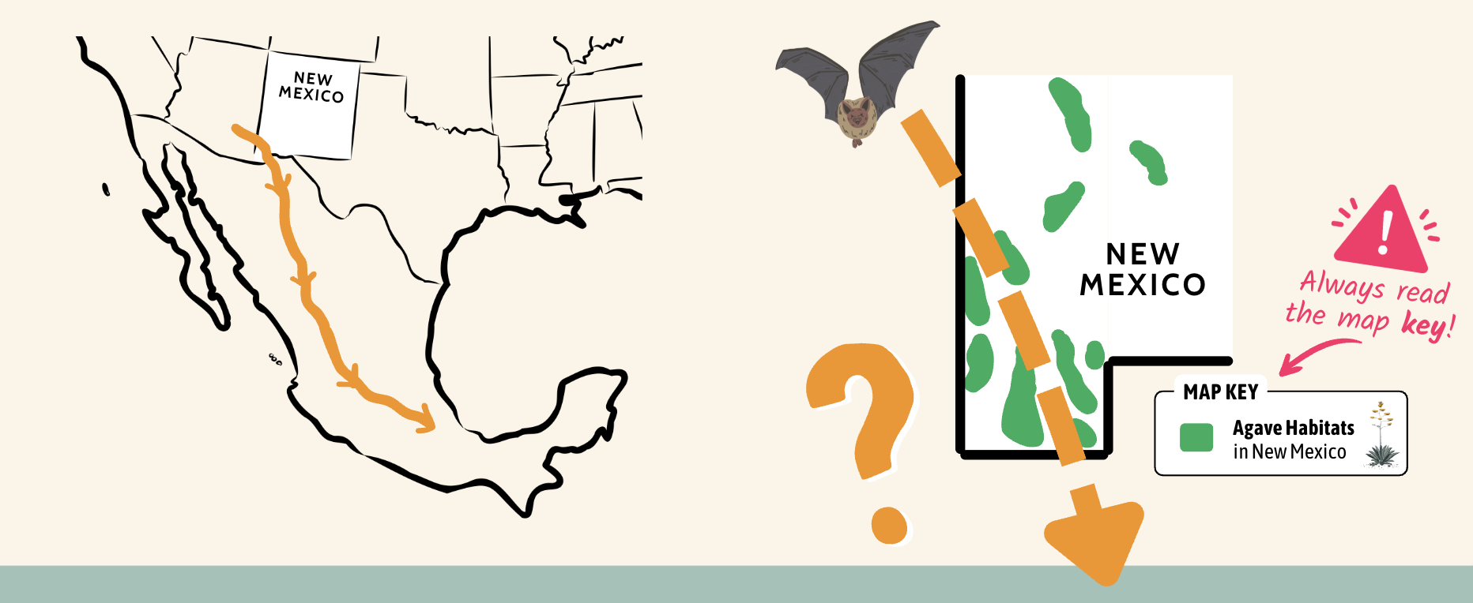
The Problem
We need to protect agave habitats (green areas on the map)
for Lesser Long-Nosed Bats in New Mexico, but we must be careful about
which ones we choose, since we can’t protect all of them.

Slide 11
1. Before we can choose
which agave habitats to protect,
we need to find out...
Answer question 1 on
your worksheet.

Slide 12
1. Before we can choose
which agave habitats to protect,
we need to find out...
c. where Lesser Long-Nosed Bats can
be found in New Mexico in the fall.
This will help us identify which agave habitats are most important to them.

Slide 13
Find the bats!
Your group will be in charge of a study to find out exactly
where Lesser Long-Nosed Bats can be found in New Mexico
during the fall migration.

Slide 14
Bat Study Methods:
Your Options
Biologists study bats in lots of different ways. Each study method has its own advantages and disadvantages.
Biologists have limited time and money, so your group can only choose one of the following study methods.
Listen carefully and think about which method
will help you learn the most about where
Lesser Long-Nosed Bats can be found in New Mexico.

Slide 15
Bat Study Methods:
Community Science
Researchers find volunteers in different towns and ask them to watch their hummingbird feeders at night.
If a volunteer sees a bat, they use a swab to get a DNA sample from the feeder.
Back at the lab, DNA analysis can identify what species of bat visited the feeder.
© 2017 T. Beth Kinsey
https://ars.els-cdn.com/content/image/1-s2.0-S2405676622000403-gr1_lrg.jpg

Slide 16
Bat Study Methods:
Sound Recording
These devices automatically record the songs and calls of bats, which are normally too high for humans to hear.
Researchers place recorders in the wilderness where they think bats might be active.
Back at the lab, software helps the researchers identify what species made each bat call that was recorded.
https://www.wildlifeacoustics.com/

Slide 17
Bat Study Methods:
Radio Tracking
Researchers capture bats and attach radio transmitters to their fur.
Over many nights, they listen for signals from the transmitters using hand-held antennae.
Back at the lab, the data can be used to create a map showing where the bats flew.
https://www.gbatnet.org/wp-content/uploads/2023/05/Green_Telemetry_for_dummies.pdf

Slide 18
Make a Choice
(5 min)
To Do
Discuss which method your group thinks will work best and choose one:
Radio Tracking
Community
Science
Sound
Recording
Lets you identify all the
bats that visit hummingbird
feeders in a few towns and cities.
Lets you identify all the
bats that fly near a few recorders.
Lets you make a map of where a small group of Lesser Long-Nosed Bats fly each night.
2. Answer questions 2 and 3 on your worksheet.

Slide 19
Bat Study Methods:
Example
Before you learn more about the study method you chose,
follow along with this example study method to practice what you and your group will do on your own afterwards.
In this example, a group chose a fourth study method called an Infrared Camera Survey.

Slide 20
Example Bat Study Method:
Infrared Camera Survey
Researchers set up infrared or heat-sensing cameras near bat roosts in caves.
When bats fly out of the roost at night, they show up in the video as bright spots.
Back at the lab, computer software helps scientists count exactly how many bats flew in front of the camera.

Slide 21
Example Bat Study Method
You’ll receive an envelope with information
about your study attached to the outside.
DO NOT OPEN THE ENVELOPE
First, you need to read
the page on the outside
carefully as a group.

Slide 22
Follow along as your teacher reads this example page:
Always read
the map key!
Read your
To Do
list

Slide 23
After reading the page, you will answer
questions 4 and 5 on your worksheet:
CAUTION: Do not copy these answers, this is just an example.
4. Circle at least one advantage of your study:
Gives very
detailed data
Covers a
big area
Doesn’t cost
much money.
5. Circle at least one disadvantage of your study:
Misses bats in
wild areas
Covers a
small area
Costs a lot
of money
Next, you can open the envelope
to view the results of your study!

Slide 24
Follow along as your teacher reads these example results:
Read your
To Do
list

Slide 25
After reading your results, answer question 6 on your worksheet:
Now it’s your turn!

Slide 26
Group Work Time
(10 min)
To Do
Read the page on the front of the envelope as a group.
Answer questions 4 and 5 on your worksheet.
Open your envelope and read the results of your study.
Answer question 6 on your worksheet.
Wait for the class discussion.

Slide 27
Class Results
What did the groups that used
different study methods learn?
Community
Science
Sound
Recording
Radio Tracking

Slide 32
Lessons Learned
No particular group was “right” or “wrong.” Different groups chose different agave habitats to protect because they had different information.
This shows why sharing data and looking at the results from different studies is so important in science.
Some studies only found bats in one or two places, but they also revealed a lot of detailed information that will help scientists protect
these bats in other important ways.
Answer question 7
on your worksheet.
E. Vasquez-Arroyo

Slide 33
Great
Work
Scientists!
BATS
+
AGAVE
Brought to you by
The Asombro Institute

