Slide 1


Agrivoltaics Scenarios:
The Pros and Cons of Using Land for Agricultural and Energy Production
DEVELOPED BY THE ASOMBRO INSTITUTE FOR SCIENCE EDUCATION (WWW.ASOMBRO.ORG)

Slide 2
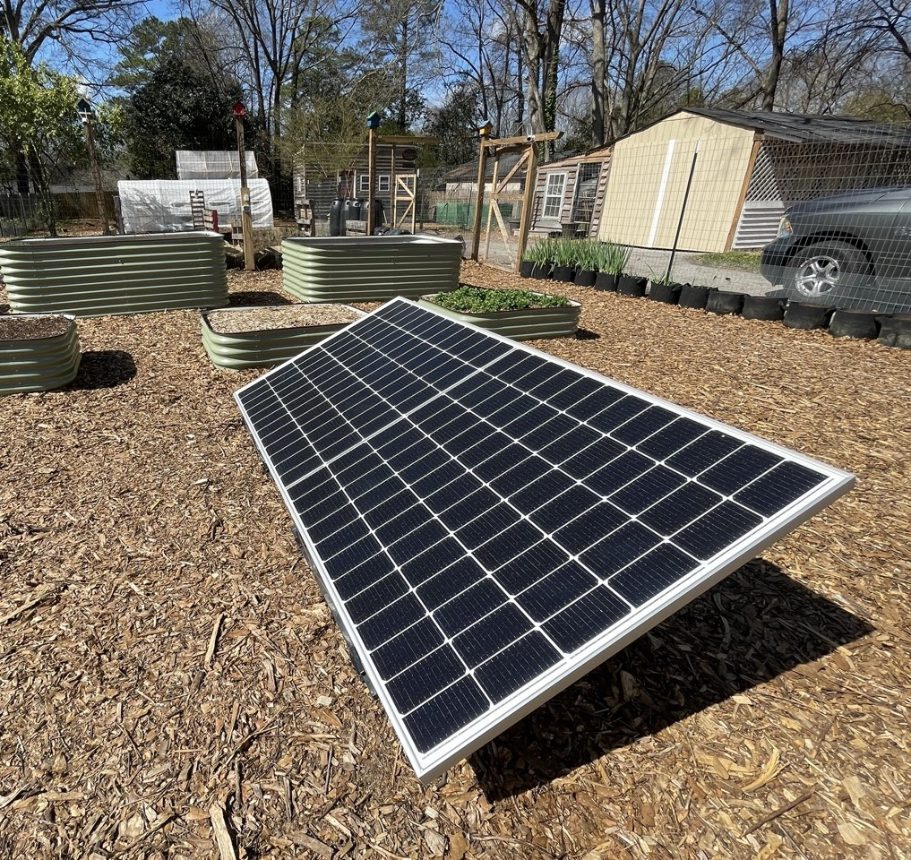

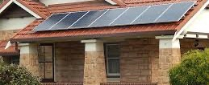
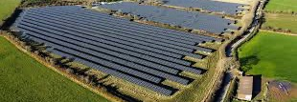
Where have you seen solar panels?
Notes:
Ask students what solar panels do and where they may have seen them. Explain that solar panels convert sunlight into electricity. Let students know that in today’s lesson, they will be looking at how solar panels could be used by farmers and ranchers.

Slide 3
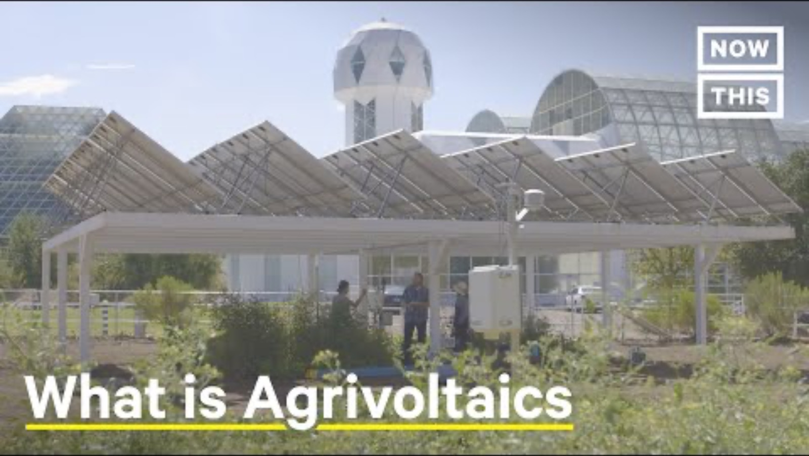
What is Agrivoltaics?
https://youtu.be/u_hRm-WFM1M?feature=shared
Notes:
Prior to starting the video, tell students to pay attention to how it explains the term agrivoltaics. Ask them to think about how agrivoltaics is being used by the farmer in the video.
Play the five-minute video: “Agrivoltaics: Solar Panels Bring Life to Struggling Farms” by Now This: https://youtu.be/u_hRm-WFM1M?feature=shared
Based on the video, ask students to define agrivoltaics. Agrivoltaics is the dual use of land for agricultural production and photovoltaic (solar energy) production.
Today’s lesson will look at scenarios where agrivoltaics might be used in the U.S. and consider the pros and cons of shifting traditional farms and ranches to agrivoltaics.

Slide 4
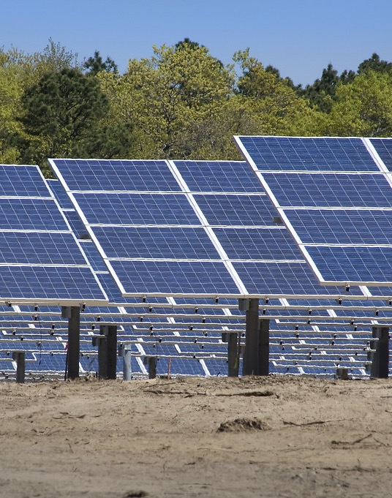

Why Agrivoltaics?
Solar Panels Need A LOT of Space
Electricity for one house for one day
=
Solar Panels
26 Full-size Beds
BUT, not just any space works!
}
Flat
Open
Sunny
Near Transmission Lines
Gross, S. (2020, January). Renewables, land use, and local opposition in the United States. The Brookings Institution. https://www.brookings.edu/wp-content/uploads/2020/01/FP_20200113_renewables_land_use_local_opposition_gross.pdf
Notes:
The U.S. is considering dual land use because solar panels take up space, and that space competes with farms and ranches.
Solar energy production needs a lot of space. Solar panels can only produce about 10 watts/meter².
To give perspective, share that the average household uses ~2,500 watts a day. It takes about the space of 26 full-size beds, side-by-side, to run a house on solar panels.
But not just any land works. It needs to be flat, open, sunny, and accessible to a city’s grid via transmission lines. Many of the ideal areas for solar farms are already being used by farmers and ranchers. Some people feel the agriculture and the solar industry are having to compete for this land. Agrivoltaics could support both.

Slide 5
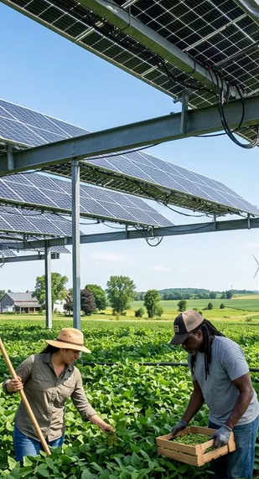
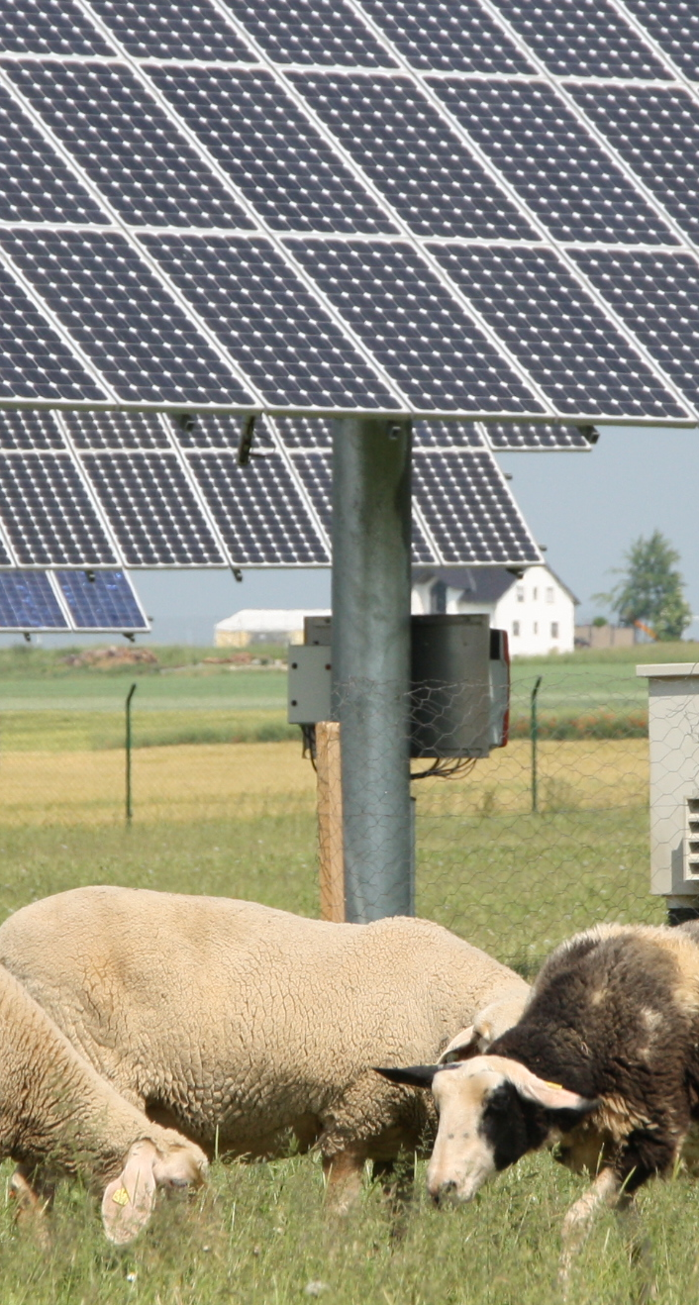


Ways to Use Agrivoltaics
Crops
Grazing Sheep
Pollinator Habitat
Cattle Pastures
Notes:
Agriculture is such a diverse industry, and there are many ways agrivoltaics could be implemented. Farmers could put them over or around different crops. Sheep and cattle could graze under them. Even pollinator habitats could be established beneath them.

Slide 6
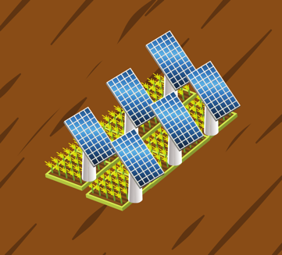
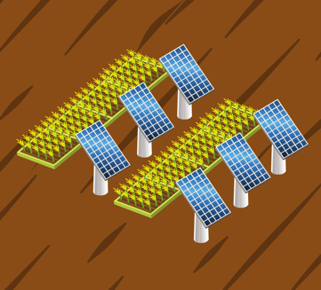
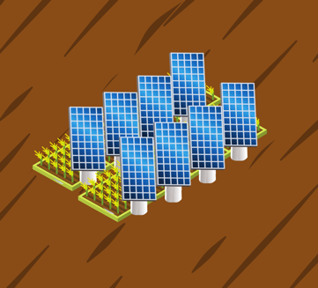
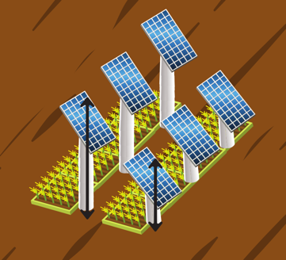
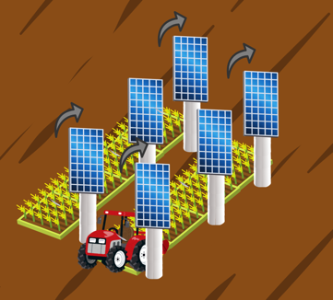
Ways to Install Agrivoltaics
Crops Underneath
Crops Alternating
Vertical Mounts
Elevated Frames
Rotating Panels
Notes:
There are also many ways solar panels could be installed.
They could be placed directly over the crops. This works best if you want the crops to be shaded during the day.
The panels could be placed in alternating rows. This works best if you don’t want as much shade and have the space to place the solar panels.
They could be mounted at different angles and could even be placed vertically as a barrier. Different angles could impact how much light is being converted to energy.
The panels could be placed on higher or lower frames, depending on the needs. It’s good to keep in mind that taller frames mean more material costs.
There are even panels that can be mechanically rotated to the angle needed. This could mean larger farm equipment could be used beneath them, or it could track the sun through the day. However, these systems are much more costly.

Slide 7
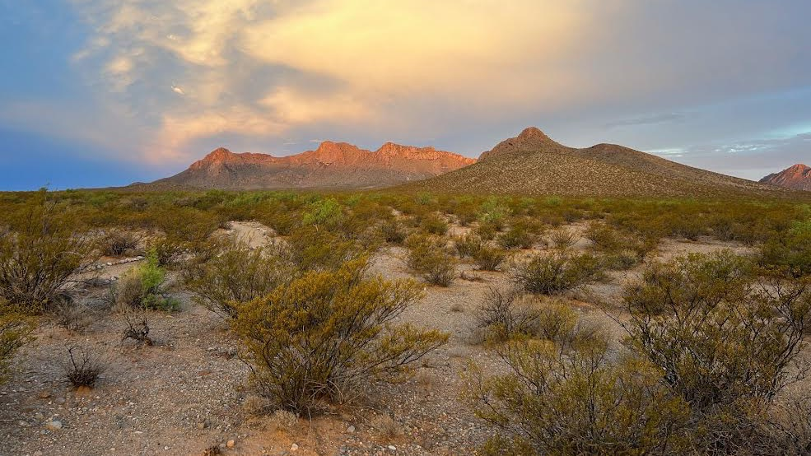
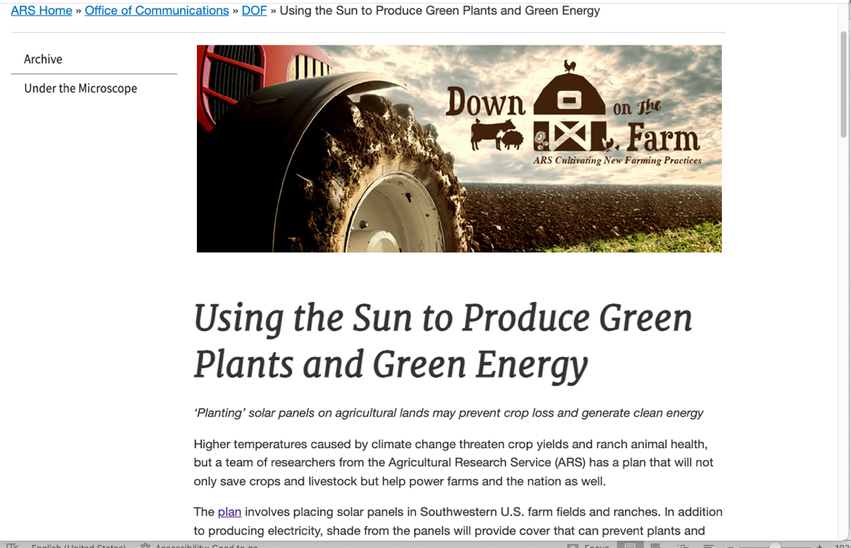



Research still needs to be done!
Notes:
Because there are many ways agrivoltaics could be implemented and installed, there are many variables to study through scientific research. Scientists at New Mexico State University and the U.S. Department of Agriculture’s Cotton Ginning Lab and Jornada Experimental Range are actively researching agrivoltaics in Las Cruces, New Mexico.

Slide 8
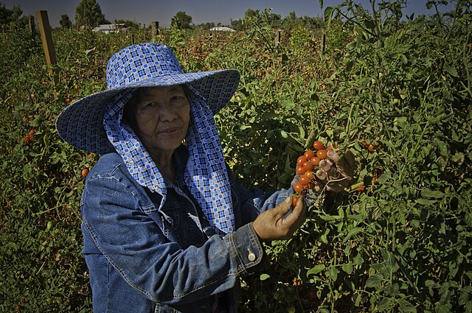
Can Solar Panels Benefit MY farm?
Scenario:
You have a farm in Arizona that is growing cherry tomatoes. You are thinking about adding solar panels to your fields. Based on the information given, do you think you should install solar panels?
Notes:
Tell students that today they are going to be farmers and ranchers trying to decide whether they should add solar panels to their farm or ranch. The first scenario will be done together as a class to show how to use the information provided to help in the decision making.
Our scenario: You have a farm in Arizona that is growing cherry tomatoes. You are thinking about adding solar panels to your fields. Based on the information given, do you think you should install solar panels?

Slide 9

As a farmer, you need to be successful!
$
?
+
+
+
=
What are my criteria for success?
How would adding solar panels impact my success?
  Grow healthy tomatoes
  Make a profit
  Don’t harm people or community
Notes:
Before evaluating the information, explain that students need to establish the farm’s criteria for success. This will help them decide whether to add solar panels. If our success is negatively affected, then solar panels may not be a good choice. On this farm, they need to continue to grow healthy tomatoes and make a profit from those tomatoes. They also need to ensure that the solar panels don’t negatively impact them, their farm help, or their community. Tell students that they need to think about how adding solar panels might affect these criteria.

Slide 10
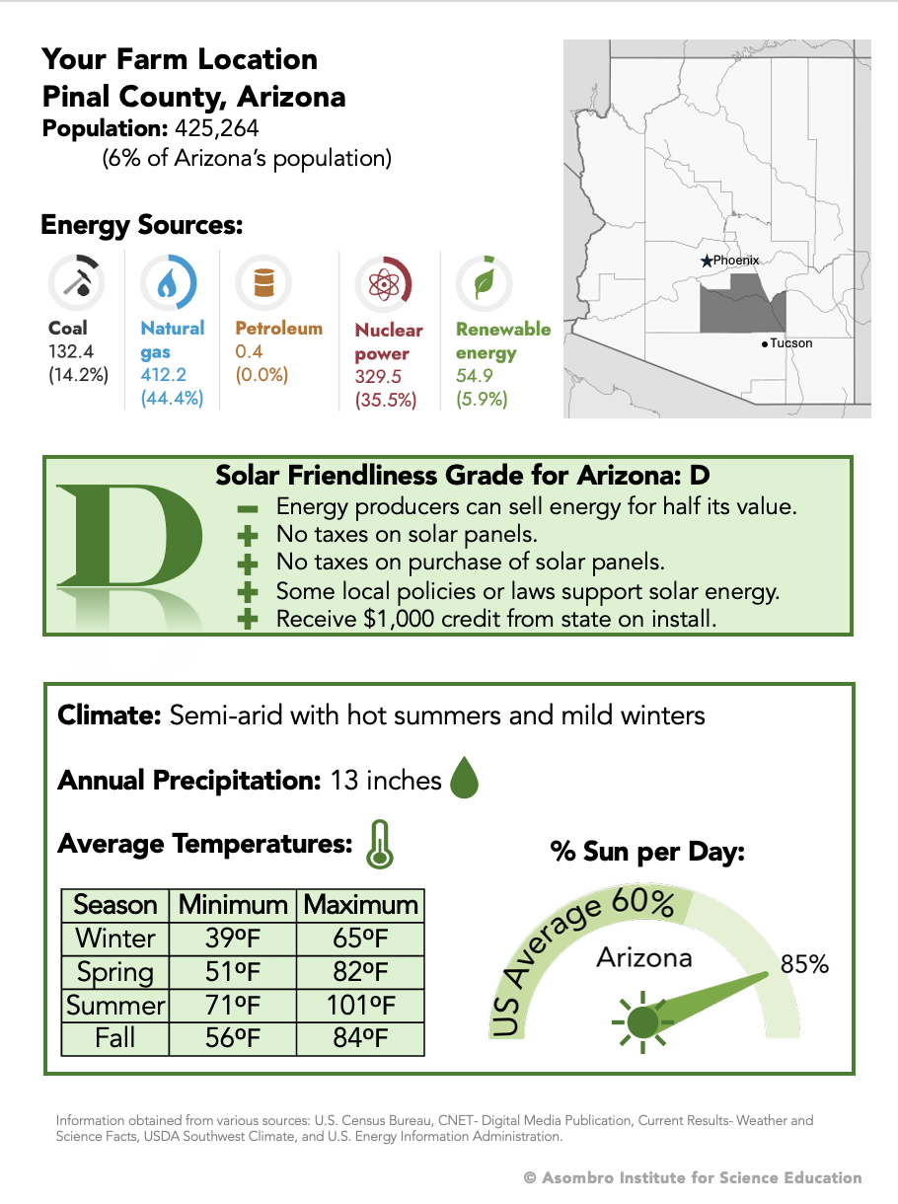
Where is my farm?
Notes:
Hand out the Arizona farm scenario sheet. Review the information about the farm location as a class. Remind students that local climates, communities, laws, and policies may impact their decision.
Ask prompting questions to help students think through how the information might affect their decision. For example:
Does it seem like we have a lot of neighbors? Does this seem like an urban or rural setting? Are there major cities nearby?
What is the main energy source currently for our state? Could solar panels impact the amount of renewable energy in our state? Would it affect the other energy industries in any way?
How friendly is our state to the idea of solar energy? For this state:
We can sell energy back to the grid, but the energy companies won’t pay us the full value for the energy we produce.
In Arizona, there is no tax on purchasing or owning solar panels.
There are some local policies supporting solar energy production, but not very many.
You receive a credit for installation, but would $1,000 make a big difference relative to the cost of solar panels?
What kind of climate do we live in? Is it hot or cold in the seasons we might be growing crops? Do we get a lot of rain?
Do we get a lot of sun during the day or not? This would impact how much energy solar panels might produce for us.

Slide 11
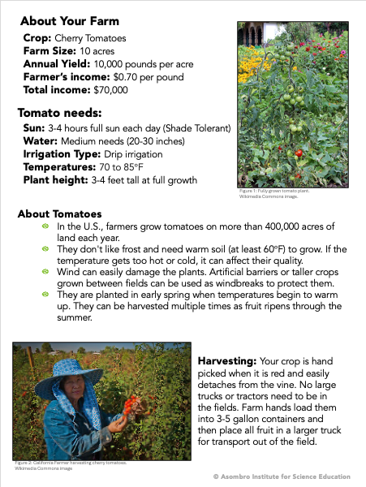
What do I produce?
Notes:
Turn the page over and look at the information about the farm as a class. Ask more prompting questions to help students connect this information to the other side. For example:
What’s our annual income? Do we seem to be making a good profit or just getting by?
What kind of climate do tomatoes need? Do they like a lot of sun? Do they need more water than our current climate gets? Would our irrigation system get in the way of the solar panels?
What kind of care and farm tools do we need to maintain our crops? Would any of those tools or care needs be difficult around solar panels? Could they damage the solar panels?
Do our plants grow big? Would we need to put our solar panels on tall stands or short ones? Would that cost more money for install? Would it make solar panel upkeep more difficult?

Slide 12
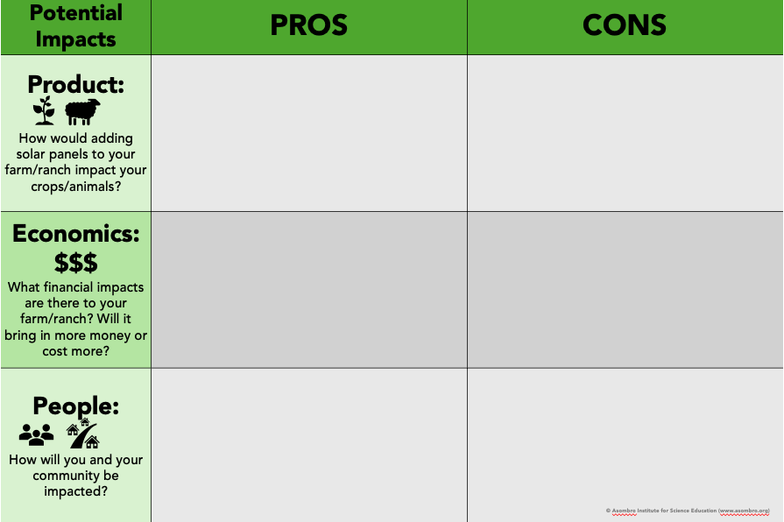
What are the Pros and Cons?
Notes:
Introduce the poster.
Remind students that they still have criteria for success that they need to meet. If there’s more harm than benefits to their crops, their profit, or the people around them, then adding solar panels may not be a good idea for their farm.
Ask students to come up with pros and cons based off the information they just read.
As students give ideas, hand them a sticky note to write their ideas on and add it to the class poster. Take a handful of answers before moving on. There does not need to be an answer for every section. It’s better if there are more positives or more negatives. If there is a pattern to their responses, share that pattern with students.
Note: All scenarios have a potential answers sheet with ideas of possible pros and cons that students might give.

Slide 13
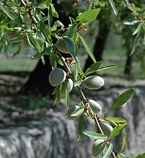
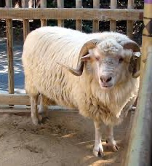
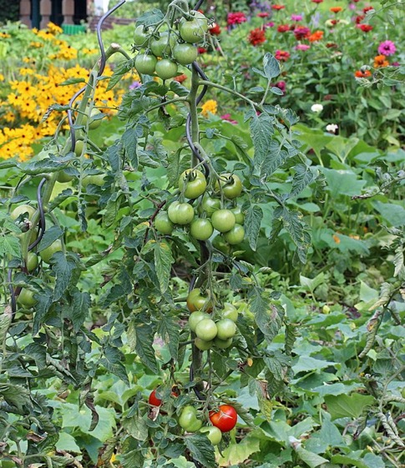
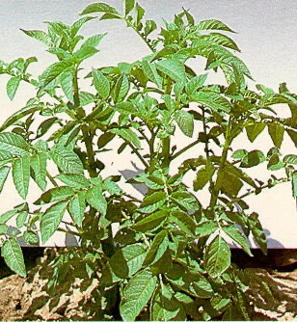
Would Agrivoltaics Work on Any Farm or Ranch?
It might help my tomato farm in Arizona, but will that be the case on other farms and ranches?
Notes:
After going through several pros and cons, ask students if they would add solar panels to their tomato farm in Arizona. Ask what information they used to justify their decision. It might benefit a tomato farm in Arizona, but would it work on a different farm or ranch?

Slide 14
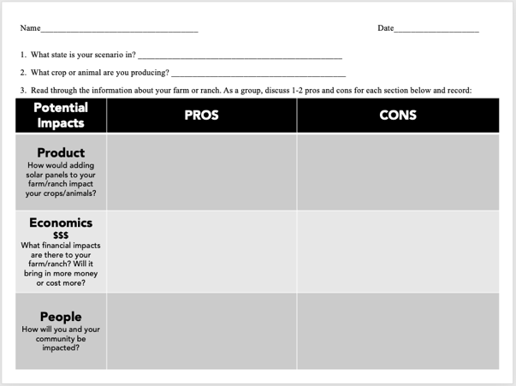
What are the Pros and Cons on My Farm/Ranch?
As a group, look through your new scenario.
Discuss the Pros and Cons sections with your team.
Answer Questions 1-3 on your worksheet.
Notes:
Split the class into pairs and have them return their Arizona scenario sheet and pick up a new state scenario sheet and a worksheet.
Instruct them to look over the information on the scenario with their partner and discuss the pros and cons.
Challenge students to try to find at least one pro and one con for each section (product, economics, people). They may have many pros or cons for some sections.
As they discuss their ideas, have them fill out Questions 1-3 on the worksheet.

Slide 15
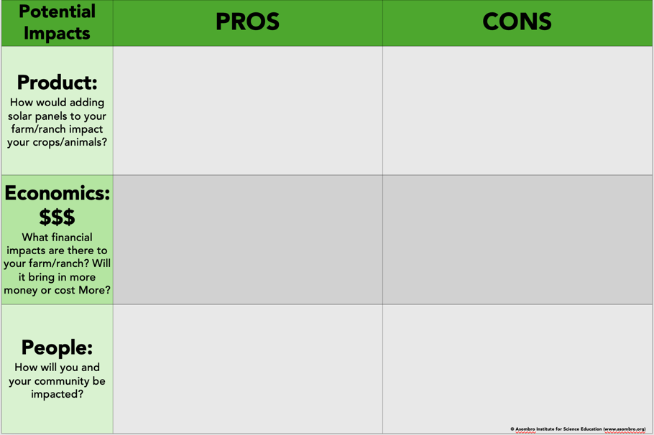




What are the Pros and Cons on My Farm/Ranch?
Put your 2 strongest arguments on sticky notes and put them on the poster.
Notes:
Give each group 2 sticky notes. Make sure those groups who have the same scenario have the same color of sticky notes.
Ask students to write their two strongest arguments on the sticky notes and place them in the correct location on the poster. They can be two pros, two cons, or one of each, but they need to be their strongest arguments.
Using the poster with sticky notes attached, talk about any patterns your students notice. Make sure the contributors of the sticky notes being discussed are sharing what scenario they had and why they felt it was a pro or con.
There may be patterns in the different colored sticky notes and where they are on the poster. Groups that have the same scenario may all find more pros or more cons.
Some submissions may be similar. These could be discussed at the same time.
Some ideas may be contradictory. The opposing contributors could talk through their reasons.
Highlight for students that while many plants and animals have similar general needs, they also have unique needs, and we may not know if agrivoltaics will succeed for every crop or on every ranch until we begin to test it. That’s why it’s being studied.

Slide 16
Based on your farm or ranch location, decide if you’ll install solar panels.
Use your pros and cons list to explain your answer.
If you’re still undecided, explain what information you need to know to help you decide.
Notes:
After the discussion, have students turn their worksheet over and choose whether they would add solar panels to their farm/ranch. When explaining their answer, they should include the pros or cons that persuaded them. If they are undecided, have students explain what information they would want before making the decision.

