Slide 1
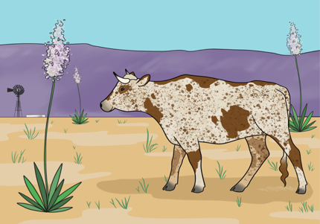
Are You This Cow’s Herd?
Ayuda
You will learn how to interpret data, use data to make an argument, and help Ayuda find her herd.
Project funded by the United States Department of Agriculture
Developed by the Asombro Institute for Science Education (www.asombro.org)
Cattle Artwork by Courtney Currier

Slide 2
People and Dogs
Do all people look the same?
Do all dogs look the same?

Slide 3
Labrador Retrievers
BOTH ARE STILL DOGS!
Weiner Dogs
variation = difference
trait = characteristic

Slide 4
Are You This Cow’s Herd?
We will be rangeland scientists.
We will collect evidence.
We will help a rancher named Alfredo find a lost cow's mother and herd or family.
Ayuda

Slide 5
What do you already know about cows?

Slide 6
Do all cows look alike?
Look at the pictures.
What differences do you see?

Slide 8
Do all cows look alike?
Look at the pictures.
What differences do you see?
The differences and similarities are called traits.
Traits can be inherited or passed down from the cow’s parents.

Slide 9
Traits
We will use this information about inherited traits to help solve a mystery!
Ayuda

Slide 10
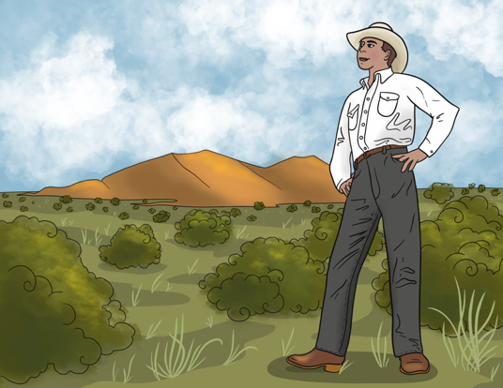
Story Time!
Alfredo, a young rancher, finds a cow wandering on his family’s ranch.

Slide 11
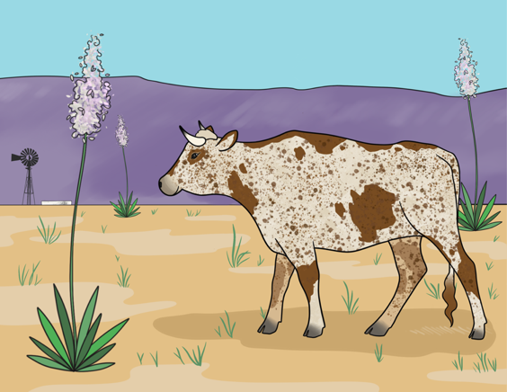
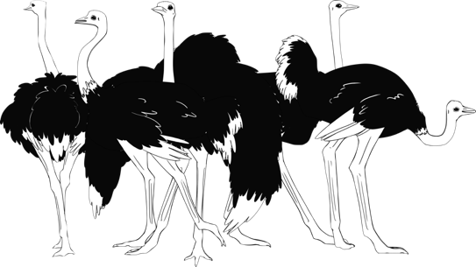
Ayuda
The cow looks familiar, but he knows it doesn’t belong on his ranch since they are ostrich farmers.

Slide 12
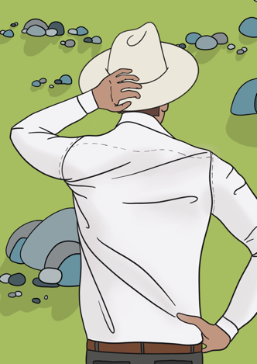
Alfredo has an idea. He can visit some cattle ranches to help return this cow to her mother and herd.

Slide 13
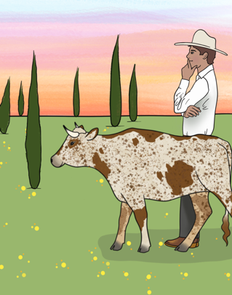
Ayuda
Alfredo notices that this cow has a collar with a nametag that says “Ayuda.” He asks Ayuda if she knows where her mother is.

Slide 14
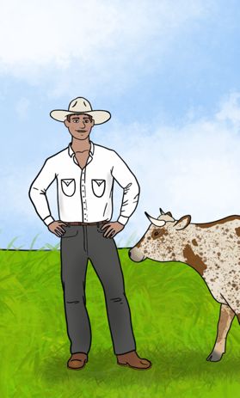
Ayuda
The cow, of course, doesn’t answer but is friendly to Alfredo.

Slide 15
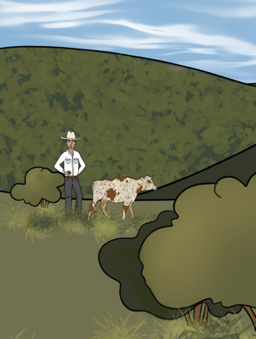
Alfredo doesn’t know where to start, but he is determined to help Ayuda get back to her mother and herd.

Slide 16
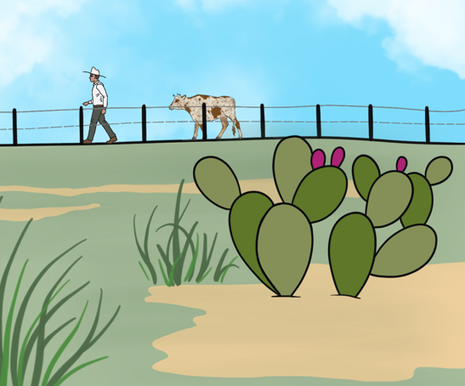
They need a rangeland scientist to help.
Will you help Alfredo and Ayuda?

Slide 17
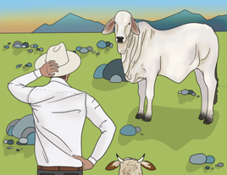
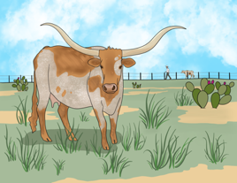
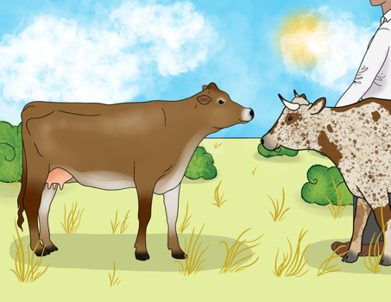
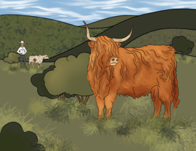
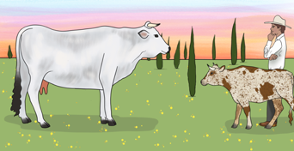
Alfredo and Ayuda will go to different ranches to compare Ayuda’s traits to the traits of cattle at the ranch.
Ayuda
You will follow their journey by going to four stations to represent the four ranches they will visit.

Slide 18
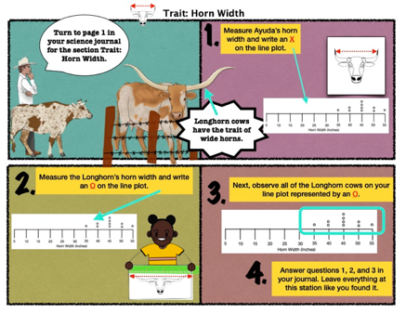
At each station:
1. Read the comic.
2. Follow the instructions to complete the tasks and answer the questions in your journal.

Slide 19
Let’s do the first station together! Trait: Horn Width
1. Read the comic.
2. Follow the instructions to complete the tasks and answer the questions in your journal.

Slide 20
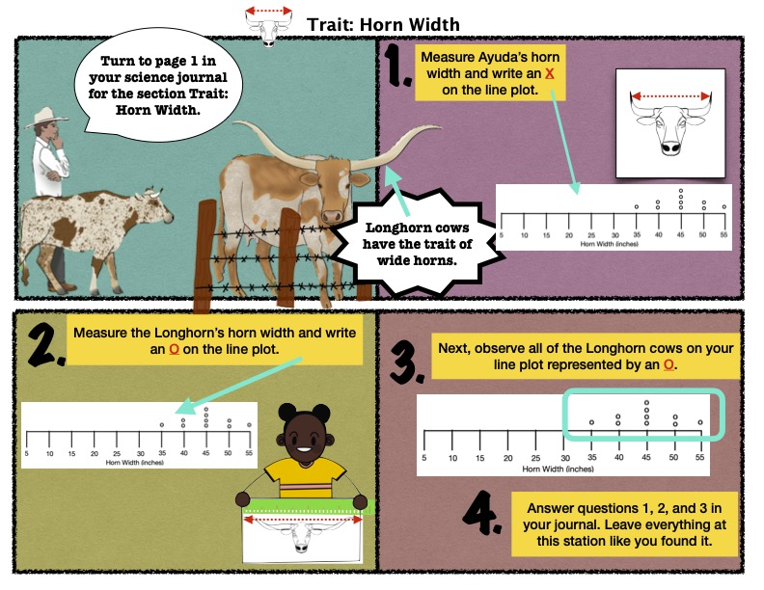
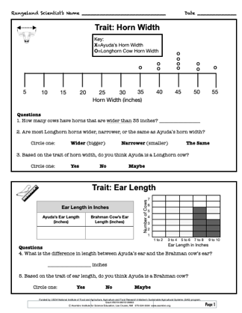
Ayuda

Slide 21
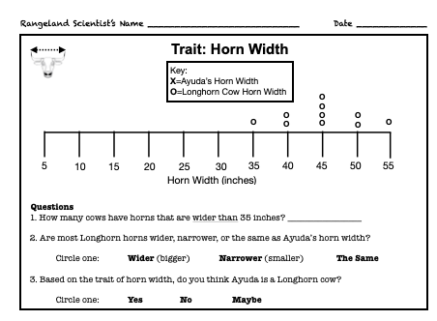

Slide 22
Now it’s your turn:
You will work in partner pairs.
You will have 15 minutes to visit all three ranches.
Here are the rules:
No running.
Complete the task at the station and leave the station neat.
Complete your work in your journal before moving to the next station.
Limit of TWO groups per station, but one group per station is better.

Slide 23
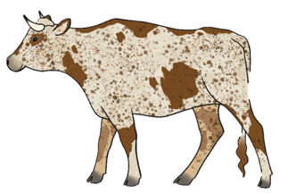
Let’s review what you discovered!
What are the traits for Ayuda?
Look at your data from each page in your science journal.
Horn width = _____ inches
Hair length = _____ inches
Ear length = _____ inches
Height = _____ inches
Ayuda

Slide 24
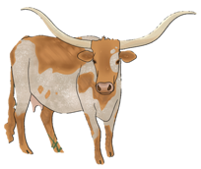
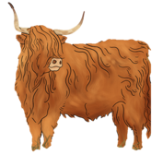
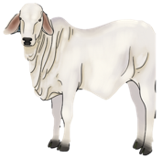
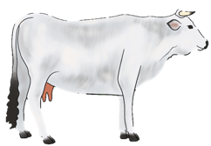
Trait | Cattle Type Does Ayuda Share These Traits?
 | Longhorn | Brahman | Highland | Chianina | Criollo
Horn Width | Yes No |  |  |  | inches
Ear Length |  | Yes No |  |  | inches
Hair Length |  |  | Yes No |  | inches
Height |  |  |  | Yes No | inches

Slide 25
Turn to page 3
Fill in the data we completed together in your journal.
Fill in the data for Ayuda’s traits
Circle “No” for Ayuda sharing these traits

Slide 26
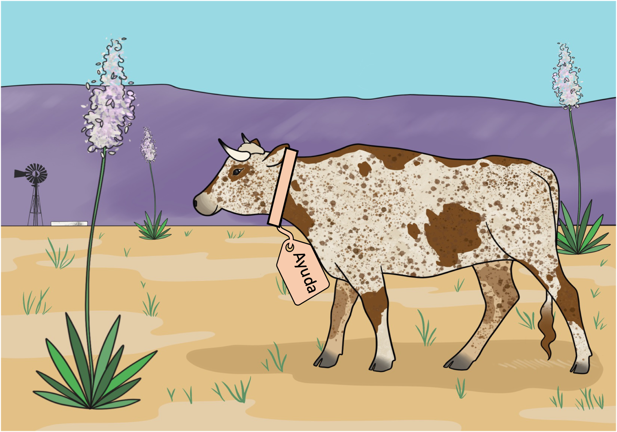
Alfredo and Ayuda travel to the last ranch…
When they get to the ranch that is supposed to contain Criollo cattle, they are nowhere to be seen.
Luckily, Alfredo has his phone with him and is able to pull up a YouTube video about the Criollo cattle.
We will watch this video now to see if Ayuda shares any traits with the Criollo cattle.
YouTube Link: https://youtu.be/ZgGli8cosr8

